Slide 1
All or None? The Dilemma of Handling WiFi Broadcast Traffic in Smartphone Suspend Mode
Ge Peng, Gang Zhou, David T. Nguyen, Xin Qi

Slide 2
Smartphone power modes
Active
Power consumption: high
Suspend
Power consumption: low
switch to suspend mode to save energy

Slide 3
Suspend mode is interrupted
What are the interrupts?
pressing the power button
application background synchronization
...
WiFi broadcast frames
switch to high power active mode
How big is the energy impact?
How to deal with them efficiently?
Power consumption increases

Slide 4
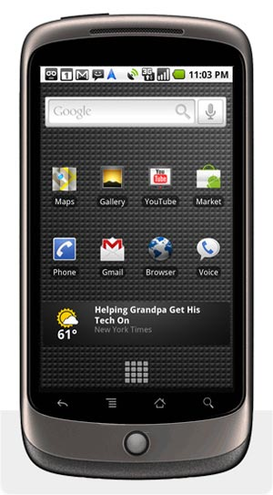
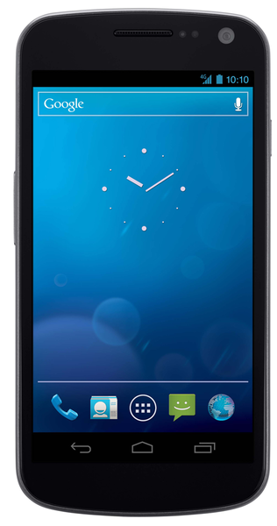
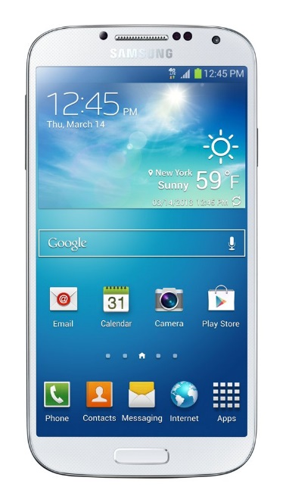
Handling WiFi broadcast traffic
HTC Hero
Nexus One
Galaxy Nexus
Galaxy S4

Slide 5
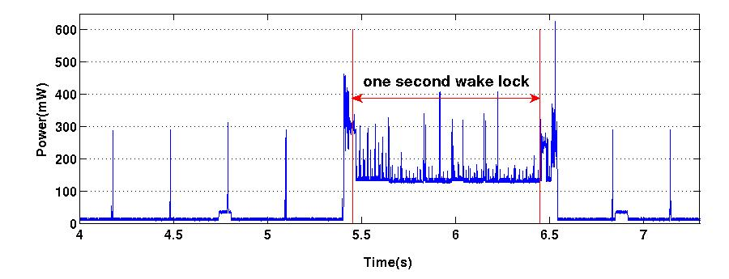
“receive-all”
HTC Hero and Nexus One: “receive-all”
Receive all UDP broadcast frames during suspend mode
Trigger a wake lock of 1 second for every data frame received
MAC layer broadcast frames with UDP payload
resume
suspend

Slide 6
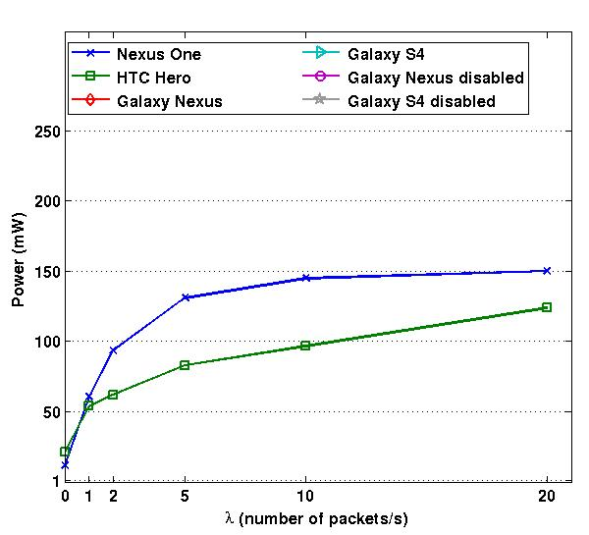
Power Impact of “receive-all”
Power (mW)
Number of UDP broadcast frames/s
The “receive-all” method suffers higher power consumption.

Slide 7
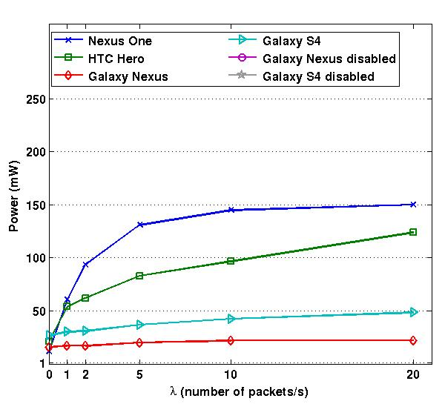
“receive-none”
Galaxy Nexus and Galaxy S4: “receive-none”
Block all UDP broadcast frames with a hardware filter
Power (mW)
Number of UDP broadcast frames/s

Slide 8
Problem of “receive-none”
The “receive-none” method blindly blocks all UDP broadcast frames during smartphone suspend mode
Applications cannot receive broadcast frames.
What are missed?

Slide 9
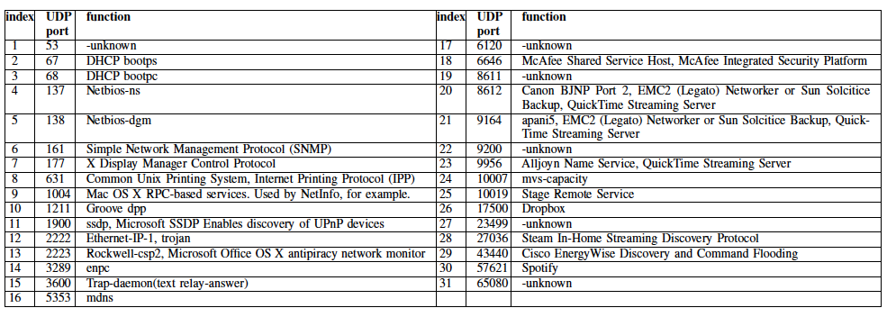
Broadcast traffic in real world
4 traces are collected in a college department, a college library,
a classroom building, and an off-campus Starbucks store, respectively.
Is anyone here?
The “receive none” method sacrifices functionality.

Slide 10
The Dilemma
How to deal with WiFi broadcast traffic during smartphone suspend mode?
“receive-all”: suffers higher power consumption
“receive-none”: sacrifices functionality
Binary Choice: All or None?

Slide 11
Software Broadcast Filter (SBF)
Useless broadcast frames
broadcast frames
Useful broadcast frames
UDP broadcast frames with a UDP port not listened on by any process on the smartphone

Slide 12
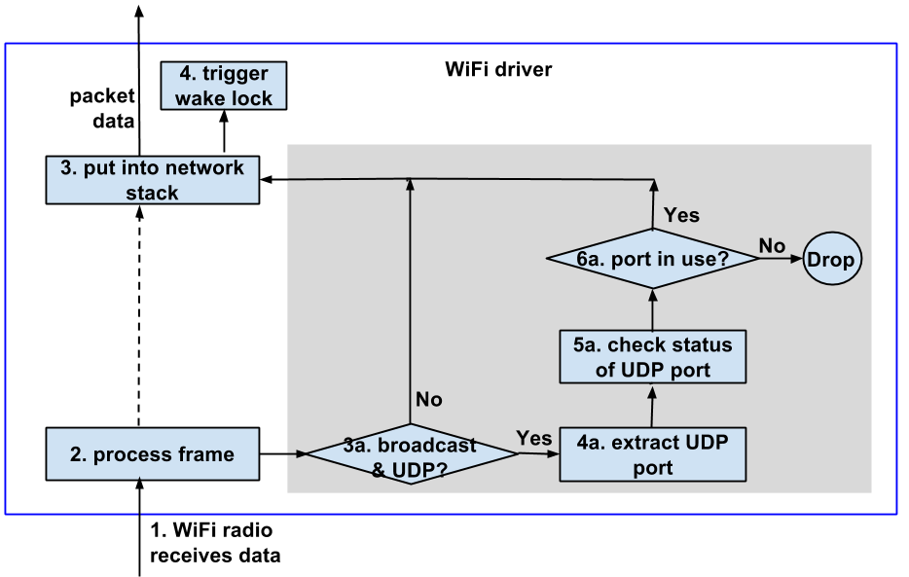
Software Broadcast Filter (SBF)

Slide 13
SBF Energy Efficiency
Energy Modeling
Trace driven simulation
Compare energy consumption of SBF to
“receive-all” method
oracle lower bound
assume that SBF has the information of future frame arrival time.
So, it can decide not to go back to suspend when the overhead is bigger than benefit.

Slide 14
SBF Energy Efficiency
SBF energy saving
Oracle energy saving
left: “receive-all”
middle: SBF
right : oracle lower bound

Slide 15
SBF Delay Overhead
To measure the local processing delay
Implement the work flow of SBF on Nexus One
Create 100 UDP sockets on the smartphone
Send 1000 UDP broadcast frames to the local network

Slide 16
SBF Delay Overhead
SBF introduces an increase of 1.07% in local processing delay.

Slide 17
Conclusion
Reveal the dilemma of handling WiFi broadcast traffic during smartphone suspend mode
“receive-all”: suffers high power consumption
“receive-none”: sacrifices functionality
Propose Software Broadcast Filter (SBF) to address the dilemma
SBF only blocks useless broadcast frames
SBF reduces power consumption by up to 52.3% with an increase of only 1.07% in local processing delay

Slide 18
Thank You!
Questions?

