Slide 1


EliMO: Eliminating Channel Feedback from MIMO
May 2017
Yongsen Ma, Gang Zhou (William & Mary), and Shan Lin (Stony Brook University)
Notes:
You will be given 25 minutes for your paper presentation, including 5 minutes for Q&A.
Tuesday, 31 May 2017 | 14:00 – 16:00
Session 5A: Wireless Networks and Protocols
Room: Silverbox Ballroom 1-2, Level 1
A High Throughput Reader Scheduling Algorithm for Large RFID Systems in Smart Environments (Paper 15)
Shigeng Zhang, Danming Jiang, Qing Zou, Jianxin Wang (Central South University, China), Xuan Liu (Hunan University, China)
EliMO: Eliminating Channel Feedback from MIMO (Paper 60)
Yongsen Ma, Gang Zhou (College of William and Mary, USA), Shan Lin (Stone Brook University, USA)
Transmit Only: An Ultra Low Overhead MAC Protocol for Dense Wireless Systems (Paper 68)
Yanyong Zhang (Rutgers University, USA), Bernhard Firner (Nvidia, USA), Richard Howard, Richard Martin, Narayan Mandayam (Rutgers University, USA), Junichiro Fukuyama (Penn State University, USA), Chenren Xu (Peking University, China)
STOOP: Stochastically-Dominant Access Point Selection in Enterprise WLANs (Paper 71)
Yu Bai, Mehmet Can Vuran, Demet Batur, Steve Goddard (University of Nebraska - Lincoln, USA)

Slide 2


MIMO Needs CSI Feedback
MIMO beamforming provides high throughput for WiFi
To achieve high beamforming performance, feedback of Channel State Information (CSI) is needed.
Implicit or Explicit CSI Feedback
Image from www.broadbandbuyer.com
Image from www.howtogeek.com

Slide 3
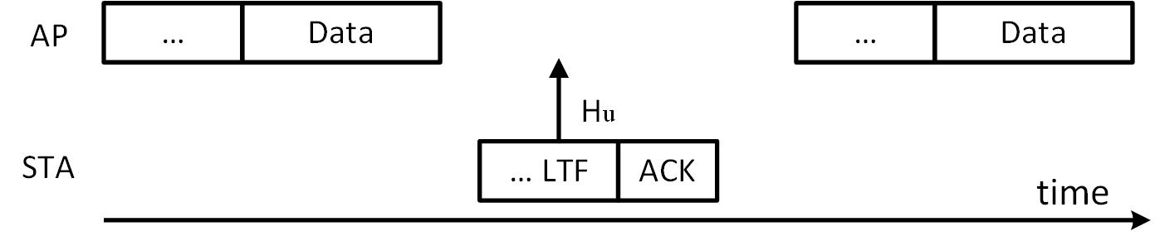
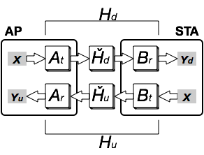
Implicit CSI Feedback
AP measures ACK’s LTF from STA to get uplink CSI
AP uses the transpose of uplink CSI as downlink CSI
Downlink CSI (Hd) and uplink CSI (Hu) are not reciprocal, leading to low SNR.
Ȟd and Ȟu: over-the-air channels
Hd and Hu: baseband-to-baseband channels
At, Ar, Bt, & Br: digital baseband channels

Slide 4
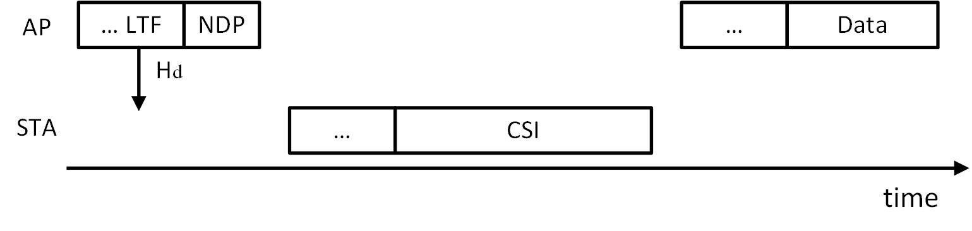
Explicit CSI Feedback
STA measures NDP’s LTF to get downlink CSI
STA sends measured downlink CSI to AP
Measuring and transmitting CSI introduce high computation & communication overhead

Slide 5
Eliminating CSI Feedback
Can we completely eliminate explicit CSI feedback?
  And achieve as high SNR as explicit CSI feedback
  With as low overhead as implicit CSI feedback
ELIMO: two-way CSI estimation for WiFi
  AP estimates downlink CSI without explicit CSI feedback
  STA does not send CSI to AP

Slide 6
Outline
Introduction
EliMO Two-way CSI Estimation
EliMO Protocol Design
Evaluation
Conclusions

Slide 7
Two-way CSI Estimation
Two-way CSI Htw Estimation:
Htw =MMSE(X,Yf)
Downlink CSI Hd Estimation:
Htw = HuHd Hd = (Hu)⁺Htw
Uplink CSI Hu Estimation:
Hu = MMSE(X,Yu)
Notes:
Hd =((Hu*Hu)⁻¹Hu*)(HuHd)
(Hu)⁺ is pseudo inverse.

Slide 8
Block Diagram
STA only needs to amplify and send FTF to AP
No need for STA to measure downlink CSI: reduced computation
No need for STA to send CSI to AP: reduced communication

Slide 9
Outline
Introduction
EliMO Two-way CSI Estimation
EliMO Protocol Design
Evaluation
Conclusions

Slide 10
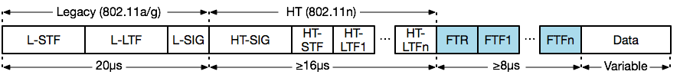
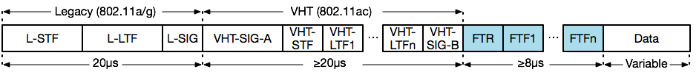
Packet Format
Implementing two-way CSI estimation in 802.11n/ac
  FTF: Feedback Training Field, received signals of LTF
  FTR: Feedback Training Request/Response
802.11n mixed mode packet
802.11ac packet
Notes:
1. 802.11n has two modes:
--- Mixed mode is compatible with 801.11 a/g.
--- Greenfield mode only has 802.11 n hearder.
2. Each FTR or FTFi is 4us.

Slide 11
MAC Operation
AP sends LTF and FTR to STA
STA puts received LTF, amplify it, and put it in FTF
STA sends LTF, FTR, and FTF to AP
AP computes downlink CSI Hd, which is used for sending the next data packet

Slide 12
Dealing with Stale CSI
Downlink CSI could be stale: Δt1 + Δt2 is too large
AP sends NDP (w/ FTR) to request STA to measure downlink CSI, when
  either similarity of two recent CSI measurements is smaller than 0.98
  or the time from the previous ACK (Δt2) is larger than 100ms

Slide 13
Outline
Introduction
EliMO Two-way CSI Estimation
EliMO Protocol Design
Evaluation
Conclusions

Slide 14
Evaluation Setup
AP & STA are laptops with Intel WiFi Link 5300 installed
  The power signal of WiFi chipset can not be programed to “amplify and transmit” in slide 7. So we use trace-driven simulation.
Downlink/uplink CSI traces (Hd & Hu)
  Frequency: 5GHz; channel width: 20MHz
  AP: 3 external antennas;
  STA: 3 internal antennas
  Transmitting power: 17/15dBm for the AP/STA
Scenarios
  Static: both AP and STA are static
  Mobile: the STA is randomly moving (~1.2m/s); the AP is static
Notes:
1. The AP has 3 external antennas, and the STA has 3 internal antennas spaced 2.4 inches apart.
2. The AP uses Zero-Force BeamForming (ZFBF) as the transmit beamforming algorithm.

Slide 15
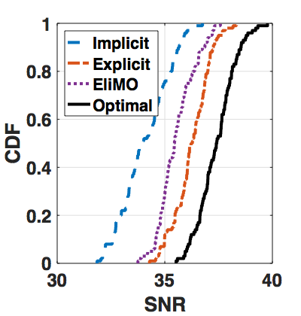
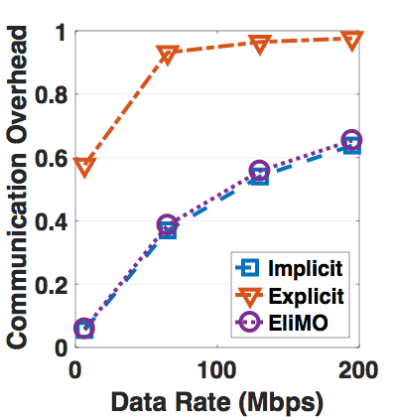
Evaluation: SNR & Overhead
tcontrol/(tcontrol+tdata)
EliMO achieves as high SNR as explicit CSI feedback, with as low overhead as implicit CSI feedback
Notes:
t_control:
--- In slide 10, everything that is NOT data is counted as t_control.
--- The whole ACK packet is counted as t_control.
--- In slide 12, the whole NDP packet is counted as t_control.

Slide 16
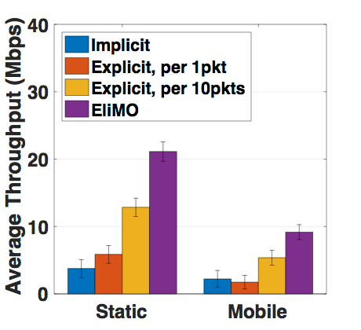
Evaluation: Throughput
When static, EliMO‘s throughput is 5X/4X/1.7X of “Implicit”, “Explicit per 1pkt", and “Explicit per 10pkts".
  “Explicit per 10pkt” means one explicit CSI feedback for every 10 data packets
When mobile, these numbers are 3.6X/4.5X/1.4X

Slide 17
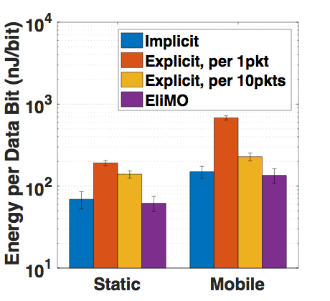
Evaluation: Energy
When static, EliMO's energy consumption is 85%/30%/50% of that of “Implicit”, “Explicit per 1pkt", and “Explicit per 10pkts".
When mobile, these numbers are 90%/17%/57%
Notes:
Packet size is 1500 byes.
Only energy of STA.
Only energy for transmission and reception, no idle listening.

Slide 18
Related Work
Compressed CSI feedback, but still need CSI feedback
  The same CSI for multiple packets, subcarriers, and/or antennae. [MobiCom’13]
  Less bits to represent CSI [MobiCom’13]
  Less frequent CSI feedback [CoNEXT’14]
No CSI feedback
  Echo-MIMO [IEEE TOSP’08] is similar to us, but not compatible with WiFi.
    Narrow-band channels without frequency-selective effects
    Over-the-air channels, not digital baseband channels
    Pure theoretical analysis, not in a WiFi compatible protocol, not tested with real devices

Slide 19
Conclusions
EliMO uses two-way CSI estimation and Feedback Training Field to accurately estimate downlink CSI without explicit CSI feedback.
EliMO is WiFi compatible.
EliMO significantly reduces computation, communication, and energy overhead for WiFi receivers.
Thank You!
This work has been supported by NSF CNS-1253506 (CAREER) and CNS-1553272 (CAREER).

