Slide 1
The 36th IEEE International Conference on Distributed Computing Systems (ICDCS’16)
Nara, Japan, June 27th -June 30th, 2016
HIDE: AP-assisted Broadcast Traffic Management to Save Smartphone Energy
Ge Peng∗, Gang Zhou∗, David T. Nguyen∗, Xin Qi‡, Shan Lin¶
∗ Computer Science Department, College of William and Mary
‡ VMware Inc.
¶ Dept. of Electrical and Computer Engineering, Stony Brook University

Slide 2
Did you charge your phone today?
7% days users charge phones 4 times a day
13% days users charge phones 3 times a day
43% days users charge phones more than once a day
18% users experienced phone blackout lasting longer than 2 hours in the month studied
Source: Estar Battery Saver
Notes:
Reference: http://mobileenerlytics.com/blog/?p=14

Slide 3
What do you expect from a new smartphone?
Longer battery life tops the list of user needs.
Source: TIME Mobility Poll, Qualcomm
Notes:
Reference: https://www.statista.com/chart/563/improvements-wanted-by-mobile-device-users/

Slide 4
Smartphone Power Modes
switch to active mode to process events
Active
Screen is on
CPU, ROM, and micro-controller circuits for various components are awake
Power consumption: high
Suspend
Screen is off
CPU, ROM, and micro-controller circuits for various components are suspended
Power consumption: low
switch to suspend mode to save energy
Notes:
Smartphones have two power modes: active mode and suspend mode.
In active mode…the system-on-a-chip, including ….. In suspend mode…
When the user is actively using the smartphone, the smartphone stays in the high power active mode to offer better performance. When the user becomes inactive for a while, the smartphone switches to low power suspend mode to save energy.
Ideally, when there is no user activity, we want the smartphone to stay in low power suspend mode as long as possible. However, in reality, suspend mode is interrupted from time to time. Consequently, the smartphone switches to active mode in order to wake up the CPU and other resources to process the interrupts.
One of the interrupts causes the system switches from suspend mode to active mode is WiFi broadcast traffic.

Slide 5
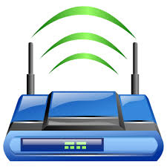
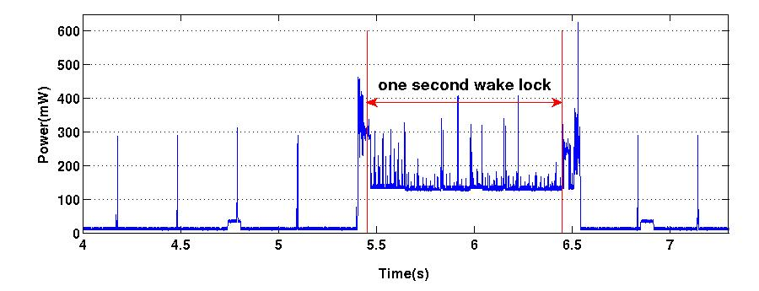
WiFi Broadcast Traffic During Smartphone Suspend Mode
Broadcast data frame
Broadcast data frame
Beacon(0)
Beacon(1)
Beacon(0)
Beacon(0)
Beacon(0)
Beacon
Beacon
Beacon
WiFi broadcast data frames with UDP payload
Beacon frame
1-bit broadcast traffic indication
buffer
Broadcast data frame
time
Notes:
Now, let’s have a look at what happens upon WiFi broadcast traffic during smartphone suspend mode. Here, WiFi broadcast traffic specifically means wifi broadcast data frame with UDP payload as they are the majority of broadcast data traffic in normal WiFi networks.
There is a smartphone and it is connected to this Wireless access point, AP for short. Here, I will show WiFi frames received by the smartphone along the time line.
When a smartphone is in suspend mode, the WiFi chip is also suspended. In order to save energy, the WiFi radio does not listen to the channel for incoming data all the time. Instead, it only listens to the channel from time to time to receive beacon frames from the AP. When not listening to the channel, the smartphone Is not able to receive WiFi data. So, a broadcast frame arrives during this time will first be buffered at the AP. Then, in the beacon frame, the AP uses one bit as broadcast traffic indication to tell clients whether there are broadcast frames buffered at the AP or not.
Here, the smartphone receives one broadcast data frame, in order to process this frame, the smartphone switches to active mode so as to wake up the CPU and other resources for the processing. At the same time, a one-second wakelock is triggered. This wakelock keeps the smartphone awake until it expires. It allows enough time for the application to process the data. Also subsequent frames can be processed immediately. Of course we have beacon frames during the rest of timeline.
We see that considerable energy is consumed for receiving and processing a broadcast frame. So, how to handle WiFi broadcast traffic efficiently during suspend mode is critical to smartphone energy efficiency.

Slide 6
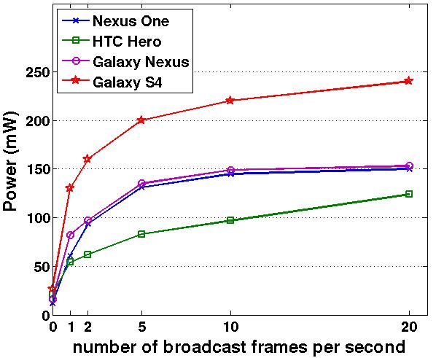
The Dilemma
“receive-all”: suffer high power consumption
Energy is wasted on unwanted (useless) broadcast frames
eg. printer service discovery
“receive-none”: sacrifice functionalities
Useful broadcast frames cannot be received
eg. local file transfer app
Source: G. Peng, G. Zhou, D. T. Nguyen and X. Qi, "All or none? The dilemma of handling WiFi broadcast traffic in smartphone suspend mode,” IEEE INFOCOM 2015.

Slide 7
Client-side Solution [INFOCOM’15]
Filter out useless broadcast traffic in the WiFi driver after they are received by smartphones*
Reduce active time
Energy is still wasted in receiving useless frames and state transfer
* G. Peng, G. Zhou, D. T. Nguyen and X. Qi, "All or none? The dilemma of handling WiFi broadcast traffic in smartphone suspend mode," Computer Communications (INFOCOM), 2015 IEEE Conference on, Kowloon, 2015, pp. 1212-1220.
Notes:
If it is a useless broadcast frame, there is no need to stay awake. The smartphone can just go back to suspend mode immediately.

Slide 8
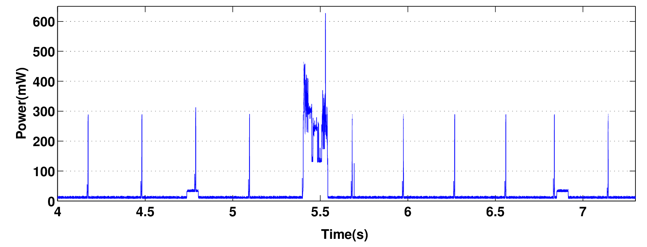
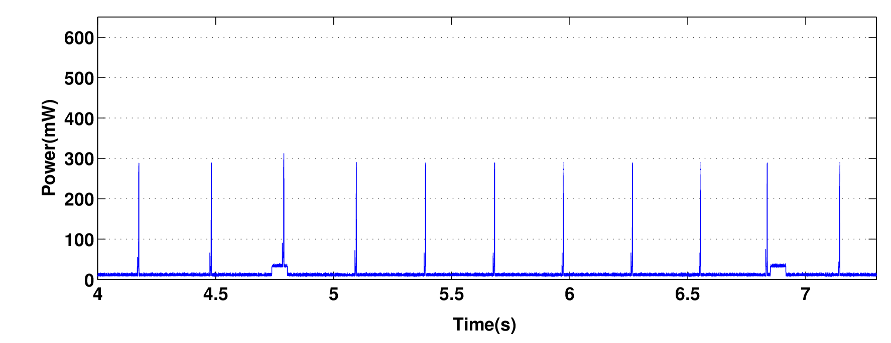
Receive-all
Client-side solution
(INFOCOM’15)
HIDE
Notes:
This is the power consumption for the receive all method measured from a smartphone, the same one we have seen before. Here, the smartphone receives a broadcast data frame.
With SBF, if this is a useful broadcast frame, we don’t change anything. But if this is a useless broadcast frame, there is no need to trigger the wakelock for applications to process the data and subsequent frames. So, SBF removes the one second wakelock. Then, the power consumption changes to this. This figure is not from real measurement. We created it from the first figure to help understand the energy saving. We see that SBF saves a lot energy. However, this is a useless broadcast frame, with SBF, the smartphone still needs to receive it and switch to active mode to determine whether this is a useless broadcast frame or not. Actually, we can do better. More energy can be saved if useless broadcast frames are identified and filtered out before they are received by smartphones. This is what we want to do in this work, we call this method HIDE.

Slide 9
HIDE: AP-assisted Broadcast Traffic Management
Useless WiFi broadcast frames are identified at the AP.
By UDP port number
useless (unwanted): UDP port not listened on
useful: otherwise
The AP hides the presence of useless broadcast frames from smartphones.
Smartphones in suspend mode do not receive nor wake up for useless broadcast frames.
Hence, smartphone energy is saved.

Slide 10
Questions (1/2)
How can AP differentiate between useful and useless broadcast frames for smartphones?
The AP does not know which UDP ports are listened on by which smartphone.
A smartphone uses UDP Port Message to tell the AP what UDP ports are listened on by itself.
The AP stores useful UDP ports in a UDP Port Table.
Notes:
Our answer to this question is to introduce a new message, UDP Port Message, to the WiFi protocol.

Slide 11
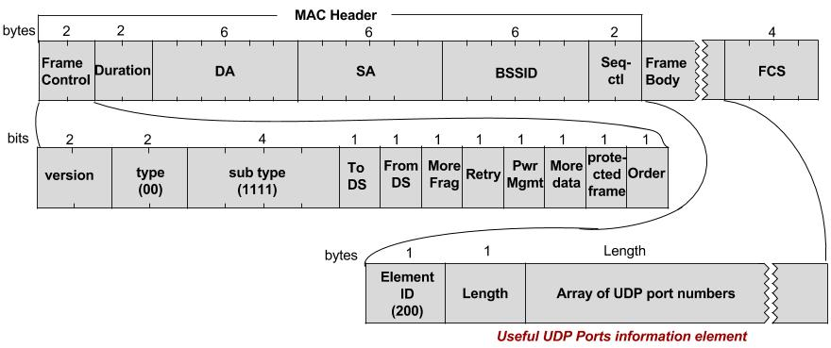
UDP Port Message
Useful UDP Port Information Element
Notes:
At the beginning, it is the standard MAC header, Then, it is the frame body, followed by FCS, frame check sequence for error detection.
In the mac header, The values in the type and subtype field tell the AP that this is a UDP Port messge.
The whole frame body contains…. The purpose of this field is to carrying a list of UDP port numbers currently listened on by the smartphone.
Upon receiving this UDP port messages, the AP stores the UDP ports in a UDP Port Table.

Slide 12
UDP Port Table
has useful broadcast frames?
buffer at AP
UDP Port Client IDs
137 | 1, 2, 3, 5
2000 | 1, 3
2005 | 2
3000 | 1, 5
5543 | 8
20210 | 2, 8
Client 1:
Client 2:
Client 3:
Client 5:
Client 8:
0
1
Broadcast frame
(UDP port: 2000)
0
Table
lookup
Broadcast frame
(UDP port: 3000)
0
1
0
1
0
Notes:
Here is an example of the UDP Port Table. There are two columns.
The ap uses this UDP Port table to determine which clients have useful broadcast frames.
At the beginning, all these values are initialized to zero. Assume there are two broadcast frames buffered at the AP, the AP extracts the UDP port number, then looks up the port number from the table.
With UDP port number 2000, this broadcast frame is useful to client

Slide 13
Questions (2/2)
How to hide the presence of useless broadcast frames?
An AP cannot simply drop a useless broadcast frame for one client as it may be useful to another client.
One bit is not enough to tell which clients have useful broadcast frames to receive.
The AP extends the broadcast traffic indication to offer one bit for each client (Broadcast Traffic Indication Map).
Notes:
After the traffic differentiation, now we have the second research question…
As long as a broadcast frame is useful to one client, the AP needs to send it out.
Currently, the AP uses one bit in the beacon frame as broadcast traffic indication. However, one bit … for example, one bit is not able to tell client A that it does not have useful broadcast frames and tell client B that is has useful broadcast frames.

Slide 14
smartphone wants to enter suspend mode
j collect useful UDP ports
k UDP Port Message
l ACK frame
n enter suspend mode
m update UDP Port Table
arrival of broadcast frames
Has useful broadcast frames or not?
o calculate Broadcast Traffic Indication Map
p beacon frame with Broadcast Traffic Indication Map
q.a stay in
suspend mode
no
q.b prepare WiFi
radio for receiving
yes
r useful broadcast frame(s)
s switch to active mode

Slide 15
Evaluation
Energy Saving
Methodology
Energy modeling
Trace-driven simulation
Solutions for comparison
receive-all
client-side solution

Slide 16
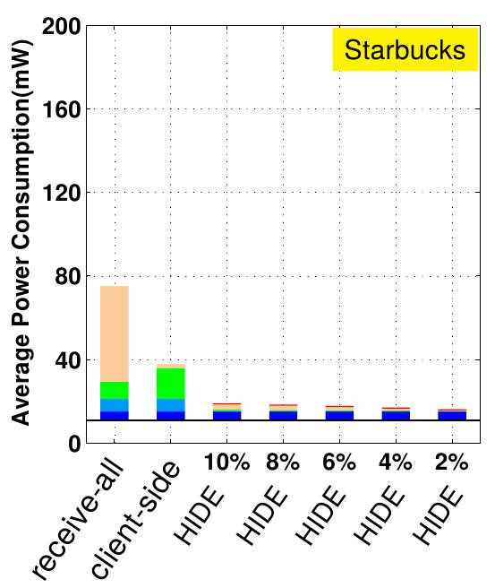
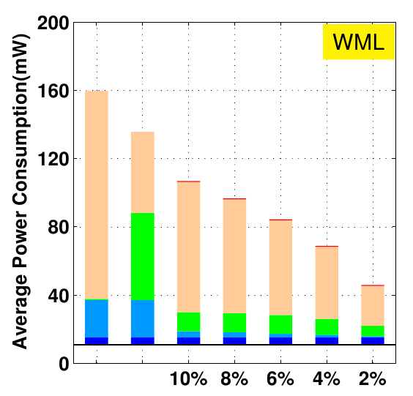
Power Consumption (Nexus One)
Starbucks
College Library
33% ~ 71%
75% ~ 79%
receiving beacon frames
receiving broadcast data frames
state transfer
stay active
overhead of HIDE
16

Slide 17
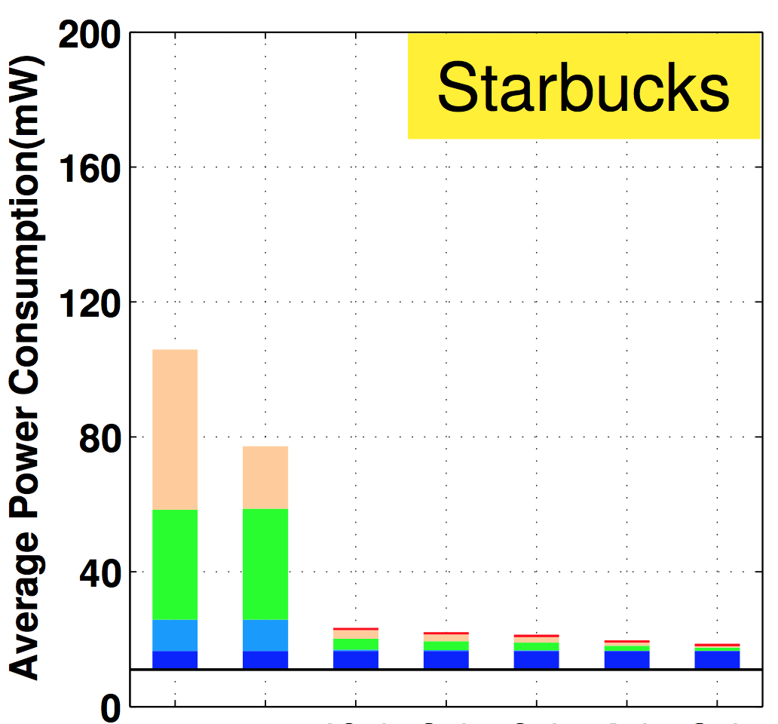
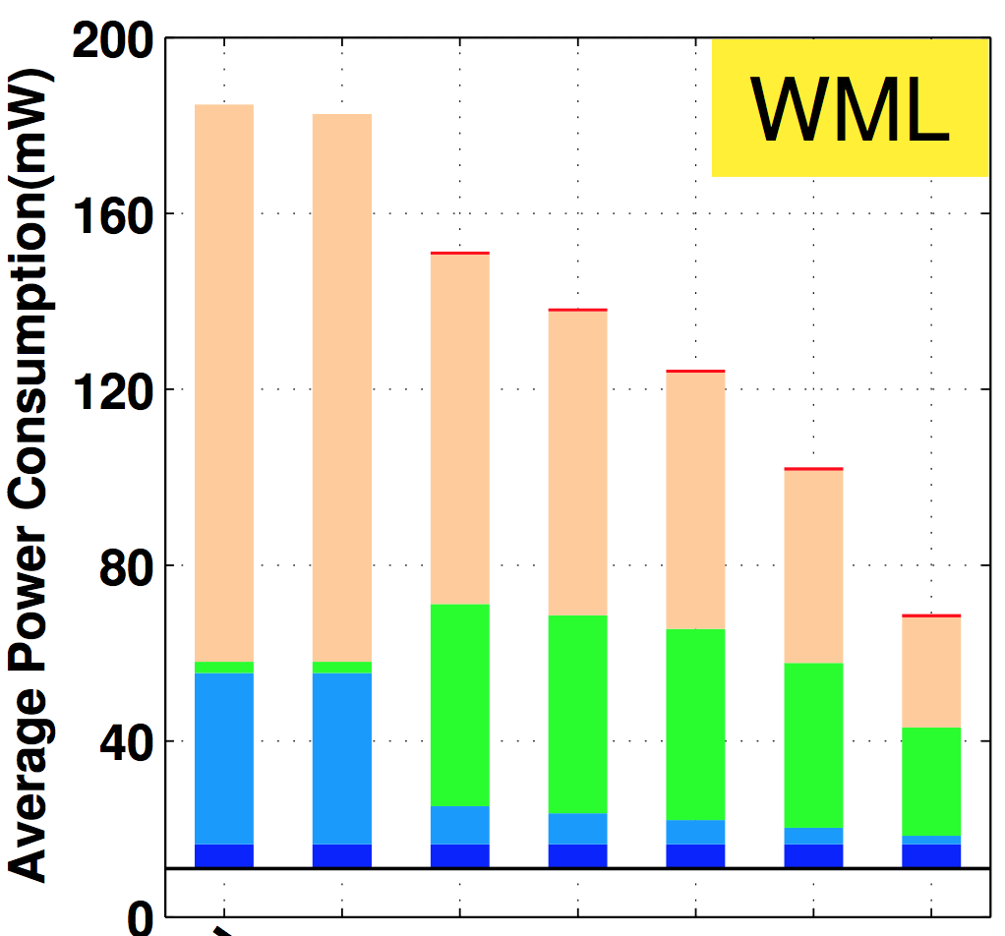
Power Consumption (Galaxy S4)
Starbucks
College Library
18% ~ 63%
78% ~ 83%
receiving beacon frames
receiving broadcast data frames
state transfer
stay active
overhead of HIDE
17
Notes:
Broadcast traffic volume: ~1 frame/s at Starbucks, ~10 frames/s at college library
(Why client side saves little at the college library scenario?) S4 has much longer state transfer time. When the phone is preparing to enter suspend mode after one broadcast frame, the next broadcast frame arrives and the phone abort entering suspend mode.

Slide 18
Evaluation
Overhead analysis
Decrease of network throughput due to transmissions of UDP Port Messages
Increase of network delay caused by UDP port operations at the AP

Slide 19
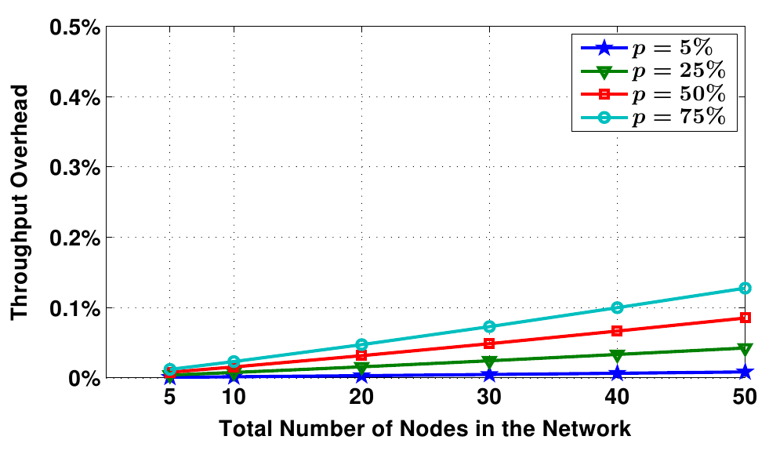
Overhead: Network Throughput
percent of nodes with HIDE enabled
Notes:
Lines of different colors represent different percentages of …
With 50 nodes in the network and 75% of the nodes are HIDE-enabled, the network throughput overhead is less than 0.2%.
The throughput overhead is negligible.

Slide 20
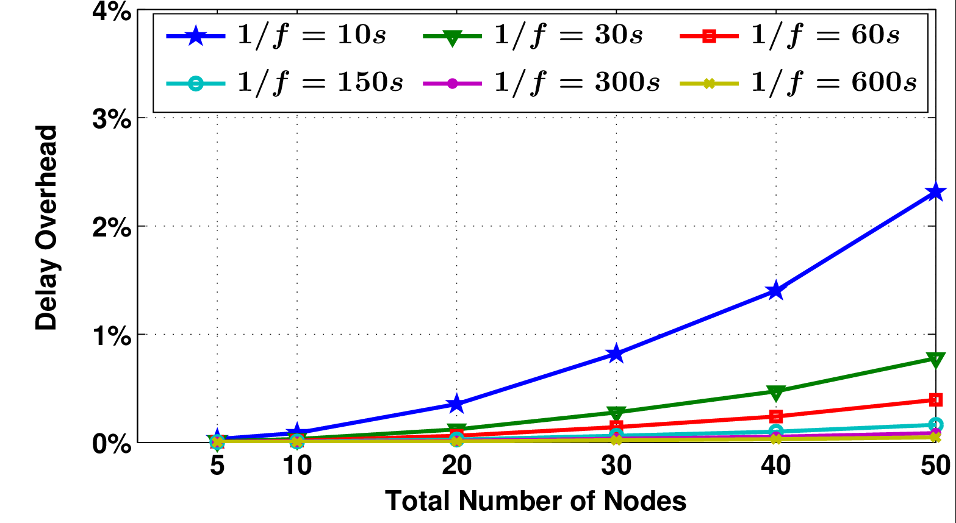
Overhead: Bounded Network Delay
sending interval
of UDP Port Messages
(50% nodes are HIDE-enabled)
Notes:
The delay overhead is minimal

Slide 21
Conclusion
HIDE: AP-assisted Broadcast Traffic Management
No useless (unwanted) broadcast frames are received by smartphones in suspend mode
Up to 82% energy saving for smartphones in suspend mode
negligible network throughput overhead and minimal delay overhead

Slide 22
Thank You!
Questions?

