Slide 1
LBVC: Towards Low-bandwidth Video Chats on Smartphones
Xin Qi, Qing Yang, David T. Nguyen, Gang Zhou, Ge Peng
College of William and Mary

Slide 2
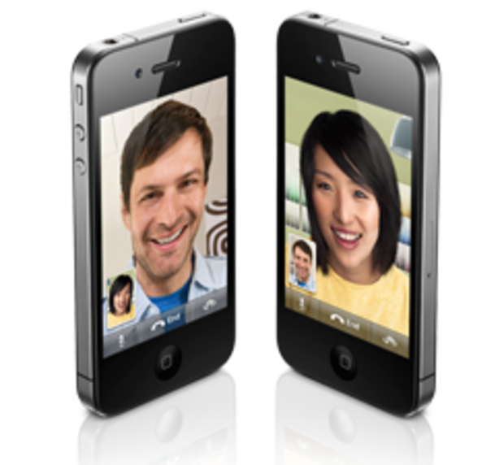
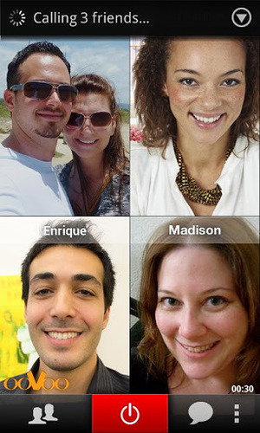
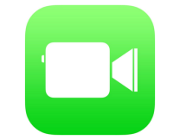
Video Chats on Smartphones

Slide 3
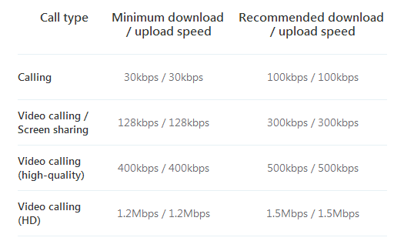
Video Chat Apps - Big Data Consumer
E.G., Skype
500MB = 1.85 h

Slide 4
Our Objective:
Reduce Data Usage of Video Chats on Smartphones

Slide 5
Outline
Measurements
LBVC Design
LBVC Implementation
LBVC Evaluation
Related Work
Conclusion

Slide 6
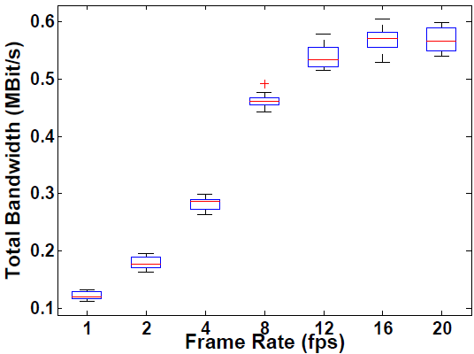
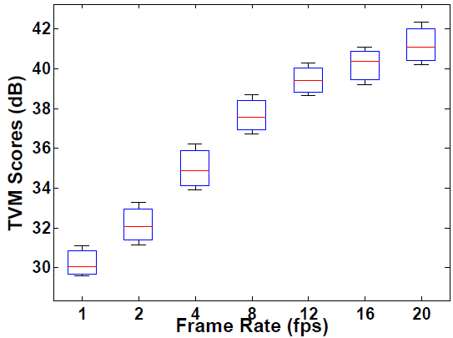
Reducing Video Frame Rate (1)
Bandwidth vs. Frame Rate
Video Quality vs. Frame Rate
(H.264 as codec)
(H.264 as codec)
Good News
Constraints
Typical frame rates adopted by video chat apps
TVM Score – a recent objective metric for mobile video quality [mobicom’12]

Slide 7
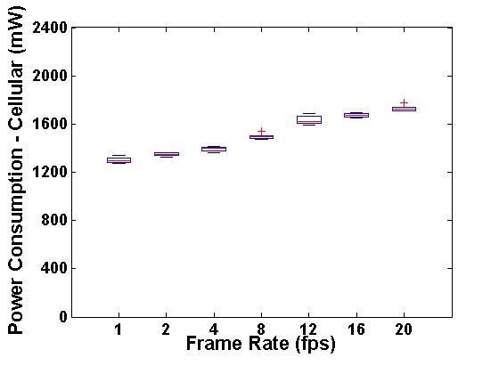
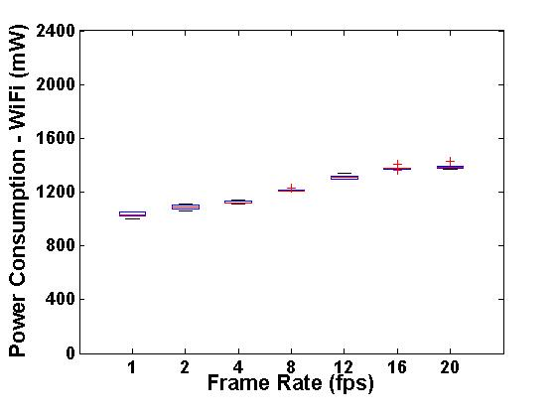
Reducing Video Frame Rate (2)
Power Consumption vs. Frame Rate
(H.264 as codec)
Power reduction is a minor benefit.

Slide 8
Research Question
How to reduce frame rate of mobile video chats without introducing obvious video quality degradation?

Slide 9
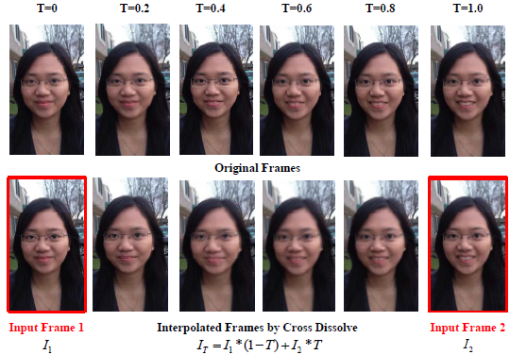
Frame Interpolation to Rescue Video Quality
The sender lowers bandwidth usage through reducing frame rate
The receiver interpolates “missing” frames to rescue video quality
However, large scene changes
between two input frames
result in strong artifacts in
the interpolated frames

Slide 10
Context-aware Frame Rate Adaption
At small frame rates, severe device vibrations are the main cause of large scene changes between two consecutive frames
To keep scene changes small between consecutive frames,
We use inertial sensors to determine whether a device vibration is severe or not
Video chats are only recorded with a small frame rate when a device vibration is not severe

Slide 11
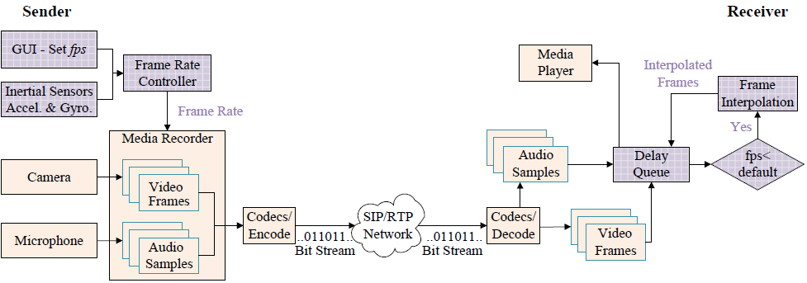
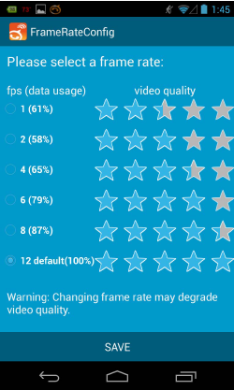
LBVC Architecture - Sender
LBVC – Low-bandwidth Video Chats
New Component

Slide 12
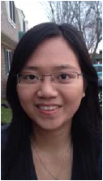
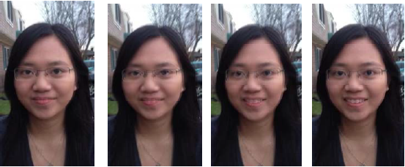
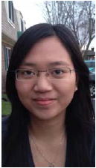
LBVC Architecture - Receiver
New Component
Intermediate Frames
Delay

Slide 13
LBVC Implementation
Implement LBVC as an extension to Linphone
Easy to add new components
a. Modify the MediaStreamer2 library
Add filters into the library to implement the cross dissolve algorithm
Use Android API in NDK to collect sensor readings
b. Implement the GUI with Java SDK
JNI to pass user input frame rate to the C library

Slide 14
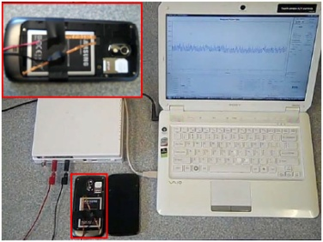
Evaluation – Setup
Use Shark for Root to capture network traffic and WireShark to analyze network traffic
Use Monsoon Power Monitor to measure power consumption
Implement a video chat recorder to record video chats and organize a user study to analyze video quality

Slide 15
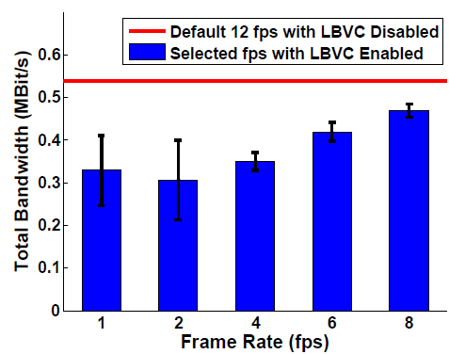
Evaluation – Bandwidth Usage
10 subject pairs, each of them performs video chats while standing or sitting
LBVC achieves bandwidth saving by up to 43%
39%
43%
35%
22%
13%
Smaller thresholds at lower frame rates
result in larger bandwidth usage variance.

Slide 16
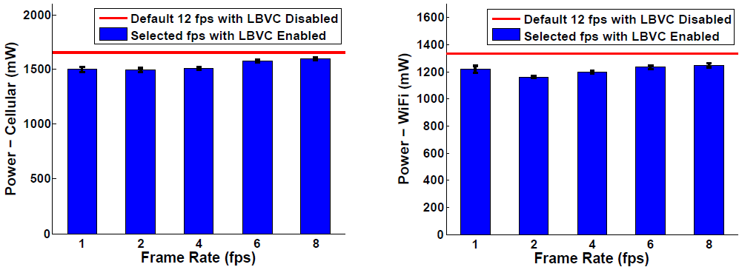
Evaluation – Power Consumption
10 subject pairs, each of them performs video chat while standing or sitting
Power saving is not a major benefit of LBVC.

Slide 17
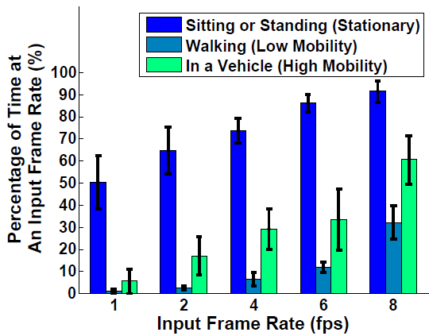
Consider Different Mobility Cases
Walking
Lowest chance to save bandwidth
Sitting in a vehicle
Percentage of Time at
User Selected Frame Rate (%)
Car moves fast, but user’s
smartphone is relatively stable;
increased chances to save bandwidth
Sitting or standing
Highest chance to save bandwidth
User Selected Frame Rate (fps)

Slide 18
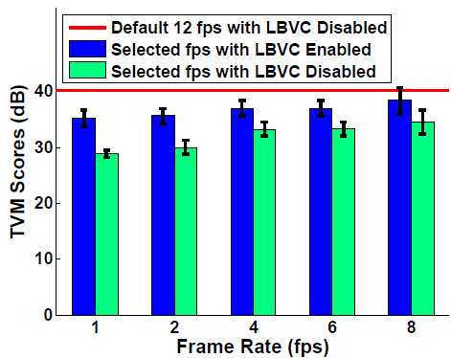
Evaluation – Objective Video Quality
Record video chats and calculate TVM scores with MATLAB.
LBVC is able to objectively maintain video quality.

Slide 19
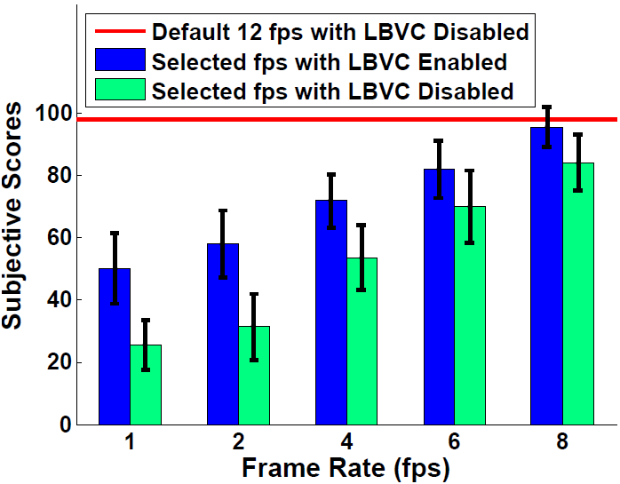
Evaluation – Subjective Video Quality
21 subject pairs; each pair rates video chats at different frame rates with LBVC disabled and enabled
LBVC maintains subjective video quality ( >= 4 fps)
At low frame rates, minor interpolation artifacts and frequent frame rate switches still affect subjective video quality
acceptable level

Slide 20
Related Work
Video streaming bandwidth reduction
Video compression methods, such as H.264 and VP8
Advanced compression methods, such as compress sensing [Meng, Infocom 2012] and context-aware image compression [Bao et al., Hotmobile 2011]
LBVC reduces bandwidth of streaming video chats through frame rate adaption instead of video compression
Image interpolation
Has been widely used in computer graphics, such as creating animations from sets of images [Kemelmacher-Shlizerman et al., SIGGRAPH 2011]
LBVC exploits image interpolation techniques to rescue the video quality of mobile video chats with decreased frame rate

Slide 21
Conclusion
LBVC
adapts the video frame rate with respect to the smartphone vibrations at the sender side
interpolates the missing frames at the receiver side
saves bandwidth by up to 35% under typical video chat scenarios as well as maintains acceptable video quality
considering the bandwidth saving, video quality and introduced delay, we recommend 4 fps (35% bandwidth saving).

Slide 22
Questions?
Thank you!

