Slide 1

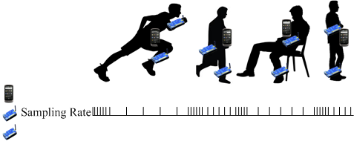
AdaSense: Adapting Sampling Rates for Activity Recognition in Body Sensor Networks
Xin Qi, Matthew Keally, Gang Zhou, Yantao Li, Zhen Ren
College of William and Mary

Slide 2
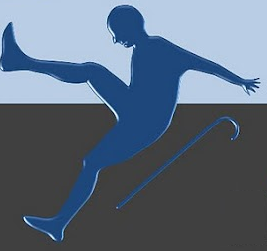


Background - Activity Recognition
Activity Recognition aims to automatically recognize user actions from the patterns (or information) observed on user actions with the aid of computational devices.
Fall Detection
Sleeping Assessment
Depression Detection

Slide 3
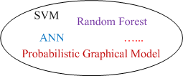

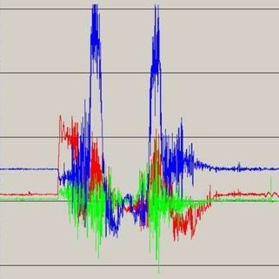
Sensing-based Activity Recognition
Problem setting
Accelerometer
Gyroscope
Temperature
Light
etc.
Running, Walking, Sitting, …
Sensing Data

Slide 4





A Dilemma
High sensors sampling rate for high recognition accuracy,
Reducing sensors sampling rate to save energy
accuracy
energy overhead
accuracy
energy overhead
de-sampled data
highly sampled data

Slide 5
Research Question
  How to reduce sensors sampling rate without sacrificing recognition accuracy?
accuracy
?
How to achieve
energy overhead

Slide 6
Preliminary Experiment
Opportunity data set, 3 subjects, 4 locomotion activities, sensors sampling rate - 30 Hz
Select 8 on-body sensors (4 accel. & gyro.)
Extract features at 30 Hz and select the best ones
At each sampling rate
  Extract the selected features
  Obtain accuracy following 10-cross validation
Sequential Forward Strategy (SFS) based Feature Selection Algorithm
Classifier – Support Vector Machine (SVM) + Radial-base Function (RBF)

Slide 7
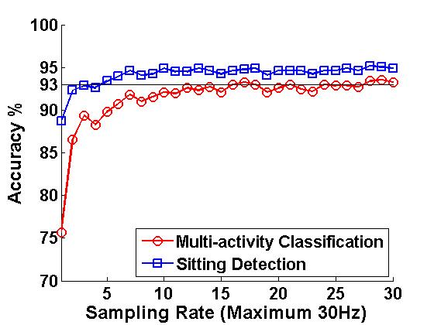
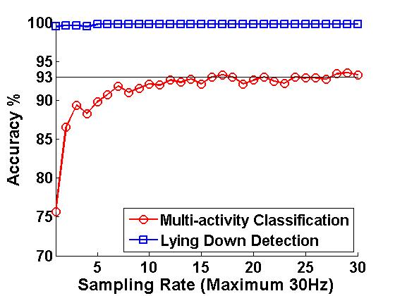
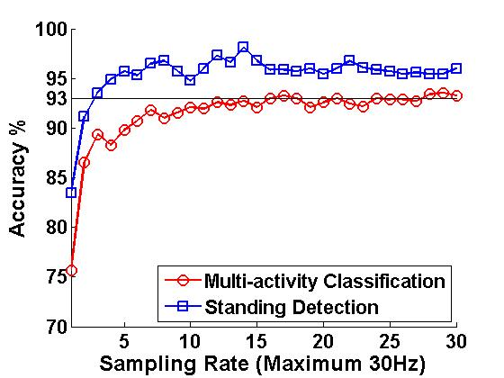
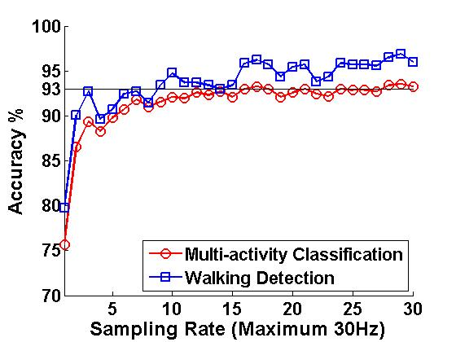
Two Motivating Observations
Given the feature set,
at each sampling rate,
detection accuracy
≥
multi-class. accuracy
Sitting
Lying Down
=
Lemma:
Given the feature set,
for any accuracy
requirement,
minimal necessary rate
for detection
≤
that for multi-class.
Standing
Walking
Implicit fact – diff. feature sets have diff.
minimal necessary sampling rates
Blue Line – Activity Detection (Binary Classification)
Red Line – Multi-Activity Classification

Slide 8
Outline
How to reduce sensors sampling rate through exploiting the Lemma?
How to reduce sensors sampling rate through exploring feature set space?
Evaluation, related work & conclusion

Slide 9
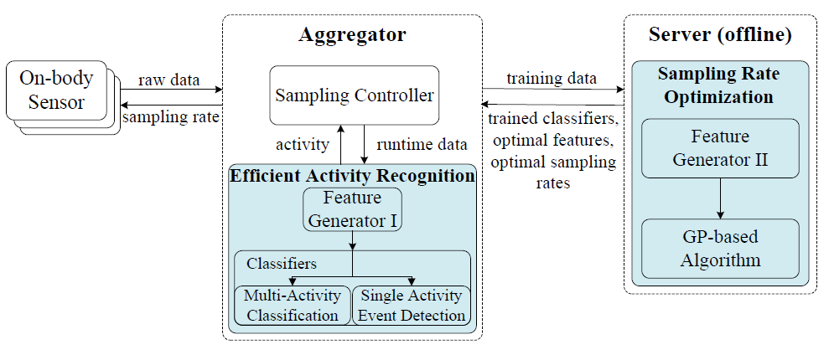
AdaSense Architecture
We design Efficient Activity Recognition (EAR) to exploit the Lemma
Exploit the Lemma

Slide 10
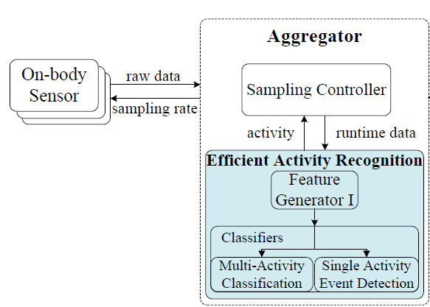

Exploit The Lemma
1. At beginning, EAR identifies current activity with multi-class.
2. EAR informs sampling controller
the predicted activity
3. Sampling controller controls sensors sampling
at the detection sampling rate of the activity
4.With de-sampled data, EAR performs single activity detection
5. Go back to 1 when an activity change is detected.
To reduce false report, activity change is detected when
EAR gets four negative activity detection results out of the
most recent five ones.

Slide 11
AdaSense in Runtime
Sensors sampling rate is reduced in average!

Slide 12
AdaSense Architecture
To further reduce sensors sampling rate, AdaSense utilizes Genetic Programming (GP) to explore feature set space
Exploit the Lemma
Explore Feature Set Space

Slide 13
Exploring Feature Set Space
Genetic Programming
  Optimization objective – minimizing the minimal necessary sampling rate for multi-activity classification under an accuracy requirement
  Minimizing necessary sampling rate for activity detection through minimizing its upper bound (a heuristic method)

Slide 14

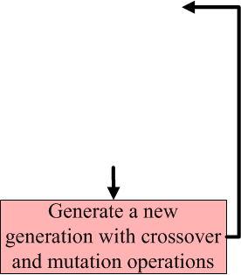
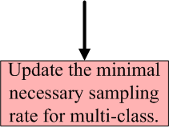
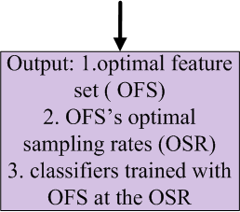
A Variant GP-based Algorithm

Slide 15
Evaluation - Setup
SVM plus RBF kernel as classifier
SFS based feature selection algorithm
Follow 10-fold cross validation routine to obtain accuracy
GP-based algorithm is implemented upon GPLAB
Set individual height as 3 and population size as 100
Two datasets: Opportunity dataset and a smartphone dataset we collect

Slide 16
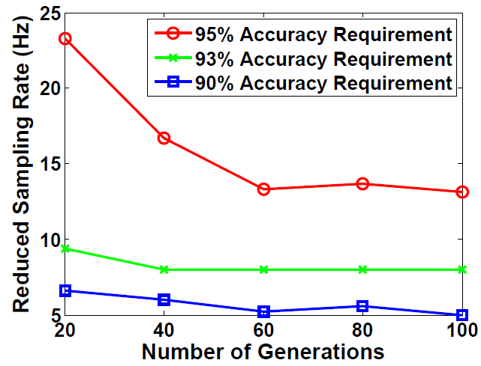
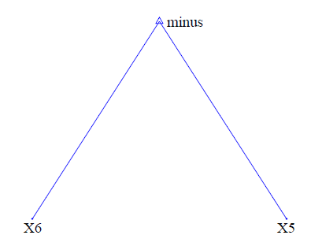
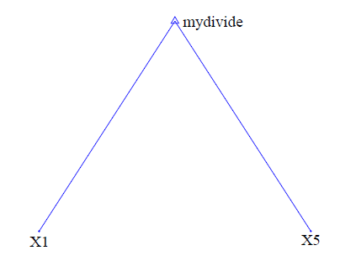
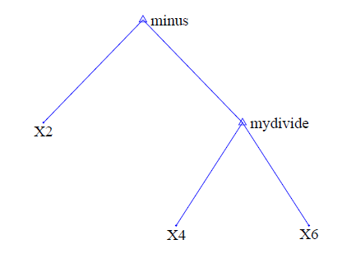

Evaluation - Results for Opportunity Dataset
GP-based algorithm convergence rate
Optimal features for subject one
60 generations are enough for the algo. to converge
Xis are the best features in the initial generation
Simple structure and operation, low cost.

Slide 17
Evaluation - Results for Opportunity Dataset
Sampling rate reduction for multi-classification
Sampling rate reduction for
activity detection (subject 1)
Sampling Rate (Hz)
Sampling Rate (Hz)
BFS – best feature set from initial generation
OFS – optimal feature set

Slide 18
Evaluation – Collecting Data with Smartphone
8 subjects, 6 activities (sitting, walking, running, lying down, standing, cycling)
Smartphone (Google Nexus One) is put into each subject’s pocket
Each subject performs each activity for 30 minutes
Record the tri-axial accelerometer readings

Slide 19
Evaluation – Results for Smartphone Dataset
Sampling rate reduction for multi-classification
Sampling Rate (Hz)
BFS – best feature set from initial generation
OFS – optimal feature set

Slide 20
Evaluation – Results for Smartphone Dataset
Sampling rate reduction for activity detection
Sampling Rate (Hz)
BFS – best feature set from initial generation
OFS – optimal feature set
Results of Subject 1

Slide 21
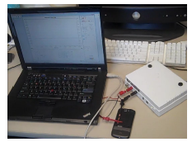
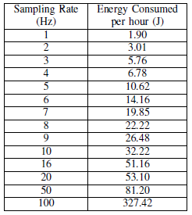
Evaluation – Results for Smartphone Dataset
Power measurement result of sensor sampling
Feature extraction and classification,
  Power 3.5mw
  Duration 12.7ms

Slide 22
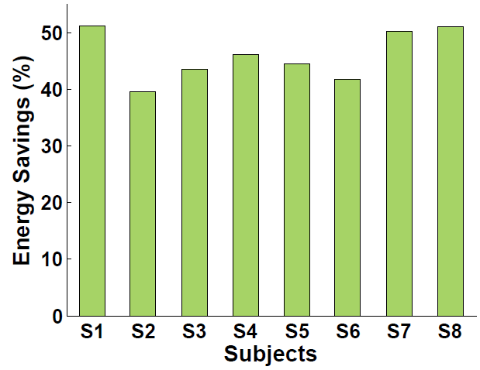
Evaluation – Results for Smartphone Dataset
Compared to A3R, a most recent sampling rate reduction method
Energy emulation - multiplies each system state duration by the corresponding energy power consumption per unit time
Energy savings: 39.4%~51.0%

Slide 23
Related Work
Context-aware sampling rate adaption
  SpeakerSense [Pervasive ‘11], SociableSense [Mobicom ‘11], EmotionSense [Ubicomp ‘10], AR3 [ISWC ‘12]
  Our work achieves more fine-grained sampling rate reduction
Energy saving through sensor cluster selection and duty cycling
  Wolfpack [Infocom ‘11], QoINF [Percom ‘11], Seemon [Mobisys ‘08]
  Our work focuses on sampling rate reduction to save sensing energy

Slide 24
Limitations
Energy savings achieved by AdaSense are limited for short-term activities
Optimal features may be overfitted to training data.
  We utilize the cross validation method in GP to alleviate overfitting

Slide 25
Conclusion
AdaSense, a framework to reduce sensors sampling rate for BSN activity recognition.
To achieve that, AdaSense
  Exploits the Lemma: combines multi-activity classification with single activity detection
  Searches an optimal feature set that requires low sampling rate with the aid of GP
AdaSense achieves 39.4%~51.0% sensing energy saving on smartphones compared to a most recent sampling rate reduction method

Slide 26
Q & A
Thanks!

Slide 27
Thank You!
The End.

Slide 28
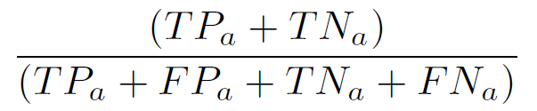
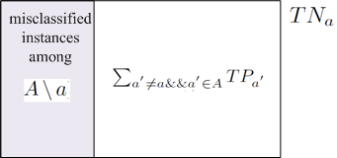



Explanation for the Lemma
Given a feature set, for single activity a, detection accuracy is
For multi-activity classification, accuracy is
1
= M
≥
+
=
2
TP – True Positive
FP – False Positive
A – Activity Set
TN – True Negative
FN – False Negative
M – # of classified instances

Slide 29
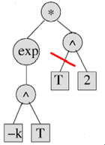
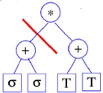
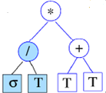
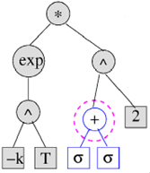
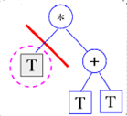
A Variant GP-based Algorithm
crossover
mutation
This picture is excerpted from slides
made by Kumara Sastry, UIUC.

