Slide 1
Exploiting VOIP Silence for WiFi Energy Savings in Smart Phones
SiFi:
Andrew J. Pyles¹, Zhen Ren¹, Gang Zhou¹, Xue Liu²
¹College of William and Mary, ²University of Nebraska

Slide 2
Problem Description
Minimize energy use during phone calls
Observation: WiFi consumes 20x more energy when power save disabled.

Slide 3
Problem Description
Research by Drago, Molinari and Vagiliani (1978) : 60% of a typical conversation is silence.
Why not enter into WiFi Power Save Mode during silence periods in conversation?

Slide 4
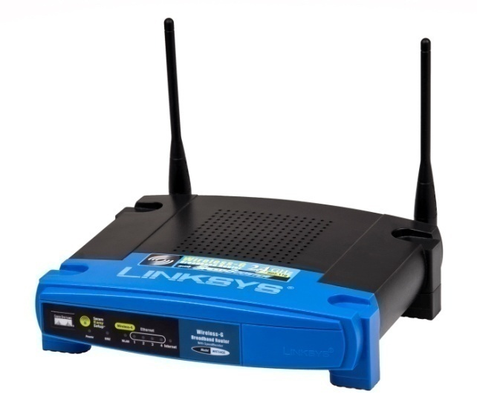
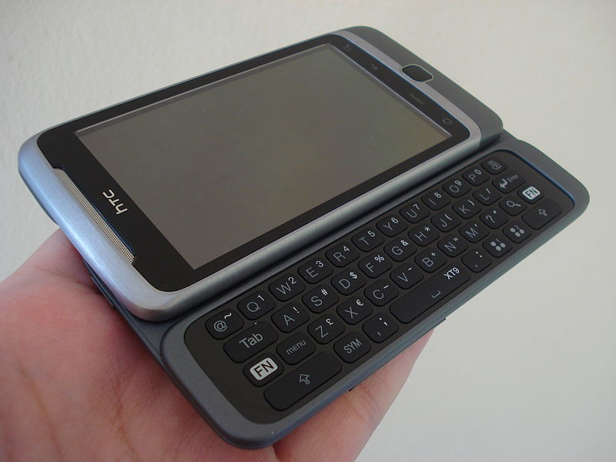
Background : WiFi Power Save
Beacon period
AP Buffers Packets
100ms
Client Sleeps
Client is awake

Slide 5
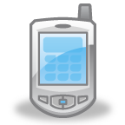
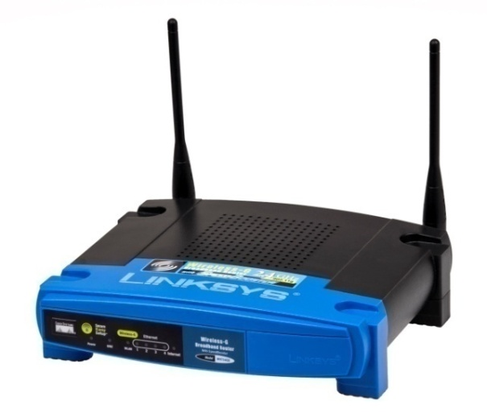

Background: Adaptive PSM
NOTE: AWAKE = CAM mode
PS-POLL
PS-POLL
PS-POLL
PS-POLL
NULL: AWAKE
NULL: SLEEP
DELAY: depending on driver implementation

Slide 6
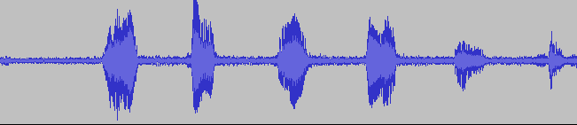
Background : RTP
non-VAD :
VAD:
Voice
Activity
Detection
VAD :
Notes:
Describe VAD, non-VAD

Slide 7
Adaptive PSM
Switch to CAM
Could be sleeping!
Delay.. STILL in CAM
NO packets for a while, time to SLEEP!
(POWER SAVE MODE ENABLE)

Slide 8
Related Work
802.11 general approaches
  Self Tuning Wireless Network Power Management, Mobicom (2003)
  Micro Power Management of Active 802.11 Interfaces, Mobisys (2008)
  Catnap: Exploiting High Bandwith Wireless Interfaces to Save Energy for Mobile Devices, Mobisys (2010)
VoIP Specific approaches
  U-APSD, IEEE 802.11e (2005)
  Hybrid Power Saving Mechanism for VoIP Services with Silence Suppression in IEEE 802.16e Systems, Communications letters (2007)
  Towards Energy Efficient VoIP over Wireless LANS, Mobihoc (2008)
Notes:
Work covers wide variety of research areas: Smart Phones, Wireless, 802.11, VoIP, etc.
U-APSD: Upstream traffic triggers AP to transmit all buffered packets
Hybrid Power Savings: During Silence periods, WiMax interface (in this case) placed in low power setting
Exponential Back-off Algorithm. PROBLEM: Long silence periods it may over sleep adding latency: Could impact performance.

Slide 9
Contributions
Exploit Silence periods using modeling and prediction
Propose Silence prediction framework called SiFi
Implement SiFi onto Android phone
Notes:
(Gang:) Put your “outline” slide righter after this slide.

Slide 10
Overview
Problem Description
Background
Related work
Contributions
Big idea
SiFi framework
Implementation
Evaluation
Conclusion
Notes:
(Gang) It may be better to put this roadmap slide after your contribution slides.
(Andy) Done

Slide 11
Big Idea
Training operation
  Gather statistics about silence gaps in conversation
Run time operation
  Detect start of silence period
  Predict length of silence period
  Enable WiFi Power Save Mode during predicted length

Slide 12
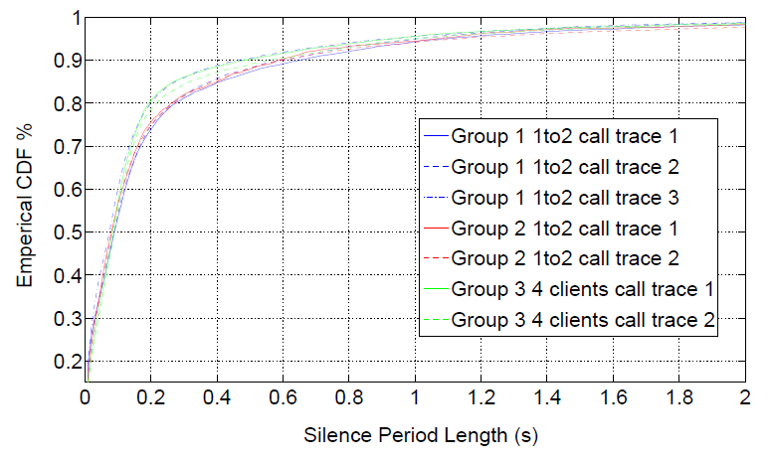
Big idea: Training
Gather Silence Periods
Store to disk
Compute ECDF
ECDF:
Empirical
Cumulative
Distribution
Function
Notes:
Future work: Potentially eliminate the training phase.

Slide 13
Big idea: Runtime
Detect start of silence period
Wait α (typically 50ms)
Determine length of sleep period: Δ
Find MAX Δ where: P(x>α + Δ| x > α ) ≥β)
β = confidence interval
Notes:
Conditional Probability:
X =
B TOO HIGH: conservative – better quality BUT modest energy savings
B TOO LOW: more energy saved - risk bad call quality

Slide 14
Introducing SiFi
Silence Prediction based WiFi energy Adaptation

Slide 15
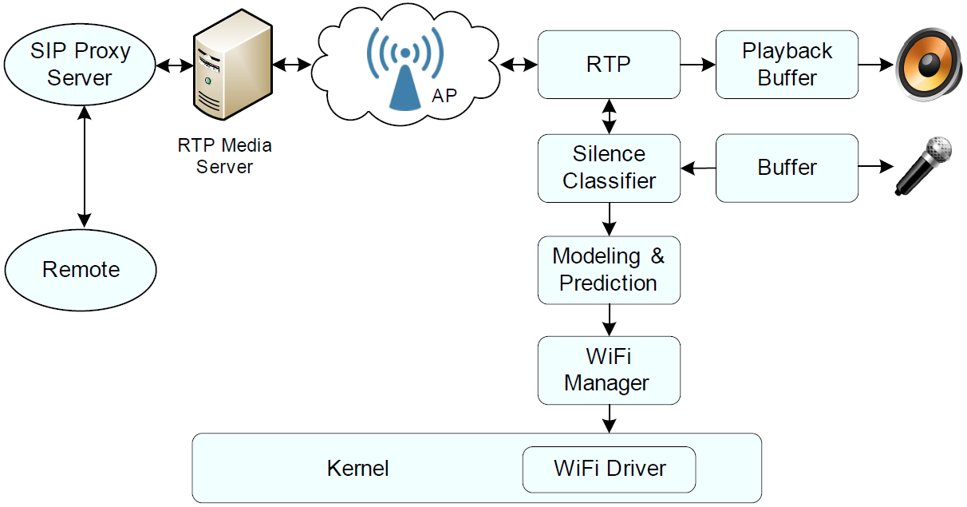
SiFi Framework

Slide 16
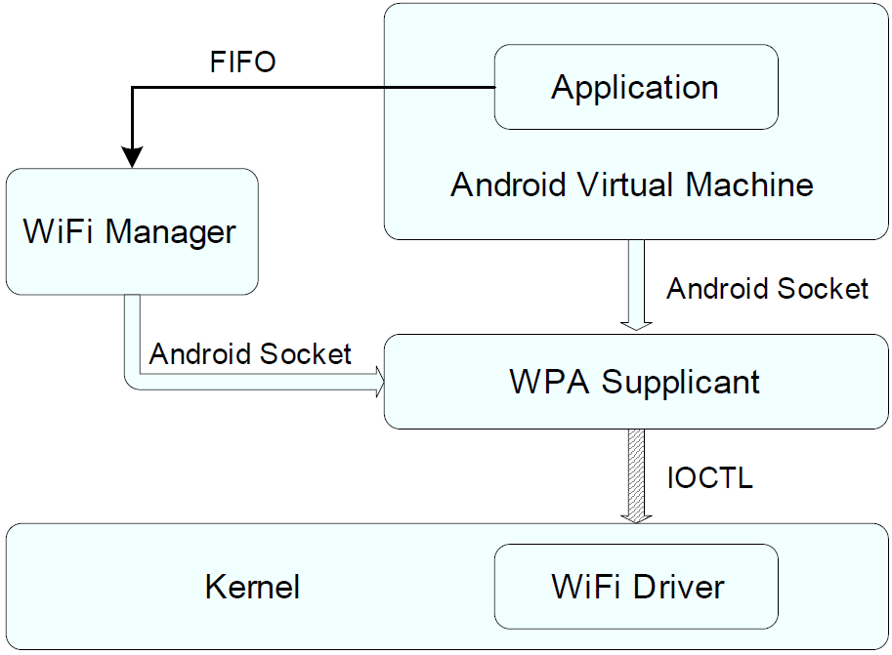
Implementation: WiFi Manager

Slide 17
Evaluation
Energy Consumption
Application Fidelity

Slide 18
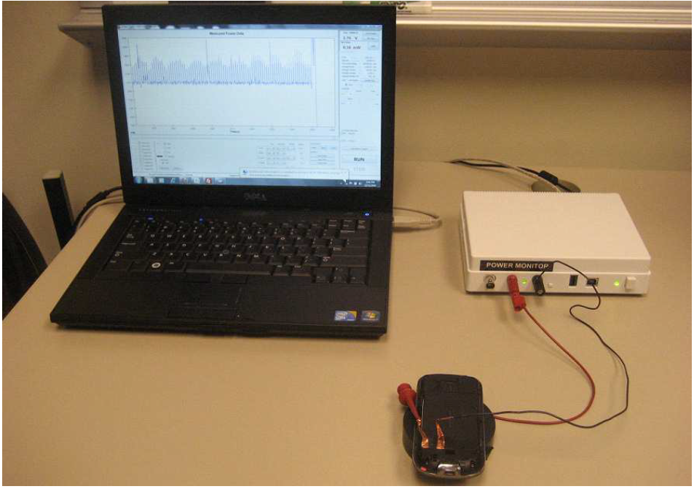
Evaluation: Energy Consumption

Slide 19
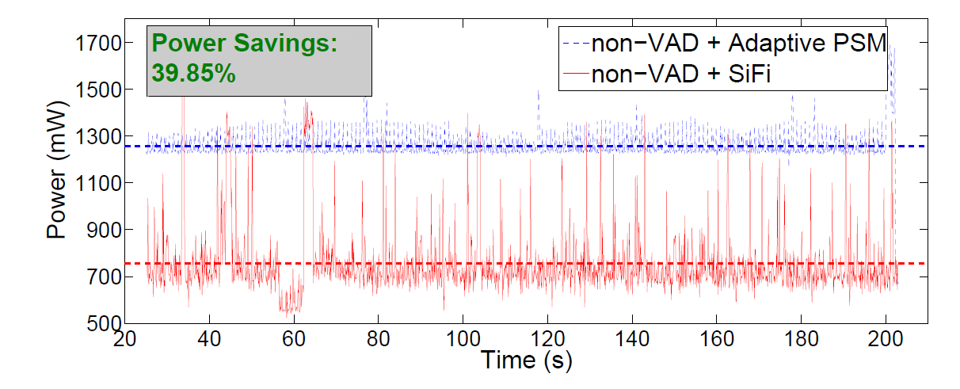
Energy Consumption: non-VAD

Slide 20
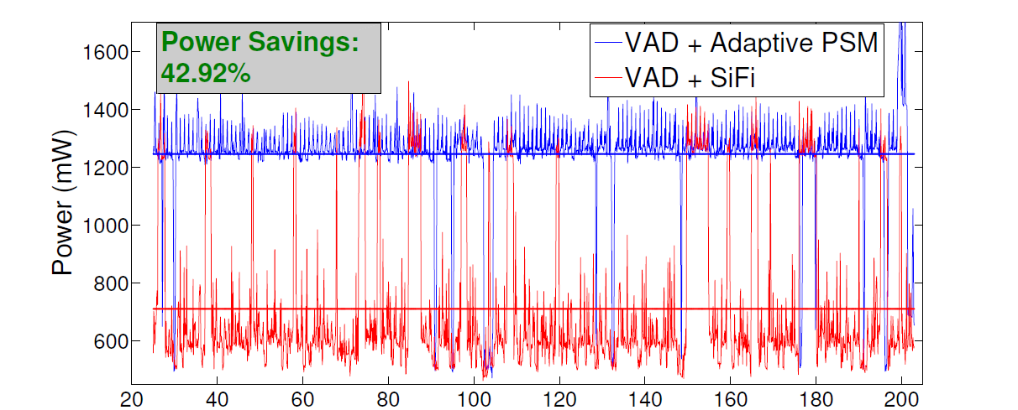
Energy Consumption: VAD

Slide 21
Evaluation: Application Fidelity
We use Mean Opinion Score (MOS) for evaluation
Notes:
(Gang): This is a similar comment as that I gave in slide 3. Put the “MOS Scoring” legend adjacent to the y-axis of your figure. Remove the “MOS Scoring” that is above the figure, since it is redundant.

Slide 22
Evaluation: Application Fidelity
MOS is a subjective measurement
Factors that impact MOS score:
  ONE-Way delay (mouth to ear delay)
  Jitter
How do we put this together?
E-MODEL:
  1 + 0.035R+7∗ 10−6R(R − 60)(100 − R)
  “R” can be approximated using one-way delay, and inferred codec information

Slide 23
Application Fidelity: Delay
One Way delay can be calculated if clocks are synced. (Can’t assume that!)
ASSUME: OWD = RTT/ 2
A
B
RTT= (Ta2 - Ta1) - (Tb2 - Tb1)

Slide 24
Evaluation: Application Fidelity
E-Model : Estimate MOS rating of a call
Notes:
(Gang): This is a similar comment as that I gave in slide 3 and 21. Put the “MOS Scoring” legend adjacent to the y-axis of your figure. Remove the “MOS Scoring” that is above the figure, since it is redundant.

Slide 25
Conclusion
Feedback from Application layer to WiFi driver = added energy savings!
Exploit Silence periods using modeling and prediction
Propose Silence prediction framework called SiFi
Implement SiFi onto Android phone

Slide 26
Questions and Discussion
Thank you!
Contact: ajpyles@cs.wm.edu
http://www.cs.wm.edu/~ajpyles
Questions?

Slide 27
backup

Slide 28
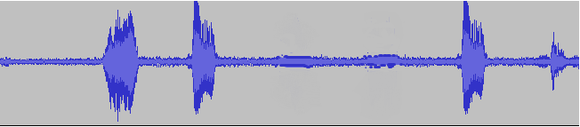
Related Work
Exploiting Idle Opportunities
  Self Tuning Wireless Network Power Management, Mobicom (2003)
  Micro Power Management of Active 802.11 Interfaces, Mobisys (2008)
  Catnap: Exploiting High Bandwith Wireless Interfaces to Save Energy for Mobile Devices, Mobisys (2010)
VoIP Specific approaches
  U-APSD, IEEE 802.11e (2005)
  Hybrid Power Saving Mechanism for VoIP Services with Silence Suppression in IEEE 802.16e Systems, Communications letters (2007)
  Towards Energy Efficient VoIP over Wireless LANS, Mobihoc (2008)
Notes:
Gang --- Since you only list two related work here, people may doubt about your expertise in this area and wonder whether you know the related work or not. So, while you can FOCUS on these two related works, you still need to MENTION other related works that the audience may know.
TODO

Slide 29
Related Work
Research by Choi and Lee (2007)
  Uses Exponential Backoff Algorithm
  Oversleeping can cause quality problems
U-APSD 802.11 standard
  Upstream traffic triggers AP to transmit all buffered packets
  Requires synchronous traffic
Two
Three
Four
Five
Notes:
Gang --- Since you only list two related work here, people may doubt about your expertise in this area and wonder whether you know the related work or not. So, while you can FOCUS on these two related works, you still need to MENTION other related works that the audience may know.
TODO

