Slide 1
Storage-aware Smartphone Energy Savings
David T. Nguyen, Gang Zhou, Xin Qi,
Ge Peng, Jianing Zhao, Tommy Nguyen, Duy Le

Slide 2
Life in Mobile Era.. 1,038,000,000 smartphone users worldwide [ibtimes] 27% increased # smartphones sold annually [IDC]
Figure Courtesy: http://www.ideas4ios.com

Slide 3
Smartphones everywhere! 75% Americans use them in bathrooms [CBSNEWS] 50% users under 25 use them while eating [Wilson]
Figure Courtesy: http://bublews.com

Slide 4
Smartphone apps do everything! 850,000 apps in apple store 05/13 [apple] 800,000 apps in google play 05/13 [Canalys] 145,000 apps in windows store 05/13 [canalys] 120,000 apps in blackberry world 05/13 [canalys]
Figure Courtesy: http://aptito.com

Slide 5
Still BIG Problem
Figure Courtesy: http://cdn.cultofmac.com

Slide 6
Smartphone Dislikes
Source: ChangeWave

Slide 7
Outline
Introduction
Background
Experimental Study
SmartStorage Design
Evaluation

Slide 8
Introduction
Researching energy consumption essential
What has been done
Performance bottleneck in storage
[Kim et al., FAST ‘12]
No direct study of storage – energy consumption correlation

Slide 9
Introduction
Research questions
How does storage affect smartphone power efficiency?
How to optimize storage to save energy?
We propose SmartStorage
Tracks smartphone I/O pattern
Dynamically configures optimal storage parameters to save energy

Slide 10
Outline
Introduction
Background
Experimental Study
SmartStorage Design
Evaluation

Slide 11
I/O Path
Red: Nexus One default static configurations

Slide 12
Outline
Introduction
Background
Experimental Study
SmartStorage Design
Evaluation

Slide 13
Approach
Investigate impact of different storage configurations on power levels
Run series of benchmarks under default configurations
Repeat benchmarks under different configurations
Compare energy consumptions

Slide 14
Setup
Rooted smartphones: Nexus One, Nexus 4
8 benchmarks
Monsoon Power Monitor

Slide 15
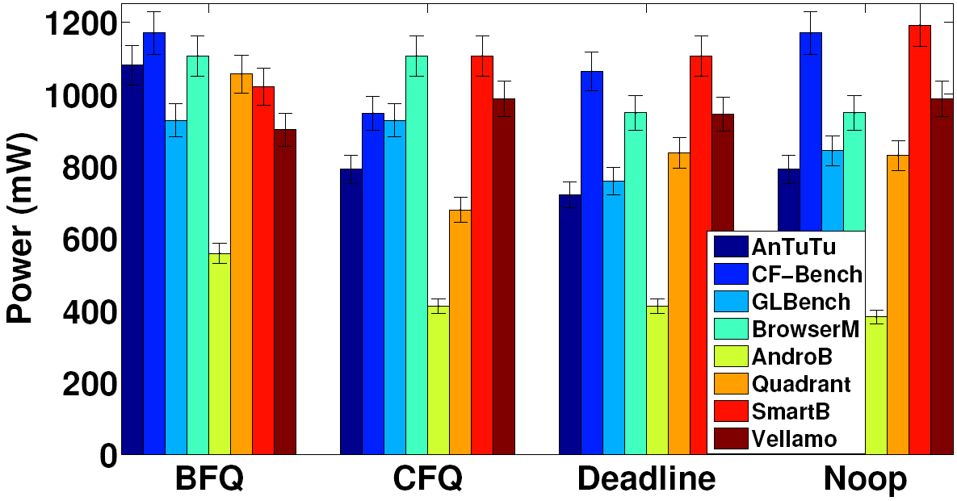
Power Consumption: Default Config. (Queue Depth 128 / Write-back cache)
Different algorithms - different power levels
No algorithm optimal for all benchmarks
Changing algorithms may save energy

Slide 16
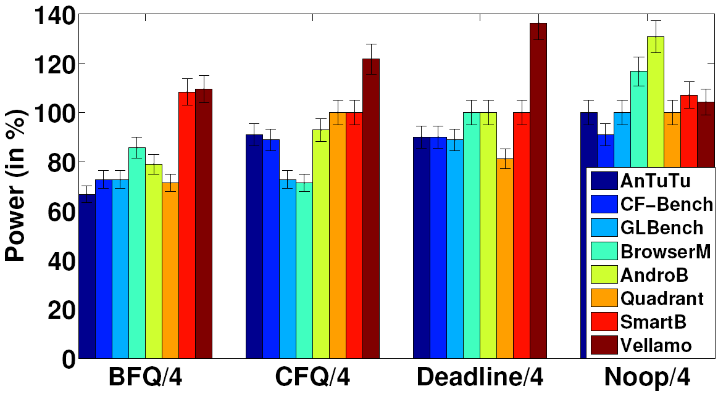
Power Consumption: Queue Depth 4
Shorter queue depth saves energy in most cases
Not storage intensive benchmarks consume more power due to overhead of smaller queue

Slide 17
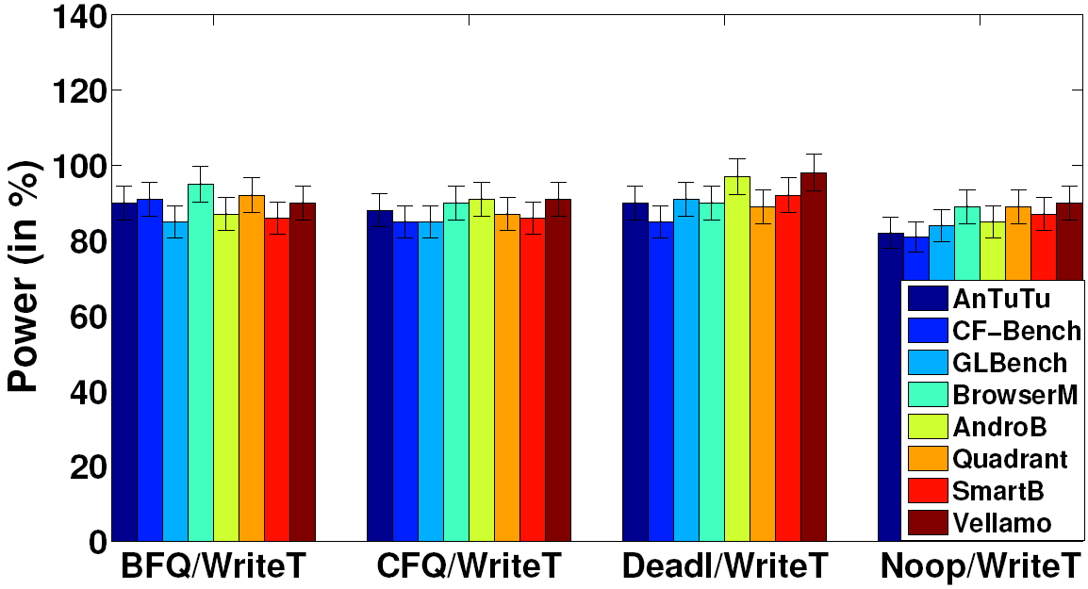
Power Consumption: Write-through Cache
Consumes less power
But requires rebuilding kernel
More details in paper…

Slide 18
Optimal Configurations
Run benchmarks with all combinations of scheduling algorithms and queue depths
Benchmark | Optimal Conf. | Power Savings | Reads/s | Writes/s
AnTuTu | Deadline/4 | 40% | 1108 | 1395
CF-Bench | CFQ/4 | 27% | 104 | 1298
GLBenchmark | Deadline/4 | 27% | 253 | 51
BrowserMark | CFQ/4 | 29% | 185 | 115
AndroBench | Noop/128 | 32% | 2260 | 104
Quadrant | BFQ/4 | 43% | 301 | 400
Smartbench | BFQ/128 | 0 | 26 | 2
Vellamo | BFQ/128 | 0 | 9 | 1
Notes:
Tell about I/O pattern for last 2

Slide 19
Outline
Introduction
Background
Experimental Study
SmartStorage Design
Evaluation

Slide 20
Big Idea
Track phone’s run-time I/O pattern
Match phone’s pattern with pattern from benchmark table
Dynamically configure parameters with optimal savings

Slide 21
SmartStorage Architecture

Slide 22
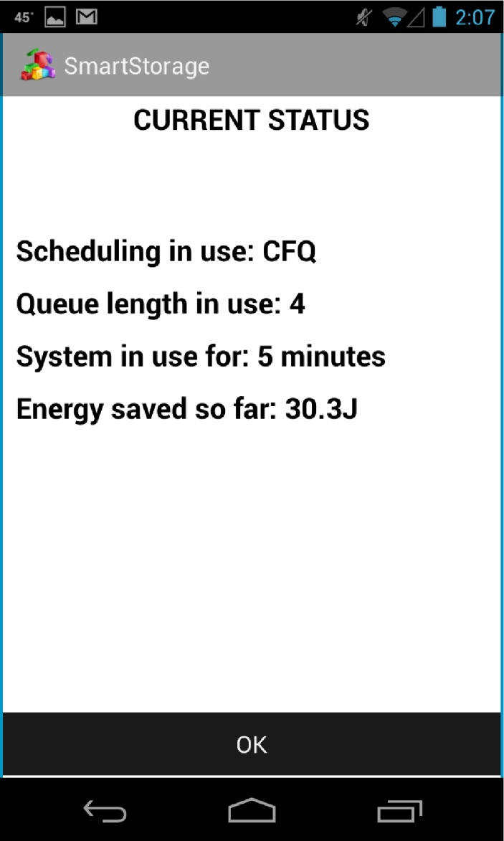
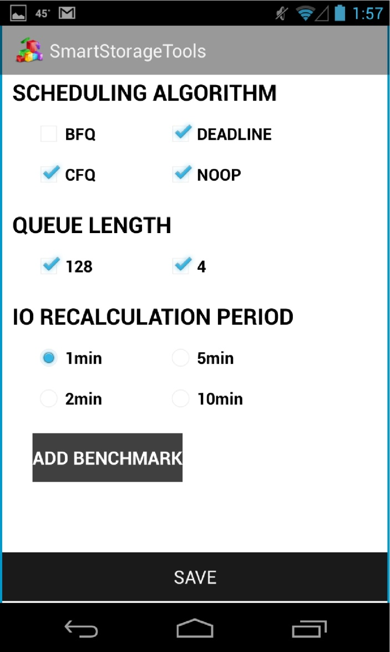
GUI

Slide 23
I/O Pattern Matching
Compare phone’s I/O pattern with patterns from benchmark table
Matching feature: $\frac{\#reads completed /second}{\#writes completed /second}$
If phone’s rate of reads/writes per second close to a benchmark from table
match is found
Else
no match

Slide 24
Outline
Introduction
Background
Experimental Study
SmartStorage Design
Evaluation

Slide 25
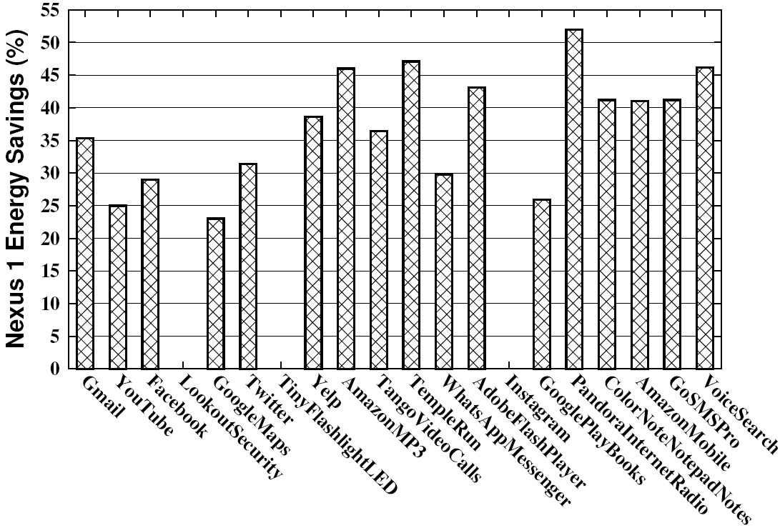
Energy Savings: Nexus One
3 apps w/ no savings – same default and optimal configs (BFQ/128)

Slide 26
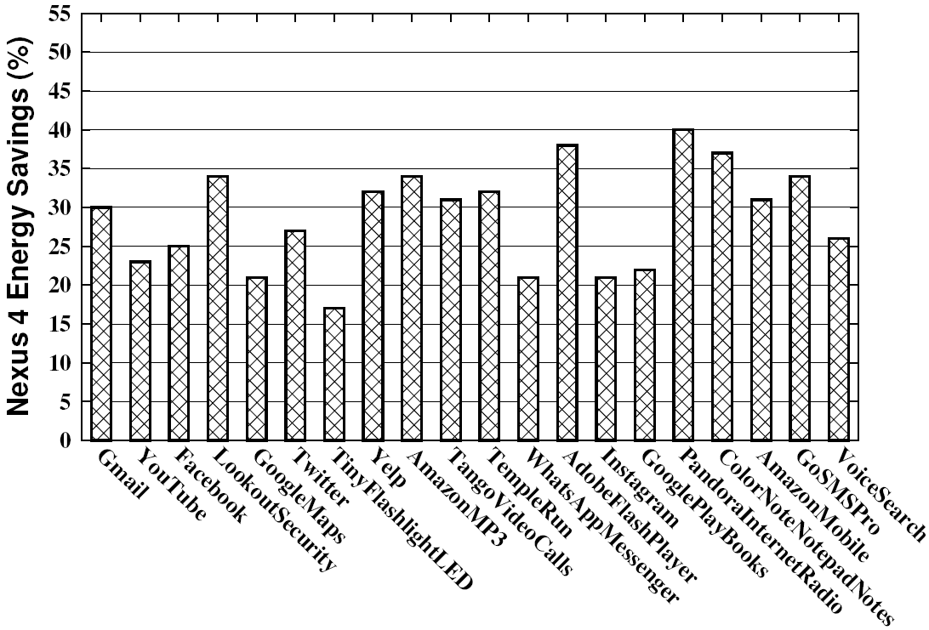
Energy Savings: Nexus 4
Lower savings due to default CFQ scheduler
Average savings of 28.8%

Slide 27
Discussion
Savings of whole phone
Savings come from optimizations on I/O path (not flash only)
How optimizations affect CPU and other subsystems still unknown
Cost: 3% app delay

Slide 28
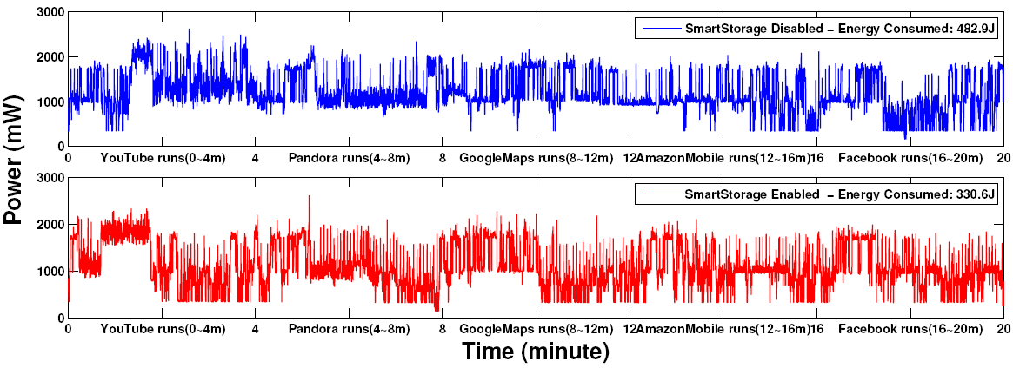
Real-time Power

Slide 29
Real-time Power
Power drop
Power drops after around 2 minutes (loading + I/O pattern recalculation)

Slide 30
Conclusions
Presented study on how storage parameters impact power levels
Introduced SmartStorage to save energy
Matches current I/O pattern to known pattern from benchmarks
Dynamically tunes parameters
Evaluation on top 20 apps shows on average 28.8% energy savings

Slide 31
Future Work
Energy savings with different caching policies / file systems / queue depths
Matching using machine learning
Adaptive I/O pattern recalculation
Root reasons of energy savings

Slide 32
Current Project Status
U.S. patent filed 12/2012
Please forward licensing inquiries to
William & Mary Technology Transfer Office

Slide 33
Project Website
SmartStorage.us

Slide 34
Thank you!

