Slide 1
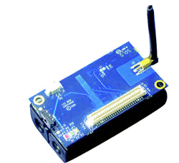
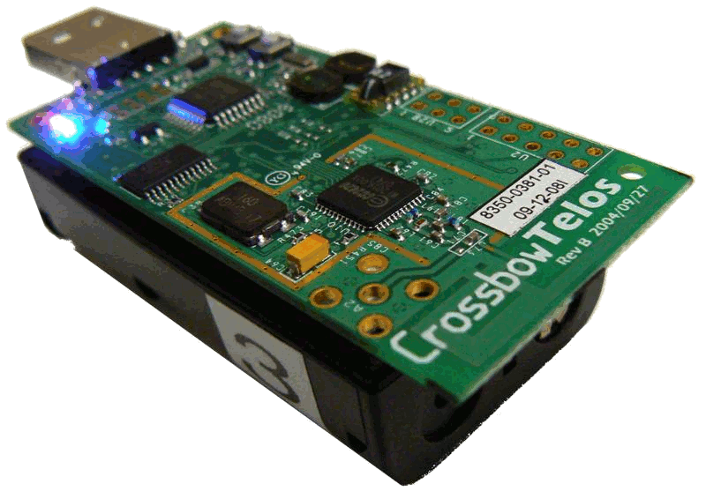
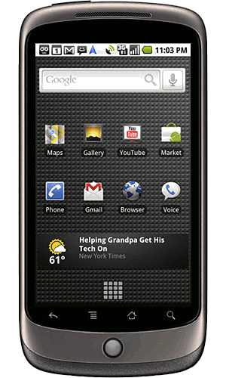
PBN: Towards Practical Activity Recognition Using Smartphone-based Body Sensor Networks
Matt Keally, Gang Zhou, Guoliang Xing¹, Jianxin Wu², and Andrew Pyles
College of William and Mary, ¹Michigan State University, ²Nanyang Technological University

Slide 2
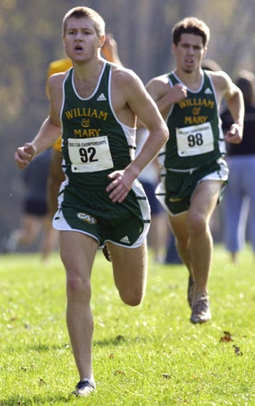
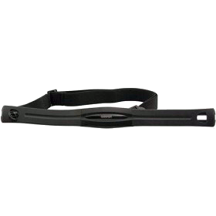
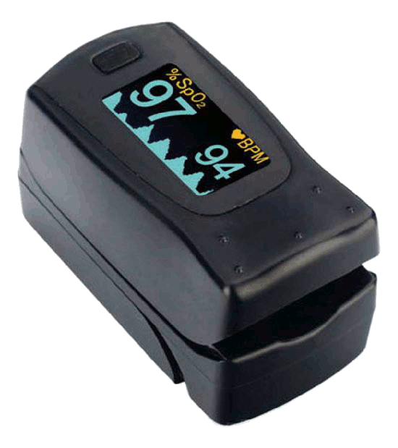
Personal Sensing Applications
Body Sensor Networks
Athletic Performance
Health Care
Activity Recognition
Heart Rate Monitor
Pulse Oximeter
Mobile Phone Aggregator

Slide 3
A Practical Solution to Activity Recognition
Portable
Entirely user controlled
Computationally lightweight
Accurate
On-Body Sensors
+Sensing Accuracy
+Energy Efficiency
Phone
+User Interface
+Computational Power
+Additional Sensors

Slide 4
Challenges to Practical Activity Recognition
User-friendly
Hardware configuration
Software configuration
Accurate classification
Classify difficult activities in the presence of dynamics
Efficient classification
Computation and energy efficiency
Less reliance on ground truth
Labeling sensor data is invasive

Slide 5
PBN: Practical Body Networking
TinyOS-based motes + Android phone
Lightweight activity recognition appropriate for motes and phones
Retraining detection to reduce invasiveness
Identify redundant sensors to reduce training costs
Classify difficult activities with nearly 90% accuracy

Slide 6
Outline
Motivation and Contributions
Related Work
Hardware and Software
Experimental Setup
PBN System Design
Evaluation
Conclusion

Slide 7
Related Work
No mobile or on-body aggregator
(Ganti, MobiSys ‘06), (Lorincz, SenSys ‘09), (Zappi, EWSN ‘08)
Use of backend servers
(Miluzzo, MobiSys ‘10), (Miluzzo, SenSys ‘08)
Single sensor modality or separate classifier per modality
(Azizyan, MobiCom ‘09), (Kim, SenSys ‘10), (Lu, SenSys ‘10)
Do not provide online training
(Wang, MobiSys ‘09), (Wachuri, UbiComp ‘10)

Slide 8
Outline
Motivation and Contributions
Related Work
Hardware and Software
Experimental Setup
PBN System Design
Evaluation
Conclusion

Slide 9
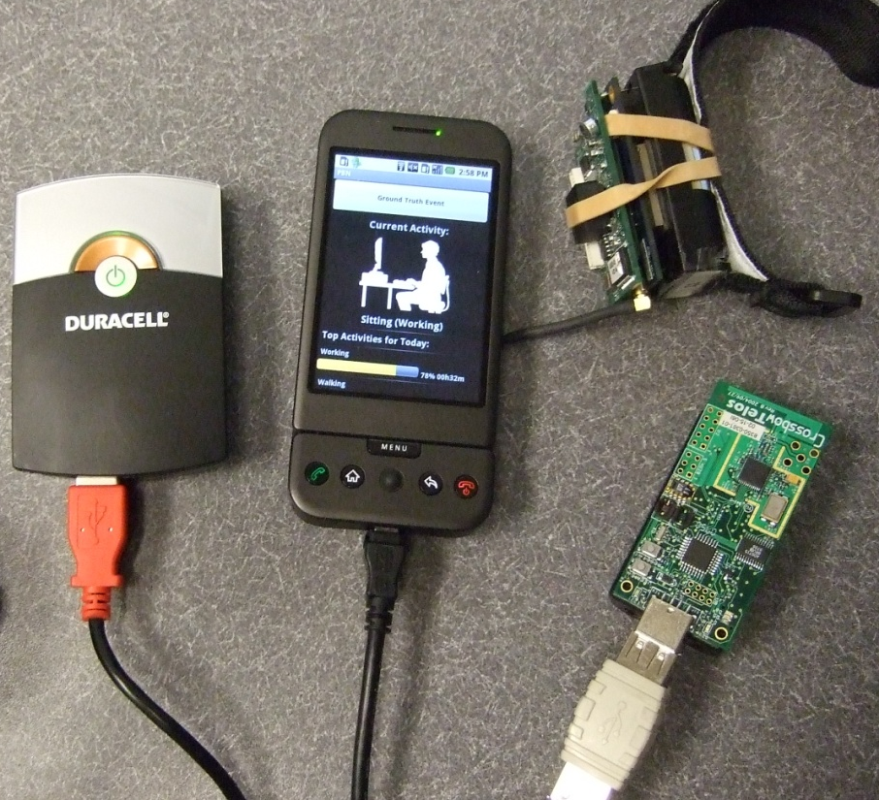
Hardware: TinyOS + Android
IRIS on-body motes, TelosB base station, G1 phone
Enable USB host mode support in Android kernel
Android device manager modifications
TinyOS JNI compiled for Android

Slide 10
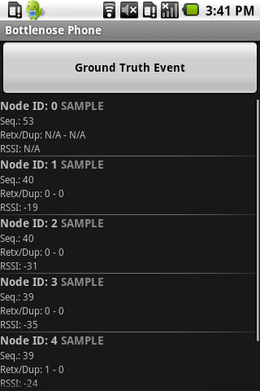
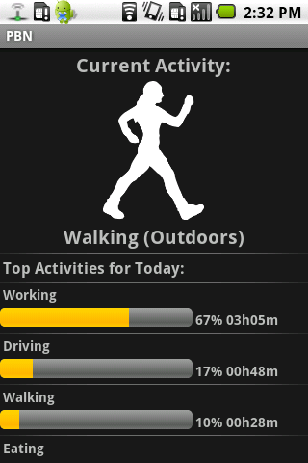
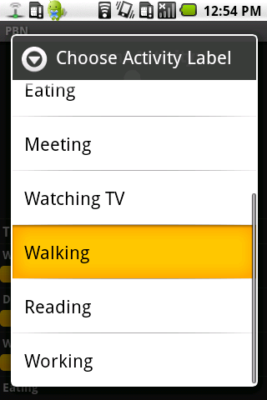
Software: Android Application
Sensor Configuration
Runtime Control and Feedback
Ground Truth Logging

Slide 11
Outline
Motivation and Contributions
Related Work
Hardware and Software
Experimental Setup
PBN System Design
Evaluation
Conclusion

Slide 12
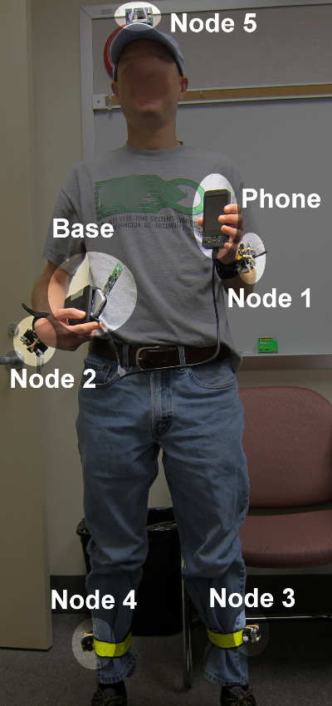
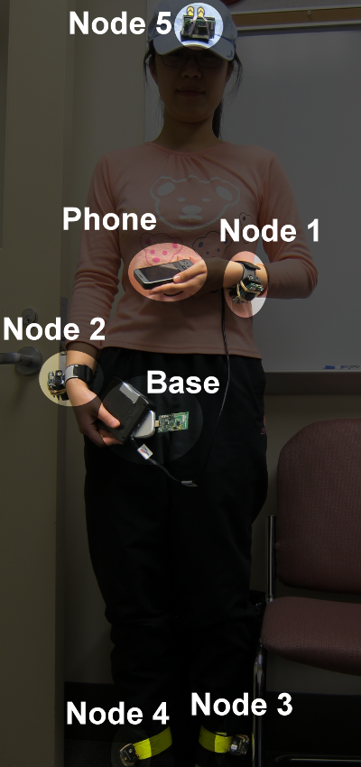
Data Collection Setup
2 subjects, 2 weeks
Android Phone
3-axis accelerometer, WiFi/GPS Localization
5 IRIS Sensor Motes
2-axis accelerometer, light, temperature, acoustic, RSSI
Node ID | Location
0 | BS/Phone
1 | L. Wrist
2 | R. Wrist
3 | L. Ankle
4 | R. Ankle
5 | Head

Slide 13
Data Collection Setup
Classify typical daily activities, postures, and environment
Previous work (Lester, et. al.) identifies some activities as hard to classify
Classification Categories:
Environment | Indoors, Outdoors
Posture | Cycling, Lying Down, Sitting, Standing, Walking
Activity | Cleaning, Cycling, Driving, Eating, Meeting, Reading, Walking, Watching TV, Working

Slide 14
Outline
Motivation and Contributions
Related Work
Hardware and Software
Experimental Setup
PBN System Design
Evaluation
Conclusion

Slide 15
PBN Architecture
Sensor Node
Local Agg.
Sensor
Sample
Controller
Sensor
Sensor
Agg. Data
802.15.4
Start/Stop
Base Station Node
USB
Phone
Sample
Controller
GUI
TinyOS
Comm. Stack
Labeled Data
Activity Decision, Request Ground Truth
Agg. Data
Sensor
Sensor Selection
Sensor
Ground Truth Management
Sensor
Training Data
Agg.
Data
Local Agg.
Retraining Detection
Activity Classification
Sensor Selection
Activity Prob, Agg. Data
Input Sensors

Slide 16
AdaBoost Activity Recognition
Ensemble Learning: AdaBoost.M2 (Freund, JCSS ‘97)
Lightweight and accurate
Maximizes training accuracy for all activities
Many classifiers (GMM, HMM) are more demanding
Iteratively train an ensemble of weak classifiers
Training observations are weighted by misclassifications
At each iteration:
Train Naïve Bayes classifiers for each sensor
Choose the classifier with the least weighted error
Update weighted observations
The ensemble makes decisions based on the weighted decisions of each weak classifier

Slide 17
Retraining Detection
Body Sensor Network Dynamics affects accuracy during runtime:
Changing physical location
User biomechanics
Variable sensor orientation
Background noise
How to detect that retraining is needed without asking for ground truth?
Constantly nagging the user for ground truth is annoying
Perform with limited initial training data
Maintain high accuracy

Slide 18
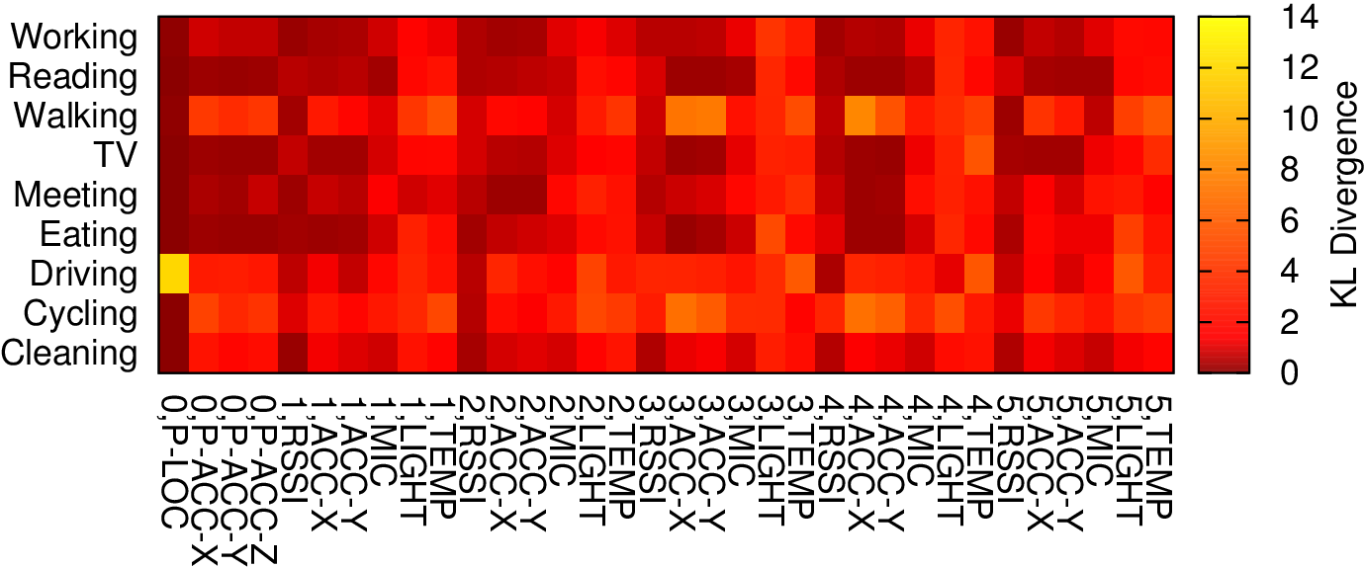
Retraining Detection
Measure the discriminative power of each sensor: K-L divergence
Quantify the difference between sensor reading distributions
Retraining detection with K-L divergence:
Compare training data to runtime data for each sensor
Activities
Sensors

Slide 19
Retraining Detection
Training
Compute “one vs. rest” K-L divergence for each sensor and activity
Walking
Driving
Working
Training Data Ground Truth:
For each sensor:
Sensors
1,LIGHT
Walking Data Partition:
1,ACC
√
vs.
√
2,MIC
D_{KL}(T_{walking},T_{other}) =
…
Walking
Training Data Distribution
{Driving, Working}
Training Data Distribution

Slide 20
Retraining Detection
Runtime
At each interval, sensors compare runtime data to training data for current classified activity
Sensors
Current AdaBoost Classified Activity: Walking
For each sensor:
1,LIGHT
1,ACC
vs.
√
D_{KL}(R_{walking},T_{walking}) =
√
2,MIC
Walking
Runtime Data Distribution
Walking
Training Data Distribution
…

Slide 21
Retraining Detection
Runtime
At each interval, sensors compare runtime data to training data for current classified activity
Each individual sensor determines retraining is needed when:
D_{KL}(R_{walking},T_{walking}) > D_{KL}(T_{walking},T_{other})
Intra-activity divergence
Inter-activity divergence
√
√
√
√
vs.
vs.
Walking
Runtime Data Distribution
Walking
Training Data Distribution
Walking
Training Data Distribution
{Driving, Working}
Training Data Distribution

Slide 22
Retraining Detection
Runtime
At each interval, sensors compare runtime data to training data for current classified activity
Each individual sensor determines retraining is needed
The ensemble retrains when a weighted majority of sensors demand retraining

Slide 23
Ground Truth Management
Retraining: How much new labeled data to collect?
Capture changes in BSN dynamics
Too much labeling is intrusive
Balance number of observations per activity
Loose balance hurts classification accuracy
Restrictive balance prevents adding new data
Balance multiplier
Each activity has no more than δ times the average
Balance enforcement: random replacement

Slide 24
Sensor Selection
AdaBoost training can be computationally demanding
Train a weak classifier for each sensor at each iteration
> 100 iterations to achieve maximum accuracy
Can we give only the most helpful sensors to AdaBoost?
Identify both helpful and redundant sensors
Train fewer weak classifiers per AdaBoost iteration
Bonus: use even fewer sensors

Slide 25
Sensor Selection
Raw Data Correlation
Sensors
Sensors

Slide 26
Sensor Selection
Choosing sensors with slight correlation yields the highest accuracy

Slide 27
Sensor Selection
Goal: determine the sensors that AdaBoost chooses using correlation
Find the correlation of each pair of sensors selected by AdaBoost
Use average correlation as a threshold for choosing sensors
Unused
2,MIC
2,MIC
3,TEMP
1,ACC
AdaBoost
1,ACC
All Sensors
3,MIC
1,LIGHT
Selected
2,TEMP
3,MIC
3,TEMP
2,TEMP
1,LIGHT

Slide 28
Sensor Selection
Goal: determine the sensors that AdaBoost chooses using correlation
Find the correlation of each pair of sensors selected by AdaBoost
Use average correlation as a threshold for choosing sensors
Unused
2,MIC
2,MIC
3,TEMP
1,ACC
AdaBoost
1,ACC
All Sensors
3,MIC
1,LIGHT
Selected
2,TEMP
3,MIC
3,TEMP
correlation(2,TEMP; 1,LIGHT)
2,TEMP
1,LIGHT

Slide 29
Sensor Selection
Goal: determine the sensors that AdaBoost chooses using correlation
Find the correlation of each pair of sensors selected by AdaBoost
Use average correlation as a threshold for choosing sensors
Unused
2,MIC
2,MIC
3,TEMP
1,ACC
AdaBoost
1,ACC
All Sensors
3,MIC
1,LIGHT
Selected
2,TEMP
3,MIC
3,TEMP
correlation(2,TEMP; 1,LIGHT)
correlation(3,MIC; 3,TEMP)
2,TEMP
1,LIGHT

Slide 30
Sensor Selection
Goal: determine the sensors that AdaBoost chooses using correlation
Find the correlation of each pair of sensors selected by AdaBoost
Use average correlation as a threshold for choosing sensors
Unused
2,MIC
2,MIC
3,TEMP
1,ACC
AdaBoost
1,ACC
All Sensors
3,MIC
1,LIGHT
Selected
2,TEMP
3,MIC
3,TEMP
correlation(2,TEMP; 1,LIGHT)
correlation(3,MIC; 3,TEMP)
2,TEMP
1,LIGHT
…
Set threshold α based on average correlation:
α = μ_{corr} + σ_{corr}

Slide 31
Sensor Selection
Choose sensors for input to AdaBoost based on the correlation threshold
Unused
2,MIC
3,TEMP
1,ACC
1,ACC
All Sensors
3,MIC
Selected
1,LIGHT
1,LIGHT
2,TEMP
AdaBoost
correlation(1,ACC; 1,LIGHT) ≤ α

Slide 32
Sensor Selection
Choose sensors for input to AdaBoost based on the correlation threshold
Unused
2,MIC
3,TEMP
1,ACC
All Sensors
3,MIC
Selected
1,LIGHT
1,ACC
2,TEMP
2,TEMP
1,LIGHT
AdaBoost
correlation(2,TEMP; 1,ACC) > α
acc(2,TEMP) > acc(1,ACC)

Slide 33
Sensor Selection
Choose sensors for input to AdaBoost based on the correlation threshold
Unused
2,MIC
3,TEMP
1,ACC
3,TEMP
1,ACC
All Sensors
3,MIC
Selected
1,LIGHT
2,TEMP
1,LIGHT
AdaBoost
2,TEMP
correlation(1,ACC; 3,TEMP) ≤ α

Slide 34
Sensor Selection
Choose sensors for input to AdaBoost based on the correlation threshold
Unused
2,MIC
2,MIC
3,TEMP
1,ACC
1,ACC
All Sensors
3,MIC
Selected
3,MIC
1,LIGHT
3,TEMP
2,TEMP
1,LIGHT
AdaBoost
2,TEMP

Slide 35
Outline
Motivation and Contributions
Related Work
Hardware and Software
Experimental Setup
PBN System Design
Evaluation
Conclusion

Slide 36
Evaluation Setup
Classify typical daily activities, postures, and environment
2 subjects over 2 weeks
Classification Categories:
Environment | Indoors, Outdoors
Posture | Cycling, Lying Down, Sitting, Standing, Walking
Activity | Cleaning, Cycling, Driving, Eating, Meeting, Reading, Walking, Watching TV, Working

Slide 37
Classification Performance

Slide 38
Classification Performance

Slide 39
Classification Performance

Slide 40
Retraining Performance

Slide 41
Sensor Selection Performance

Slide 42
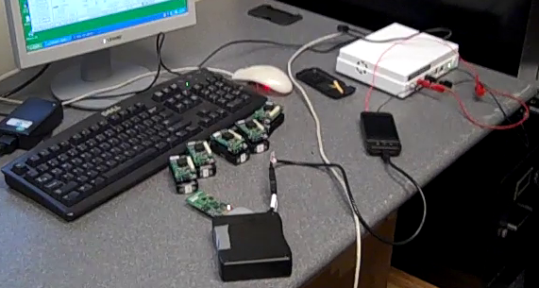
Application Performance
Power Benchmarks
Training Overhead
Battery Life
Mode | CPU | Memory | Power
Idle (No PBN) | <1% | 4.30MB | 360.59mW
Sampling (WiFi) | 19% | 8.16MB | 517.74mW
Sampling (GPS) | 21% | 8.47MB | 711.74mW
Sampling (Wifi) + Train | 100% | 9.48MB | 601.02mW
Sampling (WiFi) + Classify | 21% | 9.45MB | 513.57mW

Slide 43
Outline
Motivation and Contributions
Related Work
Hardware and Software
Experimental Setup
PBN System Design
Evaluation
Conclusion

Slide 44
Conclusion
PBN: Towards practical BSN daily activity recognition
PBN provides:
User-friendly hardware and software
Strong classification performance
Retraining detection to reduce invasiveness
Identification of redundant resources
Future Work
Extensive usability study
Improve phone energy usage

Slide 45
Questions?

