Slide 1
Remora: Sensing Resource Sharing Among Smartphone-based Body Sensor Networks
Matt Keally, Gang Zhou, Guoliang Xing¹, Jianxin Wu²
College of William and Mary, ¹Michigan State University, ²Nanyang Technological University
IWQoS 2013

Slide 2
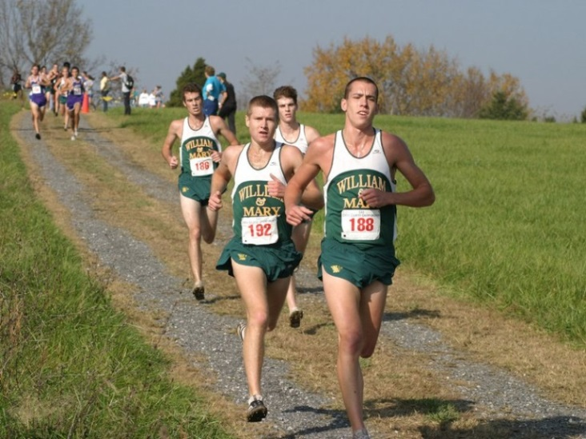
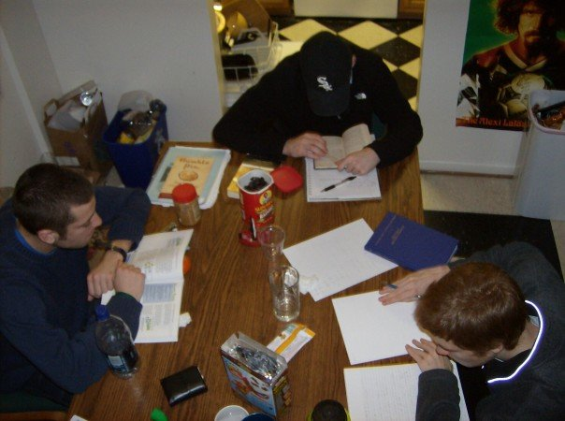
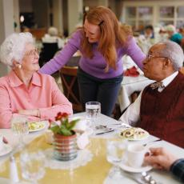
Shared Activities
Athletic Teams
University Students
Assisted Living

Slide 3
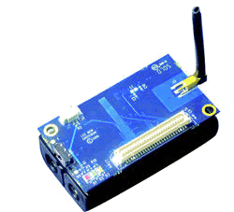
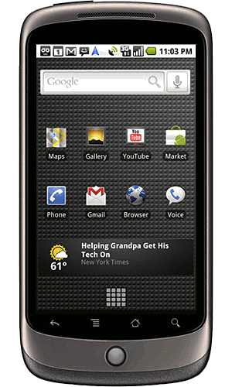
Activity Recognition with Body Sensor Networks
Athletic Performance
Health Care
Why BSNs?
On-Body Sensors
+Sensing Accuracy
+Energy Efficiency
Phone
+User Interface
+Computational Power
+Additional Sensors

Slide 4
BSN Resource Sharing
BSN users may be in physical proximity to one another
Assisted living or retirement communities
Athletic teams
Share sensors: use fewer sensors and achieve higher accuracy
Share phone classifiers: duty cycle to save phone energy

Slide 5
Remora
BSN Resource Sharing Challenges
When does sharing provide an energy benefit?
How to find shared resources that provide the best accuracy and energy benefits?
How to adapt to the dynamics of available neighbors?
Solutions
Determine the costs and benefits of sharing with an empirically created time and power model
Neighboring BSNs collaborate to choose the most accurate sensors
Neighboring BSNs collaborate to save phone energy
We provide an ensemble classifier which easily adapts to changes in neighbor availability
Sharing increases accuracy by up to 30% and battery life by over 65%

Slide 6
Related Work
Resources shared directly but do not share to achieve both high accuracy and energy efficiency
(Koukoumidis, MobiSys ‘11), (Miluzzo, MobiSys ‘10), (Lee, MobiSys ‘12)
Shared resources with data relayed through a backend server
(Bajcy, BSN ‘09), (Bao, MobiSys ‘10), (Lane, UbiComp ‘11), (Rachuri, MobiCom ‘11)
No sharing: BSN
(Abinali, UbiComp ‘10), (Lorincz, SenSys ‘09), (Chipara, SenSys ‘10), (Shih, MobiSys ‘09)
No sharing: Phone only
(Chu, SenSys ‘11), (Miluzzo, SenSys ‘08), (Wiese, UbiComp ‘11), (Rachuri, MobiCom ‘11)

Slide 7
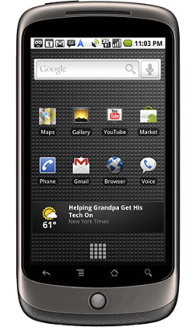
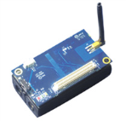
Sharing Hierarchy
Internet
Cloud sharing
Classifier sharing
Proximity Layers
Sensor sharing

Slide 8
Feasibility
Sharing Opportunity
MIT Reality Mining project: 25% of the time subjects in proximity
Evaluation: 30% of the time
Privacy
Share only in physical proximity
Public/Private sensors
Coarse grained data aggregation

Slide 9
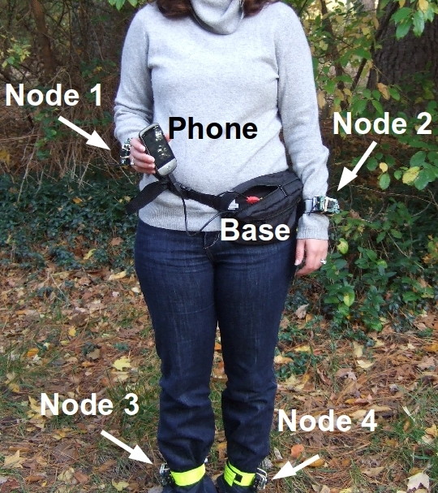
Hardware Configuration
Android Phone
3-axis accelerometer, WiFi/GPS Localization
TelosB Base Station
Android kernel USB host mode enabled
4 IRIS Sensor Motes
2-axis accelerometer, light, temperature, acoustic, RSSI
Node ID | Location
0 | BS/Phone
1 | R. Wrist
2 | L. Wrist
3 | R. Ankle
4 | L. Ankle

Slide 10
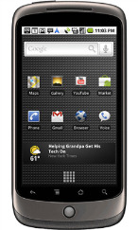
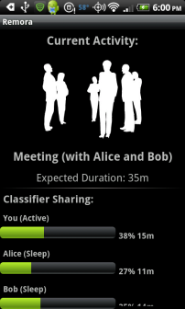
Remora Architecture
Neighbor
BSNs
Sharing-Aware Classification
Neighbor Management
Training Data Management
Collaborative Sensor Selection
Proximity Detection & Duration Prediction
Local Phone
Duty Cycling
Ensemble Classifier
Cost-Benefit Analysis
Application
Local
Motes

Slide 11
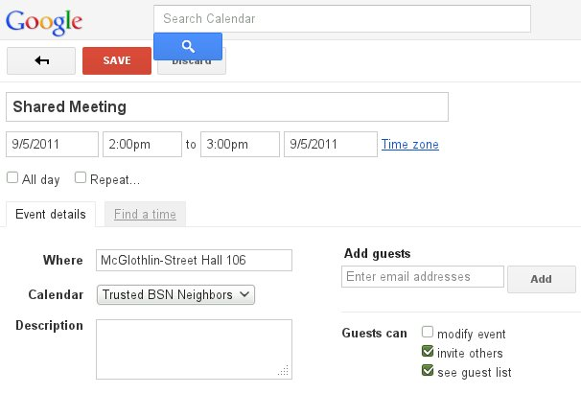
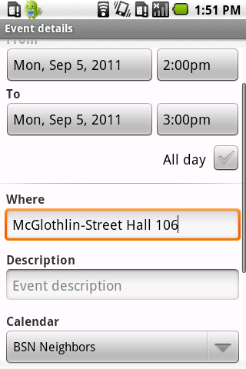
Proximity Detection and Duration Prediction
Proximity Detection
Detect neighboring BSNs by overhearing data packets
Determine when neighbors leave
Duration Prediction
Estimate how long a neighbor will be in proximity
Shared calendar or manual prompt

Slide 12
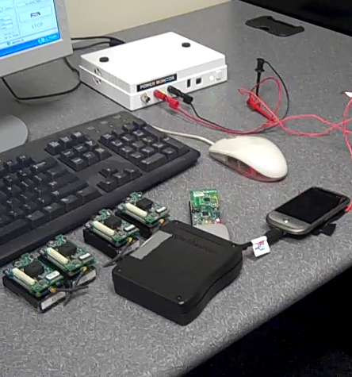
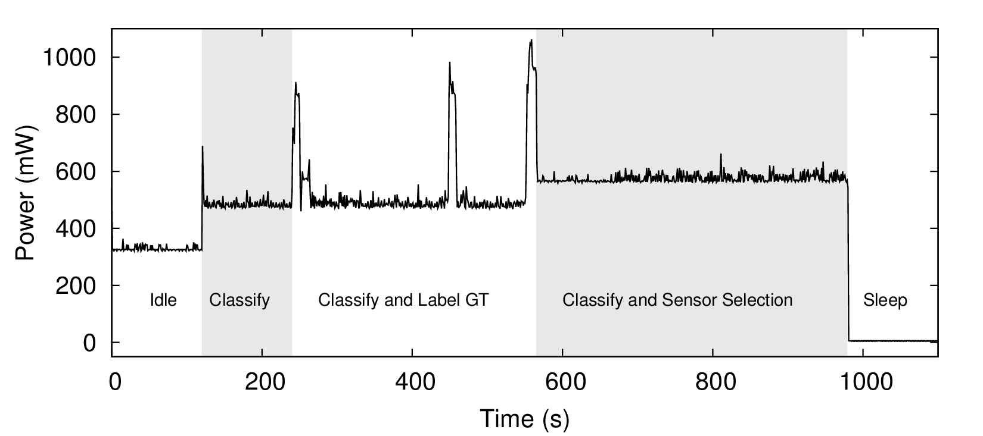
Empirical Cost Model: Power
Remora implementation with HTC Hero and motes

Slide 13
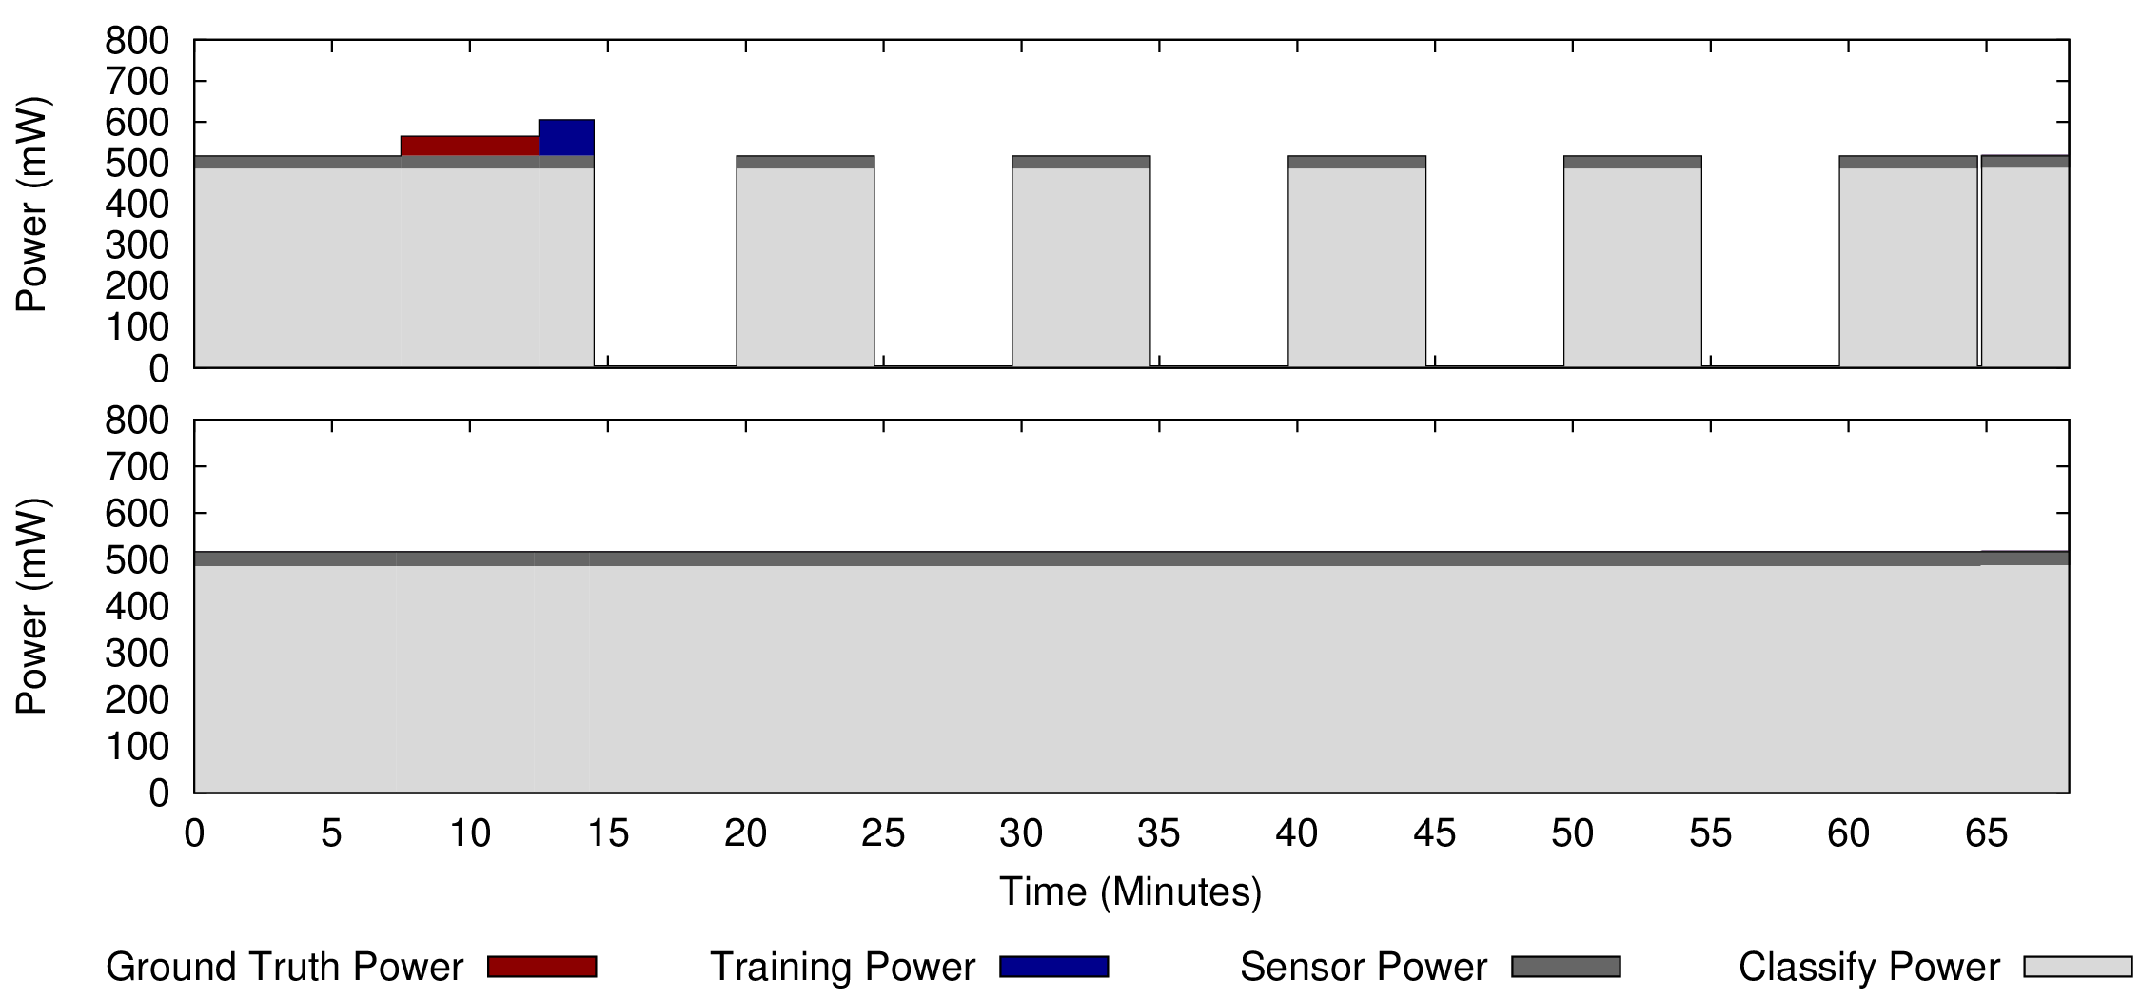
Cost-Benefit Analysis
Will sharing save energy when a neighboring BSN is detected?
Phone energy is the limiting factor in BSN lifetime
Duty cycle phone classifiers to save phone energy
Compare individual classification energy to shared classification energy
Minimum proximity duration for energy benefit:
Up to 5 BSNs: 5 to 15 minutes
10+ BSNs: more than 40 minutes
Proximity Duration
Sharing
Sharing with a small number of BSNs is more practical; most accuracy is gained by sharing with one additional BSN
No Sharing

Slide 14
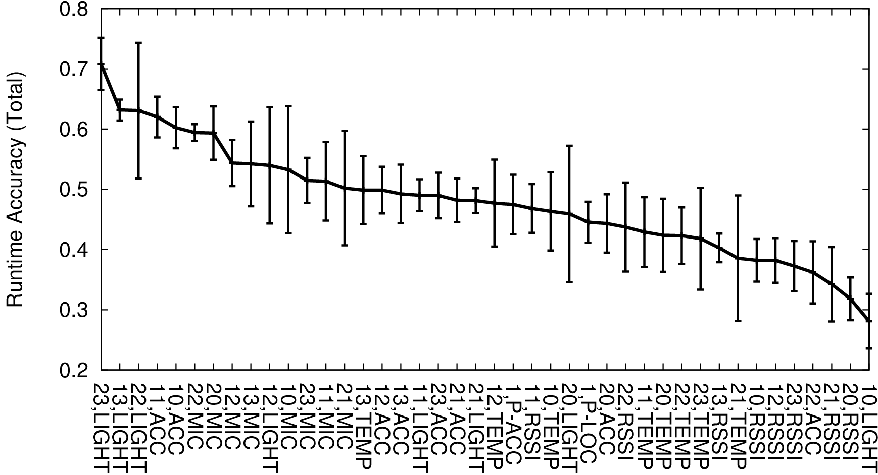
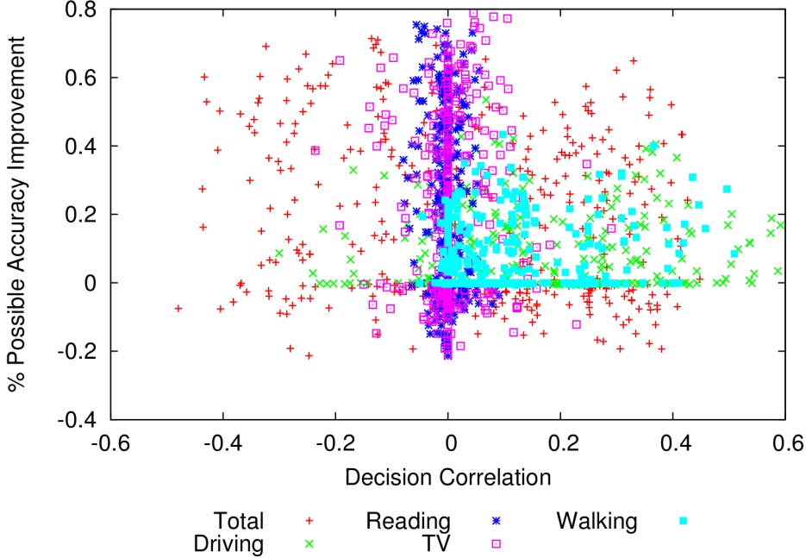
Sensor Selection Motivation
Successful ensemble classifiers must have:
Accurate weak classifiers
Weak classifiers have diverse classification results
Individual Sensor Accuracy
Sensor-Cluster Correlation

Slide 15
Collaborative Sensor Selection
Weight sensors by accuracy and decision correlation for all neighbors
Iteratively choose sensors by weight
BSN 1
BSN 2
1,LOC
10
11
12
20
21
22
Exchange Sensor Accuracies
22,ACC
10,TEMP
22,ACC
Compute weights; Choose Sensor
10,TEMP
10,ACC
10,ACC
21,MIC
12,LIGHT
21,MIC
12,LIGHT
Ensemble
Ensemble
BSN 1 Accuracy = 0
BSN 2 Accuracy = 0

Slide 16
Collaborative Sensor Selection
Weight sensors by accuracy and decision correlation
Iteratively choose sensors by weight
BSN 1
BSN 2
Sensor Weight
10
11
12
20
21
22
Sensor Weight
22,ACC
Exchange Sensor Accuracies
22,ACC
1,LOC
Compute weights; Choose Sensor
21,MIC
21,MIC
Exchange Ensemble-Sensor Correlation
10,TEMP
10,TEMP
Compute weights; Choose Sensor
10,ACC
10,ACC
12,LIGHT
12,LIGHT
Ensemble
Ensemble
BSN 2 Accuracy = .65
BSN 1 Accuracy = 0
BSN 1 Accuracy = 0
BSN 1 Accuracy = .58

Slide 17
Collaborative Sensor Selection
Weight sensors by accuracy and decision correlation
Iteratively choose sensors by weight
BSN 1
BSN 2
Sensor Weight
10
11
12
20
21
22
Sensor Weight
1,LOC
Exchange Sensor Accuracies
12,LIGHT
12,LIGHT
Compute weights; Choose Sensor
10,TEMP
10,TEMP
Exchange Ensemble-Sensor Correlation
10,ACC
10,ACC
Compute weights; Choose Sensor
21,MIC
21,MIC
Tiebreaker Choice: 12,LIGHT
Ensemble
Ensemble
22,ACC
22,ACC
BSN 1 Accuracy = .58
BSN 1 Accuracy = .75
BSN 1 Accuracy = .86
BSN 2 Accuracy = .65
BSN 2 Accuracy = .80

Slide 18
Collaborative Sensor Selection
Weight sensors by accuracy and decision correlation
Iteratively choose sensors by weight
BSN 1
BSN 2
10
11
12
20
21
22
10,TEMP
Exchange Sensor Accuracies
10,TEMP
10,ACC
Compute weights; Choose Sensor
Exchange Ensemble-Sensor Correlation
10,ACC
21,MIC
Compute weights; Choose Sensor
21,MIC
Tiebreaker Choice: 12,LIGHT
…
Ensemble
Ensemble
22,ACC
22,ACC
1,LOC
12,LIGHT
12,LIGHT
BSN 1 Accuracy = 1.0
BSN 1 Accuracy = .86
BSN 2 Accuracy = .94
BSN 2 Accuracy = .80

Slide 19
Evaluation
Parameter | Value
Number of Subjects | 6
Duration | 2 weeks
Activities | Riding a bus, Riding or driving a car, meeting, reading, running, watching TV, walking, working at a desk
Initial training data | 30 aggregated samples (5 min) per activity
Comparison | Individual classification, sensor sharing, sensor and classifier sharing

Slide 20
Accuracy

Slide 21
Battery Life

Slide 22
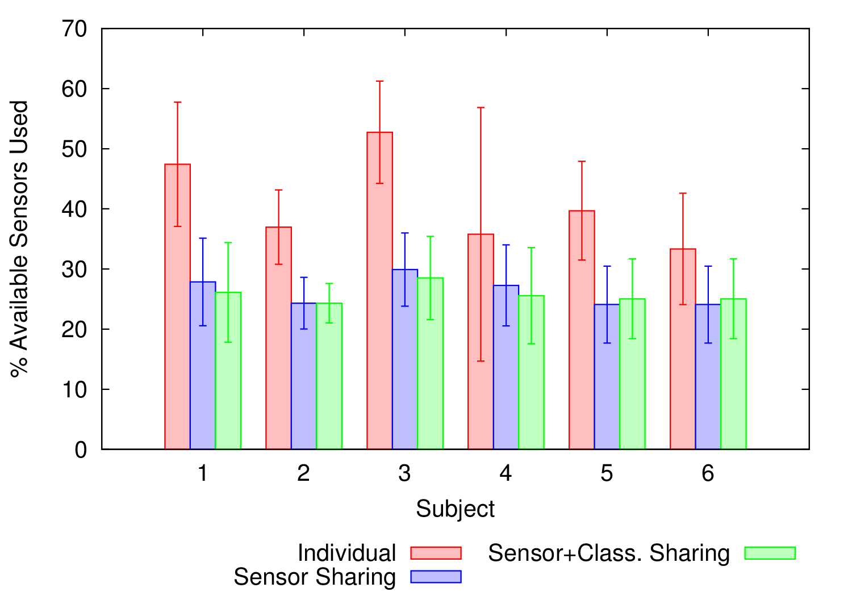
Sensor Utilization

Slide 23
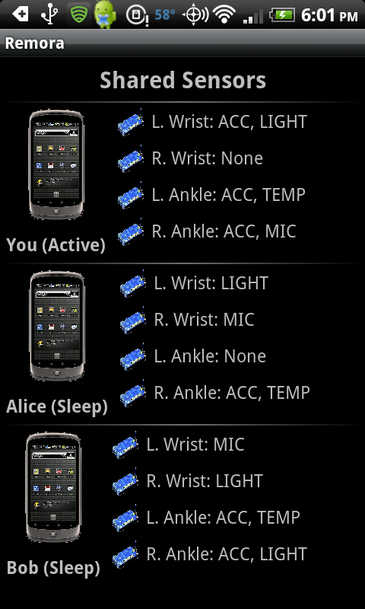
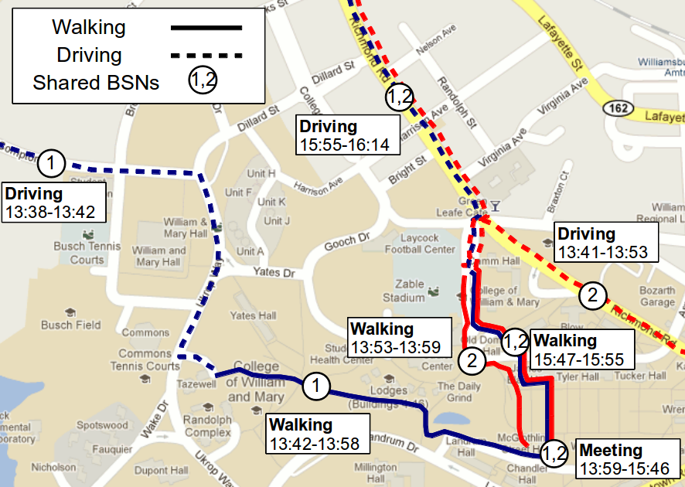
Applications
Shared Activities
Shared Sensors
Interaction History
Notes:
Laser pointer

Slide 24
Conclusion
Sharing BSN resources provides accuracy and energy savings
Share sensors: increase accuracy, save sensor energy
Share classifiers: save phone energy
We model the costs and benefits of sharing
Share only when energy can be saved
Collaborative Sensor Selection allows all BSN participants to benefit
Use only the best sensors
Turn off redundant sensors

Slide 25
Questions?

