Slide 1
PyCRA: Physical Challenge-Response Authentication For Active Sensors Under Spoofing Attacks
Presenter: Hao Xu
Computer Science
The College of William & Mary
[SMYDS15] Yasser Shoukry, Paul Martin, Yair Yona, Suhas Diggavi, Mani Srivastava, "PyCRA: Physical Challenge-Response Authentication for Active Sensors Under Spoofing Attacks", CCS 2015.

Slide 2
Motivation
Analog Signal
Sensor world
Digital Signal
sensors themselves remain largely vulnerable to attacks targeting analog signals prior to digitization.

Slide 3
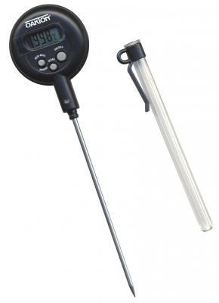
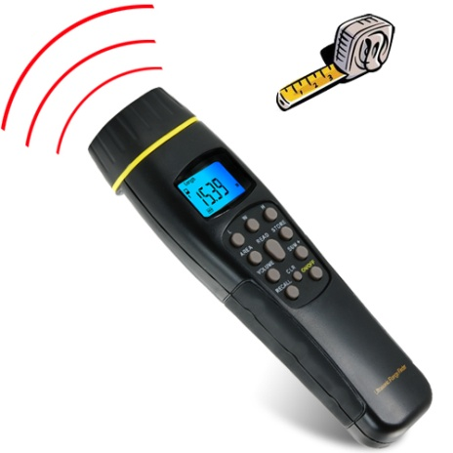
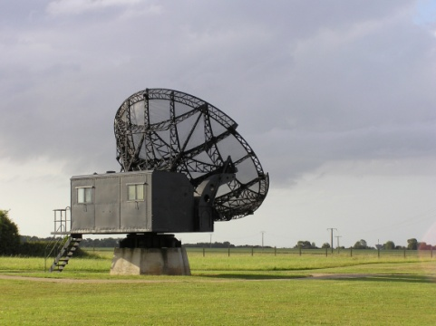
Passive and Active sensors
Passive sensors measure ambient energy.
Active sensors probe some physical entity with self-generated energy.
Passive sensors
Active sensors

Slide 4
Defining Physical Attacks
The actuator generates an analog signal (energy) which is reflected by the measured entity back to the sensor.
The received analog signal is captured and processed by the analog front-end.
The signal is then converted to a digital format which is processed once more (by the digital backend) before being sent to higher level software layers.

Slide 5
Providing security for active sensors
1) provide detection of active attackers trying to spoof the sensor
2) mitigate the effects of active spoofing attacks
3) detect passive eavesdropping attacks attempting to listen to the information received by the sensor.

Slide 6
Adversarial Goals
G1 Concealment: An attacker does not want the presence of his or her attack to be known.
G2 Signal Injection: An attacker will attempt to trick the sensor into thinking that a malicious, injected signal is the true physical signal.
G3 Signal Masking: An attacker will attempt to prevent the sensor from being able to detect the true physical signal.

Slide 7
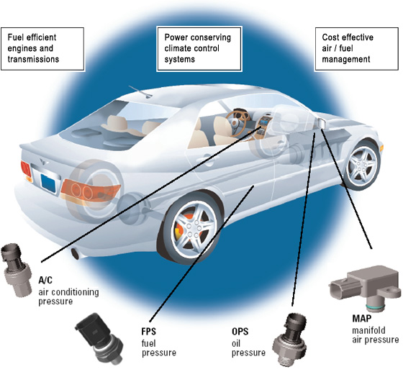
Assumptions about the Adversary
Non-invasiveness: Attacks are of a non-invasive nature—that is, the attacker is not allowed direct access to the sensor hardware. Additionally, the adversary does not have access to the sensor firmware or software, whether directly or through wired or wireless networking.
Detecting when wires connecting their various sensors have been tampered with
Sensors are often installed inside the body of a physically secured infrastructure
Existing techniques in the literature demonstrate ways to implement tamperproof packaging to protect sensors from direct, physical modifications

Slide 8
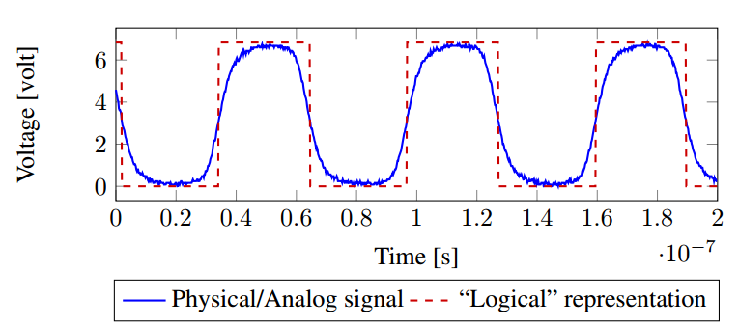
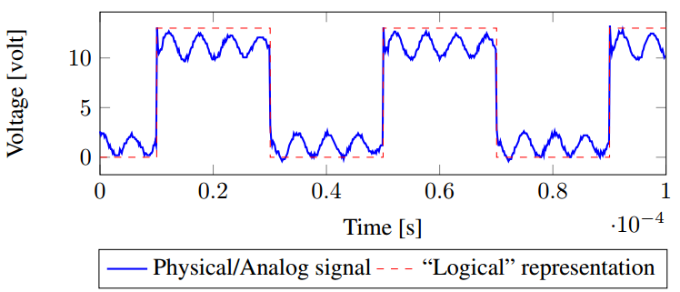
Assumptions about the Adversary(continue)
Trusted Measured Entity We assume that the physical entity to be measured by the sensor is trusted and incapable of being compromised networking.
Physical Delays (τattack): Adversaries require physical hardware with inherent physical delays. This delay, though variable in duration, is fundamental to all physical actuation and sensing hardware.
Examples of physical delays seen in typical sensing and actuation hardware, including optical sensors (left) and electromagnetic coupled (e.g., RFID) sensors (right). In each case, the measured analog signal (blue solid) lags behind the ideal, “logical” signal (red dashed), causing delays.

Slide 9
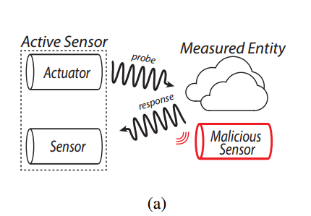
Physical Attack Types for sensors
Eavesdropping Attacks: In an eavesdropping attack, an adversary uses a malicious sensor in order to listen to the active sensor’s “communication” with the measured entity.

Slide 10
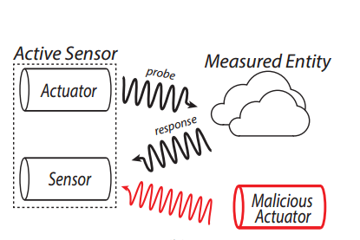
Physical Attack Types for sensors(continue)
Simple Spoofing Attacks: In a simple spoofing attack, an adversary uses a malicious actuator to blindly inject a malicious signal in order to alter the signal observed by the sensor. These attacks are simple in that the malicious signal is not a function of the original, true signal.

Slide 11
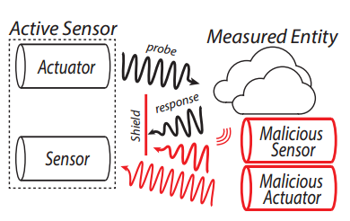
Physical Attack Types for sensors
Advanced Spoofing Attacks: an adversary uses a sensor in order to gain full knowledge of the original signal and then uses a malicious actuator to inject a malicious signal accordingly. This enables an attacker to suppress the original signal or otherwise alter it in addition to injecting a malicious signal.

Slide 12
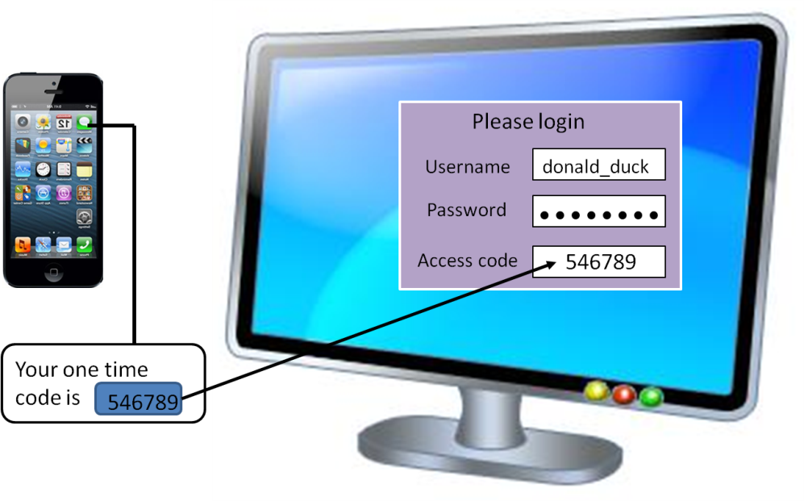
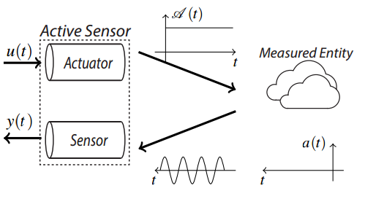
PYCRA Authentication Scheme
In traditional challenge-response authentication schemes, one party requires another party to prove their trustworthiness by correctly answering a question or challenge.
In the proposed physical challenge-response authentication, the challenge comes in the form of a physical stimulus placed on the environment by an active sensor.

Slide 13
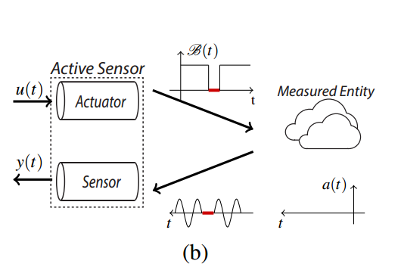
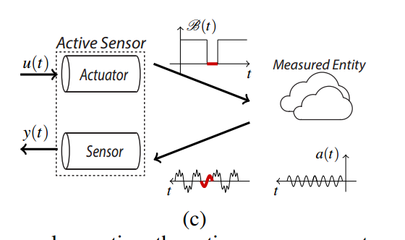
Simple PyCRA Attack Detector
We notice that the measured entity, as a participating party in this communication, is strictly passive, i.e. it cannot initiate communication; it responds only when the sensor generates an appropriate physical signal.
where u(t) is the binary modulation term and B(t) is the modulated output of the actuator.
(b) Using the proposed PyCRA scheme, the sensor generates a modulated signal B(t). If there is no attack present, the reflected signal diminishes if the active sensor’s actuator is driven to zero;
(c) Using the proposed PyCRA scheme while the sensor is under attack (by signal a(t)), a malicious signal is detected during the period when the actuator is disabled.

Slide 14
The Confusion Phase
we use this fundamental limit in order to enhance PyCRA and introduce additional security.
Between the active phase (e.g., u(t) = 1) and the silent phase (e.g., u(t) = 0)—called the confusion phase. In this phase, the active sensor uses its actuator to generate a signal u(t) that is small enough to barely exceed the noise level. Next, we wait in this confusion phase for a random time tcon f usion before entering the silent time.

Slide 15
χ 2 PyCRA Attack Detector
we can remove its effects from the measured response, ensuring that any residual energy measured while u(t) = 0 belongs to an external source such as an attacker.
An accurate model of the sensor’s actuator dynamics
Obtaining the Sensor Model

Slide 16
χ 2 PyCRA Attack Detector(continue)
χ 2 Detector

Slide 17
Case Study (1) Detecting Active Spoofing Attacks For Magnetic Encoders
Magnetic encoders rely on magnetic variations to measure the angular velocity of a gear or wheel and are often designed to handle dust, mud, rain, and extreme temperatures without failing.
Provide a signal whose frequency corresponds to the speed of a gear.
Typical magnetic encoders operate by generating a magnetic field in the presence of a rotating ferromagnetic tone ring or tone wheel.
Each sensor and consequently the motor controller is able to infer the angular velocity of any given gear, wheel, or motor.
Measuring the frequency of this reflected signal over time.

Slide 18
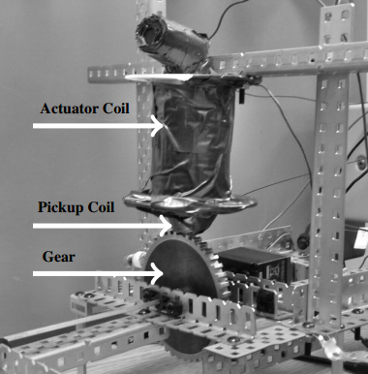
The PyCRA-secured Magnetic Encoder
The actuator coil depicted is much larger than would be required in a commercial product, because it consists of a magnetic core and a hand-wound high-gauge wire.

Slide 19
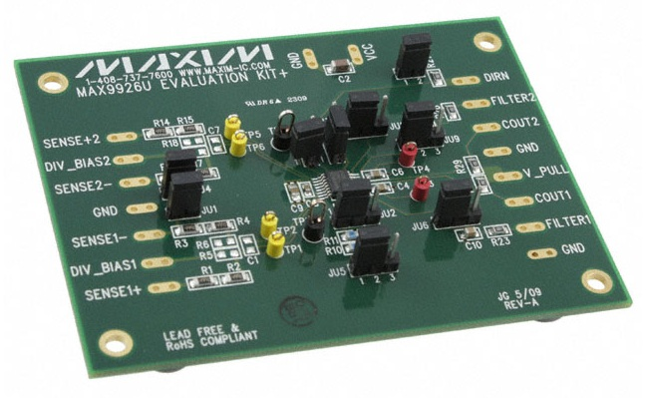
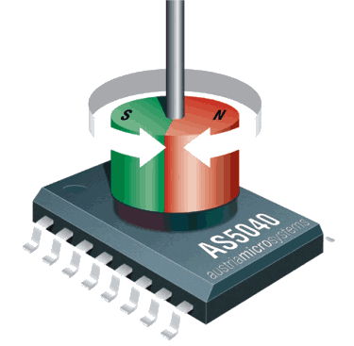
Testbed Calibration against natural variations
Once the sensor is placed in a testbed, multiple natural variations, mechanical asymmetries, and other environmental factors degrade the accuracy of such models. To account for these variations, we use a simple learning mechanism to estimate the noise level in the measurements and the deviation between the expected outputs (as per the model) and the actual outputs.

Slide 20
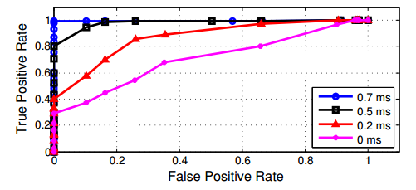
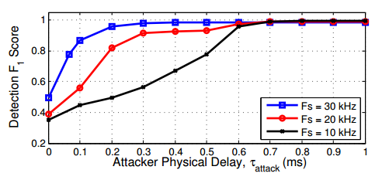
Attack Detection for Magnetic Encoders
We begin with a simple spoofing attack [T2] in which an attacker injects a sinusoidal wave of varying frequency.
(a) the accuracy of attack detection for a simple spoofing attack with sampling rate Fs = 10 kHz and a range of τ_attack
(b) attack detection accuracy as a function of τattack for several sampling rates, Fs.

Slide 21
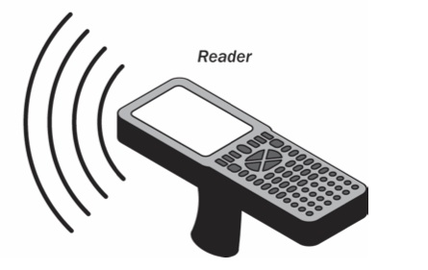
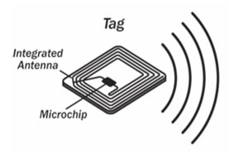
Case Study(2): Detection of Passive Eavesdropping on RFID
An adversary listens or records the same physical signals captured by the sensor.
Passive Eavesdropping on RFID
RFID tags can be classified as either passive or active based on the source of their energy. While passive tags rely on the energy transmitted by an RFID reader in order to power their electronics, active tags have their own power supplies.
To carry out an eavesdropping attack, a sniffing device must be placed in close proximity to the RFID reader so that it can measure the electromagnetic waves transmitted by the reader and reflected by the tag.

Slide 22
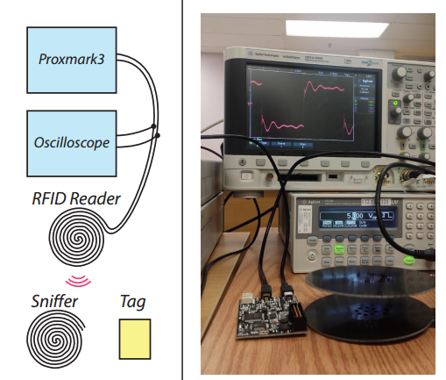
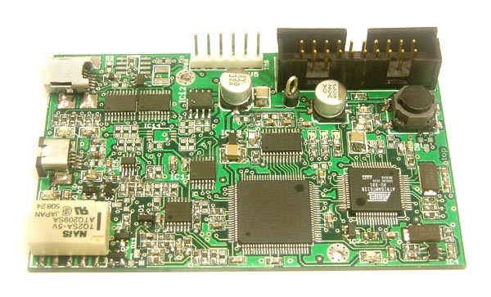
Hardware Setup and Real-time Results
Two identical low frequency RFID antennas are used. The first RFID antenna is used as the legitimate RFID reader while the second is used to eavesdrop.
The set of 20 images (middle) is a sparse light field captured with our camera.

Slide 23
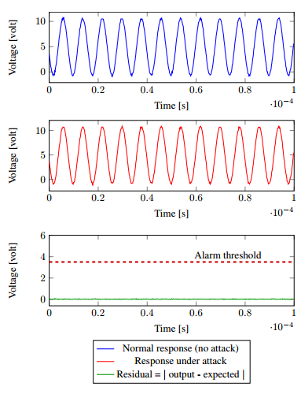
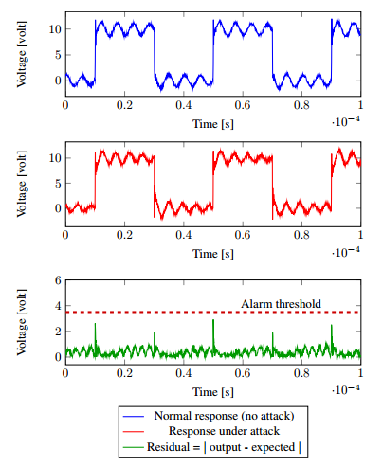
Real-time Results
Results of using PyCRA when only an RFID tag is present in the proximity of the PyCRA-enabled reader
Results of using standard 125KHz signal for detection.

Slide 24
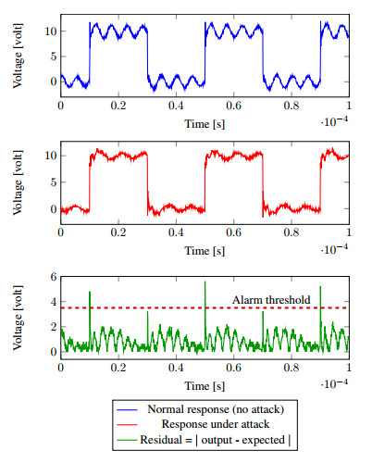
Real-time Results(continue)
Top figure shows the response to the physical challenges when no eavesdropper is placed in the proximity of the RFID reader. The middle figure shows the response to the physical challenges when (a) an eavesdropper antenna (b) passive tag only (c) passive tag + eavesdropper antenna are placed in the proximity of the reader. Finally, the bottom figure shows the value of the residuals calculated by PyCRA along with the alarm threshold.
Results of using PyCRA in detecting eavesdropping when both an RFID tag and an eavesdropper antenna are present in the proximity of the PyCRA-enabled reader.

Slide 25
Case Study(2): Extending PYCRA For Attack Resilience
Extend the PyCRA authentication system to provide attack resilience as well
The signal reflected by a magnetic encoder’s tone ring is a sinusoidal wave dominated by a single frequency component.
In the existence of an attacker and using Fourier analysis, we can reasonably expect to observe energy concentrated at multiple frequencies.
For example, we can use our earlier χ 2 estimator as an attack indicator for any given frequency component using the recursive Discrete Fourier Transform (DFT) with the following form:

Slide 26
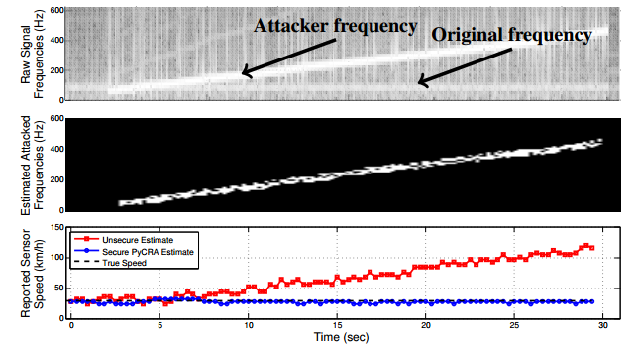
Implementation
A shifted lens is equivalent to a lens with a prism.
The result of these experiments for a swept frequency attack, where the malicious (red) signal is accurately detected and therefore easily subtracted from the measured signal, providing a more robust estimate of the signal of interest.

Slide 27
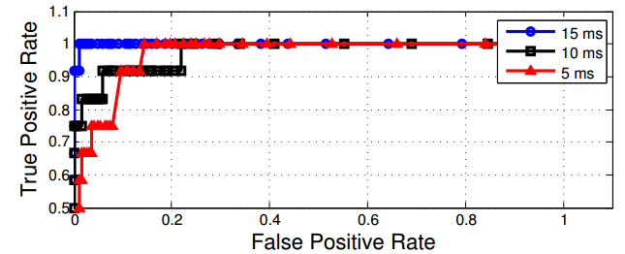
Implementation
A shifted lens is equivalent to a lens with a prism.
The accuracy of this prediction in terms of true and false positive rates as a function of τ_attack. Here we demonstrate accurate attack characterization and mitigation even for τattack delays as low as 5 ms. In addition, the PyCRA-secured magnetic encoder remains robust even in the face of an active cancellation spoofing attack, where the attacker attempts to use destructive interference to destroy the signal of interest.

Slide 28
Conclusion
We have presented PyCRA, a physical challenge-response authentication method for active sensors. The driving concept behind PyCRA is that, through random physical stimulation and subsequent behavior analyses, we are able to determine whether or not a sensor is under attack and, in some cases, remain resilient to attacks.
Physical challenge-response authentication can accurately and reliably detect and mitigate malicious attacks at the analog sensor level.
More broadly, PyCRA offers security to a wide array of systems (not just sensors) where inputs are mapped to outputs by well-understood models.

Slide 29
Quiz
What is main difference between active sensor and passive sensor?
Give one Assumptions about the Adversary.
Why Eavesdropping Attacks is important? Use example to explain
Notes:
Passive sensors measure ambient energy
Active sensors probe some physical entity with self-generated energy
An attacker might measure magnetic waves during an exchange between an RFID reader and an RFID tag, learning potentially sensitive information about the tag. These attacks are passive, meaning that the attacker does not inject any energy into the system.

Slide 30
Thank you !!!

