Slide 1
Secure Multiparty Computations on Bitcoin
Presenter: Cheng Li

Slide 2
MPC
Secure Multiparty Computation Protocol:
Group of mutually distrusting parties to compute a joint function f on their private inputs.
During the execution of a protocol, the parties cannot learn more information about the inputs of the other participants than they would learn if f was computed by T_{f} (third trusted party).
Misbehaved parties should not be able to influence the output of the honest parties more than they could by modifying their own inputs.

Slide 3
Example: Marriage Proposal Problem
a=?
b=?
Marriage
Proposal
a & b
a & b
Alice
Bob

Slide 4
Example: Marriage Proposal Problem
a=0
b=1
Marriage
Proposal
a & b=0
a & b=0
Alice
Bob
I don’t know whether Bob want to marry me.
I know Alice don’t want to marry me.
Bob’s privacy is preserved when Alice is not willing to marry.

Slide 5
MPC
Fairness
The protocol always terminates if the minority of the parties is malicious, and the output is known to each honest participants.
Two-player protocols do not provide complete fairness.

Slide 6
Gambling
clients
Trusted Third Party
clients
Gambling Website
clients

Slide 7
Gambling
Can we use MPC to real life gambling?
No
MPCs do not provide fairness when no honest majority among the participants.
MPCs do not provide security beyond the trusted-party emulation.
Notes:
The majority malicious parties prevent honest parties from learning the correct result.
In marriage proposal problem, MPC may not guarantee that Alice and Bob will eventually take action according to the result.

Slide 8
Gambling
Two naive approaches to deal with them:
Reputation system
It will not prevent us from malicious activities.
Incorporate final transaction into the protocol
The transaction will be executed automatically.
However, there are many banks…

Slide 9
MPCs on Bitcoin
Adapts MPCs into the bitcoin system
Distributed nature without a central authority.
Infeasible for anyone take control over the system.
Money is transferred directly between two parties (no need for another trusted party).

Slide 10
Outline
Introduction
Bitcoin & Security Model
Bitcoin-based Timed Commitment Scheme
Lottery Protocol
Two-party Lottery
Conclusion

Slide 11
Bitcoin
Bitcoin blocks
Users maintain a chain of blocks.
New block B_{i} = T_{i} || H(B_{i-1})||R
If a transaction t is contained in a block Bi and several new blocks on top of it, then the adversary cannot revert t unless it has more commutating power than half of the Bitcoin network.
random salt
new transaction list
hash of previous block

Slide 12
Bitcoin
One user pays in bitcoins
It creates a transaction and broadcast it to other nodes in the network.
Other nodes validate it and broadcast further and add it to the block they are mining (newest block).
One node obtain a new block
It broadcasts its block to the network.
Other nodes validate transactions in it and its hash and accept it by mining on top of it.

Slide 13
Bitcoin
Ledger
We can imagine that there is a trusted third-party called Ledger to record the distributed transaction information.
Bitcoin Transaction
Node address: public key pk, used for verifying the signatures.
Corresponding private key sk is used for signing.

Slide 14
Bitcoin Transaction
T_{x}=(y, B.pk, v, sig_{A}(y, B.pk, v))
T_{x} is valid only if
A.pk was the recipient of T_{y}
The value of T_{y} was at least v
The transaction Ty has not been redeemed earlier
The signature of A is correct
a transaction from address A.pk to address B.pk
input (redeemed) transaction index
signature of A
amount transferred

Slide 15
Bitcoin Transaction
More than one transaction can be redeemed in one transaction.
T_{x}=(y₁, y₂, …, y_{l}, B.pk, v, sig_{A1}(y₁, B.pk, v), …, sig_{Al}(y_{l}, B.pk, v))
Add lock-time t into transaction
T_{x}=(y₁, y₂, …, y_{l}, B.pk, v, t, sig_{A1}(y₁, B.pk, v, t), …, sig_{Al}(y_{l}, B.pk, v, t))
T_{x} becomes valid only if time t is reached.
Transaction can be identified by hash H(T_{x})

Slide 16
Bitcoin Transaction
Output-script function
The transaction T_{x} redeeming T_{y} is valid if π_{y} evaluates to true on input T_{x.}
Witness
Used to make the script π_{y} evaluate to true on T_{x}
T_{x}=(y₁, …, y_{l}, π_{x}, v, t, σ₁, …, σ_{l})
time t is reached
every π_{i}([T_{X}], σ_{i}) is true, i in [1,l]
None of the transaction has been redeemed before
script for T_{x}
body[T_{x}]
witness

Slide 17
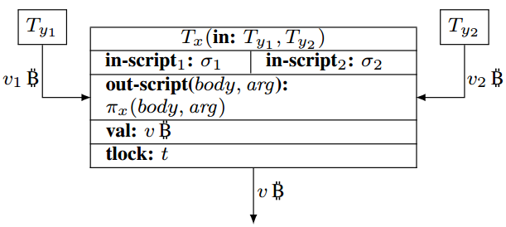
Input transactions

Slide 18
Transaction’s signature
Any transaction T_{x} redeems T_{y1} should guarantee that π_{y1}([T_{x}], σ₁) is true.

Slide 19
Verify signature
π_{x} is true if σ₁ and σ₂ pass the verification

Slide 20
Security Model
Secure connections between parties are not guaranteed.
The only “trusted component” in the system is the Bitcoin chain, which is contained in Ledger. Each node in bitcoin network has one copy of Ledger.
Transaction Malleability
Each party access pattern to Ledger can be publicly known.

Slide 21
Outline
Introduction
Bitcoin & Security Model
Bitcoin-based Timed Commitment Scheme
Lottery Protocol
Two-party Lottery
Conclusion

Slide 22
Commitment Scheme
Two phase
commitment phase: CS.Commit(C, d, t, s)
opening phase: CS.PayDeposit(C, d, t, s)
C: Committer
d: value of transaction
t: tolerated latency of commit
s: the secret

Slide 23
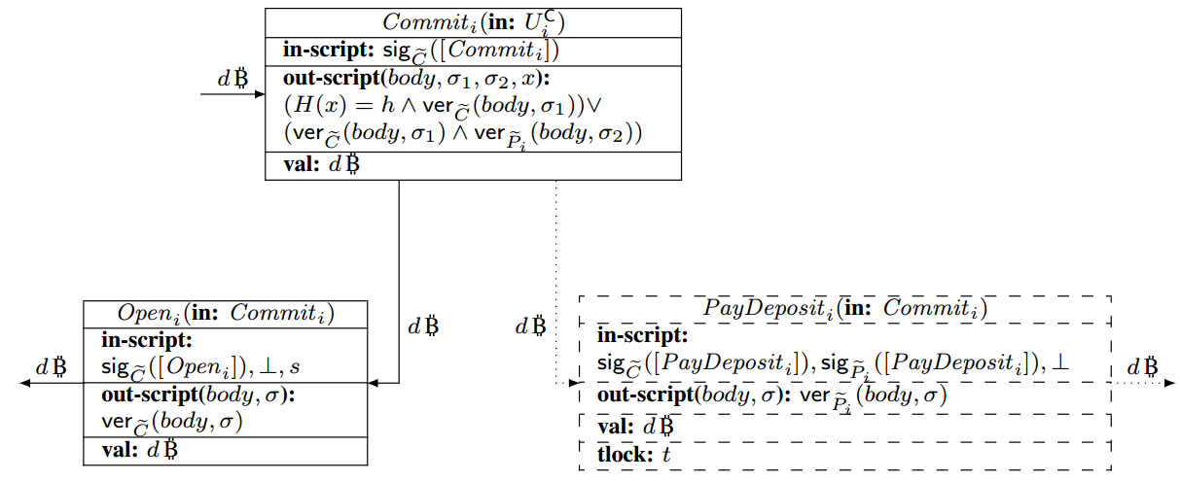
The CS protocol
C sends n transactions Commit_{i} to Ledger.
If some of Commit_{i} does not appear on Ledger in max_{ledger} or they look incorrect, the parties abort.

Slide 24
The CS protocol
C sends PayDeposit_{i} transaction to P_{i}.
If it does not arrive, P_{i} halt

Slide 25
The CS protocol
C sends to the Ledger n transaction Open_{i} and reveal the secret s.
The Open_{i} transaction’s in_script can make the out-script function of Commiti to be true.

Slide 26
The CS protocol
If within time t the Open_{i} transaction does not appear on Ledger, P_{i} signs and sends PayDeposit_{i} to the Ledger.
The PayDeposit_{i} transaction’s in_script can make the out-script function of Commiti to be true.

Slide 27
The CS protocol
If C is honest and sends Openi to the Ledger within time t, then all the bitcoins belong to C again, or they will belong to recipients.

Slide 28
Outline
Introduction
Bitcoin & Security Model
Bitcoin-based Timed Commitment Scheme
Lottery Protocol
Two-party Lottery
Conclusion

Slide 29
Lottery Protocol
Lottery protocol executed among a group of parties P₁, …, P_{n}. All the group member put their money to one place and one parties will got all the money if it wins.
An application of MPCs on Bitcoin.

Slide 30
Lottery Protocol
Winner choosing function
f(s₁, …, s_{n})
s_{i} is the secret input of P_{i}
The output of f(s₁, …, s_{n}) should be uniformly random when given uniformly random input.

Slide 31
Lottery Protocol Transactions
PutMoney
A sends 1 bitcoin transaction to the Ledger
Compute
If A finds that other parties is cheating, it can redeem PutMoney back.
Compute can redeem PutMoney

Slide 32
Lottery Protocol Transaction
ClaimMoney
If s_{A} is the answer then A get the money, or B get the money

Slide 33
Lottery Protocol
Is this protocol secure?
No. One party could refuse to send out its secret s and terminate the protocol with a result that no one could redeem the Compute transaction.

Slide 34
Secure Lottery Protocol
How to force the adversary to give out the result?
Upgrade Lottery Protocol with CS protocol we mentioned before.
Adversary should pay the deposit if he refuse to send out the result.

Slide 35
Secure Lottery Protocol
Initialization Phase:
Each player generates key pair, and distributes its public key.
Each player generate its secret from
Deposits Phase:
For each player P_{i}, commits CS.Commit(P_{i}, d, t+4max_{Ledger}, s_{i})
If any two commitments of different players are equal, then the players abort the protocol.
Commit, PayDeposit, PutMoney, Compute

Slide 36
Secure Lottery Protocol
Execution Phase:
Each player puts PutMoney transaction to Ledger. The player halts if any of those transaction did not appear on Ledger before t+2max_{Ledger.}
For each i≥2, P_{i} computes its signature on transaction Compute and sends it to P₁
P₁ puts all received signatures into inputs of transaction Compute and put it to the Ledger. If Compute did not appear in t+3max_{Ledger}, the players halt.
Each player puts its Open transaction to the Ledger to reveal its secret. If one player did not reveal its secret in time t+4max_{Ledger}, other players send the PayDeposit transaction to the Ledger to redeem the deposit of that player.
The winner gets the money by sending transaction ClaimMoney to the Ledger.
Notes:
show it on whiteboard.

Slide 37
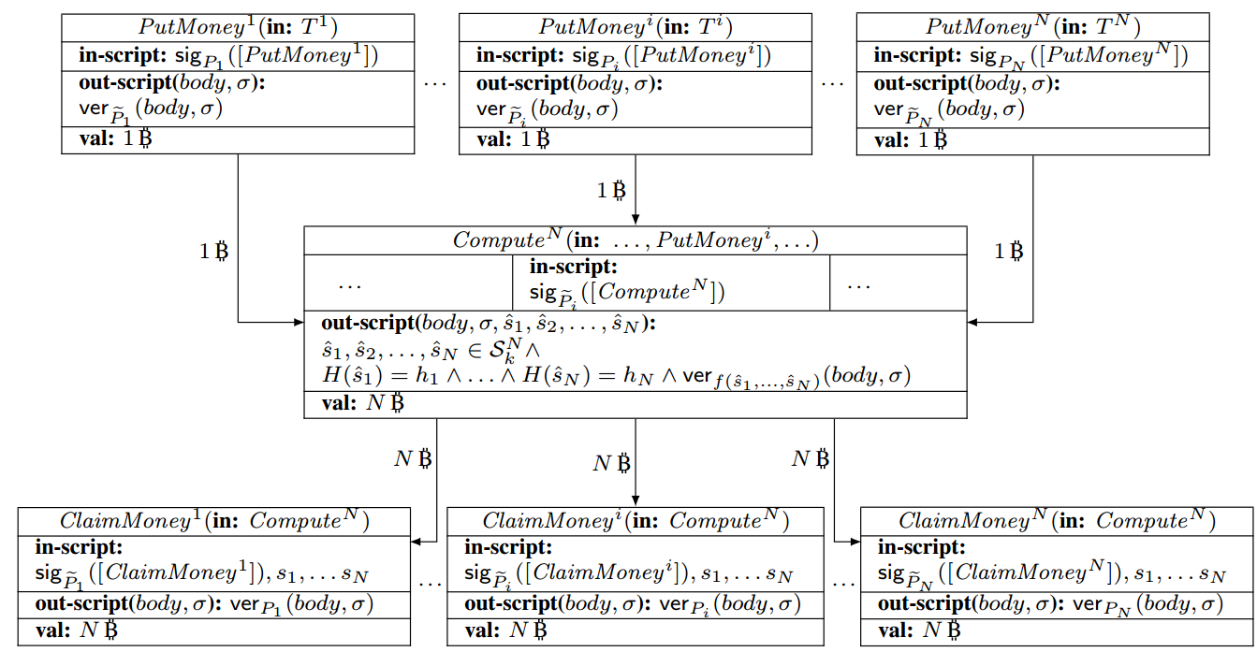
Each player puts PutMoney transaction to Ledger. The player halts if any of those transaction did not appear on Ledger before t+2max_{Ledger.}

Slide 38
For each i≥2, P_{i} computes its signature on transaction Compute and sends it to P₁

Slide 39
P₁ puts all received signatures into inputs of transaction Compute and put it to the Ledger. If Compute did not appear in t+3max_{Ledger}, the players halt.

Slide 40
The winner gets the money by sending transaction ClaimMoney to the Ledger.

Slide 41
Each player puts its Open transaction to the Ledger to reveal its secret. If one player did not reveal its secret in time t+4max_{Ledger}, other players send the PayDeposit transaction to the Ledger to redeem the deposit of that player.

Slide 42
Outline
Introduction
Bitcoin & Security Model
Bitcoin-based Timed Commitment Scheme
Lottery Protocol
Two-party Lottery
Conclusion

Slide 43
Two-party Lottery
Without using deposits
Only works for two-party situation except we can assume the channel between parties and Ledger is private.

Slide 44
Two-party Lottery
Deal with “Nasty Bob”
Force Bob to reveal its secret whenever it wants to redeem PutMoney

Slide 45
Two-party Lottery
Compute₂
Alice computes her input script and sends it to Bob
Bob add his input script and posts Compute₂ on the Ledger.

Slide 46
Two-party Lottery
The ClaimMoney₂ remain unchanged
Sending have no risk
It is the signature of the entire body which cannot leak any information of PutMoney_{A} transaction.
If Bob put it to Compute₂, it will reveal its secret s_{B}.
Alice may not reveal her secret when she learns she lose.

Slide 47
Two-party Lottery
More secure version
If Alice does not show her secret within certain time, Bob could redeem Compute transaction.
Modify Compute transaction.
Introduce new transaction Fuse.

Slide 48
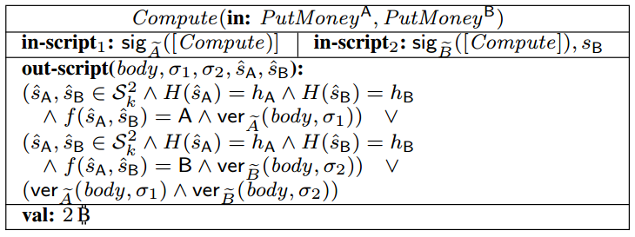
After 2max_{Ledger} time, Fuse will be redeemed by Bob

Slide 49
Alice
Bob
If h_{A} and h_{B} are equal, then the protocol abort

Slide 50
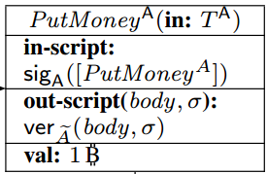
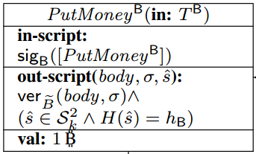
Alice
Bob
Ledger
Both of them continue when both of the PutMoney are on the Ledger.

Slide 51
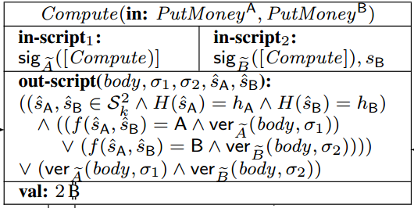
Alice
Bob
Both of them compute the Compute transaction.
Alice sends the signature to Bob and Bob verify it.
Bob adds its signature and secret to Compute.

Slide 52
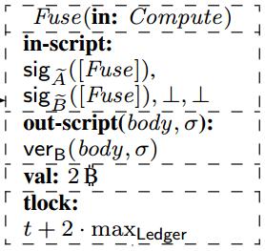
Alice
Bob
Bob verify the signature and halts if it is incorrect.

Slide 53
Alice
Bob
Ledger
If Compute did not appear on the Ledger within max_{Ledger}, than Alice halts.

Slide 54
Alice
Bob
Ledger
If Bob does not receive s_{A} within 2max_{Ledger}, it will send Fuse to the Ledger to redeem Compute

Slide 55
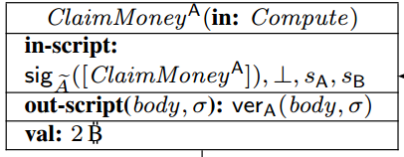
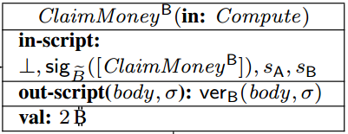
Alice
Bob
Ledger
Either Alice or Bob wins the game according to the result of f(s_{A}, s_{B}) by using ClaimMoney Transaction

Slide 56
Outline
Introduction
Bitcoin & Security Model
Bitcoin-based Timed Commitment Scheme
Lottery Protocol
Two-party Lottery
Conclusion

Slide 57
Conclusion
MPC
Do not provide fairness
Do not guarantee the execution of one action.
MPC on Bitcoin
Timed Commitment Scheme (CS)
Multiparty Lottery Protocol (with deposit)
Two-party Lottery Protocol (without deposit)

Slide 58
Thank you!
Questions?

