Slide 1
Traceability Challenge 2011: Using TraceLab to Evaluate the Impact of Local versus Global IDF on Trace Retrieval
Adam Czauderna, Marek Gibiec, Greg Leach, Yubin Li
Yonghee Shin (presenter), Ed Keenan, Jane Cleland-Huang
TEFSE’11, 23, May, 2011

Slide 2
Motivation
Manual creation of traceability links is a time and effort consuming task.
Vector space model has been used to automatically create traceability links based on term frequency, but have room for improvement.
There is no standard framework for traceability experiments, making difficult to perform repeated studies on additional data sets and comparison between traceability techniques
Individual researchers have to invest time and effort to construct their own experimental environment.

Slide 3
Grand Challenges
C-GC1: Develop link recovery techniques for textual artifacts that are at least as accurate as manual processes and are much more time and cost effective.
L-GC1: Define standard processes and related procedures for performing empirical studies during traceability research.
L-GC2: Build benchmarks for evaluating traceability methods and techniques.

Slide 4
C-GC1: Vector Space Model using Global IDF
Vector Space Model
Computes the similarity between source artifacts and target artifacts using frequency of terms.
Each source and target artifact are represented as a vector of weighted terms for the terms in source artifacts.
TF-IDF weighting method: Term frequency (TF)*Inverse document frequency (IDF)
Similarity is computed as consign of the angle between the two artifacts.
Local IDF: Compute IDF from target artifacts (project specific)
Global IDF: Compute IDF from general corpus

Slide 5
L-GC1/L-GC2: TraceLab
An experimental workbench designed for modeling and executing traceability experiments
Graphically model and execute a traceability experiment as a workflow of components
Provide basic components for experiments and can be extended using TraceLab SDK.

Slide 6
Experiment
Goal
Compare the quality of traceability links generated using the local IDF and global IDF values from the experiment using TraceLab
Documents to obtain global IDF
American National Corpus (ANC)
Data Sets
Data Sets | Source (#) | Target (#) | # of traces
CM1-Subset1 | High level req. (22) | Low level req. (53) | 45
EasyClinic | Use cases (30) | Classes (47) | 93
E-Tour | Use cases (58) | Java code (116) | 327
WV-CCHIT | Requirements (116) | Regulatory requirements (1064) | 587

Slide 7
Experiment Modeling on TraceLab

Slide 8
Results : Average Precision
Average Precision
Average of precision at each retrieval of documents
Returns a higher value when more relevant documents are retrieved earlier
Data Sets | Local IDF | Global IDF
CM1-Subset1 | 0.482 | 0.386
Easy Clinic | 0.721 | 0.196
E-Tour | 0.331 | 0.192
WV-CCHIT | 0.296 | 0.294

Slide 9
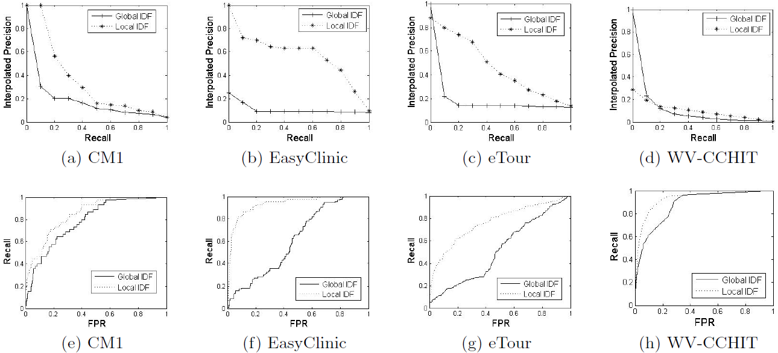
Results : Interpolated Precision / ROC

Slide 10
ConclusionS
Local IDF approach outperforms global IDF approach especially for the data sets that contain non-english languages and many technical terms.
TraceLab can effectively support to model and execute traceability experiments.

Slide 11
Thank You!

