Slide 1
Cracking-Resistant Password Vaults using Natural Language Encoders
Rahul Chatterjee, Joseph Bonneauy
Ari Juelsz, Thomas Ristenpart
Presented by: Shengye Wan
Some slides come from authors and Tuan

Slide 2
Password Vault (PV)
Cloud Storage
Plaintext Vault
PKCS#5
encryption
Encrypted Vault
family00
family01
family.1
qwerty
poiuyt.12
0xe1f3f4a…
0x73bc52e…
0x4e5e373…
0x3c8b8ea…
0xe33188a…
mypass4
Master password
Notes:
A key security concern is what will happen if an attacker gets hold of an encrypted password vault; the attacker might either compromise the server or exfiltrate the vault from the user’s machine. In theory the encryption of the vault should protect the valuable user site credentials, but in practice …

Slide 3
Offline Attacking PV
0xe1f3f4a…
0x73bc52e…
0x4e5e373…
0x3c8b8ea…
0xe33188a…
Vault Ciphertext
Attacker’s guesses
123456
password
…
…
…
mypass4
abc123
nicole
Daniel
.
.
.
趬?%?U? Á
ऑޕ؆ॠؕीڐʁޕ؆ࠔॠؕ?ीڐʁ ɠڅ՗ݸՙдͩؓ३sU%aհ̰ԹЂء҅փٖ
Decryption
(PKCS#5)
Output of Decryption
Random Junk
Notes:
the vault can be cracked using an offline Brute-force attack. Take the vault cipher text, and try to decrypt with master password guesses. When the wrong master password is used, decryption will fail, or output JUNK...

Slide 4
Offline Attacking PV (Cont’d)
0xe1f3f4a…
0x73bc52e…
0x4e5e373…
0x3c8b8ea…
0xe33188a…
Vault Ciphertext
Attacker’s guesses
123456
password
…
…
…
mypass4
abc123
nicole
Daniel
.
.
.
?%?U?ऑޕ؆ॠؕीڐʁ Á趭؆ॠؕ?aڐʁ 购փЩͣɠڅ३sU%հ̰ԹЂءٖ?%a
Decryption
(PKCS#5)
Output of Decryption
Random Junk

Slide 5
Offline Attacking PV (Cont’d)
0xe1f3f4a…
0x73bc52e…
0x4e5e373…
0x3c8b8ea…
0xe33188a…
Vault Ciphertext
Attacker’s guesses
123456
password
…
…
…
mypass4
abc123
nicole
Daniel
.
.
.
family00
family01
family.1
qwerty
poiuyt.12
Decryption
(PKCS#5)
Output of Decryption
Yes,
it is.
Runtime of the attack =
# of decryption attempts
Offline Work*
Notes:
but when the real master password is used the easy-to-recognize legitimate plaintext will be recovered.
The runtime of the attack is the number of decryption attempts he has to make. Standards for password-based encryption like PKCS#5 suggest using hash chains and salting, but this only slows down the attack by constant factor.
We call the total attacker computational effort “Offline Work” as it requires no interaction with any servers.

Slide 6
Threat Model
Password-Based Encryption (PBE) with weak secrets
Message-Recover(MR) attack
--The attacker could use brute-force to guess the password
(70% of passwords can be cracked <1bn guesses)
--Once the attacker decrypt one message successfully, he or she could get much more information
Secrets have complex distributions: natural language
Notes:
So what, how much offline work is required of attackers?
Unfortunately, passwords are notorious for their low entropy. Veras et al. showed recently that modern password crackers can guess 70% of human-chosen passwords with only 1 billion attempts. We don’t expect the master passwords to be any better on average. The bottom line is: If you loose your vault today, with very high probability, it will be cracked by tomorrow.

Slide 7
Outline
Threat Model
Related Work
System Design
Technical Details
Evaluation
Conclusion
Discussion

Slide 8
Related Work– Kamouflage
abcdef12
abcdef02
abcdef#1
thomas
temple#00
0xe1f3f4a…
0x73bc52e…
0x4e5e373…
0x3c8b8ea…
0xe33188a…
family00
family01
family.1
qwerty poiuyt.12
0xe1f3f4a…
0x73bc52e…
0x4e5e373…
0x3c8b8ea…
0xe33188a…
shishi1
mypass4
PKCS#5
PKCS#5
travis99
travis12
travis@7
soccer smiles@33
0xe1f3f4a…
0x73bc52e…
0x4e5e373…
0x3c8b8ea…
0xe33188a…
violet9
PKCS#5
scooby33
scooby45
scooby@3
vanbus weiwei!69
0xe1f3f4a…
0x73bc52e…
0x4e5e373…
0x3c8b8ea…
0xe33188a…
zxcvbn9
N = 4
(3 decoy vaults)
PKCS#5
Notes:
Bojinov, Burzstein, Boyen and Bonneh proposed a clever idea of hiding the real password vault in a list of decoy vaults. The setup is like this. They create bunch of decoy vaults and decoy master passwords, encrypt each of the vault using corresponding master password and store the whole list of cipher text as the Vault Ciphertext.

Slide 9
Kamouflage (Cont’d)
N = 4
(3 decoy vaults)
Real Vault, when
mpw = real password
0xe1f3f4a…
0x73bc52e…
0x4e5e373…
0x3c8b8ea…
0xe33188a…
0xe1f3f4a…
0x73bc52e…
0x4e5e373…
0x3c8b8ea…
0xe33188a…
Kamouflage
Decryption
Decoy Vault, when
mpw ∈ decoy passwords
0xe1f3f4a…
0x73bc52e…
0x4e5e373…
0x3c8b8ea…
0xe33188a…
0xe1f3f4a…
0x73bc52e…
0x4e5e373…
0x3c8b8ea…
0xe33188a…
Junk
None of the above
mpw
Notes:
Bojinov, Burzstein, Boyen and Bonneh proposed a clever idea of hiding the real password vault in a list of decoy vaults. The setup is like this. They create bunch of decoy vaults and decoy master passwords, encrypt each of the vault using corresponding master password and store the whole list of cipher text as the Vault Ciphertext.

Slide 10
Cracking Kamouflage—Naïve Attack
shishi1
violet9
mypass4
zxcvbn9
abcdef12
abcdef02
abcdef#1
thomas
temple#00
travis99
travis12
travis@7
soccer smiles@33
family00
family01
family.1
qwerty poiuyt.12
scooby33
scooby45
scooby@3
vanbus weiwei!69
To check if vault is real or decoy: login attempt using password
Runtime of the Attack = Offline Work of PBE + N/2 Online Work
(N = # of explicitly stored vaults)
Kamouflage security claim: naïve attack is the best possible
Notes:
In attacker’s perspective at the end of the game the persistent attacker will get a bunch of plausible looking vaults and he has no clue which one of this is the real one. So, in idea scenario the attacker has to try online with credentials from each vault to check the validity of that vault. The runtime of the attack will be all offline work and some online work proportional to N, the number of decoy vaults generated at the time of encryption.

Slide 11
Cracking Kamouflage—Problem
family00
family01
family.1
qwerty poiuyt.12
Real
mypass4
abcdef12
abcdef02
abcdef#1
thomas
temple#00
travis99
travis12
travis@7
soccer smiles@33
scooby33
scooby45
scooby!3
vanbus weiwei!69
Decoys
....
shishi1
violet9
zxcvbn9
Notes:
But, we discovered a different story. We found that the way Kamouflage generates decoys has a subtle security flaw in it. To generate the decoys they do the following, take the vault passwords, parse them into continuous sequence of letters, digits or symbols and then replace every sequence with a similar length and type sequence randomly sampled from a static dictionary generated by preprocessing RockYou password leak. It repeats the process N-1 times to generate all N-1 decoy password vaults, It repeats the same for generating decoy master passwords and there lies the problem. Observer all the mastre passwords share same template!!

Slide 12
Cracking Kamouflage—Speed up
Attacker guesses
Kamouflage
Vault
…
…
veronica
viper01
violet9 whatsup!
Wlidcat2
year2012
secret7
…
…
mypass4
Plausible Vault
travis99
travis12
travis#7
soccer smiles#33
Kamouflage
Decryption
Master Password has 6 characters + 1 digit.
Speed up!
Notes:
Now, an attacker, when trying to decrypt Kamouflage vault ciphertext, ... able to get a plausible vault looking output from the Decryption, he knows the master password also has the same structure as this password.
Check violet9 with online query
If not, move to next master password w/ structure

Slide 13
Cracking Kamouflage—Now Result
Kamouflage claimed (for N=10³):
100% offline work of standard Password Based Encryption
+
N/2 = 500 expected online queries
Simulations with Yahoo password leak:
50% offline work of standard Password Based Encryption
+
11 expected online queries
Notes:
on an average a kamouflage encrypted vault can be cracked in half the time that require to crack a vault that is encrypted with traditional password based encryption scheme. Moreover, they claimed that the attacker will need to make N/2 online queries which is 500 in case of N equals to 1000. N is the number of vaults in the vault cipher text. We found on an average our attacker can figure out the real vault in less than 11 online queries. And there is no easy fix for this hide-in-a-list approaches like Kamouflage.

Slide 14
Related Work–Honey Encryption
Encryption maps a key and message to a ciphertexts
Decryption recovers messages from ciphertexts
With the wrong key, decryption will emit a plaintext that “looks” plausible
Its cornerstone is distribution-transforming encoder (DTE)

Slide 15
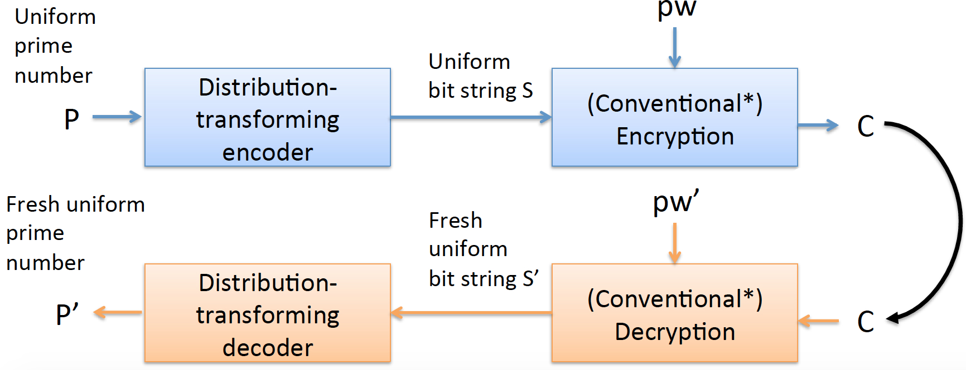
HE Working Flow
Using hash value to encrypt/decrypt a prime number

Slide 16
Contributions
Discovering a subtle vulnerability in Kamouflage and showing how to crack it by the vulnerability
Introducing the concept of natural language encoders and showing how to build them from typical password models
Using NLEs as the basis for a password vault system called NoCrack

Slide 17
Technical Details–NLEs
Natural-Language Encoders (NLE)
building DTEs that securely encode samples from distributions of natural language-type text
Several ways to convert password sampler techniques to secure NLEs

Slide 18
NLEs–Uniform Random
Uniformly random, fixed-length strings of symbols drawn from an alphabet that consists of the 96-character ASCII characters, every string looks like: s₁||s₂ ||…||s_{k}, where s_{i}∈∑ (s_{i} : the position of s_{i} in ∑)
Encoding: outputs a large random integer X_{i} that X_{i} mod 96 = s_{i}
Decoding : Given input X₁||X₂ ||…||X_{k}, it yields output s₁||s₂ ||…||s_{k} such that s_{i} = X_{i} mod 96
We refer to this DTE as UNIF
Notes:
As an example, it is simple to construct a DTE for uniformly random, fixed-length strings of symbols drawn from an alphabet that consists of the 96-character ASCII printable characters. Encoding works in a symbol-by-symbol manner on an input string s₁||s₂ ||…||s_{k}, where s_{i}∈∑. Let s_{i} denote the position of s_{i} in ∑. under some canonical ordering of ∑. Then for each symbol s_{i} in turn, encode outputs a large (e.g., 128-bit) integer X_{i} selected randomly subject to the constraint X_{i} mod 96 = s_{i}.
Decoding operates in the natural way: Given input X₁||X₂ ||…||X_{k}, it yields output s₁||s₂ ||…||s_{k} such that s_{i} = X_{i} mod 96 . Straightforward extensions that we omit for brevity allow construction of a DTE over passwords that conform to standard password-composition 8 policies (such as needing at least one integer, one special symbol, etc.). We refer to this DTE as UNIF .

Slide 19
NLEs–Password Models
A password (probability) mode is a function:
p : ∑* → [0, 1] that assigns a probability to every password
Using the inverse sampling DTE
Inefficient but the smallest password models

Slide 20
NLEs–Password Samplers
View a sampling model for passwords as a deterministic algorithm Samp:
Input: a uniformly random bit string U
Output: a password P with probability p(P)
Decode(U) = Samp(U)
Build Encode(P) that samples uniformly from Samp⁻¹(P):
n-gram models
Probabilistic context-free grammar (PCFG) models

Slide 21
NLEs– n-gram Models
An edge from node to w_{i-(n-1)}…w_{i-1} to w_{i-(n-2)}…w_{i} is labeled with w_{i} and Fw_{i-(n-1)}…w_{i-1} (w_{i}). Example: password
assw sswo (F: CDF of that string)
To sample from the model:
1) starts at start node
2) samples from [0, 1), finds the first edge whose CDF value is larger than the sample.
3) Move to next node until a node have a stop symbol.
o
F_{assw}(o)

Slide 22
NLEs–PCFG Models
S → (pdf) (cdf) | W₆ | W₆D₁ | D₆ | W₈ | …. | Y₈
 | 0.20, 0.20 | 0.12, 0.32 | 0.10, 0.42 | 0.09, 0.51 |  | 0.001, 1.00
W₆ → (pdf) (cdf) | abcdef | qwerty | greats | horror | …. | invent
 | 0.15, 0.15 | 0.11 , 0.26 | 0.095 , 0.355 | 0.09, 0.445 |  | .002, 1.00
…

Slide 23
NLEs–PCFG Models (Cont’d)
Encode( pw ):
Create a parse tree of the password in the base PCFG
Encode each rule in the parse tree
pad with random numbers (if needed)
Encoding
Parse Tree
0.23,
0.12,
0.20,
0.13,
0.93,
….
S → W₈D₂;
W₈ → ‘password’;
D₂ → ‘12’;
password12

Slide 24
NLEs–PCFG Models (Cont’d)
Decode ( list of bit-string ):
Decode each bit-string into rules and construct the parse tree from ‘S’ (stop when it is complete)
Get the string that is generated by the parse tree.
Encoding
Parse Tree
0.23,
0.12,
0.20,
0.13,
0.93,
….
S → W₈D₂;
W₈ → ‘password’;
D₂ → ‘12’;
password12

Slide 25
NLEs–SG Models
SG: Sub-Grammar PCFG
P: a user’s set P of passwords is encrypted under a master password
Encoding first parses all the passwords in P using the trained PCFG
Generating a new sub-grammar PCFG that consists of the cumulative set of rules used in parsing the passwords in P
The rule probabilities are copied from the original PCFG and then normalized over the sub-grammar PCFG
Notes:
if DTE-decode samples passwords from a smaller domain than the actual trained PCFG, it will often end up using the same password components or full passwords

Slide 26
NLEs–SG Models (Cont’d)
Normalized
Sub-grammar PCFG
Sub-grammar
S → W₆Y₁D₁ ;0.18
S → W₁Y₁D₁W₆;0.02
S → W₆Y₁D₂ ;0.15
S → W₆D₂ ;0.12 W₆ → mywisc;0.001 W₆ → qwerty ;0.12 Y₁ → # ;0.05 Y₁ → < ;0.01 D₁ → 1 ;0.19 D₁ → 3 ;0.11 W₁ → i ;0.2 D₂ → 12 ;0.23 D₂ → 89 ;0.009
S → W₆Y₁D₁ ;0.37
S → W₁Y₁D₁W₆;0.045
S → W₆Y₁D₂ ;0.35
S → W₆D₂ ;0.25 W₆ → mywisc;0.01 W₆ → qwerty ;0.99 Y₁ → # ;0.855 Y₁ → < ;0.145 D₁ → 1 ;0.63 D₁ → 3 ;0.37 W₁ → i ;1.00 D₂ → 12 ;0.99 D₂ → 89 ;0.01
Real
mywisc#1
i<3mylife
mywisc#1
mywisc#12
qwerty89

Slide 27
Evaluation
Security goal: output of Decrypt should look “real”
Machine learning classifiers
Yahoo leak dataset, 50% attack success:
 | NoCrack | Kamouflage
Offline work | 20,000 | 10,000
Online work | 6,666 | 11
Attacker will have to make many online queries

Slide 28
Evaluation (Cont’d)
50%
Best NLE
50%
60%
NLE using PCFG
(by Weir et al.)
35%
Classifier thinks 35% of the decoy
passwords are more realistic than the real one!
100%
Worst NLE
0%
α
r
Classification accuracy
Rank-of-real

Slide 29
Evaluation (Cont’d)
Classifiers for decoy and real passwords
Trained the Base PCFG with RY-tr leak (#Decoy)
Tested with RY-ts, MySpace , Yahoo leaks (#Real)
Metric of Evaluation:
Accuracy of classification (α)
Rank-of-real based on classifier’s confidence (r)
Report average over all the passwords in each of the test leaks

Slide 30
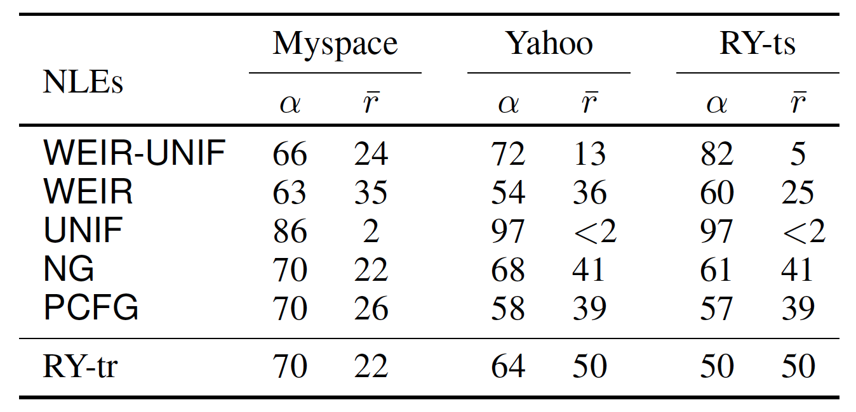
Evaluation (Cont’d)
For different decoy / true password source pairs, percentage classification accuracy (α) and percentage average rank (r) of a real password in a list of q = 1,000 decoy passwords for ML adversary. Lower α and higher r signify good decoys.

Slide 31
Conclusion
Kamouflage Vulnerability: An effective attack against only prior work on decoy techniques
Natural Language Encoder: Devising a new mechanism to create decoys
NoCrack: The Prototype of a Password Vault that utilizes NLE and HE; Offering most of the functionalities of modern password vaults
Notes:
There are of course some limitations. For example, NoCrack won’t force online attacks if an attacker has some specific side information about a user’s vault (e.g., their password on some site). Here though, we get the same level of security as traditional password-based encryption. Also, currently we don’t support situations in which the master password is related to vault passwords, but we have some ideas about how to deal with this.
Of course, our attacks were best effort, and we currently have no proof that techniques for distinguishing decoys will not improve. So trying to break our decoy generation approach, and in turn improve it, would be very interesting future work.

Slide 32
Discussion
Side information about the victim might decrease online work significantly
Master password related to the passwords inside the vault
Website password restrictions
Recognizing decoys?
Notes:
Add my opinion!
There are of course some limitations. For example, NoCrack won’t force online attacks if an attacker has some specific side information about a user’s vault (e.g., their password on some site). Here though, we get the same level of security as traditional password-based encryption. Also, currently we don’t support situations in which the master password is related to vault passwords, but we have some ideas about how to deal with this.
Of course, our attacks were best effort, and we currently have no proof that techniques for distinguishing decoys will not improve. So trying to break our decoy generation approach, and in turn improve it, would be very interesting future work.

Slide 33
Quiz
What’s the problems of Kamouflage?
What’s the practical problem when we want to use the previous Honey Encryption to build a password vault?
Why do we want to use sub-grammar PCFG?

Slide 34
Thank You!
Shengye Wan
Department of Computer Science
College of William and Mary

