Slide 1
GUITAR: Piecing Together Android App GUIs from Memory Images
CSCI680 Advanced Systems and Network Security
Authors: Brendan Saltaformaggio, Rohit Bhatia, Zhongshu Gu, Xiangyu Zhang, Dongyan Xu
Presenter: Yongsen Ma

Slide 2
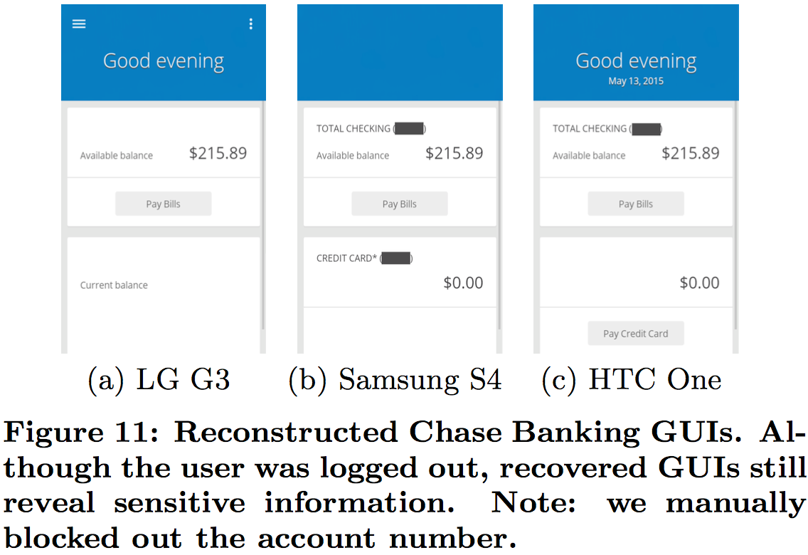
Android App GUIs
Android App GUIs display rich semantic and contextual information.
For digital forensics, “image-and-analyze” is needed to recover apps’ GUIs.
State-of-the-art techniques rely on individual in-memory data structures.
diverse visual elements
deallocation for backgrounded apps

Slide 3
GUITAR
How to effectively piece together Android app GUIs from memory images?
GUITAR: “an app-independent technique which automatically reassembles and redraws all apps’ GUIs from the multitude of GUI data elements found in a smartphone’s memory image”
Reconstructing GUI tree topology
Remapping drawing operations
Runtime recreation for GUI redraw

Slide 4
Related Work
Memory forensics by recovering individual data structures
Value-invariant signatures: known in-memory value patterns or invariants
Structural-invariant signatures: interconnection of data structure networks
DSCRETE: automatically render application output for recovered data structures
application-specific, requires live data structures
DEC0DE: recovers plain-text call logs and address book entries by probabilistic finite state machines
VCR and many others: recovering app-specific data from memory images
only focus on specific types of program data, while GUITAR focuses recovers GUIs and redraws the GUIs in the same view as seen by smartphone users

Slide 5
Outline
GUITAR Design
Reconstructing GUI Tree Topology
Remapping Drawing Operations
Runtime Recreation for GUI Redraw
Evaluation
GUI Data Elements
Reconstructed GUIs
GUI Reconstruction Over Time

Slide 6
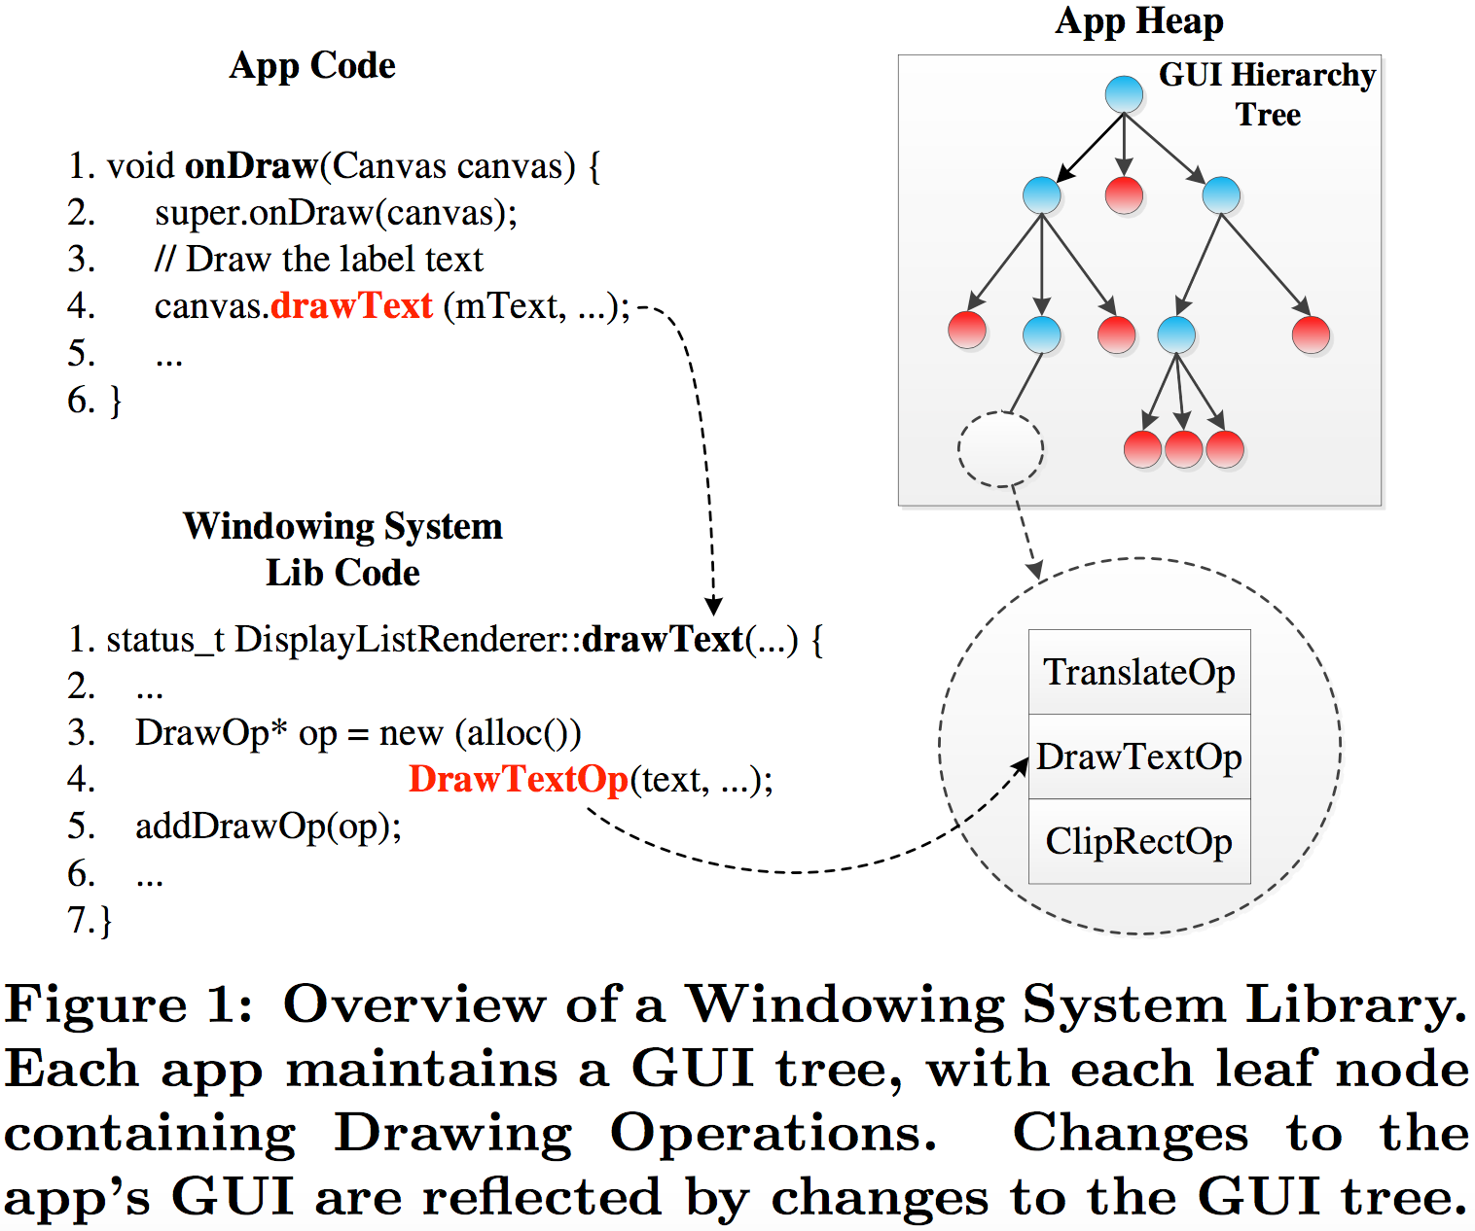
Android GUI Framework
Recovering pixel buffer: only the currently visible app’s GUI
In-memory windowing system: GUI hierarchy tree with drawing operations
current geometric layout and graphical content
each app’s visual presentation and display

Slide 7
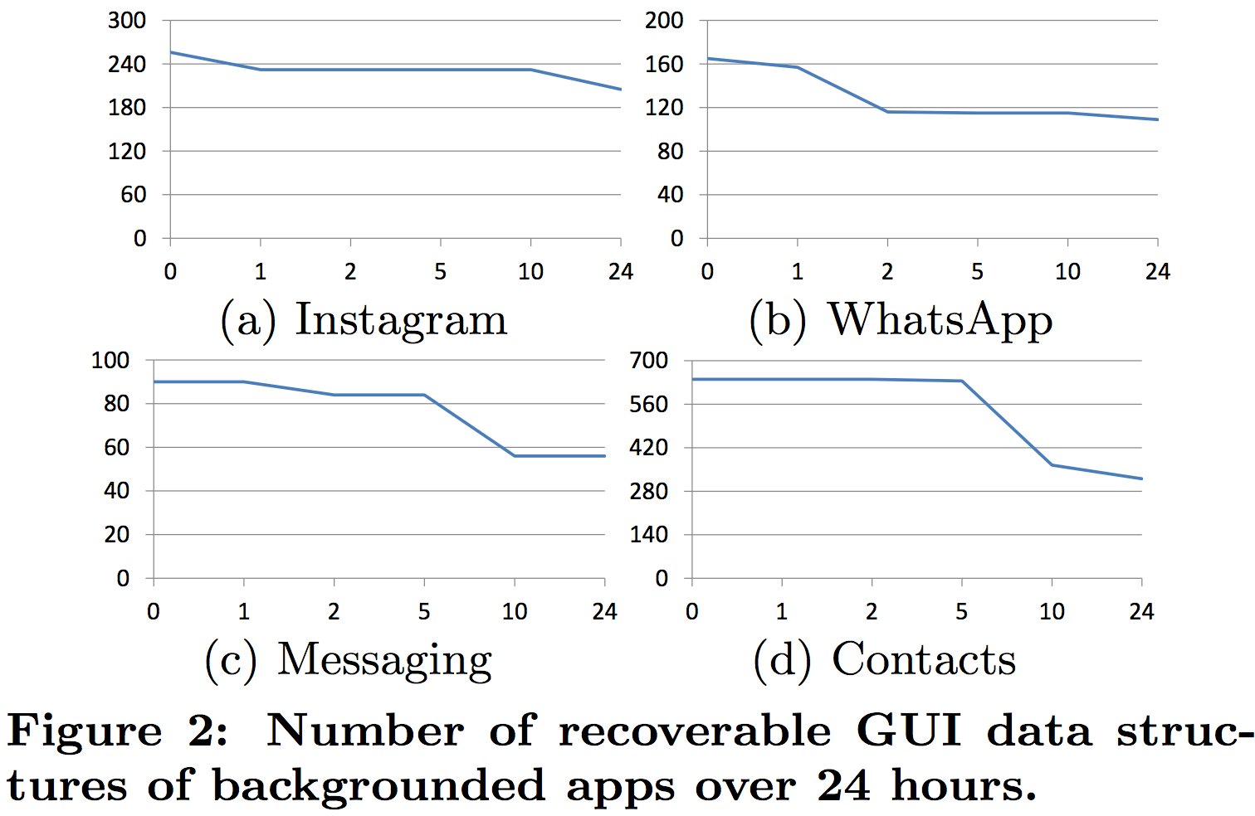
Recoverable GUI for Backgrounded Apps
Backgrounded apps in Android: GUI tree will be deallocated and critical pointers will be set to NULL.
many nodes remain in free heap
portion of GUI data is recoverable
A lot of GUI data is recoverable even after 24 hours
Missing node do not affect the redrawing of the remaining GUI

Slide 8
Challenges and Solutions
Key pointers in the GUI tree are explicitly nullified, so the original layout needs to be pieced together from disconnected nodes.
depth-first topology recovery: reconnect internal parent nodes automatically
GUI’s graphical contents need to be restored by geometrically re-mapping the leaf TreeNodes back to the DrawOpLists.
bipartite graph weighted assignment: semantic hints in drawable graphical content
several key data structures’ functional inheritance is lost in the memory image
forced polymorphism: patch lost inheritance information

Slide 9
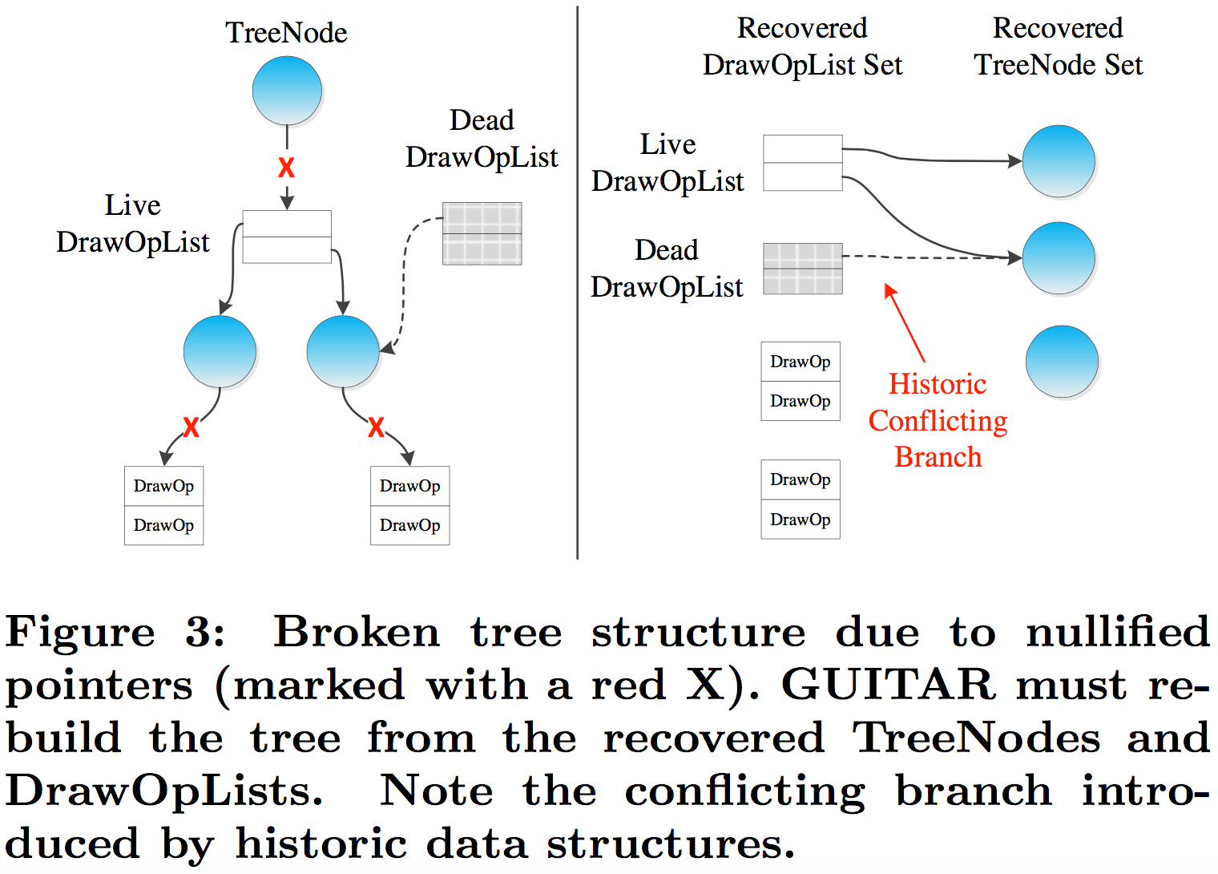
Reconstructing GUI Tree Topology
NULL pointers for backgrounded apps
TreeNode ⇏ DrawOpList
Parent TreeNode ⇏ Child TreeNode
GUI tree from disconnected nodes sets
Java objects ⇒ reverse GUI layout ⇒ parent of each TreeNode
child-to-parent paths and DrawOpList-to-child pointers ⇒ parent-to-DrawOpList pointers

Slide 10
Reconstructing GUI Tree Topology
Dealing with conflicting branches
Mark the conflict while mapping both DrawOpList to the parent TreeNode
Removed later by leveraging characteristics of the visual GUI content
Rebuilding the GUI hierarchy by pre-order depth-first traversal of the recovered TreeNode
Starts at the tree’s root
For a parent TreeNode, locates all TreeNodes which have the parent TreeNode as a parent
Searches each DrawOpList for those which point to any child of the parent
Matches the located DrawOpList to the parent TreeNode
Stops when a leaf is reached

Slide 11
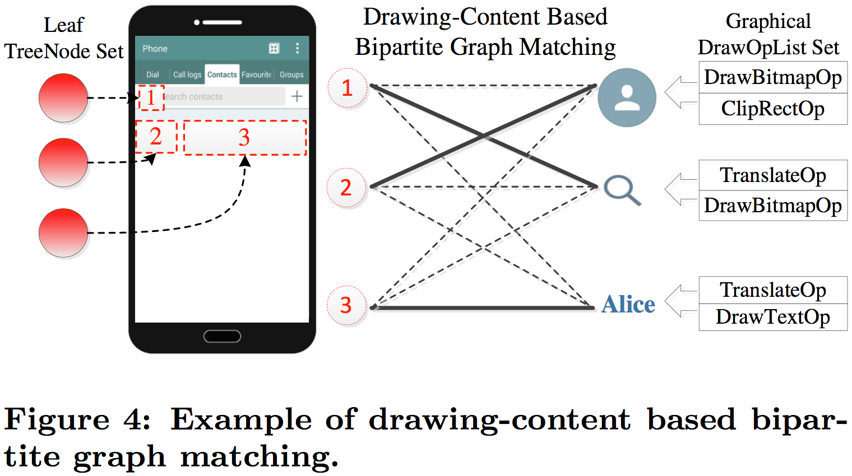
Remapping Drawing Operations
Matching leaf TreeNodes to DrawOpLists’ drawable GUI content
Computes geometric screen area described by each leaf TreeNode
Finds a best global match to the drawable GUI content
Weighted assignment problem
DrawOpList ⇒ source vertex set
Leaf TreeNodes ⇒ sink vertex set

Slide 12
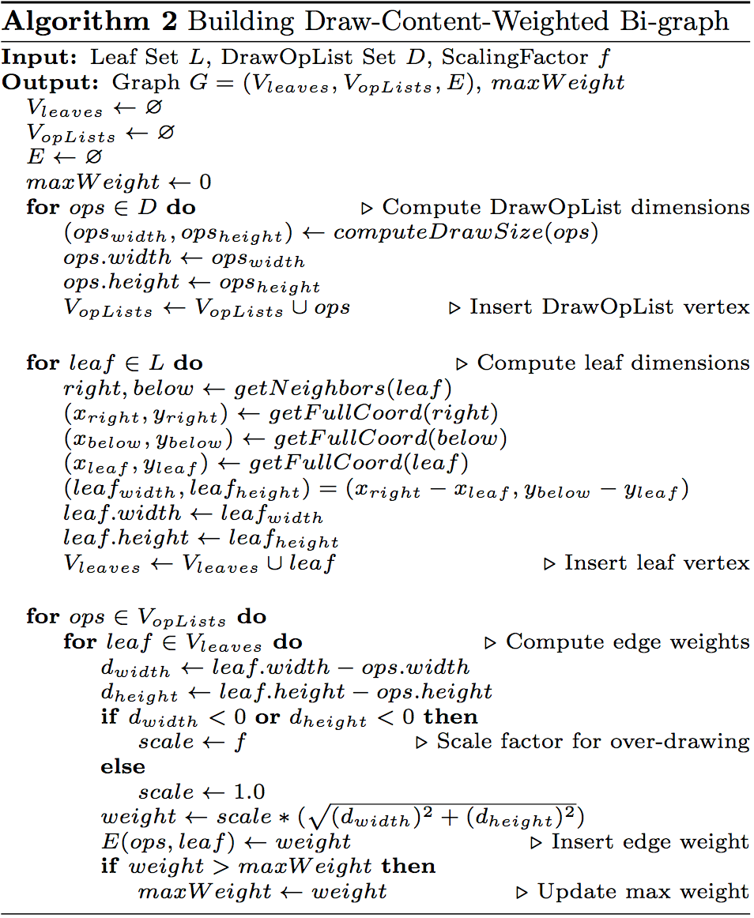
Remapping Drawing Operations
Building a weighted bipartite graph
Computes the maximum dimensions of the graphical output for each DrawOpList
Computes each leaf’s full-screen coordinates
Computes edge weights for under- or over-drawing
Computes the screen area of each leaf TreeNode
Solving the assignment: draw DrawOpLists to the max
Extra DrawOpLists: TreeNode ⇒ multiple DrawOpLists
Extra TreeNodes: Adding fake DrawOpList vertices

Slide 13
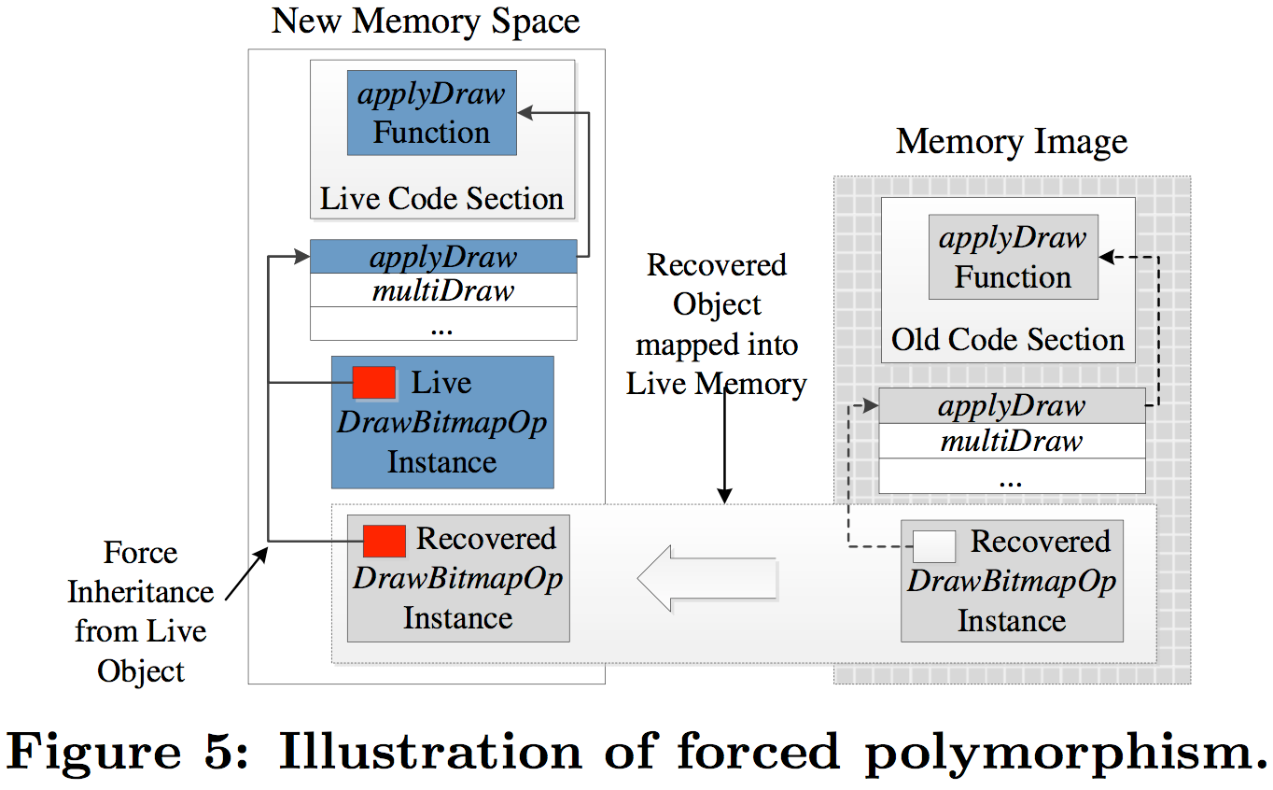
Runtime Recreation for GUI Redraw
Forced Polymorphism: recreates functional inheritance
determines the true runtime type of each recovered object
allocates a new instance of the new matching type of the live object
redirects function dispatch table of recovered objects to live objects
GUI Redraw: grafts GUI tree to Android windowing system
inserts the recovered GUI tree as a subtree within the running app’s GUI

Slide 14
Outline
GUITAR Design
Reconstructing GUI Tree Topology
Remapping Drawing Operations
Runtime Recreation for GUI Redraw
Evaluation
GUI Data Elements
Reconstructed GUIs
GUI Reconstruction Over Time

Slide 15
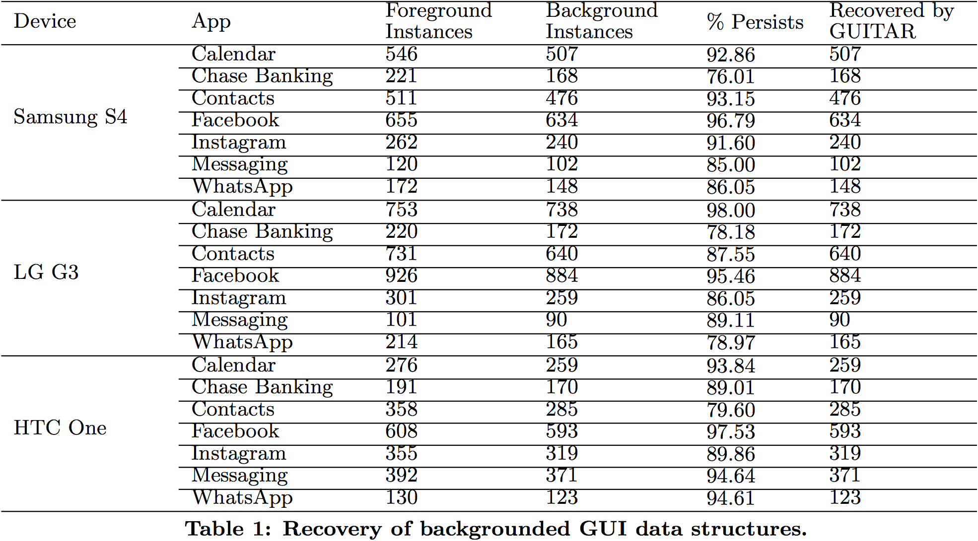
Evaluation: GUI Data Elements
Evaluation
Implementation: plug-in for the Android emulator
Input: a subject Android device’s memory image
Output: recovered app GUIs on emulator screen
Devices: HTC One, LG G3, Samsung Galaxy S4
OS: Android 4.4
Apps: popular and vendor-specific apps

Slide 16
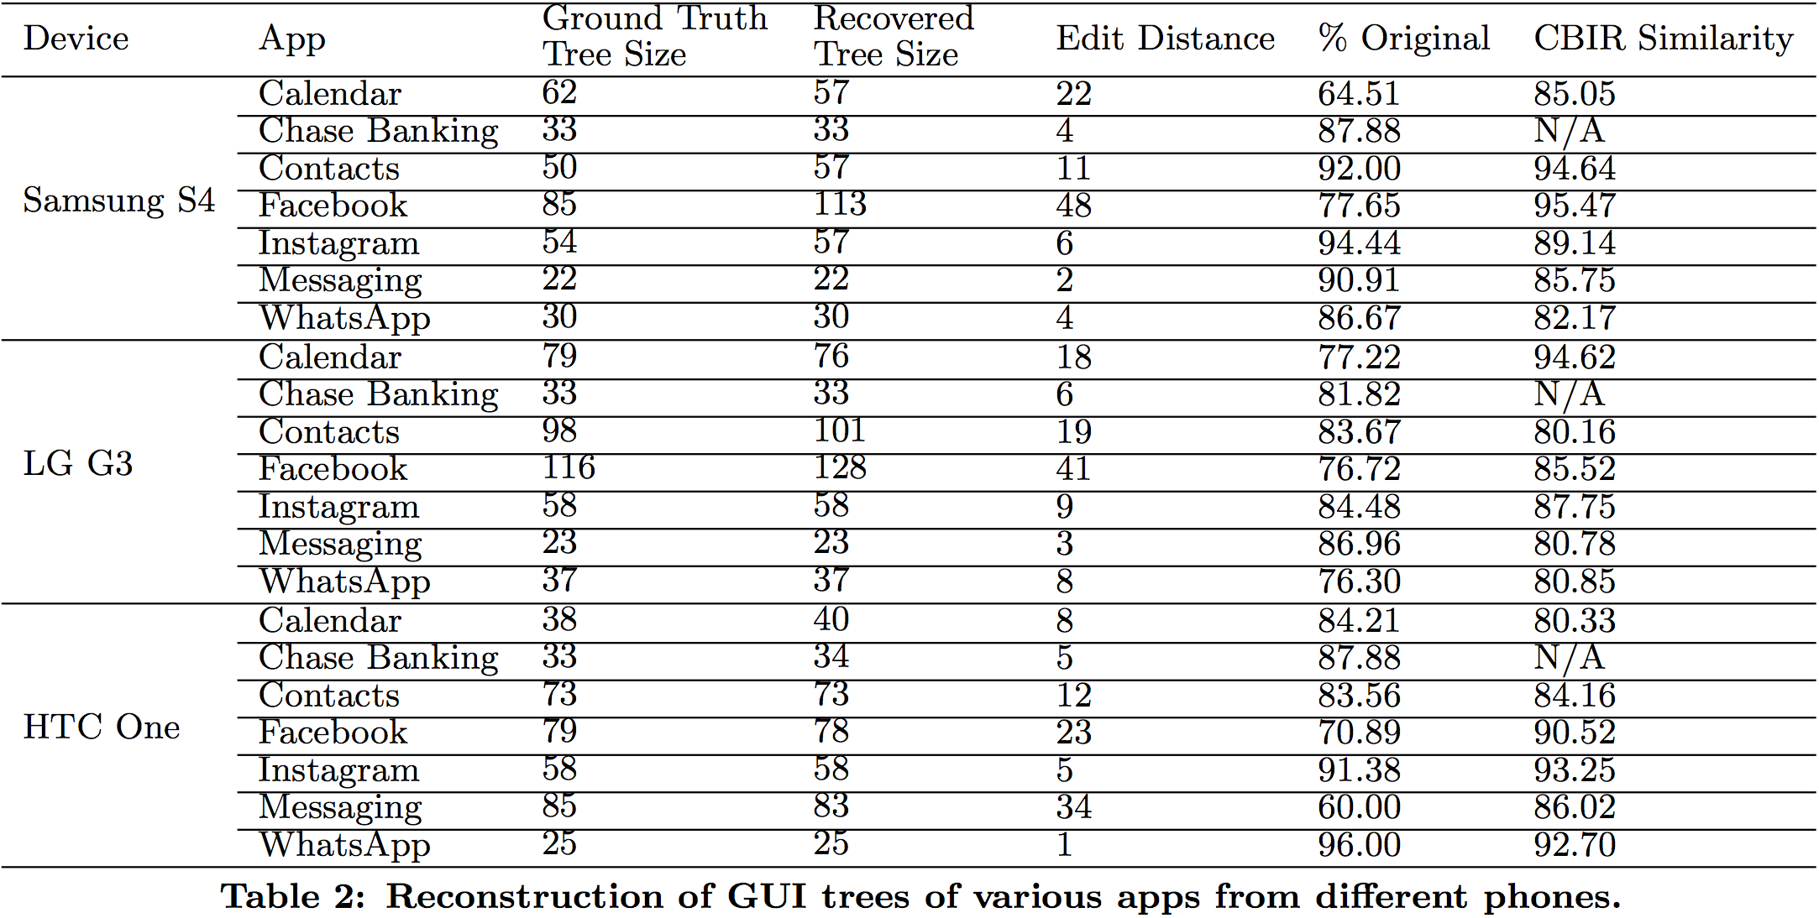
Evaluation: Reconstructed GUIs
Similar GUI trees
Small edit distances
Simple permutations
CBIR: 80.16%-95.47%

Slide 17
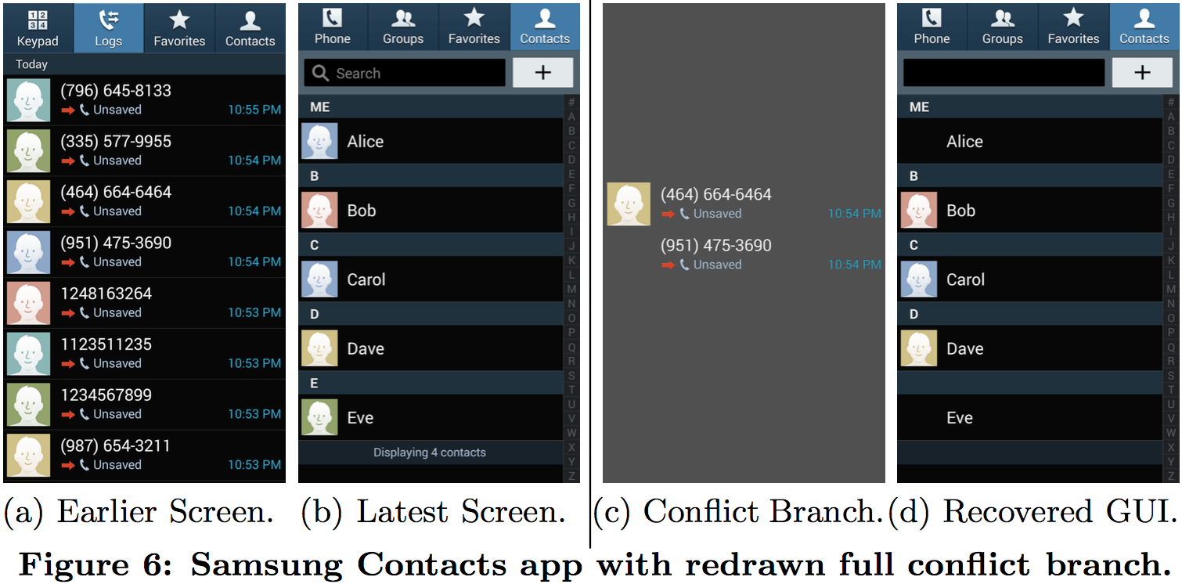
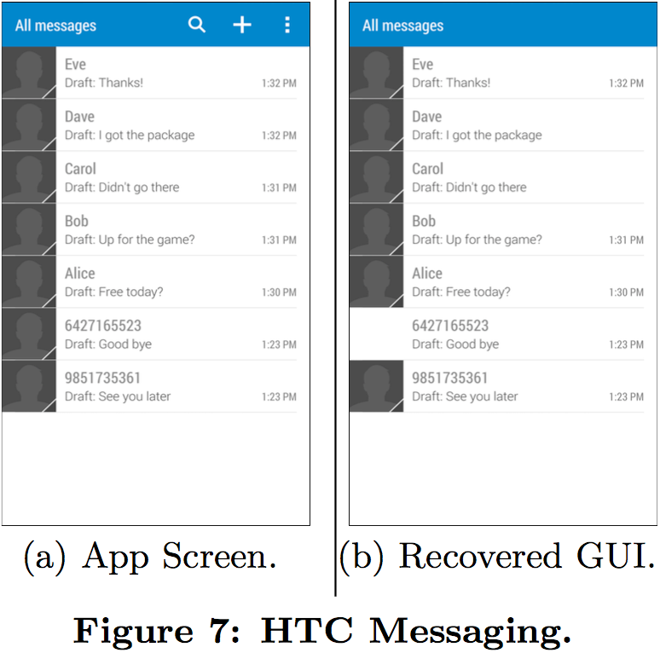
Evaluation: Reconstructed GUIs
7 larger GUI trees
Historic GUI data
Conflicting branches
4 smaller GUI trees
Too few data structures with visual GUI contents are recovered
It removes empty branches which result in blank areas in the recovered GUI

Slide 18
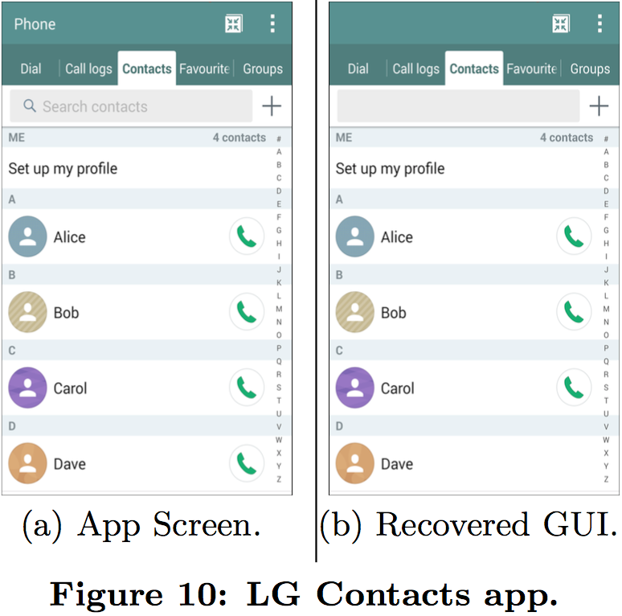
Evaluation: Reconstructed GUIs
Apps | Samsung Facebook | LG G3 Contacts
Edit Distance | 48 | 19
% Original | 77.65 | 83.67
CBIR Similarity | 95.47 | 80.16

Slide 19
Evaluation: Reconstructed GUIs

Slide 20
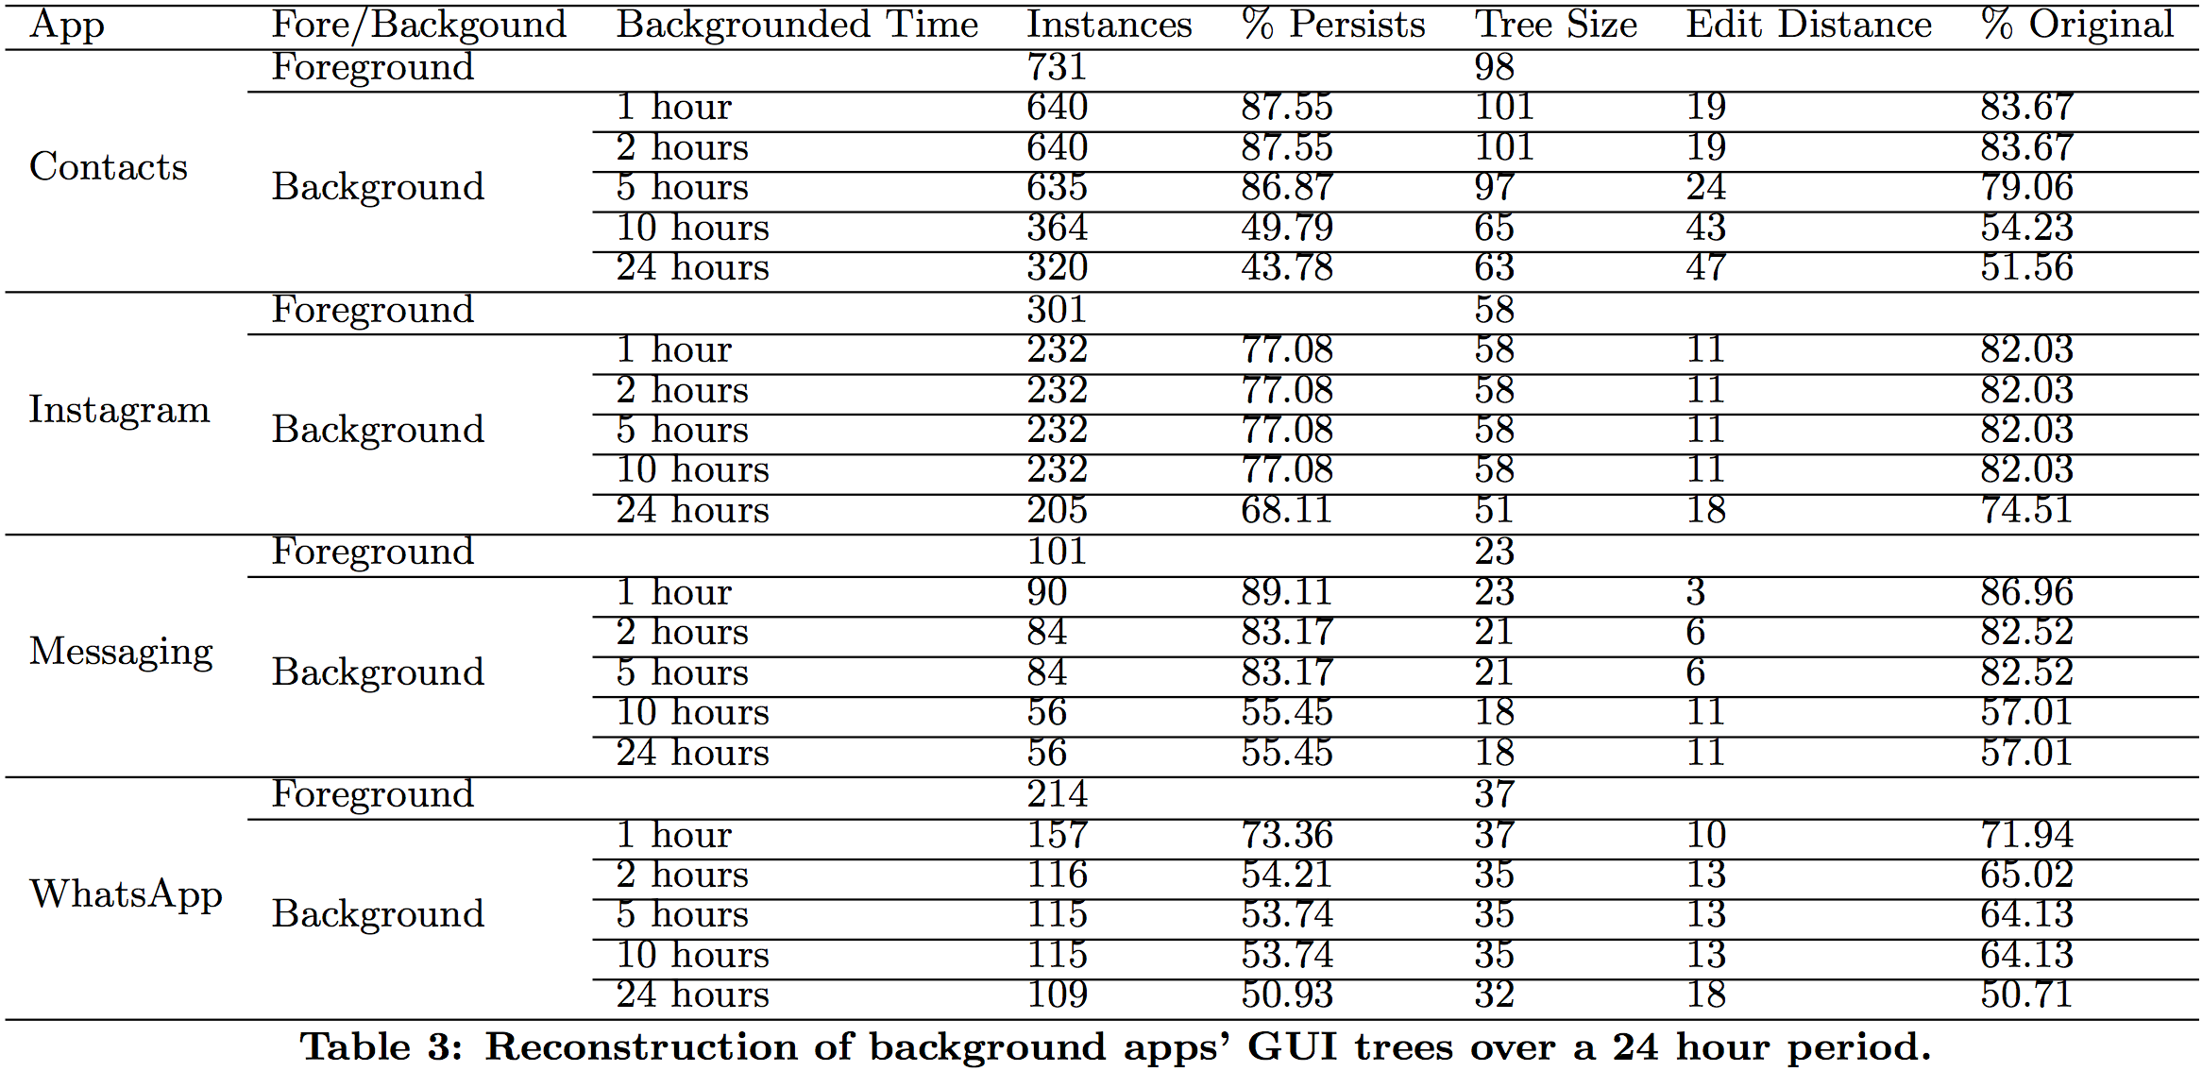
Evaluation: GUI Reconstruction Over Time

Slide 21
Evaluation: GUI Reconstruction Over Time

Slide 22
Summary
Conclusion
The paper presents a memory forensics technique called GUITAR to automatically recover and redraw Android GUIs from the memory image.
Instead of recovering individual data structures, GUITAR takes reallocated GUI data structures as input and pieces them together to recreate the original GUI.
Limitations
Highly depends on the performance of the recovery of GUI data structures
Highly depends on how OS deals with background apps (e.g., size of the free heap space)
Needs a balanced and complete bipartite graph for solving the weighted assignment

Slide 23
Questions
Why are there conflicting branches for the initially reconstructed GUI tree?
Why does GUITAR need to add fake DrawOpLists on the initial GUI tree?
Why are some reconstructed trees larger than their Ground Truth Trees?

