Slide 1
UCognito: Private Browsing without Tears
Meng Xu, Yeongjin Jang, Xinyu Xing, Taesoo Kim, and Wenke Lee
Present by Zhang He

Slide 2
Keywords
Privacy
Browser

Slide 3
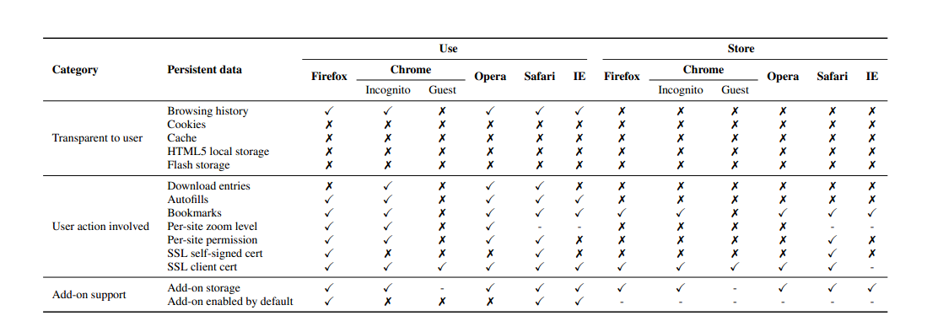
Private Browsing

Slide 4
Privacy Goals
Stealthiness: should not be stored
Freshness: persistent data should not be used

Slide 5
Overview
Research Problem
Existing Problem and Motivation
Major research
Uverifier
Ucognito
Evaluation
Conclusion
Quiz

Slide 6
Chrome and FireFox
How do they support the private browsing?

Slide 7
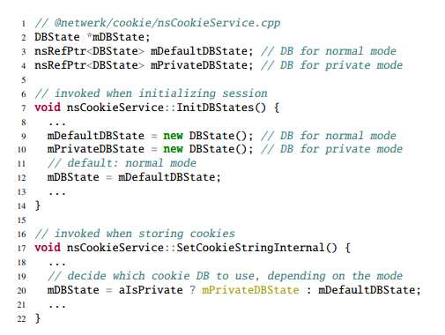
Complexity to implement

Slide 8
Bug report samples related to private mode implementation in Firefox and Chrome.

Slide 9
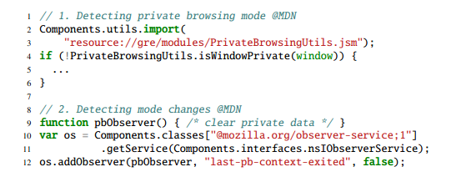
Limitation
Each add-on has to take a special care on private mode
This amount of complexity results in many privacy issues in popular add-on.

Slide 10
Caveat Interface for Add-on
FireFox: takes the approach of manual app re-view
Chrome:

Slide 11
Testing private browsing
Goal: employ a systematic way to identify and support the features/components that persist data during a browsing session
Environment:feasible with a small code base and in a slow development cycle

Slide 12
Overview
Research Problem
Existing Problem and Motivation
Major research
Uverifier
Ucognito
Evaluation
Conclusion
Quiz

Slide 13
Uverifier: Privacy Violation Detector
Three major components:
• a script-based driver that drives a browsing session
• a system call tracer
• an analyzer
Test:
• To test stealthiness goal, we run one private session (A) only.
• To test freshness goal, we run one public session (A) and one private session (B) consecutively.

Slide 14
Privacy Violations
OCSP cache
PNaCl translation cache
Nvidia’s OpenGL cache

Slide 15
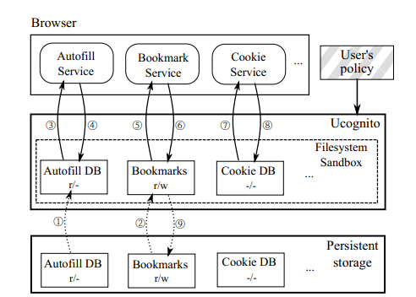
Ucognito
Filesystem sandboxing
Policy system kicks in at two points

Slide 16
Policy System
• CLEAN: create an empty file to prevent file-copying from the original user profile to the private profile
• COPY: copy a file or sub-directory to the private profile from existing user profile, to employ existing settings
• WRITE: allow data to be written back to the user profile after the session closes

Slide 17
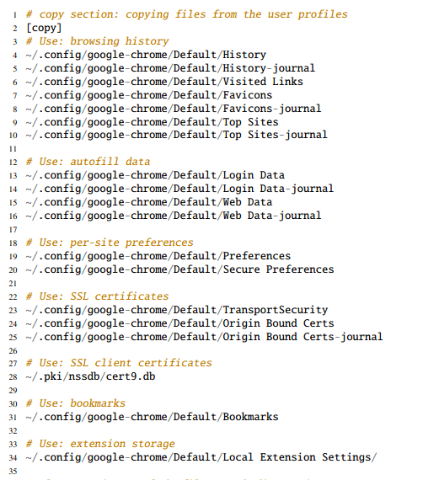
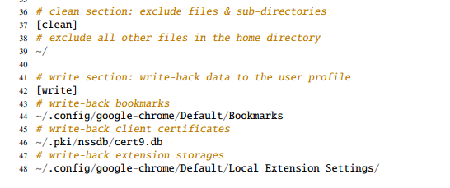
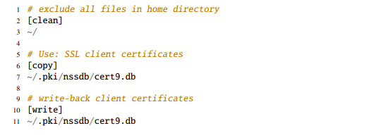
private mode of Google Chrome
guest mode of Google Chrome

Slide 18
IMPLEMENTATION
Sandboxing Layer
System call hooking:
Placed hooks on 50 system calls
Containing file access:
rewrite the path argument on each system call entrance
first argument (path) is on /home/user/.config
rewrite the path to
/tmp/ucognito-pid/home/user/.config

Slide 19
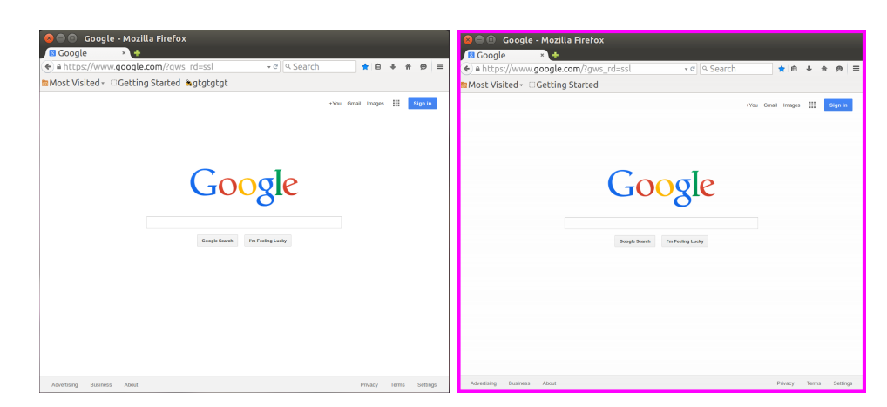
UI Layer

Slide 20
Launching a Private Mode
Example: Google Chrome web browser
Whole procedure:
1. Initialization phase
2. Browser starting phase
3. Browsing phase
4. Cleaning phase

Slide 21
Overview
Research Problem
Existing Problem and Motivation
Major research
Uverifier
Ucognito
Evaluation
Conclusion
Quiz

Slide 22
Evaluation
What are the use cases for UCOGNITO?
2. How flexible and general is UCOGNITO’s policy in implementing private browsing schemes of popular browsers?
3. How much is the performance overheads?

Slide 23
Preventing Privacy Violations
OCSP cache
PNaCl translation cache
Nvidia’s OpenGL cache
UCOGNITO is able to mitigate all these privacy violation cases

Slide 24
Supporting Add-ons

Slide 25
Policy Flexibility

Slide 26
Browsing Performance

Slide 28
Overview
Research Problem
Existing Problem and Motivation
Major research
Uverifier
Ucognito
Evaluation
Conclusion
Quiz

Slide 29
CONCLUSION
Problem:
Private browsing is not implemented consistently and correctly in major browsers
Contribution:
Uverifier
Ucognito
Stop all known privacy leaks
Overhead (1-2.5%)
Limitation:
Only applied to Chrome and FireFox
UCOGNITO on Linux

Slide 30
Overview
Research Problem
Existing Problem and Motivation
Major research
Uverifier
Ucognito
Evaluation
Conclusion
Quiz

Slide 31
Quiz
Q1:What is the most important thing(goal) of privacy browsing?
Q2:Why Ucognito doesn’t require to changing of browsers and system kernel?
Q3:When we use CLEAN policy, what shall we do if a path is specified as CLEAN?

Slide 32
Thank you!

