Slide 1
ZigZag: Automatically Hardening Web Applications Against Client-side Validation Vulnerabilities
CSCI 680 Advanced System and Network Security
Presented by Xianchen Meng

Slide 2
Background
Same Origin Policy
http://store.company.com/dir/page.html
URL | Result | Reason
http://store.company.com/dir2/other.html | Success
http://store.company.com/dir/inner/another.html | Success
https://store.company.com/secure.html | Failed | Different protocol
http://store.company.com:81/dir/etc.html | Failed | Different port
http://news.company.com/dir/other.html | Failed | Different host
Notes:
First, I will introduce an important background knowledge called same origin policy
the same-origin policy is an important concept in the web application security model. Under the policy, a web browser permits scripts contained in a first web page to access data in a second web page, but only if both web pages have the same origin. An origin is defined as a combination of URI scheme, hostname, and port number.^{[1]} This policy prevents a malicious script on one page from obtaining access to sensitive data on another web page.
Here is a example about same origin policy.
The source URL is http://store.company.com/dir/papge.html
And the first and second are from same origin and fit the same origin policy because you can see that they are from same host, have same protocol (http) and from same port (default port 80)
The last three examples are failed because the first one has different protocol https and second one has different port 81 and the third one from different host.

Slide 3
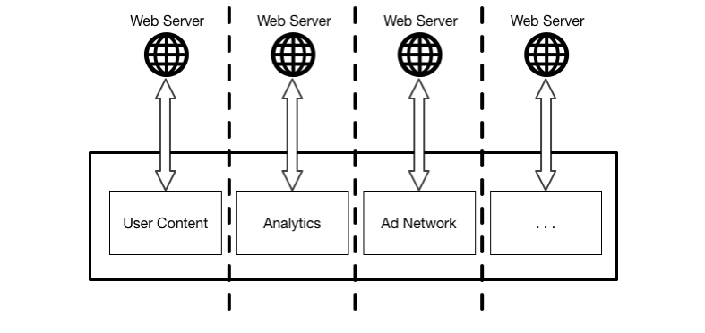
Background
Same Origin Policy
Image from:https://www.usenix.org/sites/default/files/conference/protected-files/sec15_slides_weissbacher.pdf
Notes:
This is a figure about same origin policy.
The javascript in different host can only operate themselves ,can not operate or visit the information on other web host, like cookies
For example, the advertisement network cannot visit the user content like user name or user password in the cookie because they are different origin from different host.
From this you can see that same origin policy is the basic security policy in web
Imaging without such policy, a malicious website can steal a real login page in bankofamarican or wellsfrago. When users try to login in their bank account, the malicious website can get all the information
It is aweful.
So the same origin policy can guarantee such situation will not happen.

Slide 4
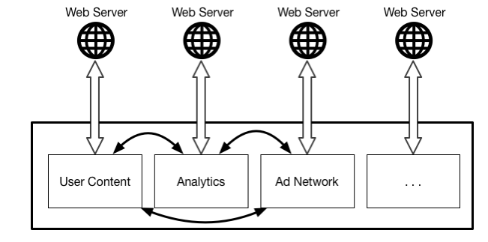
Background
HTML 5
API: postMessage
Image from:https://www.usenix.org/sites/default/files/conference/protected-files/sec15_slides_weissbacher.pdf
Notes:
Although same origin policy is great, but we still need some communications between different pages which are from different host.
Do you have met such situation that when you when you visit some shopping website and make a payment on the other website like some onlinebank website. The shopping website will not know whether you have paid or not so it always pop a dialog box, let you make a choice whether you have paid or not because in the same origin policy , the shopping website can not get information from a different host. It you choose yes I have already paid it , the shopping website will refresh the page and show the result.
But with this api: postMessage . The onlinebank website can post a successful message to shopping website and the shopping website will automatically refresh itself for users instead of refreshed manually by users
This is just a simple example, there are some other advantages without Same origin policy.

Slide 5
Background
While postMessage provides much greater flexibility to application developers, it also opens the door for vulnerabilities to be introduced into web applications due to insufficient origin checks or other programming mistakes.
postMessage
client-side validation vulnerabilities
Notes:
BUT!
While this provides much greater flexibility to application developers, it also opens the door for vulnerabilities to be introduced into web applications due to insufficient origin checks or other programming mistakes.
What we should concern is the security problems behind postMessage. It will cause client-side validation vulnerabilities because of the insufficient client-side validation.

Slide 6
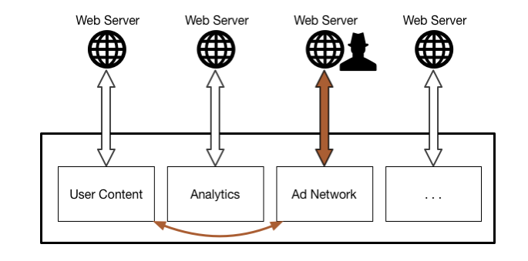
Background
client-side validation vulnerabilities
Image from:https://www.usenix.org/sites/default/files/conference/protected-files/sec15_slides_weissbacher.pdf
Notes:
Here is an example of the client-side validation vulnerabilities.
The attacker can pretend as ad network and steal the user content cookies if user content and ad network use postmessage to communicate with each other and the user content did insufficient client-side validation to recognize whether it is a real ad network or not.

Slide 7
Background
client-side validation vulnerabilities
function listener(event){
if (event.origin.indexOf("domain.test") != -1){
eval(event.data);
}
}
Developer must verify origin correctly
"domain.test.attacker.com"
Image from:https://www.usenix.org/sites/default/files/conference/protected-files/sec15_slides_weissbacher.pdf
Notes:
Here is the detail example of the insufficient client-side validation
You can see that the client-side validation is to verify whether the host contains domain.test. If it is then the javascript will think oh it is the real one , I can transmit data about user to it.
but the developer my did insufficient client-side validation because if a attacker use a url like domain.test.attacker.com, and the javascript will still think this is a real one, however, some sensitive data have been leaked into the attackers.

Slide 8
Outline
Background
Motivation
Example of webmail service
System overview
Learning phase
Enforcement phase
Invariant Detection and Enforcement
Program Generalization
Evaluation
Quiz

Slide 9
Motivation Email example
attacker
user
Notes:
Here is an example the author gave us in the paper.

Slide 10
Motivation Email example
attacker
user
Notes:
To tamper with the ad network, an attacker must be able to invoke postMessage in the same context. This can be achieved by exploiting XSS vulnerabilities from user content, framing the webmail service, or exploiting a logic vulnerability. Hence, the attacker has to send an email to a victim user that contains XSS code
That is the first step.

Slide 11
Motivation Email example
attacker
user
domain.test.attacker.com
domain.test
Notes:
When attacker get the postMessage pattern, he can create a malicious website, containing the same words domain.test like this because now he knows the user content component in email service will communicate with domain.test by postMessage which has client-side validation vulnerabilities.

Slide 12
Motivation Email example
attacker
user
domain.test.attacker.com
domain.test
Notes:
And then there will be communication between users content and domain.test.attackers.com, the fake one

Slide 13
Motivation Email example
attacker
Cookie leak
user
domain.test.attacker.com
domain.test
Notes:
And finally, the attackers will get the users cookie, gaining the information he wants from the users. That will cause cookie leak to attackers.

Slide 14
Goal
Secure JavaScript Apps
Harden the buggy Apps
the app like before: benign but buggy
Fully automatic
no developer interaction
Detection /defense in browser alone
no modification on browser
Prevent unknown vulnerabilities
Notes:
This paper want to create a method or implement some design to secure javascript apps.
First is harden the buggy apps. Just like the apps like before, it is benign but has bugs in it and make itself unsecure.
Second this design should be fully automatic and no developer interaction with it so that user can easily use.
Third the detection and defense should be done in browser alone and this design should not modify the browser.
And final one is it can prevent unknow vulnerabilities.

Slide 15
Zigzag overview
Anomaly detection system preventing CSV attacks
Instrumentation of client-side JavaScript
A proxy between client and server or an app
Two phases
Learning of benign behavior
Prevent attacks
Notes:
this is what the author implemented , a system called Zigzag
It has anomaly detection system preventing csv(client side validation) attacks
ZigZag can transparently instrument JavaScript programs
It can be a proxy between client and server or an app .
It is consisted of two phases: learning phase and enforcement phase

Slide 16
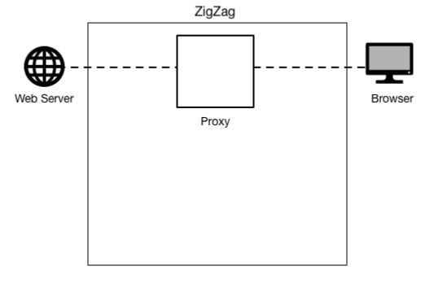
Learning Phase
Image from:https://www.usenix.org/sites/default/files/conference/protected-files/sec15_slides_weissbacher.pdf
Notes:
Let’s get to the first phase: learning phase. I will use some detail animation to illustrate these two phases.
Here is the structure of websever Zigzag and client browser.

Slide 17
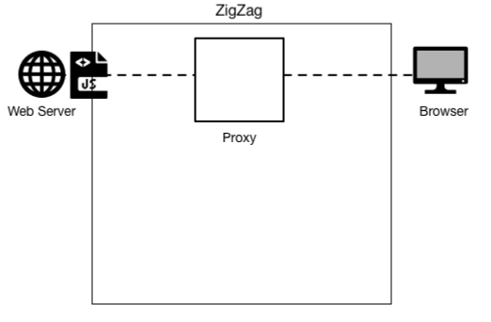
Learning Phase
Image from:https://www.usenix.org/sites/default/files/conference/protected-files/sec15_slides_weissbacher.pdf
Notes:
First a javascript file wants to be transmitted from webserver to the client

Slide 18
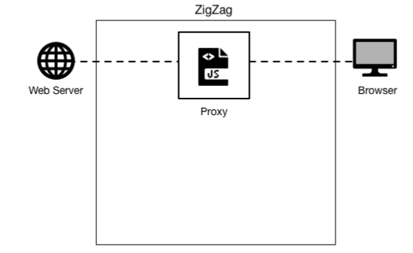
Learning Phase
Image from:https://www.usenix.org/sites/default/files/conference/protected-files/sec15_slides_weissbacher.pdf
Notes:
And then, because of the zigzag proxy , the javascript will be read by the zigzag system

Slide 19
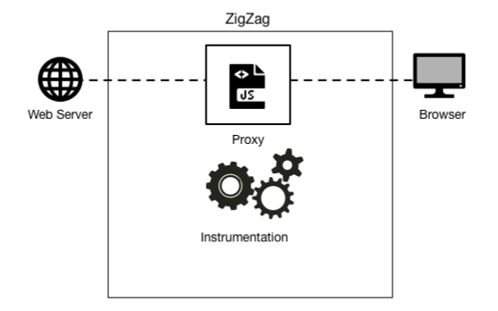
Learning Phase
Image from:https://www.usenix.org/sites/default/files/conference/protected-files/sec15_slides_weissbacher.pdf
Notes:
The zigzag system do instrumentation on the javascript file
Maybe you will confuse about the instrumentation I will talk about the detail later.

Slide 20
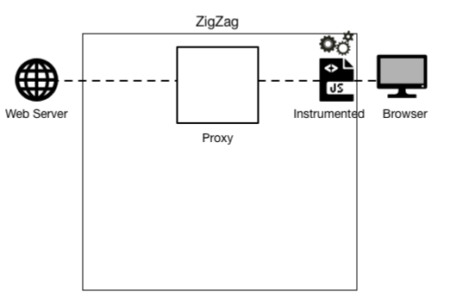
Learning Phase
Image from:https://www.usenix.org/sites/default/files/conference/protected-files/sec15_slides_weissbacher.pdf
Notes:
Then the instrumented js file has been sent to the client browser

Slide 21
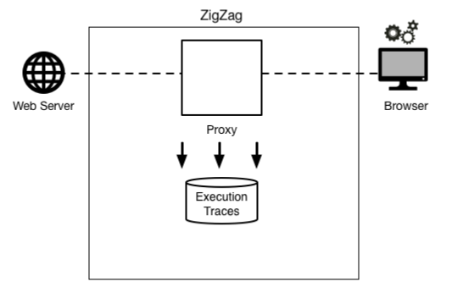
Learning Phase
Image from:https://www.usenix.org/sites/default/files/conference/protected-files/sec15_slides_weissbacher.pdf
Notes:
And when the browser begin to run the instrumented js file, the zigzag trace the execution of js file

Slide 22
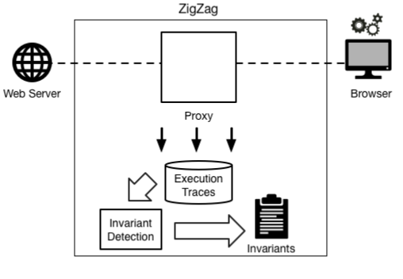
Learning Phase
Image from:https://www.usenix.org/sites/default/files/conference/protected-files/sec15_slides_weissbacher.pdf
Notes:
And do the invariant detection to find out which is the invariant when the js file runs. And finally the zigzag will store these invariants into an inventory and finish the learning phase.

Slide 23
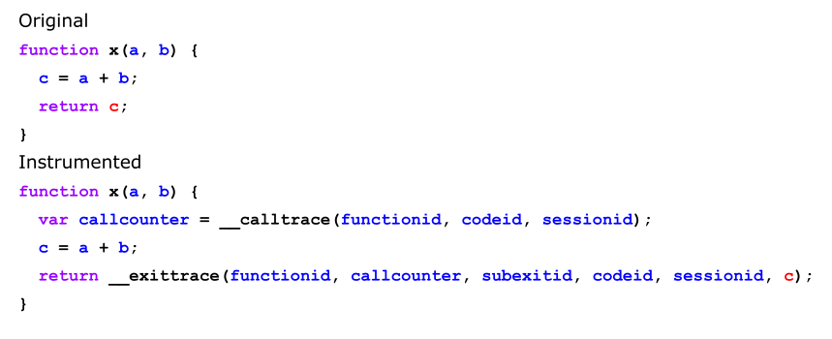
Instrumentation Details
Image from:https://www.usenix.org/sites/default/files/conference/protected-files/sec15_slides_weissbacher.pdf
Notes:
Here is the instrumentation details.
You can see the original js file like this .
C=a+b and return c; quite simple function.
And after instrumented, the zigzag add two function into this file calltrace and exittrace. Do you remember the trace execution?
When we run this file on client , the two added function will be run and the trace execution will be run. In learning method , the variants will be collect into an inventory and then exittrace and return c , finishing the function of the original one.

Slide 24
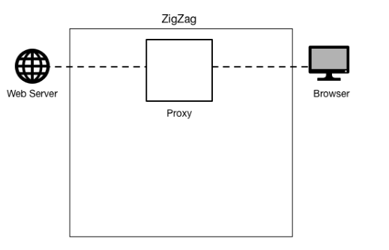
Enforcement Phase
Image from:https://www.usenix.org/sites/default/files/conference/protected-files/sec15_slides_weissbacher.pdf
Notes:
Here is the illustration about how the enforcement phase works.

Slide 25
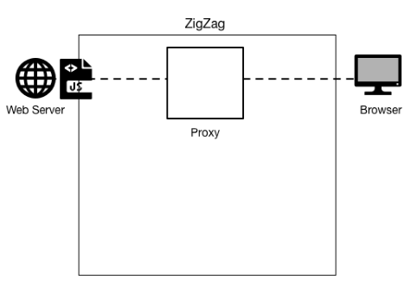
Enforcement Phase
Image from:https://www.usenix.org/sites/default/files/conference/protected-files/sec15_slides_weissbacher.pdf
Notes:
First the same as learning phase, the web server wants to transmit a js file to client

Slide 26
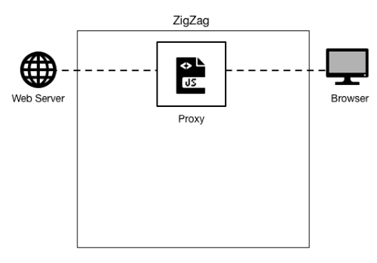
Enforcement Phase
Image from:https://www.usenix.org/sites/default/files/conference/protected-files/sec15_slides_weissbacher.pdf
Notes:
And then the js file get to the zigzag proxy like learning phase

Slide 27
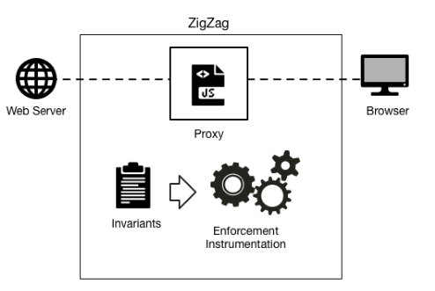
Enforcement Phase
Image from:https://www.usenix.org/sites/default/files/conference/protected-files/sec15_slides_weissbacher.pdf
Notes:
And then the zigzag instruments the js file and puts the invariants collected by the learning method into the enforcement instrumentation

Slide 28
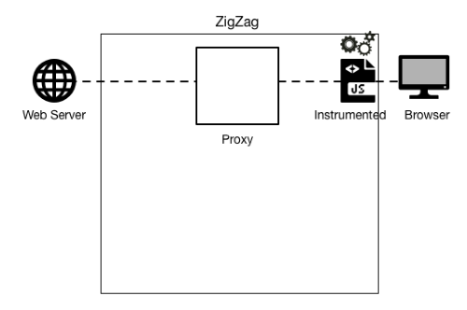
Enforcement Phase
Image from:https://www.usenix.org/sites/default/files/conference/protected-files/sec15_slides_weissbacher.pdf
Notes:
And the instrumented js file has been sent to the client

Slide 29
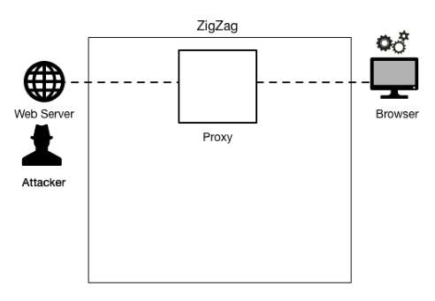
Enforcement Phase
Image from:https://www.usenix.org/sites/default/files/conference/protected-files/sec15_slides_weissbacher.pdf
Notes:
When the js file runs in the client browser, and assume that this is a malicious js file like the figure shows, may be sent by the attacker because of the csv vulnerabilities.

Slide 30
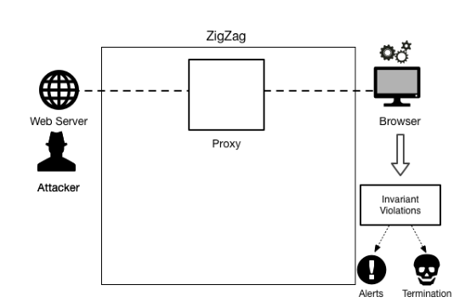
Enforcement Phase
Image from:https://www.usenix.org/sites/default/files/conference/protected-files/sec15_slides_weissbacher.pdf
Notes:
When the instrumented js file running , the invariants in this file will not fit the inventory of invariants collected by the learning phase . Encountering the invariant violation ,the zigzag will make alerts or terminate execution on the client.
The enforcement details will be introduced later in my presentation.

Slide 31
Invariant Detection
Invariants supported by ZigZag
Notes:
From the two phase mentioned above , we can know that the invariant detection is the one of most important parts in the zigzag system.
Here is a table shows the invariants supported by zigzag
We can see some simple example like data type numbers the invariants can be equality, inequality
The string data type , the invariants can be the length of this string ,isemail or not and so on

Slide 32
Invariant Detection
Univariate invariants
the length of a string
the percentage of printable characters in a string
the parity of a number
Multivariate invariants
x == y
x+5 == y
x < y
Notes:
The invariant can be divide into two kinds
One is univariate invariants and the other one is multivariate invariants
Here is some examples of univariate and multivariate invariants
the length of a string
the percentage of printable characters in a string
the parity of a number
Are univariate invariants
The equality and inequality like
x == y
x+5 == y
x < y
Are multivariate invariants

Slide 33
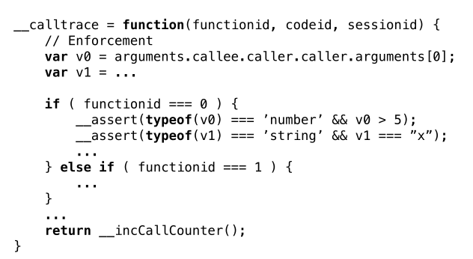
Enforcement Details
Notes:
invariant enforcement is another basic process in zigzag system.
Here is the details of enforcement
When we get the inventory of invariants, the calltrace will add these invariants into it and compare them with the variants collected in the new js files.
For example zigzag tests whether the typeof(v0) is number and v0>5 or not and whether typeof (v1) is string and v1= x or not.
If the new js files has vaiants violation, then the zigzag will alert or terminate the js file like I mentioned before.

Slide 34
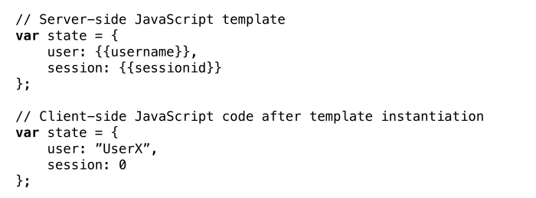
Program Generalization
Example of a JavaScript template
Notes:
Modern web applications often make use of lightweight templates on the server, and sometimes within the browser as well. These templates usually take the form of a program snippet or function that largely retains the same structure.
Here is an example of a javascript template
You can see that var state has very similar structure user: username and session sessionid.
There are many other template like timestamp , user identifier and so on .
The zigzag system can not recognize these template with different concrete data as a malicious js file.
So zigzag should do some generalization works.

Slide 35
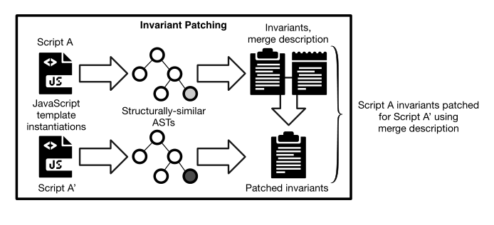
Program Generalization
Programs differ, but ASTs are similar
Notes:
Even if a template has different concrete data , their AST abstract syntax tree are similar.
So The zigzag can use AST to judge whether they have the same structure or not.
From this figure we can see that
After compare their AST, if similar , then merger there invariants inventory into a new one.
And zigzag will use the new patched invariants inventory to do the invariant enforcement work.

Slide 36
Limitations
The system was not designed to be stealthy or protect its own integrity if an attacker manages to gain JavaScript code execution in the same origin. If attackers were able to perform arbitrary JavaScript commands, any kind of in-program defense would be futile without support from the browser.
anomaly detection relies on a benign training set of sufficient size to represent the range of runtime behaviors that could occur. If the training set contains attacks, the resulting invariants might be prone to false negatives.
Notes:
Although the zigzag system has done a good job on preventing CSV vulnerabilities, it still has two main limitations
One is The system was not designed to be stealthy or protect its own integrity if an attacker manages to gain JavaScript code execution in the same origin. If attackers were able to perform arbitrary JavaScript commands, any kind of in-program defense would be futile without support from the browser.
The other one is anomaly detection relies on a benign training set of sufficient size to represent the range of runtime behaviors that could occur. If the training set contains attacks, the resulting invariants might be prone to false negatives.
So you should guarantee that the training procedure is benign so that zigzag can work well.

Slide 37
Evaluation
Four real-world vulnerable sites
Synthetic webmail application
Attacks caught
Functionality retained
Notes:
The author conducted the evaluation on four real-world vulnerable sites and a synthetic webmail application in the paper. I will just introduce some of the detail about the evaluation.
In the adition.com:This application is part of a European ad network. Zigzag has recognized that no origin check is performed in this app.
playforex.ru This application contains an incorrect origin check that only tests whether the message origin contains the expected origin (using indexOf), not whether the origin equals or is a subdomain of the allowed origin.
From the result given by the zigzag, zigzag can successfully catch some attacks and still retain the functionality.

Slide 38
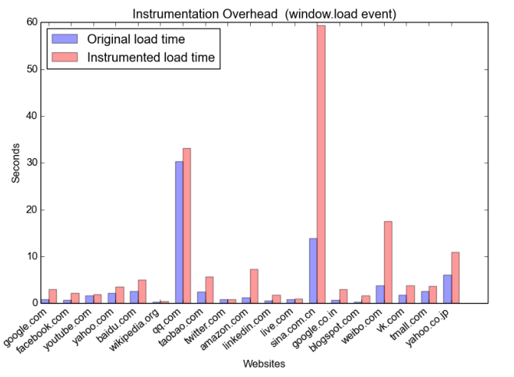
Performance
Median overhead: 2.01s
Notes:
This figure show the performance of zigzag, End-to-end performance benchmark on the Alexa 20 most popular websites
The blue bar is the original load time and the pink bar is instrumented load time.
We can see the instrumented load time is not much higher than the original load time except these one anomaly data.
sina.com.cn is an obvious outlier, with an absolute average overhead of 60 seconds. With 115 inlined JavaScript snippets and 112 referenced JavaScript files, this is also the strongest user of inline script. Due to the complexity of sina.com.cn, the zigzag doesn’t work well.
But the median overhead is 2.01s , which is quite good performance.

Slide 39
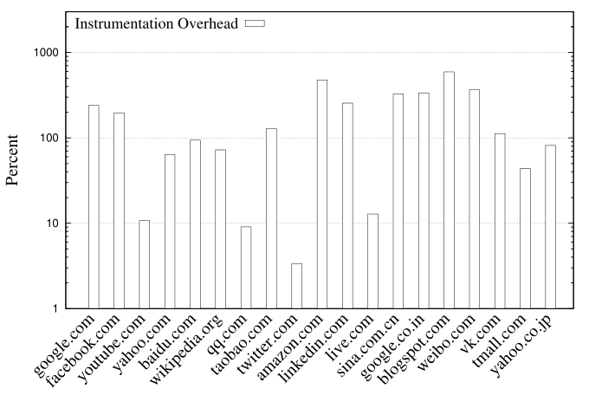
Performance
Median overhead: 112%
Notes:
This is the percentage of Overhead due to instrumentation
The median overhead is 112% which means zigzag will cost two times of the original load time.

Slide 40
Performance
0.66ms overhead
Notes:
To measure small-scale runtime enforcement overhead, we created a microbenchmark consisting of a repeated postMessage invocation where one iframe (A) sends a message to another iframe (B), and B responds to A
From this table we can see that the difference between uninstrumented and intrumented is 0.66 ms. Quite small overhead.

Slide 41
Contributions
In-browser anomaly detection system for hardening against previously unknown CSV vulnerabilities
Invariant patching: extending invariant detection to server-side templates
Extensively evaluate both the performance and security benefits of ZigZag
Notes:
The main contributions of the author’s work is
In-browser anomaly detection system for hardening against previously unknown CSV vulnerabilities
Invariant patching: extending invariant detection to server-side templates, a very common technique for lightweight parameterization of client-side code
extensively evaluate both the performance and security benefits of ZigZag, and show that it can be effectively deployed in several real scenarios, including as a transparent proxy or through direct application integration by developers

Slide 42
Quiz:
1.What are the two phases of Zigzag?
2.What are the two basic processes of Zigzag?
3.What are the two limitations the author mentioned of Zigzag?

