Slide 1
Sound-Proof: Usable Two-Factor Authentication Based on Ambient Sound
Nikolaos Karapanos, Claudio marforio, Claudio Soriente and Srdjan Capkun
Institute of Information Security
ETH Zurich
Presenter: Rongdong Chai

Slide 2
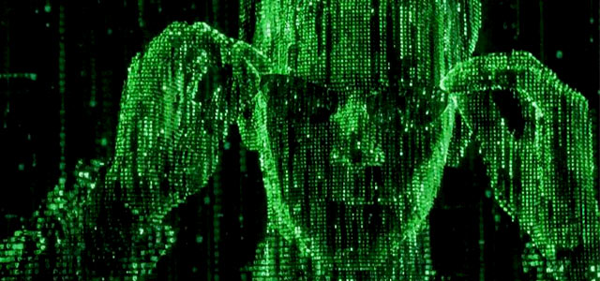
Weakness
Password-Only authentication sometimes is weak
Password => The word helping hacker pass your account

Slide 3
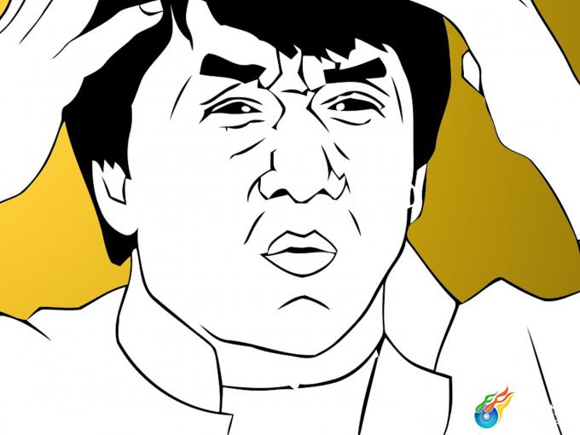
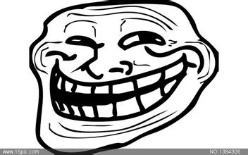
Helpless?
You
Attacker

Slide 4
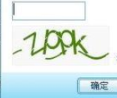
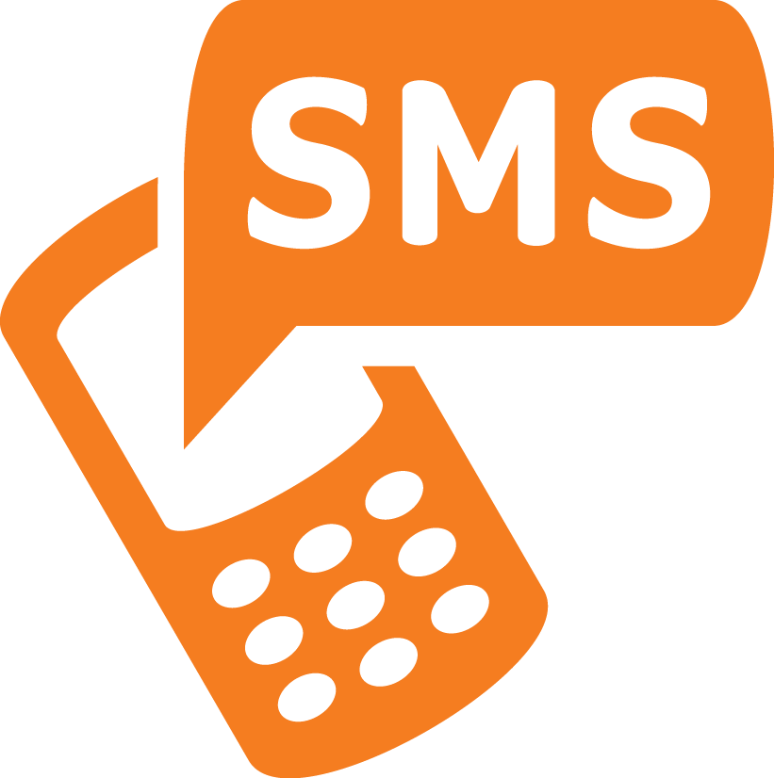
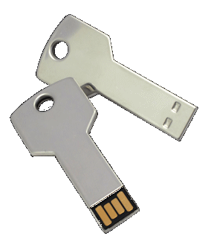
What to do
2 factor-authentication
Is it a good solusion?
Protect online accounts when password leaked
Require extra steps to log in
SMS
Portable device
Online code

Slide 5
Related Work
Traditional 2FA
Hardware tokens
Software tokens
Reduced-Interaction 2FA
Short-range Radio Communication
Near-ultrasound
Location Information
Other sensors

Slide 6
Assumptions
Attacker gained username and password
Attacker goal => authenticate to servers
Attacker wins if s/he convice servers that s/he hold the second authentication.

Slide 7
Assumptions
User phone CANNOT be compromised
Compromised phone
=
password-only authentication(one factor)
User computer CANNOT be compromised
Man-In-The-Browser attack -> hijack user’s session
=> defeat any 2FA mechanism

Slide 8
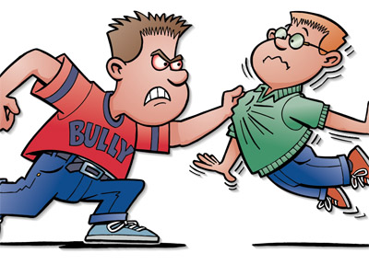
Ignore
Co-located attacker
Man-In-The-Middle adversary
[29] On the effective prevention of TLS man-in-the-middle attacks in web applications
Give me your phone or you die!

Slide 9
Important Background
One-thrid Octave Bands
Roughly 20Hz – 20kHz
10-> 1/3; 1->1/2
Cross-correlation
Standard measurement of two time series

Slide 10
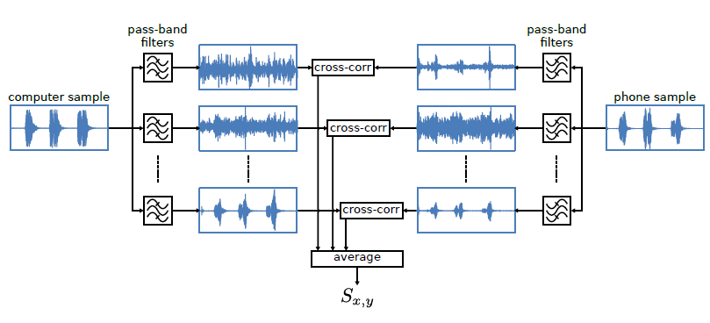
Sound-Proof Architecture
Similarity Computation Block

Slide 11
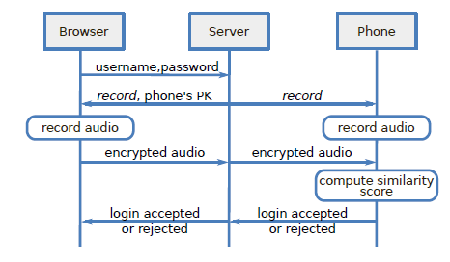
Sound-Proof Overview

Slide 12
Sound-Proof Weakness
Quiet Environment
User-made noise
Co-located Attacks
Secure phone-computer channel
User-phone interaction

Slide 13
Implementation
Web Server and Browser
Software Token
Time Synchronization
Run-time Overload

Slide 14
Evaluation
Important Parameters
Average power threshold
Highest clock difference experienced
Cross-correlation threshold
Contiguous octave bounds

Slide 15
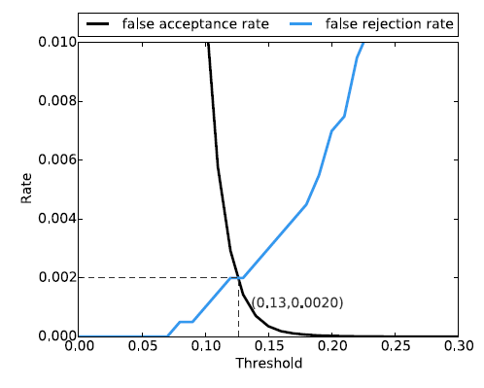
FRR/FAR with τ_{C}

Slide 16
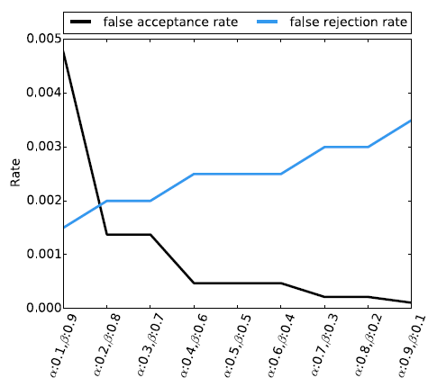
FRR/FAR in different cases

Slide 17
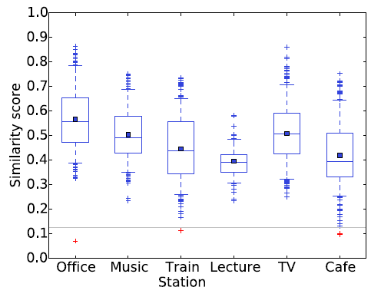
Environment Impact on FRR

Slide 18
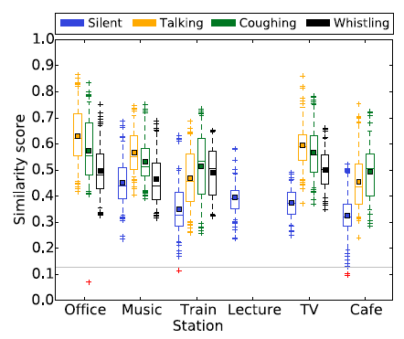
User Activity

Slide 19
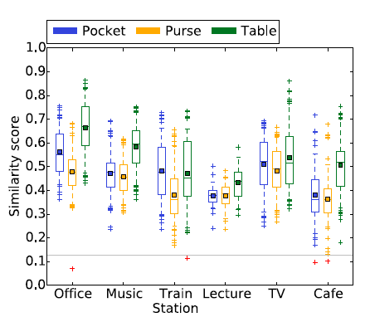
Phone Position

Slide 20
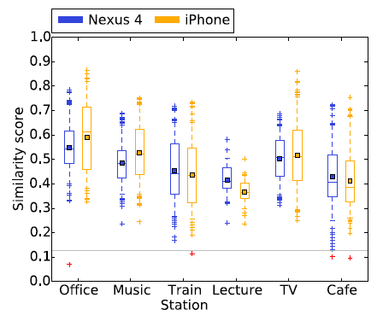
Phone Model

Slide 21
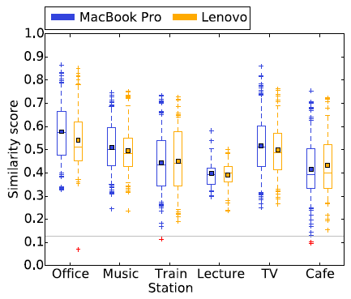
Computer

Slide 22
User Study
Goal: -- evaluate Sound-Proof
-- compare with Google 2FA
User unaware of the difference
System Usability Scale(SUS) score

Slide 23
Results
Demographics
SUS Scores
Login Time
Failure Rates
Post-test Questionnaire

Slide 24
Addition
Software and Hardware Requirements
Other Browsers
Privacy
Quiet Environments
Fallback to Code-based 2FA
Failed Login Attempts and Throttling
Login Evidence
Continuous Authentication
Alternative Devices
Logins from the Phone
Comparative Analysis

Slide 25
Contributions
Propose Sound-Proof
Prototype for both Android and iOS
Conduct user study

Slide 26
Conclusion
2FA mechanism – Sound-Proof
Work even in pocket/purse
More usable than Google 2FA
Prefer to use
Foster large-scale adoption

Slide 27
Quiz Questions
What will the author do if the ambient sound is too low?
What are the 2 reasons that makes the majority of users to choose Sound-Proof?
Is Sound-Proof 100% secure? Why?

Slide 28
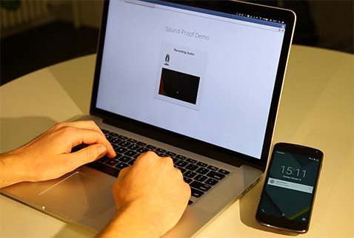
Thank You!

