Slide 1
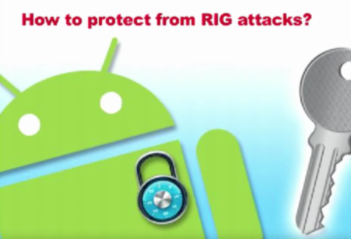
Leave Me Alone: App-level Protection Against
Runtime Information Gathering on Android
Nan Zhang∗, Kan Yuan∗, Muhammad Naveed†, Xiaoyong Zhou∗ and XiaoFeng Wang∗
Presenter: Fan Luo
Revised from authors’ slides

Slide 2
Road Map
RIG (Runtime Information Gathering)
Protection against RIG
Implementation and Evaluation

Slide 3
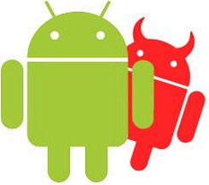
RIG Attacks
Runtime-Information-Gathering (RIG)
- Collect runtime information from target app (the victim)
- Directly steal or indirectly infer sensitive user information
1) Design weaknesses of the OS
shared communication channels such as Bluetooth
2) Side channels
memory and network-data usages
Notes:
In all these attacks, a malicious app needs to run side-by-side with the target app (the victim) to collect its runtime information.
RIG attacks exploit apps to obtain sensitive user data “ranging from phone conversations to health information;”
RIG, in this case, refers to “any malicious activities that involve collected data produced or receive by an app during its execution, in an attempt to directly steal or indirectly infer sensitive user information.”
Stealing of sensitive information from apps is always considered to be one of the most critical threats to Android security.
Recent studies show that this can happen even to the apps without explicit implementation flaws, through 1)exploiting some design weaknesses of the operating system, e.g., shared communication channels such as Bluetooth, and 2) side channels such as memory and network-data usages.

Slide 4
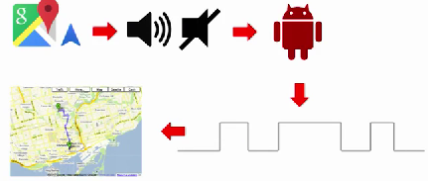
Android Permission Issues
Voice Recorder can tape any phone conversation.
Determine user’s driving route with Google Navigator
Game app with Bluetooth permission can also download patient data from a Bluetooth glucose meter
Notes:
Android user’s driving route could be determined by looking at sequences of the duration for the voice guidance produced by Google Navigator.
A malicious app can abuse the permission it gets “to directly collect sensitive data from the target app running in the foreground.”
a game app with the Bluetooth permission for connecting to its playpad can also download patient data from a Bluetooth glucose meter.”
An official app of an external medical device, such as a blood glucose meter, can be monitored for collecting patient data from the device through the Bluetooth channel, before the official app is able to establish its connection with the device.

Slide 5
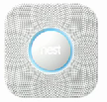
Android-based Internet of Things (IoT)
IoT Devices
1. Belkin NetCam Wi-Fi Camera with Night Vision
Designed for home surveillance and motion detection
Report to the house owner remotely
2. Nest Protect
Shipped 440,000 of its smoke alarms
in the United States between Nov. 2013 and Apr. 2014
Notes:
Android-controlled IoT devices such as Belkin NetCam Wi-Fi Camera with Night Vision and Nest Protect are equally vulnerable to RIG attacks.
runtime-information-gathering (RIG) attacks an emerging security threat to Android and Android-based Internet of Things (IoT) systems.
Belkin NetCam is a wireless IP camera designed for home surveillance and motion detection. It can detect burglars or other persons presence using motion detection and report the house owner remotely.
Malware monitoring popular Android-based home security systems can figure out when the house is empty and the user is not looking at surveillance cameras, and even turn off the alarm delivered to her phone.

Slide 6
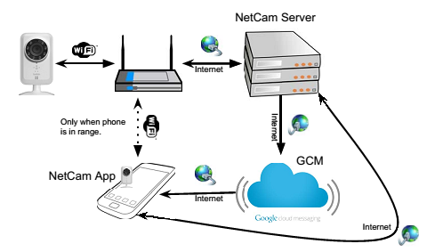
NetCam Communication Model

Slide 7
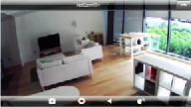
NetCam Attacks
Utilize two side channels
Traffic statistics: tcp_snd and tcp_rcv
CPU usage: /proc/<pid>/stat
Three steps
Infer if anybody is at home
Mute alarm
Infer anybody is watching surveillance
Motion Detection
Notes:
can be used by an adversary for malicious purposes such as theft or robbery.

Slide 8
How to Protect from RIG attack ?

Slide 9
Previous Works
Enhancing access control causes compatibility issues
+ Prevent information leaks during security-critical operations
such as phone calls
+ Remove public resources that could be used for a side-channel analysis
- Inevitably make the system less usable
- Cause compatibility issues
Notes:
modifying either the Android OS or the apps under the threat. Specifically, one can enhance Android’s access control mechanism to prevent information leaks during security-critical operations such as phone calls, and remove the public resources that could be used for a side-channel analysis. This, however inevitably makes the system less usable and causes compatibility issues for the apps that already utilize the public resources for legitimate purposes (mobile-data monitor [16

Slide 10
Previous Works
Modify OS
Complicated and painful (Android OS ecosystem: fragmentation)
New protection takes a long time before it can reach Android devices worldwide;
New RIG attacks continue to be brought to the spotlight;
It is less clear what an app can do by itself to control its information exposed by the OS.
Notes:
due to the fragmentation of the Android ecosystem deployment of any OS-level solution is often complicated and painful: whenever Google comes up with a patch, individual device manufacturers need to customize it for all their devices before passing its variations to the carriers, who will ultimately decide whether to release them and when to do that. Even in the case that the manufacturers are willing to build the protection into their new products, given the slow pace with which Android devices are upgraded, it is almost certain that the new protection will take a long time before it can reach any significant portion of the 1 billion Android devices worldwide On the other hand, new RIG attacks continue to be brought to the spotlight [2], [4], [5], [7], [17]–[19], effective mitigation is therefore in an urgent need for safeguarding Android users private information. Furthermore, pushing the problem to the app developers is by no means a good idea, as it is less clear what an app can do by itself to control its information exposed by the OS: for example, it cannot disable the recording activity of another app; also adding noise to an app’s CPU, memory and data statistics may not eliminate the side-channel leaks and certainly increases its performance overhead.

Slide 11
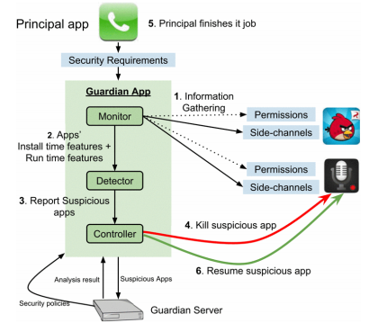
App Guardian
Information Gathering
- Permissions, side-channels
Install / Run time features
Report suspicious apps
kill suspicious app
Principal finished
Resume suspicious app
Notes:
The researchers proposed a novel technique to defend against “this new category of attacks;” they developed App Guardian, which “changes neither the operating system nor the target apps, and provides immediate protection as soon as an ordinary app (with only normal and dangerous permissions) is installed.” Their app thwarts a malicious app’s runtime monitoring attempt by pausing all suspicious background processes when the target app is running; it then automatically resumes them after the app stops.

Slide 12
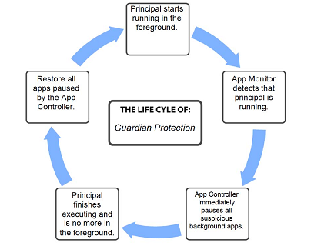
Life cycle of Guardian Protection
Normal Mode
Ward Mode
Notes:
Ward Mode

Slide 13
Monitoring

Slide 14
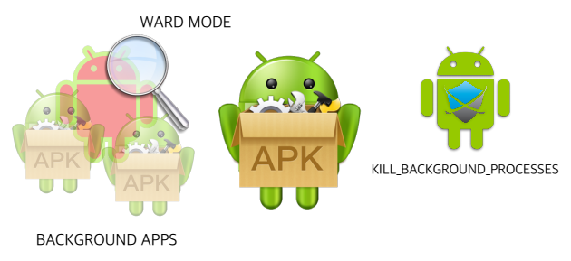
Entering the ward

Slide 15
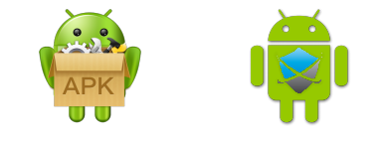
Entering the ward
oom_adj score (-17 ~ 15)
(typically) 9
2

Slide 16
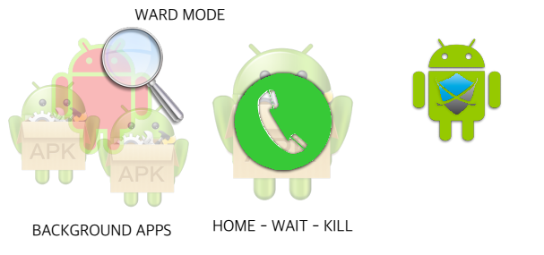
Exiting the ward

Slide 17
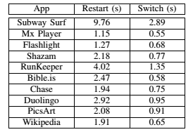
Impacts on Performance
Close an app which might be restarted later
+ App states are well preserved
- Take longer time than Switch to foreground

Slide 18
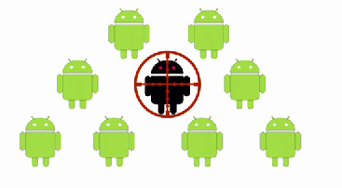
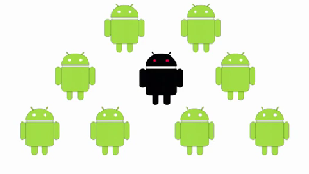
Finding suspicious App
Use malicious app’s side channel

Slide 19
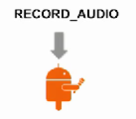
Finding suspicious App (Cont.)
Data Stealing Attacks
1. RECORD_AUDIO permission
2. Start Audioin_X process to record audio
(/proc/<pid>/task/<tid>/status)
Side-channel Attacks
How frequently app uses the CPU resources
Number of times schedule to use CPU

Slide 20
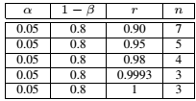
Behavior change
Challenge:
- keep low profile before the principal show up
- act aggressively afterwards
Solution:
Pearson correlation coefficient (r)

Slide 21
Collusion
Challenge:
Multiple apps sample at a lower rate but still collect sufficient information
Solution:
Grouping apps with same signature
Detect link-installed apps
Ask user if less obvious recommenendation

Slide 22
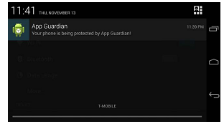
Self Protection
Use startForceground to start a service
Prevent it from killed by
KILL_BACKGROUND_PROCESSES

Slide 23
Evaluation and analysis

Slide 24
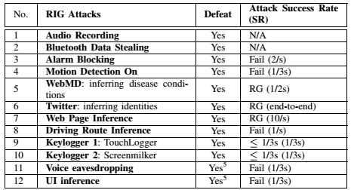
Effectiveness
Defeat all 12 RIG Attacks

Slide 25
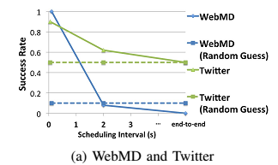
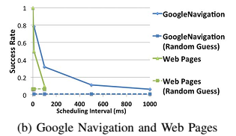
Effectiveness

Slide 26
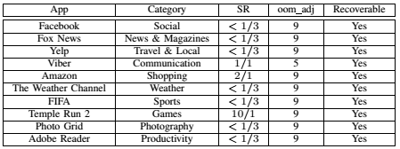
Utility Impacts and Performance
475 popular Apps from 27 categories on Google Play Store
- 92 apps (19.3%) apps potentially needs to be closed
- 8 apps (1.68%) may affect phone users’ experience

Slide 27
Overhead
CPU & Memory usage
Two Nexus5 phones with 250 apps installed on each
- In ward mode, 5% CPU Resource, 40MB Memory
- Out of ward mode, < 1% CPU
Battery Usage
Two Nexus5 phones with 50 apps installed on each
- In ward mode, 0.12% ~ 0.18% per hour
- Out of ward mode, 0.75% ~ 1.05% per day
- Estimate a day, 0.84~ 1.18% per day

Slide 28
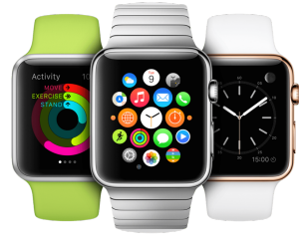
Discussion and future work
Detection and Separation A more accurate identification of malicious activities will help
Background process protection
Protect background process at minimal cost
Sanitization
Thoroughly clean up the principals’ execution
environment after the program stop running
Possible side-channel attack on iOS / WatchOS

Slide 29
Conclusion
Serious of RIG attacks on Android
IoT systems are also vulnerable
App Guardian
App level protection
Uses side channel to protect principle

Slide 30
Questions
1. Why there is an urgent need to mitigate the RIG threat to mobile devices ?
2. What have been achieved by App Guardian?
3. Two main idea of App Guardian ?

Slide 31
Thank you !

