Slide 1
What the App is That?
Deception and Countermeasures in the Android User Interface
CSCI680 Advanced Systems and Network Security
Authors: Antonio Bianchi, Jacopo Corbetta, Luca Invernizzi, Yannick Fratantonio, Christopher Kruegel, Giovanni Vigna
Presenter: Yongsen Ma

Slide 2
GUI Confusion Attacks
Many smartphone users trust applications such as mobile banking or shopping.
Mobile OSs usually run multiple apps concurrently.
GUI confusion attacks:
A malicious app M remains active in the background
M silently waits for the user to login into the bank app B
M changes its own appearance to mimic B’s user interface and “steals the focus”
The user insert personal banking credentials to the malicious app M

Slide 3
Related Works
GUI confusion attacks: only focus on specific attacks, like tapjacking, phishing, etc.
this paper generalizes these attacks and introduces some novel attacks.
GUI defense: augments the system keyboard
this paper extends the covered attack surface by considering more attack scenarios
Android malware analysis: only focus specific techniques
this paper focus on how users interact with different apps
security-related information: works for browsers
this paper use web-based methods to mobile systems

Slide 4
Contributions
Detail analysis of GUI deception attacks attackers can use to confuse users.
Two-layer defense to mitigate GUI attacks:
static analysis: identifies code that could launch GUI confusion attacks
on-device defense: an indicator securely informs app origins to users
A user study with 308 subjects evaluates the attacks and on-device defense.

Slide 5
Outline
GUI Confusion Attacks
Detection via Static Analysis
UI Defense Mechanism
Evaluation
Summary

Slide 6
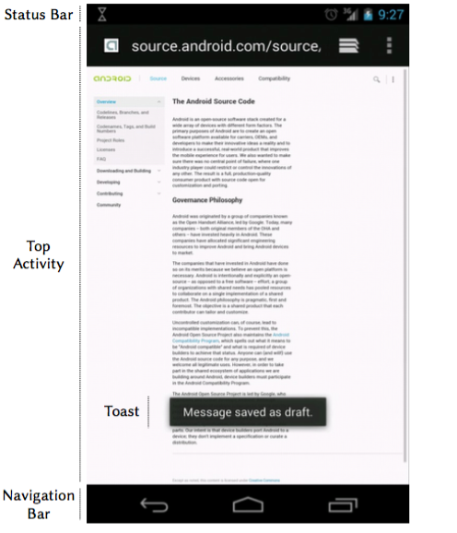
Android User Interface
Views: buttons, text fields, images, etc.
Activities: defines actions when the View elements are activated.
Windows: a virtual surface where graphical content is drawn as defined by the contained Views.

Slide 7
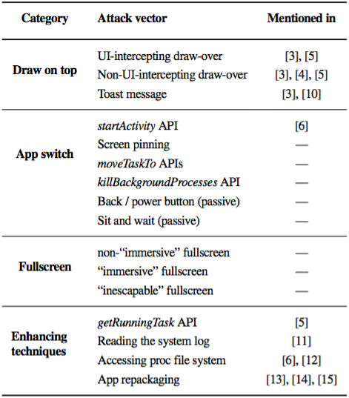
GUI Confusion Attacks
GUI confusion attacks allow for launching stealthy and effective phishing-style or click-jacking-style operations
Attack vectors:
Draw on top: draw graphical elements over others
App switch: steal focus from the top app
Fullscreen: draw on the device’s entire screen
Enhancing techniques:
detect how the user is interacting with the system
create graphical elements mimicking existing ones

Slide 8
Confusion Attack by Android GUI API
A tool checks how the main Android GUI APIs can be used to mount a GUI confusion attack
startActivity: how a newly-started Activity is placed on the Activities’ stack
The type of Android component calling startActivity.
The launchMode attribute of the opened Activity.
Flags passed to startActivity.
“inescapable” fullscreen Windows: an app can influence the appearance of a Window
Modifying the Window’s TYPE.
Specifying certain flags that determine the Window’s layout.
Calling the setSystemUiVisibility API with specific flags to influence the appearance and the behavior of the navigation bar and the status bar.

Slide 9
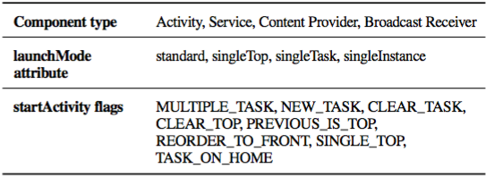
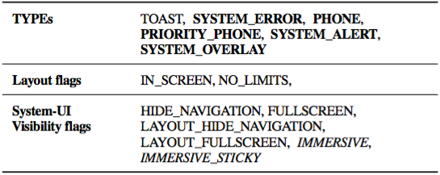
Confusion Attack by Android GUI API
An Activity is drawn on top of each other (Android 4.4) as opened by calling startActivity
from a Service, a Broadcast Receiver, or a Content Provider with the NEW_TASK flag.
from another Activity and it has the singleInstance launch mode.
from another Activity and certain launch modes and flags are used.
“inescapable” fullscreen Windows
Component types, flags, and launchMode values
Widow types and flags

Slide 10
Outline
GUI Confusion Attacks
Detection via Static Analysis
UI Defense Mechanism
Evaluation
Summary

Slide 11
Static Analysis of GUI confusion attacks
Input: apk file; Output: a summary of the potentially-malicious techniques that it uses
checks which permissions the app requires in its manifest
extracts and parses the app’s bytecode and identifies all the possible attack techniques
backward program slicing to check possible argument values of identified API calls
flag the app as (potentially) malicious by analyzing the app’s control flow

Slide 12
Detecting Attack Techniques
Identifying attack vectors and enhancing techniques
Draw on top: addView
App Switch: startActivity, moveTaskToFront, killBackgroundProcesses.
Fullscreen: setUiVisibility
Get information about the device state: getRunningTasks, system log, /proc
Application classification: an app is suspicious if
it tries to get information of the device state
it uses an attack vector
there is a path in the call graph where 1 happens and then 2 happens

Slide 13
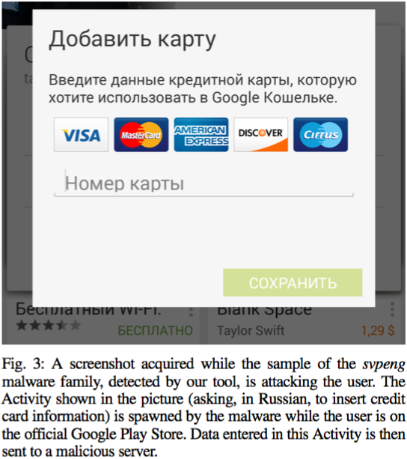
Detecting Results
benign1: 500 random apps from Google Play Store.
benign2: 500 “top free” apps from Google Play Store.
app-locker: 20 app-locker apps in Google Play Store.
malicious: 1,260 apps from Android Malware Genome.

Slide 14
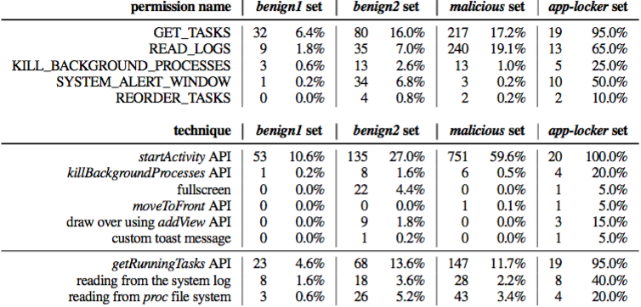
Evaluation: GUI Data Elements
Top: 3/5 permissions are frequently used by benign applications.
Bottom: just looking at API calls is not enough for detection.

Slide 15
Evaluation: Reconstructed GUIs
benign1: 2 suspicious -> 2 app-lockers
benign2: 26 suspicious -> 2 app-lockers
app-locker: 18/20 detected
benign2: 25 detected -> 21 DroidKungFu

Slide 16
Outline
GUI Confusion Attacks
Detection via Static Analysis
UI Defense Mechanism
Evaluation
Summary

Slide 17
UI Defense
Goal: establish a trusted path to inform the user without compromising UI functionality.
Which app is the user actually interacting?
Who is the real author of that app?
Conveying trust information to the user.
Principles:
Offering security guarantees comparable with how a modern browser presents a critical (i.e., banking) website, identifying it during the entire interaction and presenting standard and recognizable visual elements.
Allowing benign apps to continue functioning as if our defense were not in place, and not burdening the user with extra operations such as continuously using extra button combinations or requiring specific hardware modifications.

Slide 18
Detecting the Target App
Normally, the top Activity (and, therefore, the top app) is the target of user interaction, with two important exceptions:
Utility components such as the navigation bar and the status bar (Section II-A) are drawn separately by the system in specific Windows.
An app, even if not currently on top of the Activity stack, can di- rect a separate Window to be drawn over the top-activity Window.

Slide 19
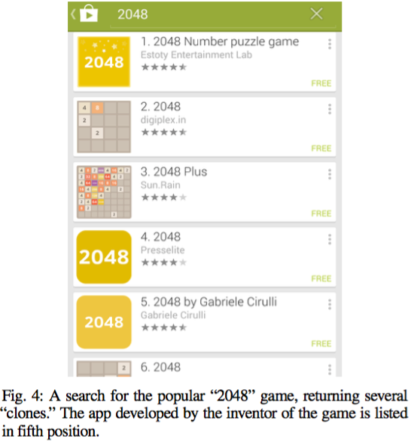
Detecting the App Author
Turn the unique identifier of an app into a message suitable for screen presentation
shows app’s developer name
uses Extended-Validation HTTPS to validate it
Other options
show app’s name as it appears in the market
must be unique and trustworthy
associates apps with domain names
no resist spoofing, lack of official vetting

Slide 20
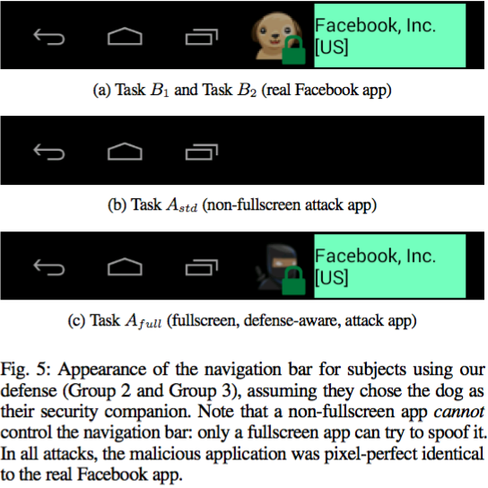
Conveying Trust Information to the User
choose the navigation bar as the “trusted” position that will behave like the URL bar.
dynamically change information shown on the navigation bar
Fullscreen apps
a “secret image” chosen by the user
unreadable by non-system applications
similar to “SiteKey” or “Sign-in Seal”

Slide 21
Detecting the Target App and its Author
Possible statuses of the screen
conveying trust information to the user

Slide 22
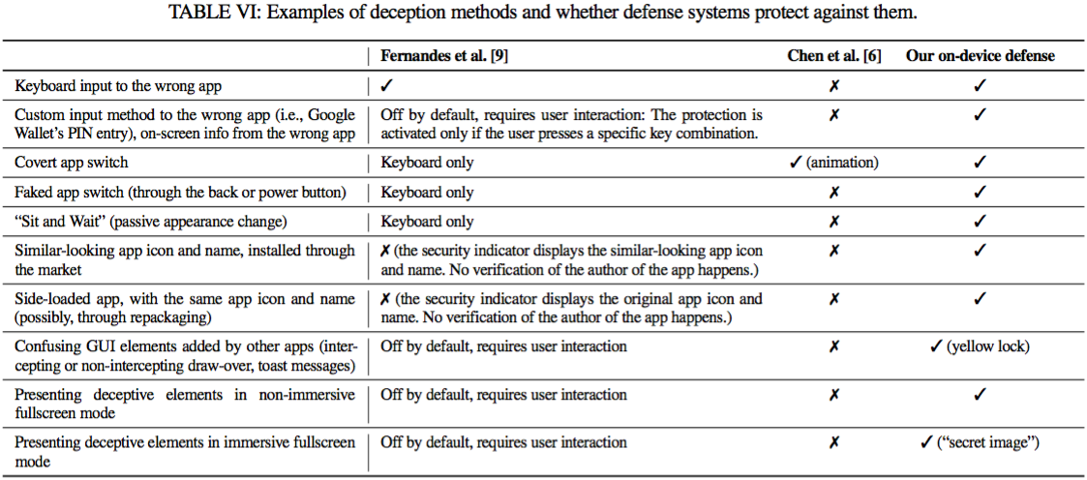
UI Defense: Overview

Slide 23
Outline
GUI Confusion Attacks
Detection via Static Analysis
UI Defense Mechanism
Evaluation
Summary

Slide 24
Evaluation
The effectiveness of GUI confusion attacks: do users notice any difference or glitch when a malicious app performs a GUI confusion attack?
How helpful our proposed defense mechanism is in making the users aware that the top Activity spawned by the attack is not the original one.
Amazon Mechanical Turk, noVNC client, hardware-accelerated emulated Android 4.4
Group 1: unmodified Android system w/o on-device defense
Group 2: system w/ on-device defense, w/o explanation of how it works
Group 3: system w/ on-device defense, w/ explanation of how it works

Slide 25
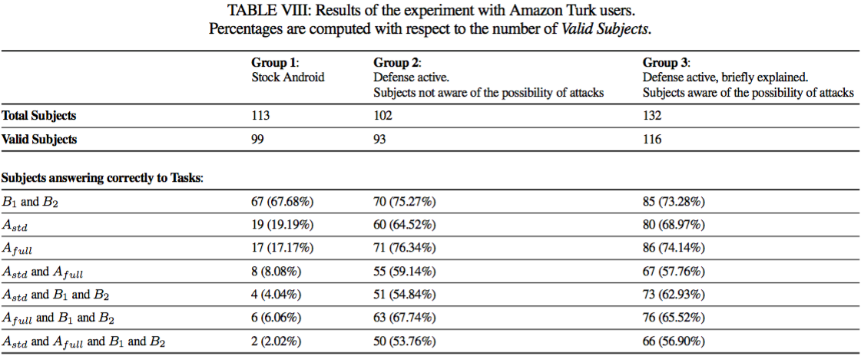
Evaluation Results

Slide 26
Outline
GUI Confusion Attacks
Detection via Static Analysis
UI Defense Mechanism
Evaluation
Summary

Slide 27
Summary
Contributions
detail analysis of Android GUI confusion attacks
two-layer defense to prevent GUI confusion attacks
a user study to demonstrate the effectiveness
Limitations
assumes Android OS is not compromised and the navigation bar is trusted
false alerts of common benign apps that create “always-visible” Windows
evaluation by the hardware-accelerated emulator but not real devices

Slide 28
Questions
What is a draw on top attack?
What causes the difference between sets benign1 (random apps) and benign2 (top apps) on detection results?
How to prevent a malicious application from inferring the “secret image” for fullscreen apps?

