Slide 1
Privacy Preserving Payments in Credit Networks
By: Moreno-Sanchez et al from Saarland University
Presented By: Cody Watson
Some Slides Borrowed From NDSS’15 Conference

Slide 2
What is a Credit Network?
Weighted directed graph used to represent credit
The graph represents unconsumed credit
Credit paths can have multiple different nodes
Banks and third parties can be intricately incorporated into the network

Slide 3
Real Life Example
Well I could loan that to you
I need 100$

Slide 4
Ok I owe you 100$. How about another 400?
No, I will only loan you a maximum of $400. You can loan me 100$ when I need it

Slide 5
$400
$100

Slide 6
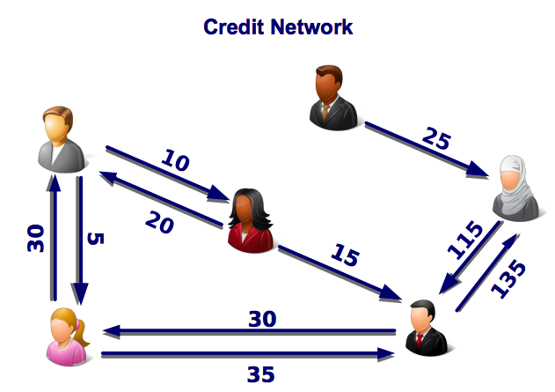
Credit Networks’ Size and Pattern
Networks can be very large and very intricate
Banks can be “users” contained within the network
Not just for credit, also for email (Ostra)

Slide 7
How Does the Network Work?
The weighted paths are decremented when used
Multipath allow different transfers to go through simultaneously
Multiple users can be involved in a single transaction

Slide 8
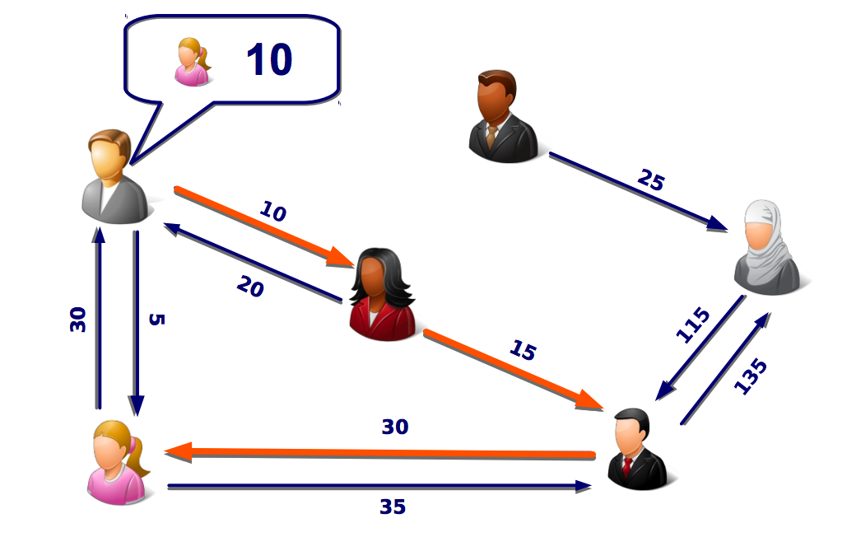
Example of Active Network

Slide 9
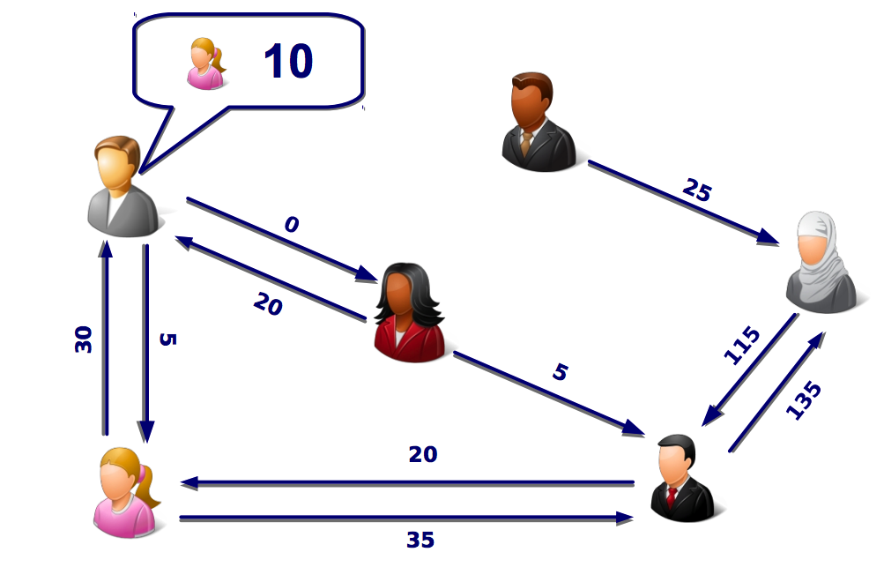
After Transaction

Slide 10
What Makes This Possible?
Universe Creator
This process creates a path between a sender and a receiver of credit through an intermediary node which we call a landmark
The Universe creator then produces a landmark universe by using a BFS algorithm to link all nodes to the landmark node with the shortest distance
Path Stitcher
Reads the landmark universe searching for a path for a given amount of credits to go through
If a path is found the transaction is carried out, otherwise the graph is unchanged

Slide 11
Who Runs These Networks?
Network service providers
Help stop DOS attacks by charging a small fee
Responsible for executing valid user requests
Has potential to view transactions and information to carry out correlation attacks

Slide 12
Outline
Background
What is the Problem?
Other Solutions
PrivPay
Value Privacy
Receiver Privacy
Modules
Limitations
Contributions
Performance Analysis & Evaluation
Conclusion
Quiz

Slide 13
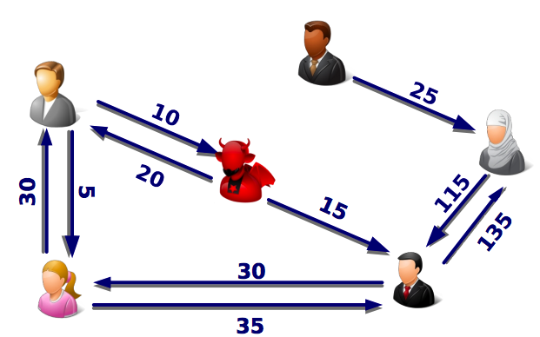
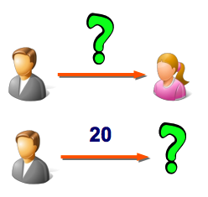
What is the Problem?
Credit networks are relatively new and one area of research that is lacking is privacy
The two main areas where privacy is needed is value privacy and receiver privacy

Slide 14
Other Solutions
Simple Anonymization
Ineffective because all transactions are linkable to each other and susceptible to deanonymization attacks
Decentralized solutions: Only system users are to be trusted with credit links
Availability and efficiency plummet since service providers cannot perform transactions without the users presence online
Holding back credit values but providing the topological network graph
Correlation attacks and revealing of actual identity of users

Slide 15
PrivPay
Proposed solution for the problem
Must achieve the goals of performance, accuracy, rate limiting, generality and scalability
Relies on small trusted execution environment which runs novel oblivious algorithms without revealing any information
Requires SC (secure processor) hardware as well as ORAM which is oblivious to data

Slide 16
High Level Idea of Value Privacy
Both ideas of privacy are based on a complicated game played by the attacker and challenger.
This game demonstrates a simple concept. That the attacker cannot determine with certainty the value of the transaction between two parties.
Implementation of balanced transactions

Slide 17
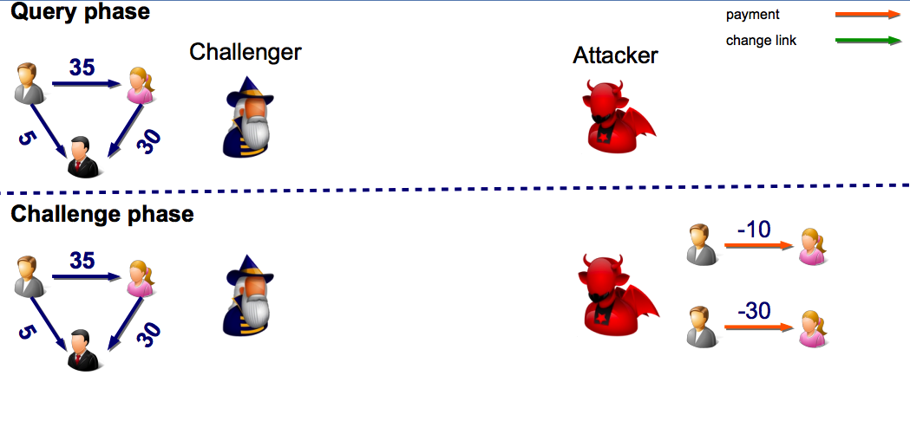
Balanced Transaction Process

Slide 18
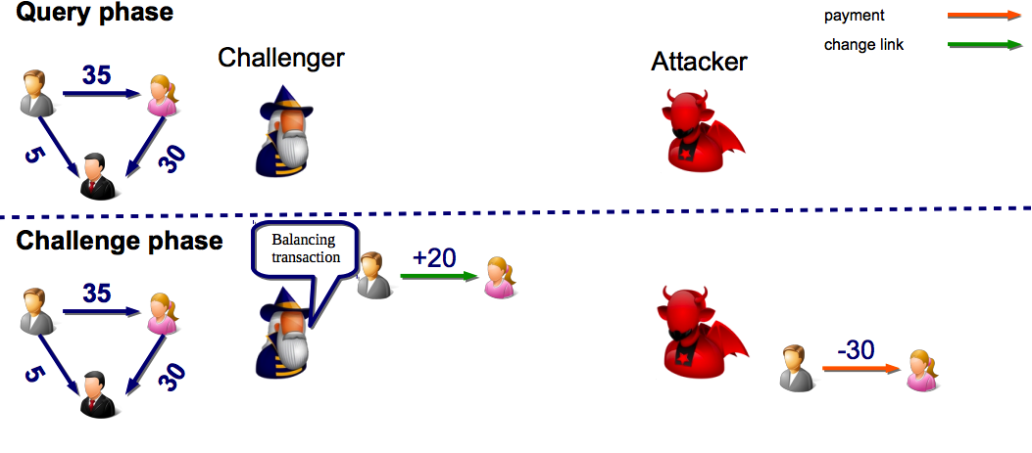
Challenger Balances

Slide 19
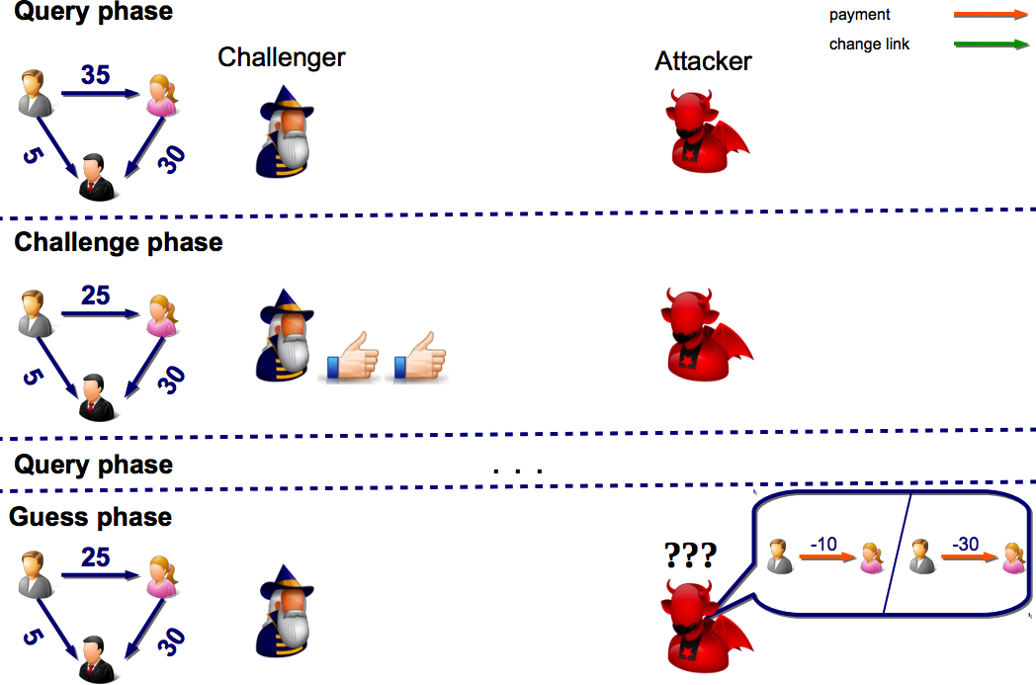
Confusion

Slide 20
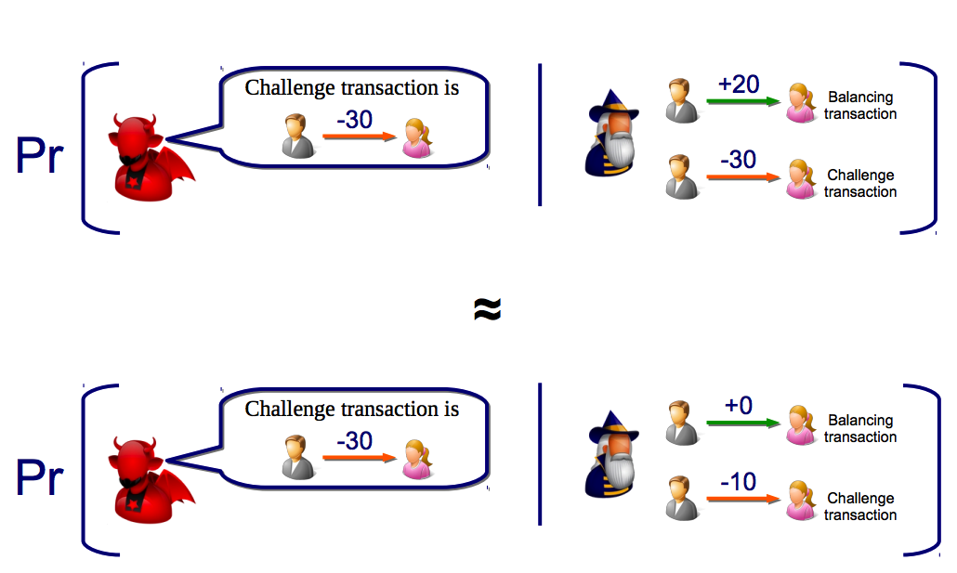
Final Result

Slide 21
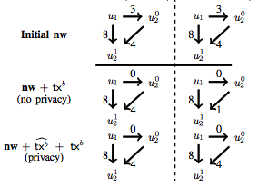
Receiver Privacy
The attacker cannot know who the receiver is
Solve by similar process to value privacy

Slide 22
PrivPay Modules
Universe Creator Module
Uses oblivious BFS algorithm to compute paths
Results in landmark universe
Transaction Module
If credit is available it makes the payment
Finds shortest path from sender to landmark node and from landmark node to receiver

Slide 23
Limitations of PrivPay
Requires a private communication channel with service provider
Requires hardware and correct implementation of hardware to protect landmark universe and data
Added overhead
Assumptions
User can set up private communication channel with service provider
Network graph is stored in pre-processed data storage in ORAM
Keys are managed by the SC hardware

Slide 24
Contributions
Data oblivious algorithms for creation of network
No need for computational cryptography on user end
Formalize privacy properties of interest for credit networks
Can implement immediately due to low dependencies

Slide 25
Evaluation
Security analysis showed PrivPay has…
Oblivious BFS algorithm for creation
Privacy for memory
Value privacy
Reciever privacy
Noted that algorithms could be optimized
Implemented on Ripple for 4 months
Composed over 20,000 transactions

Slide 26
Performance Evaluation
1.5 seconds to carry out pay and chglink methods for the network.
Change credit link = 0.1 seconds
22 seconds for ObliBFS algorithm
95% accuracy compared to 97% state of the art
It is scalable to Ripple which had over 24,000 nodes and about 50,000 links

Slide 27
Comparison
Time is in ms

Slide 28
My Opinion
Paper had many theorems with only rough proofs of each.
Evaluation was weak because it compared with one other approach and it did worse
Not convinced the time delay is acceptable in their comparative approach

Slide 29
Conclusion
Established the privacy goals and implementations needed to complete those goals
Demonstrated value and receiver privacy
Implemented PrivPay in order to complete goals for credit network privacy
Created Theorems and short proofs for goals and evaluated approach

Slide 30
Quiz
Name the two types of privacy that are essential for credit networks?
What do balance transactions do?
What does the Path Stitcher do?

