Slide 1
GenoGuard: Protecting Genomic Data against Brute-Force Attacks
Zhicong Huang, Erman Ayday, Jacques Fellay, Jean-Pierre Hubaux, Ari Juels
Presented by Chuong Ngo

Slide 2
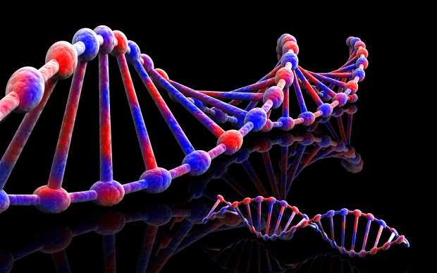
The Genomic Future

Slide 3
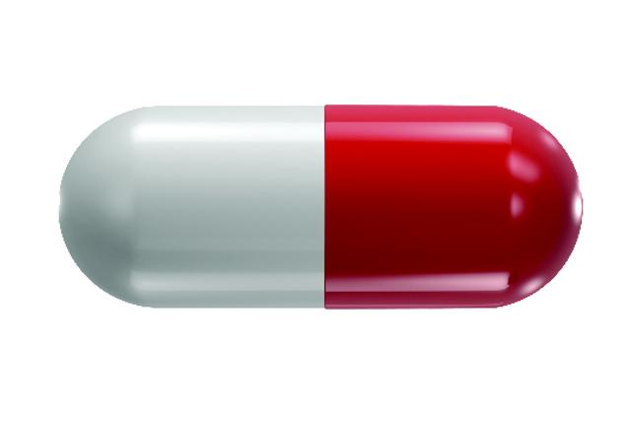


The Genomic Future

Slide 4
The Genomic Future

Slide 5
The Genomic Future

Slide 6

The Genomic Future

Slide 7

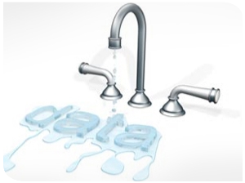
The Dangers of the Genomic Future

Slide 8
The Dangers of the Genomic Future

Slide 9
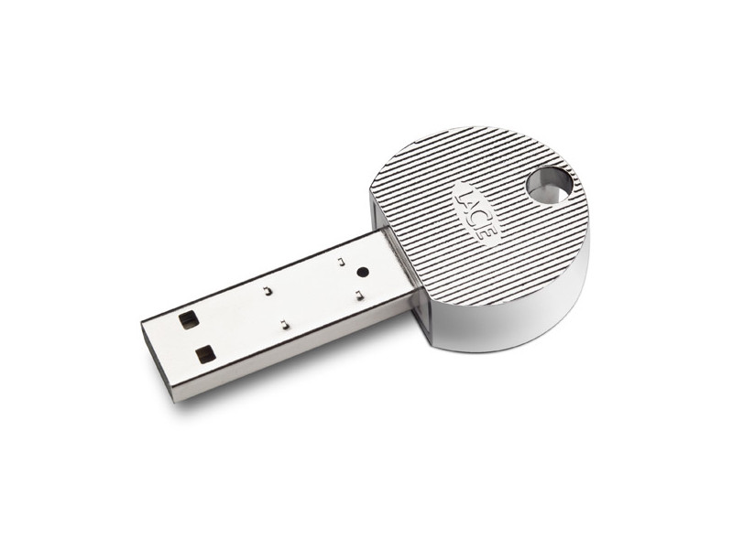

The Current Landscape

Slide 10
The Current Landscape

Slide 11
The Current Landscape

Slide 12
GenoGuard is honey encryption with n-gram derived seeds.

Slide 13
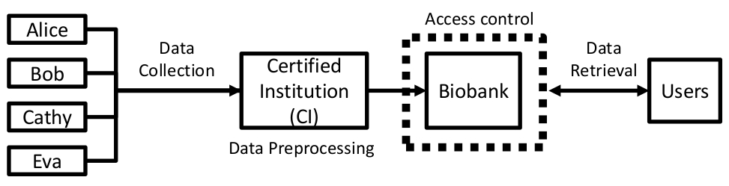
GenoGuard - System Model

Slide 14
GenoGuard - System Model
Protection Mechanisms (e.g. encryption)

Slide 15
GenoGuard - System Model
Authentication
Protection Mechanisms (e.g. encryption)

Slide 16
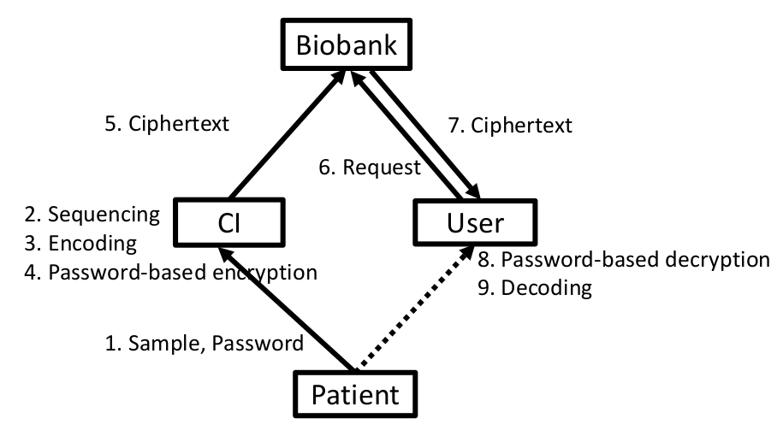
GenoGuard - Protocol

Slide 17
GenoGuard - Encoding
(0, 2)
Encoder
Seed
PBE
Single Nucleotide Variants
Encrypted Seed

Slide 18
GenoGuard - Encoding
0
2

Slide 19
GenoGuard - Encoding
[0, 6)
0

Slide 20
GenoGuard - Encoding
0
2
[0.54, 6)

Slide 21
GenoGuard - Modeling
Linkage disequilibrium and allele frequency
K-th order Markov chains
Recombination rates

Slide 22
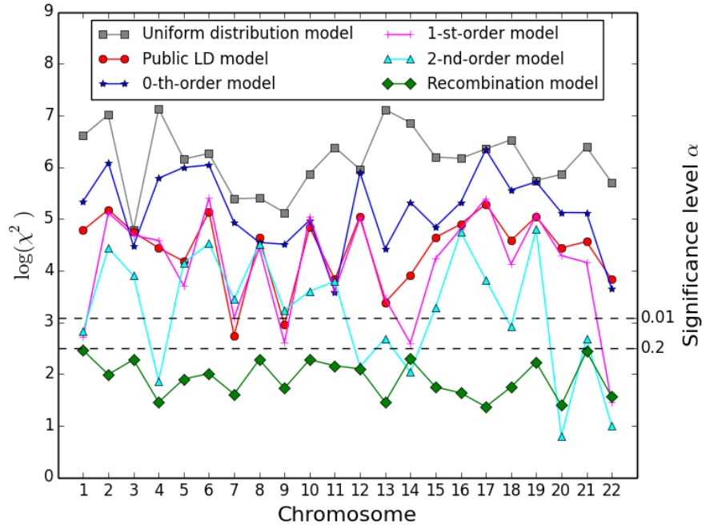
Evaluation - Model Fitness

Slide 23
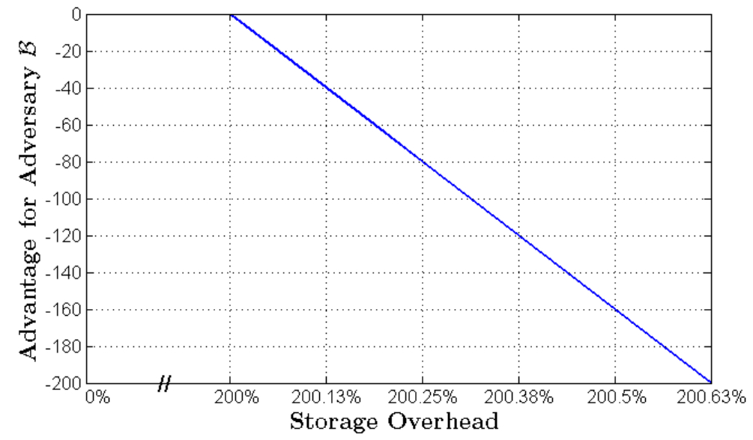
Evaluation - Storage Overhead

Slide 24
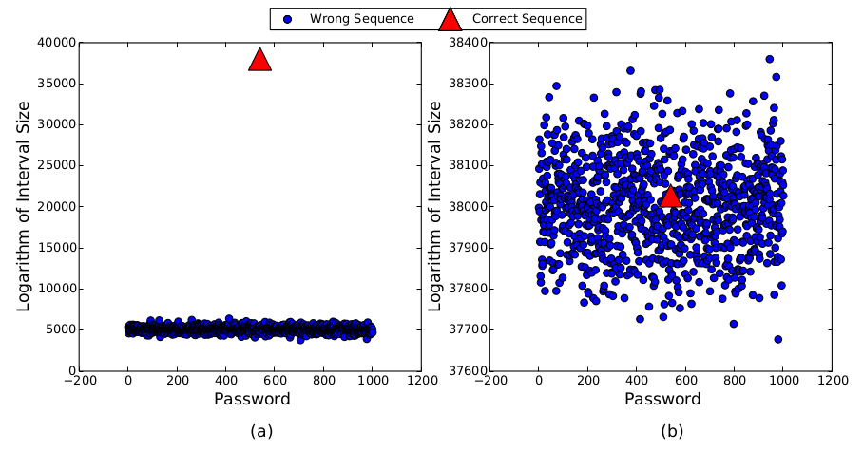
Evaluation - Experimental Security

Slide 25
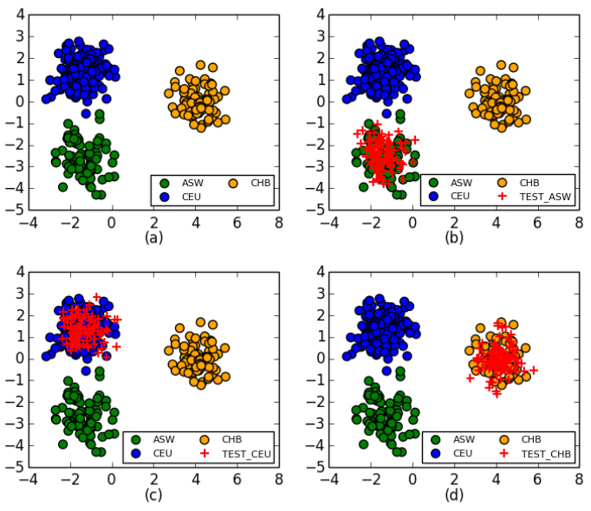
Side Attacks - Ancestry Compatibility

Slide 26
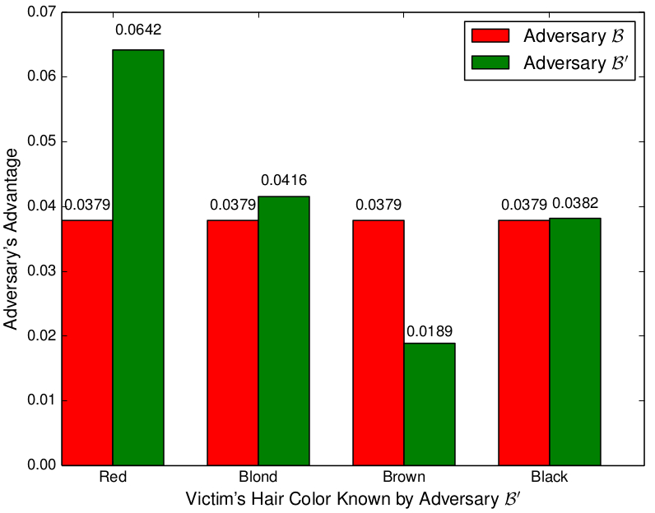
Side Attacks - Hair Color

Slide 27
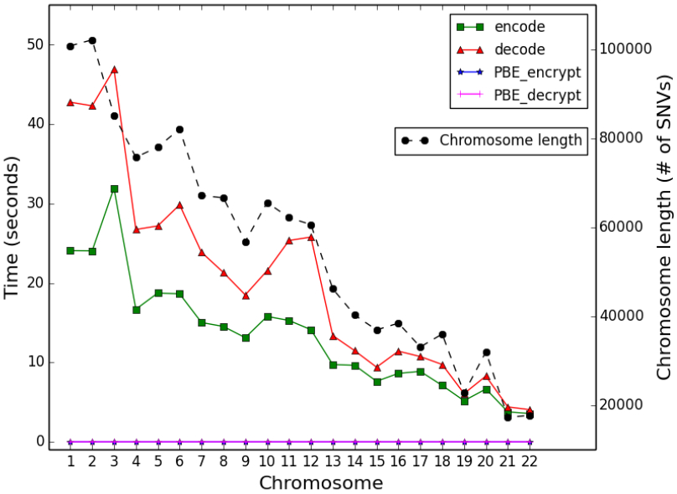
Side Attacks - Chromosomes

Slide 28
Conclusion

Slide 29
Discussion
What are the potential weakness of GenoGuard?
Does the use of Markov chains make sense? Why or why not?
Do the authors claims of GenoGuard’s security make sense? Why or why not?

