Slide 1
DEFY:A Deniable,Encrypted File System for Log-Structured Storage
Timothy M. Peters
Mark A. Gondree
Zachary N.J. Peterson
Presented by Nan Liu

Slide 2

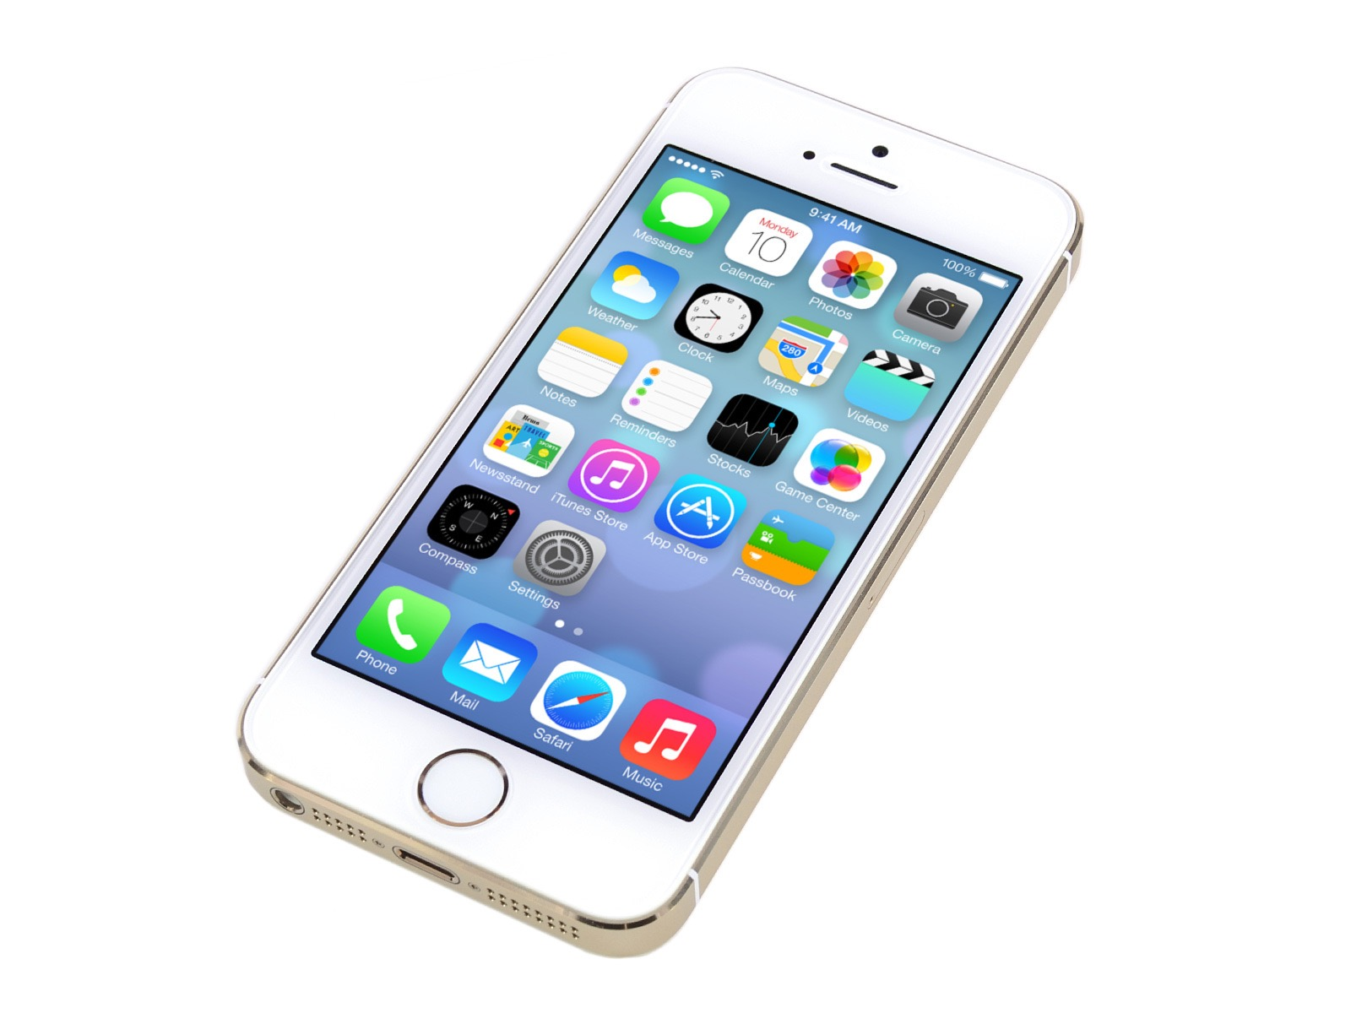
The problem

Slide 3
Existing methods
Anderson’s first file system of plausible deniability: use block replication and random block placement.
StegFS: use a block allocation table to track files.
DenFS:provide deniability when cloud server becomes compromised.(The model is not appropriate for threats associated with seizure of mobile devices)

Slide 4
Existing methods
Mobiflage:a deniable filesystem for Android devices.(The system lack support for more than one deniability level)
WhisperYAFFS: a system providing full disk encryption on flash devices.(It provides only confidentially without authenticity or plausible deniability. The use of plaintext block sequence number leaks the history of block updates)

Slide 5
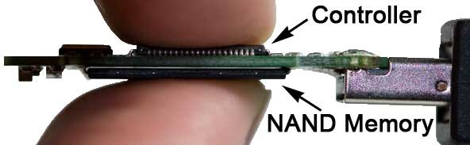
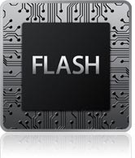
Background
Wear leveling
NAND & YAFFS

Slide 6
Contributions
DEFY: The Deniable encrypted file system from YAFFS.
Log-structured design
deniability levels
authenticated encryption
efficient secure deletion
snapshot resistent

Slide 7

Security Model
Adversaries:
Single-view adversaries
Snapshot adversaries
Security Definitions:
Plausible deniability

Slide 8
Design Requirements
Deniability Levels
Secure Deletion
Authenticated Encryption
Minimizing Data Loss
Wear Leveling
Easily Deployable

Slide 9
Deniability
Levels imply privacy equivalence
Levels provide a total order
High levels reveal lower levers
Revealing a level provide no information about unrevealed levels

Slide 10
DEFY
Authenticated Encryption
Encryption-Based Deletion
Metadata for DEFY
Minimized Data Loss

Slide 11
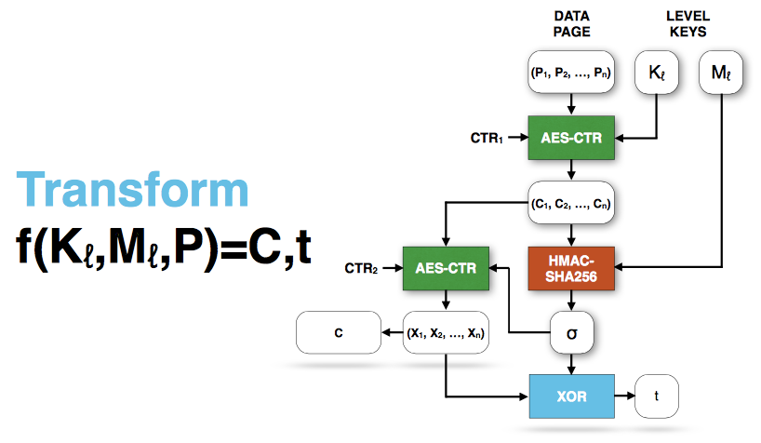
Encryption

Slide 12
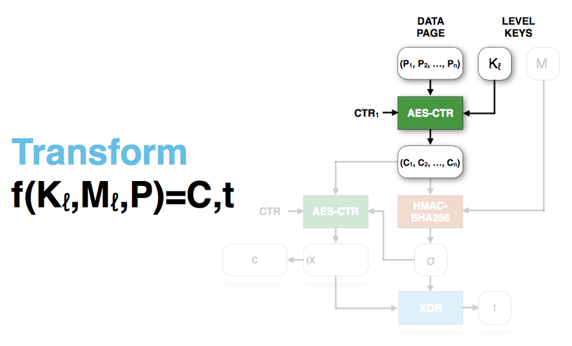
Encryption

Slide 13
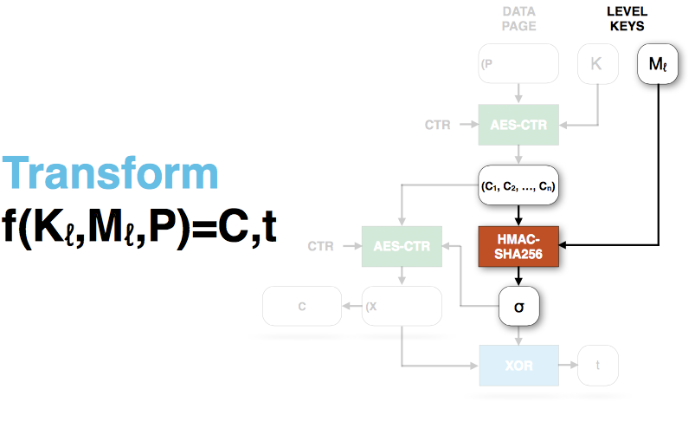
Encryption

Slide 14
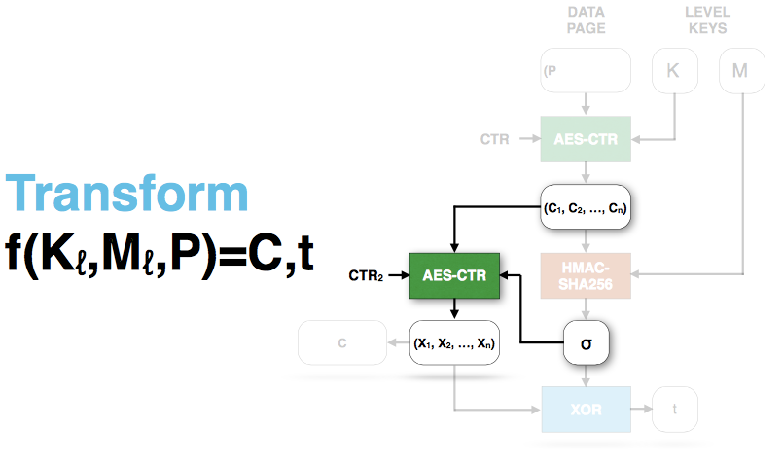
Encryption

Slide 15
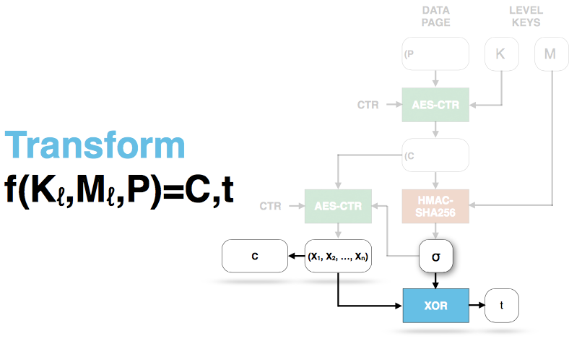
Encryption

Slide 16
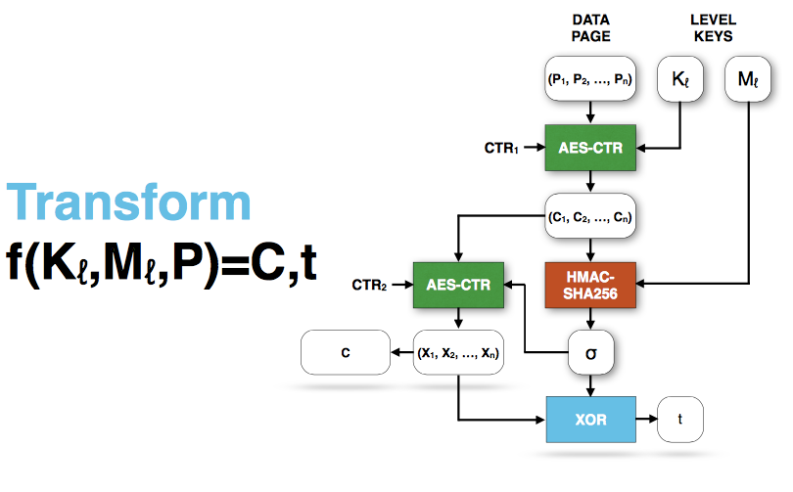
Decryption
4
3
1
2

Slide 17
Secure Deletion
A page can never be decrypted without all cipher text blocks.
Tag can be overwritten to securely delete the corresponding page.

Slide 18
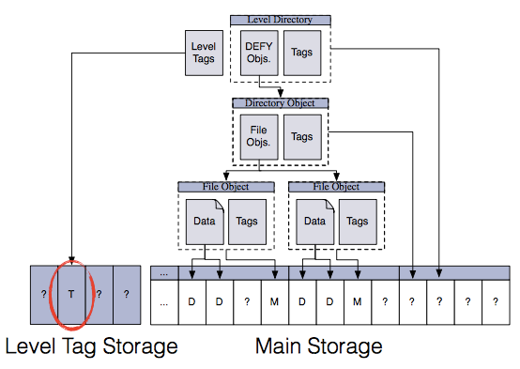
Metadata

Slide 19
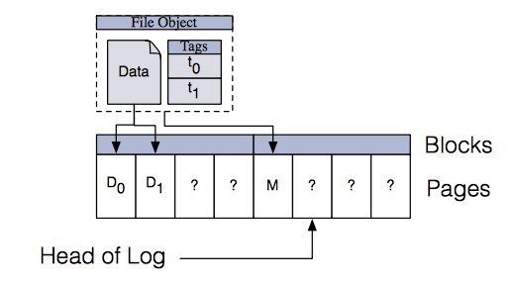
Metadata

Slide 20
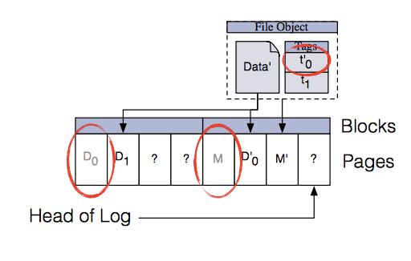
Metadata

Slide 21
Minimized Data Loss
When a level is revealed, all lower levels are also revealed.
A one-level-per-block policy.

Slide 22
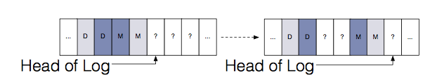
Security

Slide 23
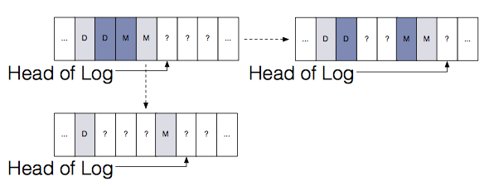
Security

Slide 24
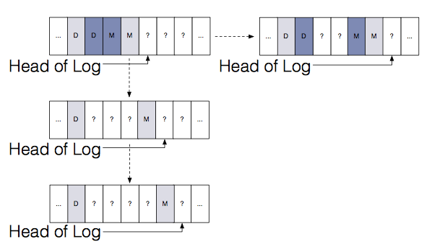
Security

Slide 25
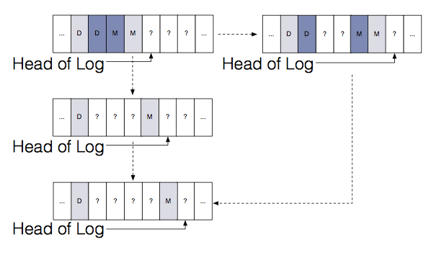
Security

Slide 26
DEFY in Real Life
users must use system correctly
doesn’t protect against malware or colluding carriers
few have explored deniability against coercive adversaries

Slide 27
Status & Future Work
DEFY is released as free and open source software
Confirm loss of semantic security in flash
Formalize notions of deniability

Slide 28
Quiz
What are the two types of passive adversaries for deniable file system?
Comparing to YAFFS, what extensions does DEFY include?
What DEFY do to implement a secure deletion?

