Slide 1
Poisoning Network Visibility in Software-Defined Networks: New Attacks and Countermeasures Sungmin Hong, Lei Xu, Haopei Wang, Guofei Gu
Present by He Zhang

Slide 2
What is SDN?
Software-Defined Networking (SDN) is a new programmable network framework tha decouples the control plane from the data plane.
The data plane handles hardware level network packet processing based on high level policies from the control plane.
SDN enables users to design and distribute innovative flow handling and network control algorithms conveniently, and add much more intelligence and flexibility to the control plane.

Slide 3
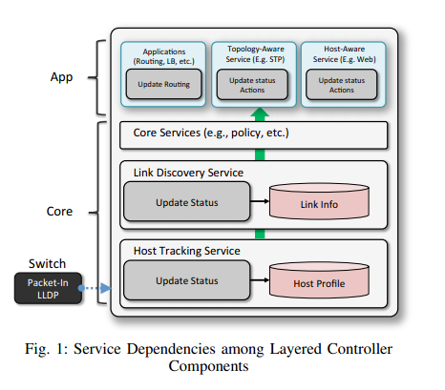
SDN OpenFlow
OpenFlow is a leading implementation of SDN that defines the communication protocol between the control plane and the data plane.
The OpenFlow controller maintains topology information and provides visibility to upper services and applications.

Slide 4
Operational Distinctions Between SDN and Legacy Networks
The Distinctions Between Legacy Networks and OpenFlow Networks Highlighted in This Paper

Slide 5
OpenFlow Topology Management
Topology management includes three parts: switch discovery, host discovery and internal links (switch-to-switch link) discovery. It is controlled by Topology Management Services.
Within the OpenFlow controller:
Host Tracking Service (HTS) maintains a host profile that includes MAC address, IP address, location information and VLAN ID. Host profile is maintained to track the location of a host and is updated dynamically.
Link Discovery Service (LDS) uses Open Flow Discovery Protocol (OFDP) to detect internal links between switches.trolled by Topology Management Services.

Slide 6
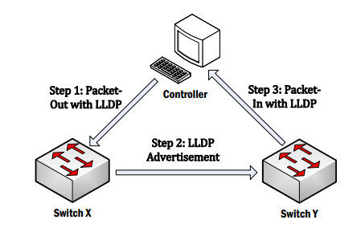
Link Discovery Service
The link discovery procedure in an Open-Flow network.
Open Flow Discovery Protocol (OFDP), which refers to LLDP (Link Layer Discovery Protocol) packets, to detect internal links between switches.

Slide 7
Threat
If fundamental network topology information is poisoned, all the dependent network services will become immediately affected, causing catastrophic problems.
Host location hijacking Attack and link fabrication attacks are two network topology poisoning attacks that are introduced in the paper.

Slide 8
Host Tracking Services in current OpenFlow controller platforms
(1) MAC address
(2) IP address
(3) Location information (i.e., the DPID and the port number of the attached switch as well as the last seen timestamp).

Slide 9
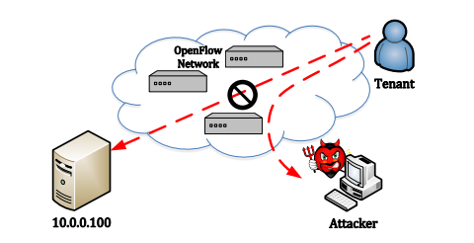
Host Location Hijacking Attack
Host Tracking Service maintains a host profile for each end host to track network mobility.
The lack of consideration on security for the update process provides an opportunity for an adversary to tamper host location information which in turns affects routing decisions and hijack the traffic towards the host.

Slide 10
Web Impersonation Attack

Slide 11
Link Fabrication Attack
OpenFlow adopts OFDP by utilizing LLDP packets for topology management. There exist security flaws during the link discovery procedure which opens the door to inject fake links into network topology.
In a “Fake LLDP Injection” and by monitoring the traffic from OpenFlow switches, the attacker can obtain the genuine LLDP packet, modify the specific contents of the LLDP packet, generates fake LLDP packets to announce bogus internal links between two switches.
In “LLDP Relay”, when receiving an LLDP packet from one target switch, the attacker repeats it to another target switch without any modification constructing a fake topology view

Slide 12
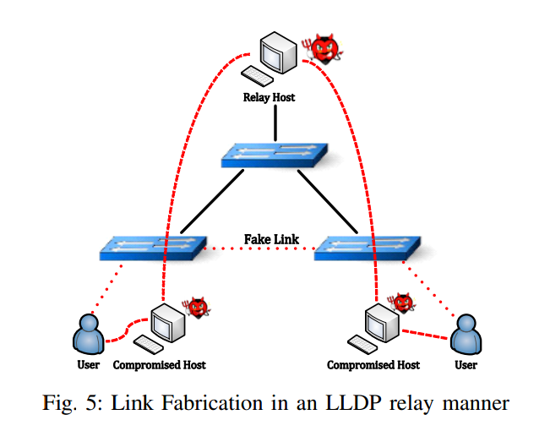
LLDP Relay
Here, we discuss two ways to build a communication channel to relay LLDP packets, by physical links and by a tunnel.

Slide 13
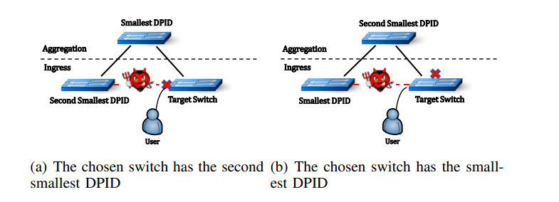
Denial of Service Attack

Slide 14
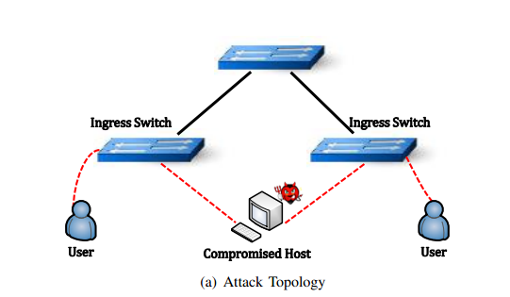
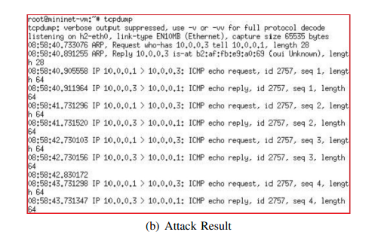
Man-In-The-Middle Attack

Slide 15
Static Defense Strategies
This defense is obviously not attractive as the manual management is tedious, error-prone and not scalable in practice.

Slide 16
Dynamic Defense Strategies against Host Location Hijack
Authenticate Host Entity: Authenticate a host by adding additional public-key infrastructure - a host encodes the new location information into an unused field of packet with the encryption using its private key
This adds storage overhead for keeping public keys in the OpenFlow controller side and computation overhead for handling each Packet-In message.
Overhead and cost for the management of all keys of hosts
Verify the Legitimacy of Host Migration
verify the legitimacy of the host migration by checking the precondition (Port-Down) and post condition (Host unreachable in old location)
Performance overhead but lighter and more feasible

Slide 17
Dynamic Defense Strategies against Link Fabrication
Authentication for LLDP packets
Adds extra controller-signed authenticator ((HMAC) code) TLVs in the LLDP packet and check the signature when receiving the LLDP packets.
It fails to defend against the Link Fabrication attack in an LLDP relay/tunneling manner.
Verification for Switch Port Property
Check if any host resides inside the LLDP propagation
If OpenFlow controllers detect host-generated traffic (e.g., DNS) from a specific switch port, Device Type of that port is set as HOST, otherwise switch ports are set as SWITCH.

Slide 18
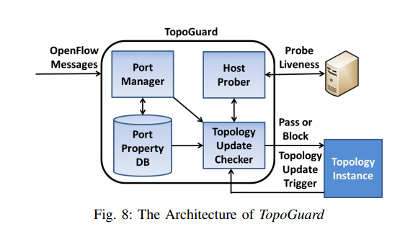
TopoGuard Prototype System - Automatic and real-time detection Extension
Port Manager tracks dynamics of switch ports (ANY, SWITCH and HOST)
Port Property maintains host list to verify the trustworthiness of a host migration.
The Host Prober tests the liveness of the host in a specific location by issuing a host probing packet.
topology Update Checker verifies the legitimacy of a host migration, the integrity/origin of an LLDP packet and switch port property

Slide 19
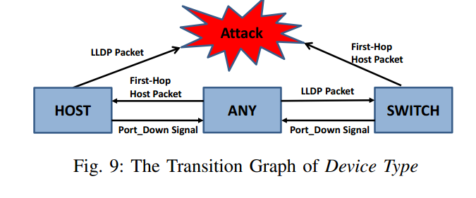
Port Property Management
Properties for each switch port in an OpenFlow controller.

Slide 20
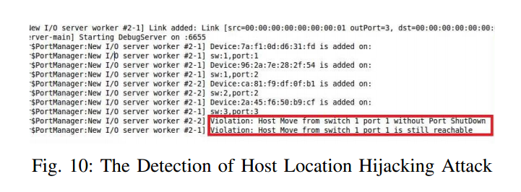
TopoGuard Implementation - Effectiveness
A prototype implementation of TopoGuard on the master version of Floodlight.

Slide 21
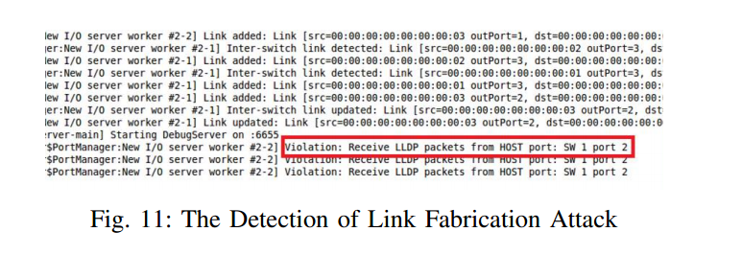
TopoGuard Implementation - Effectiveness
When the compromised hosts start relaying LLDP packets, TopoGuard detects the violation of Device Type of particular ports

Slide 22
TopoGuard Implementation - Performance
The performance penalty imposed by TopoGuard mainly comes from the Link Discovery Module and the Packet-In message processing.
Port Manager incurs a slight delay over the normal LLDP and host-generated packets processing.

Slide 23
Summary
SDN is a new programmable network framework.
OpenFlow is a leading implementation of SDN.
OpenFlow Topology Management services and examples of related security attacks.
Propose TopoGuard framework for automatic and real-time detection extension to OpenFlow.

Slide 24
Limitations
OpenFlow is an open protocol but not mandatory for SDN and accordingly this is an OpenFlow specific research.
The paper avoids some security features such as ARP and LLDP protection because of static nature.
Holistic approach is not considered (SDN as part of the whole network). Security of the network and underlying networking components are essential for SDN security.
The approach is considering topology management services security as a silo solution. Not considered in relation to other layers or components of SDN architecture.
Performance and security issues that may arise as a result of the use of keyed-hash message authentication code (HMAC) as an optional TLV for LLDP packets.

Slide 25
Contributions
We perform the first security analysis on the SDN/OpenFlow Topology Management Service. In particular, we have discovered new vulnerabilities in the Device Tracking Service and Link Discovery Service in eight current mainstream SDN/OpenFlow controllers.
We propose Network Topology Poisoning Attacks to exploit the vulnerabilities we have found. We demonstrate the feasibility of those attacks both in the Mininet emulation environment and a hardware SDN testbed.
We investigate the defense space and propose automatic mitigation approaches against Network Topology Poisoning Attacks, along with a prototype defense system, Topo Guard, currently implemented in Flood-light, but could be easily extended to other controllers.
Our evaluation shows that Topo Guard imposes only a negligible performance overhead.

Slide 26
Quiz
1. To dynamically discover topology, the Link Discovery Service (LDS) inside OpenFlow controllers uses what protocol?
2. To build a communication channel to relay LLDP packets, adversary can sets up physical links between two switches. If this is not feasible, what can the adversary use ?
3. What is the role of TopoGuard?

Slide 27
Thank you!

