Slide 1
Moving Targets: Security and Rapid-Release in Firefox
Presented by Carlos Bernal-Cárdenas
Presented by Carlos Bernal-Cárdenas

Slide 2
Motivation

Slide 3
To design, build, and deploy secure applications, [...] integrate security into your application development life cycle and adapt your current soft- ware engineering practices and methodologies to include specific security-related activities

Slide 4
Related Work
Software Development
Woody et al. surveyed Agile developers about the impact of security engineering activities on software development using Agile approaches
Seacord et al. notes that the traditional model of patching-and-install is problematic
Bessey et al. discuss the prevailing attitudes towards software upgrades in terms of the number of bugs generated by each release

Slide 5
Related Work
Firefox Software Engineering
Firefox has been the focus of prior research concerning software quality in its long history as open source project
Khomh et al. evaluates the effect of rapid release model using different metrics as proposed in this paper
Number bug after release
Median daily crash count
Median uptime
Almossawi’s work takes into account of the maintainability of Firefox since RRC version

Slide 6
Related Work
Lifecycle Issues
Foundational work on vulnerabilities lifecycles concluded that “Windows of vulnerabilities” exist, during which software is more likely compromised
Gopalakrishna and Spafford speculated that the increased rate of discovery of vulnerabilities was the result of a learning of time
However, Ozment points out, this incorrectly assumes that a fixed number of users form the total are looking for vulnerabilities
Clark et al. posited the existence of a grace period enjoyed by software immediately following its release

Slide 7
Goals
Validate whether the switch to Agile RRC development introduce large numbers of new vulnerabilities into software
Identify the moment in which the code base are vulnerabilities being discovered
Check if the number of vulnerabilities detected have increased since the switch to RRC

Slide 8
Outline
Motivation
Related Work
Contributions
Methodology
Conclusion
Quiz

Slide 9
Contributions
New data set of Firefox vulnerabilities
Quantitative evidence of:
Low rate of increase on vulnerabilities since Firefox RRC
Major vulnerabilities are not in the new code
Vulnerabilities are not disclosed until RRC version gets obsolete
Observation that frequent releases might provide some protection
Further supporting evidence for an exploit-free grace period provided by attacker’s learning curve

Slide 10
Methodology
Assumptions
With each addition of new code , a number of new software defects are also added
New vulnerabilities are also introduces and will be discovered and disclosed
The attackers are analyzing code bases searching for weaknesses in both old and new code

Slide 11
Methodology
Vulnerability Taxonomy
Baseline Vulnerabilities
Vulnerabilities that affect the original codebase on which RRC was based
Regressive Vulnerabilities
Vulnerabilities discovered and disclosed in code after the version in which it was introduced has been obsoleted by a more recent version
New Vulnerabilities
Vulnerabilities that affects the current version of code at the time the disclosure but that do not affect previous versions

Slide 12
Methodology
Why Firefox?
Since the initial release in 2004 Firefox has been an open source project
Firefox has a well maintained and frequently available bug database
Frequent target of attackers
Bug Bounty program
Firefox has historical development in ESR and RRC approaches

Slide 13
Methodology
Data Collection
617 Bug IDs were issued from the inception of RRC and the time of writing of this paper
Extraction of the code from the mercurial repository
Include file extensions such as .c, .cc, .cpp, .css, .h, …
Look into the Firefox’s Extended Support Reseases

Slide 14
Methodology
Limitations
Unknown vulnerabilities make the date of any given vulnerability hard to obtain
In this paper the authors uses the disclosure date as an approximation for the discovery date
Since Firefox is a frequent attack target, Mozilla responds fast issuing inter-cycle point releases for critical vulnerabilities

Slide 15
RRC Versus ESR
RRC
ESR
“Rapid release advances our mission in important ways. We get features and improvements to users faster. We get new APIs and standards out to web developers faster.”
“Maintenance of each ESR, through point releases, is limited to high-risk/high-impact security vulnerabilities and in rare cases may also include off-schedule releases that address live security vulnerabilities.”

Slide 16
RRC Versus ESR
What would we expect to see?
RRC
ESR
Increase in the number of vulnerabilities
“Rapid release advances our mission in important ways. We get features and improvements to users faster. We get new APIs and standards out to web developers faster.”
“Maintenance of each ESR, through point releases, is limited to high-risk/high-impact security vulnerabilities and in rare cases may also include off-schedule releases that address live security vulnerabilities.”
The scope of vulnerabilities should change
Frequent changes should increase the rate of vulnerabilities

Slide 17
Research Questions
Does the addition of 250k+ LOC every 42 days markedly increase the number of vulnerabilities discovered and disclosed?
Is the scope of disclosed vulnerabilities confined to RRC?
Are the RRC vulnerabilities easier to find?

Slide 18
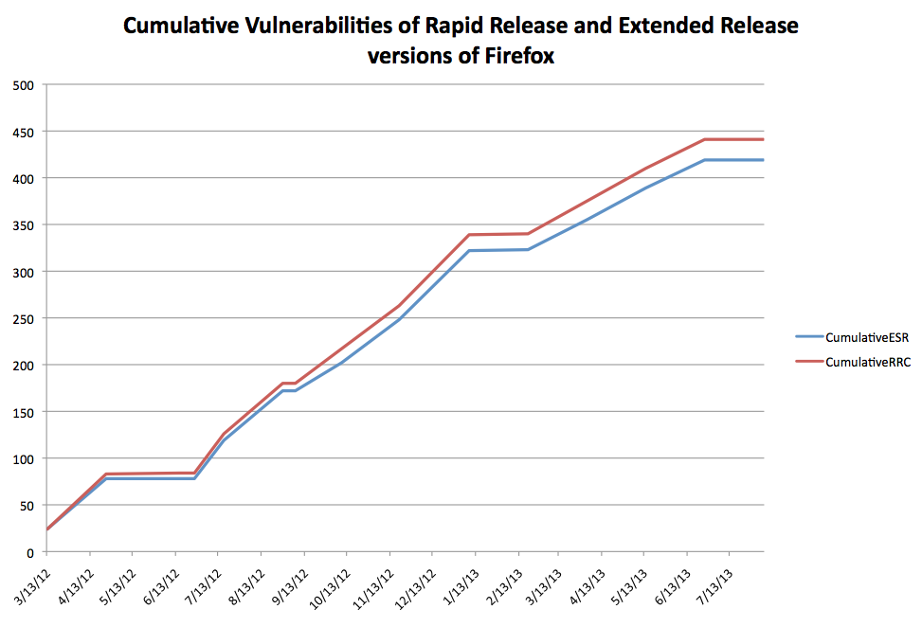
RQ1

Slide 19
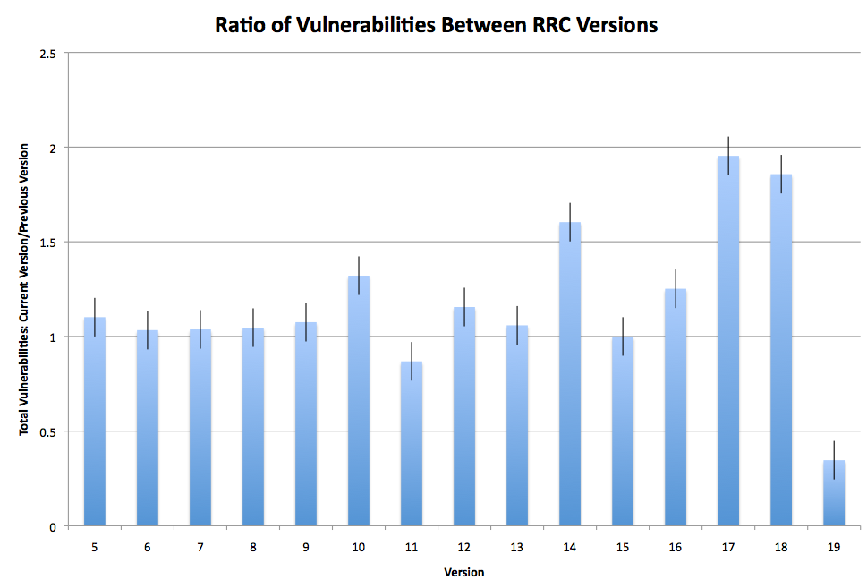
RQ1

Slide 20
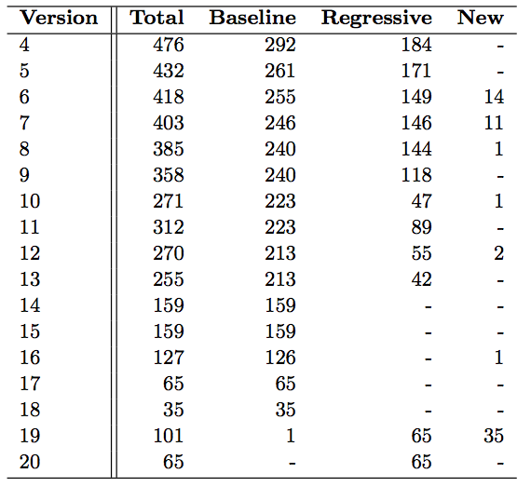
RQ2

Slide 21
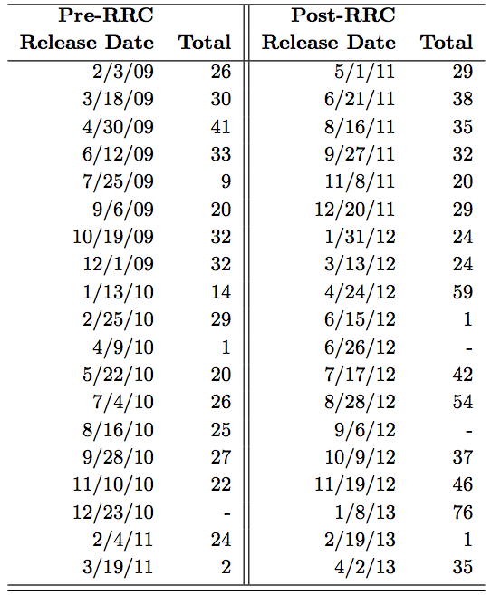
RQ3

Slide 22
Conclusions
Vulnerabilities are disclosed on the older code at least as often as they are in the newer code
Firefox rapid-release cycles expose the software to a shorter window of vulnerability
The authors’ study suggested that familiarity with a codebase is a useful heuristic for determining how quickly vulnerabilities will be discovered

Slide 23
Quiz
What are the 4 reasons the authors choose Firefox as subject in their study?
What is the main focus of Agile approaches compare to models intended to produce secure systems?
Why rapid-release cycles expose Firefox to a shorter window of vulnerabilities?

Slide 24
Questions
?

