Slide 1
EASEAndroid: Automatic Analysis and Refinement for SEAndroid Policy via Large-scale Audit Log Analytics
Ruowen Wang,
Xinwen Zhang, Peng Ning,
Douglas Reeves, William Enck,
Dingbang Xu, Wu Zhou, and Ahmed M. Azab
Adapted from author’s slides
Presenter: Hongyang Zhao

Slide 2
Security Enhanced Android
SEAndroid
  Security enhancements to Android.
  Enforce mandatory access control (MAC) policy between subjects (process) and objects (files, sockets)
Notes:
SELinux is Security-Enhanced Linux
Enforce mandatory access control (MAC) policy on system-level operations between subjects (process) and objects (files, sockets)
confine user programs and system servers access to files and network resources

Slide 3
The core of SEAndroid : Policy
Policy rule
  Define which domain of subjects can operate which class and type of objects with a set of permissions
  Subject: process
  Object: files, sockets
  Label: assigned to subjects/objects that share same semantics
  Domain: subject label
  Type: object label
Notes:
Define which domain of subjects can operate which class and type of objects with a set of permissions, open, read, write,
Each subject/object has one or more labels. Label defines the attribute of the subject/object.

Slide 4
Policy Language
Security labels ⬄ Concrete Subjects/Objects
  app_data_file <=> /data/data/.*
Allow rules grant benign operations
  allow appdomain app_data_file:file {read write execute}
Neverallow rules define privilege escalation
  neverallow untrusted_app init:file {read}
Notes:
All the files under this path, have the same labels.
App is subject label. All the process in app have the same label: app
Allow process with the app domain to open and read file class objects assigned with app_data_file type (label)
Process with untrusted_app domain are not allowed to read the file class objects with init type (label)

Slide 5
SEAndroid Policy Challenges
Require Complete Redesign of Policy
  Android is different from traditional Linux
Require Policy Analysts to Have Both
  Domain Knowledge (Allow Benign Accesses)
  Security Expertise (Prevent Malicious Accesses)
Require Continuous Refinements
  New Android releases
  New attacks

Slide 6

SEAndroid Policy Challenges
“Vendors don’t know how to write policies”
    --@pof “Defeat SEAndroid” at Defcon 2013

Slide 7
Problem Statement
Current solution to SEAndroid policy refinement
  Analyze audit logs to refine policies
    Log access events not matched with allow rules
    Analysts parse the logs to refine policy
Goal
  Reduce the manual effort required to refine SEAndroid policy using audit logs.

Slide 8
Real-World Challenges
Millions of such audit logs
Unknown new benign & malicious access patterns mixed together
Continuous efforts due to Android updates and emerging new attacks
Notes:
Challenge of audit logs
First, audit logs are collected from millions of real-world devices, and purely manual analysis is impractical.
Second, the audit logs contain both benign access patterns and malicious access patterns.
Third, the functionality of both benign applications and malicious exploits is continually changing/upgrading, requiring frequent reassessment of the deny/allow
boundary to refine the policy

Slide 9
EASEAndroid
Elastic Analytics of SEAndroid
Features:
  Analyze audit logs in a large scale
  Classify new benign & malicious access patterns
  Propose new security labels and rules as policy
Key insight:
  Model policy refinement as semi-supervised learning

Slide 10
Audit log
Audit Log
  Log access events not matched with allow rules
Information in one access event
  Security labels of the denied access
  Syscall Subject Info (e.g. process)
  Syscall Object Info (e.g. file path)
We model as 6-tuple access pattern
  <sbj, sbj_label, perm, tclass, obj, obj_label>

Slide 11
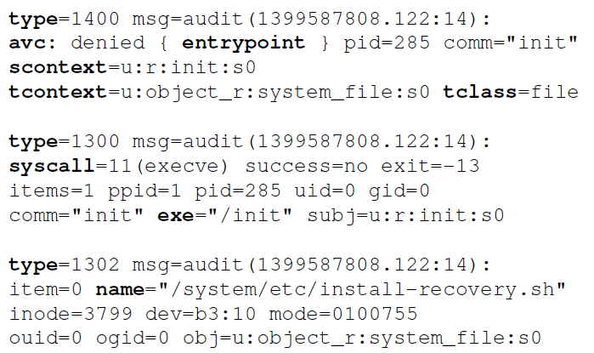
Audit log
Labels & Permission
Syscall & process info
Object info

Slide 12
Audit log
Access Event
  Cause the audit log entries.
  Result from a policy denial, or an auditallow policy rule
Access Pattern (6-tuple)
  Map access events to access pattern
  <sbj, sbj_label, perm, tclass, obj, obj_label>
Notes:
auditallow : allow but logs the access
Many access events may map to the same access pattern

Slide 13
Audit log
  <sbj, sbj_label, perm, tclass, obj, obj_label>
<“/init”, “init”, “entrypoint”,“file”,
“/system/etc/install-recovery.sh”,“system file”>

Slide 14
Semi-learning
Observation
  Labeled data: insufficient and expensive
  Unlabeled data: sufficient and easy to collect
Semi-learning
  Correlate features in unlabeled data with labeled data, infer the labels of the unlabeled instances with strong correlation.

Slide 15
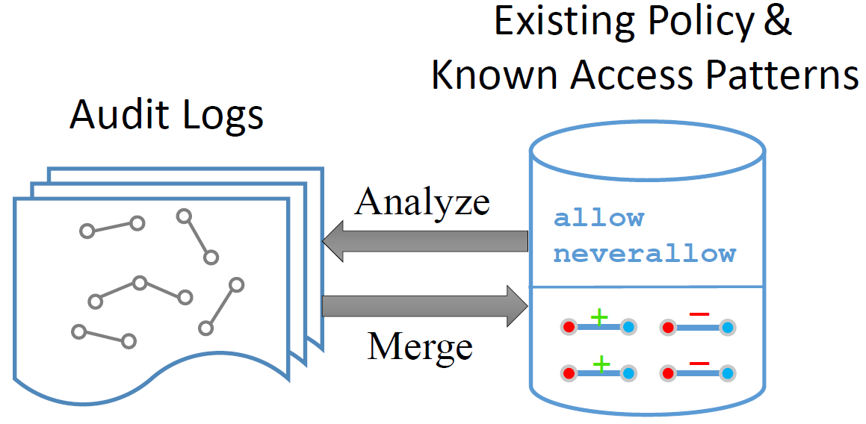
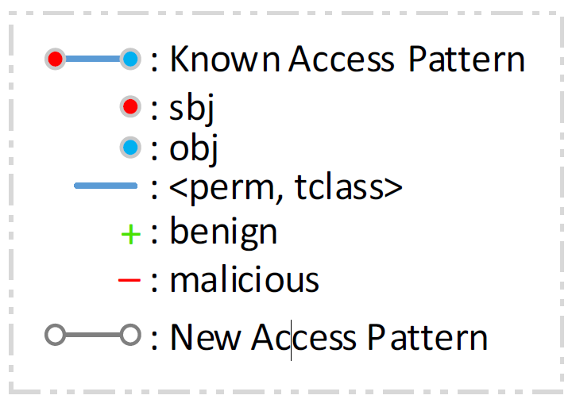
Key Insight
Learning Unknown based on Semantic Correlations
  A known malicious subject: an unseen behaviors (malicious)
  A system daemon: perform a new/similar operation (benign)

Slide 16
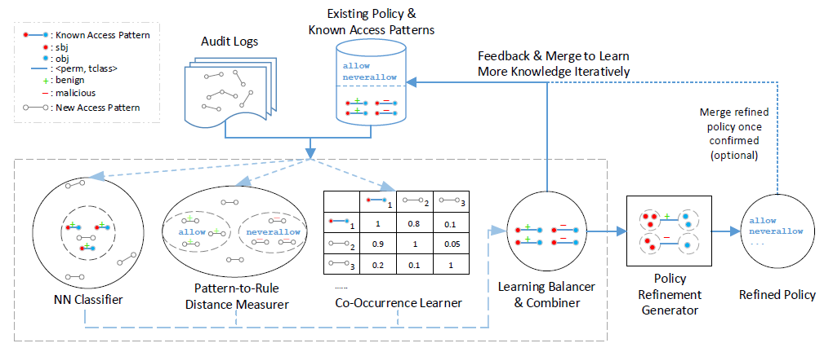
EASEAndroid Architecture
Notes:
The goal of each algorithm is to find semantic correlations between unknown new access patterns and existing knowledge base, in order to classify each new access pattern as benign or malicious

Slide 17
Nearest-Neighbor (NN) Classifier
Observation
  Known sbjs perform new access patterns
    Android apps/binaries update with new features
  New sbjs perform known access patterns
    Certain operations become popular, and are copied by other new applications
NN Classifier identifies connections between
  Known subjects ⬄ New access patterns
  New subjects ⬄ Known access patterns
Notes:
Nearest-neighbors-based (NN) learning is a common technique for classifying an unlabeled instance based on its nearest labeled neighbors within a defined distance.
Two observation:
First, known subjects often perform previously unseen access patterns in audit logs. This scenario often occurs when Android applications and system binaries are updated with new capabilities.
Second, some known access patterns are also performed by new subjects. This scenario occurs when certain operations become popular and are copied by other new applications.
These two scenarios cause known subjects and patterns to be semantically connected with new subjects and patterns.
EASEAndroid leverages this connectivity as the distance metric to design the NN classifier. Nearest-neighbors-based (NN) learning is a common technique for classifying an unlabeled instance based on its nearest labeled neighbors within a defined distance. In this case,
when multiple known subjects connect to the same new pattern the NN classifier can infer whether the new pattern is benign or malicious, based on the majority of the connected known neighbors (subjects). If all the known subjects are benign, then the new access patterns are likely to be benign.
when multiple known patterns connect to the same new subject, the NN classifier can infer whether the new subject is benign or malicious, based on the majority of the connected known neighbors (patterns).

Slide 18
Pattern-to-Rule Distance Measurer
Observation
  New access patterns close to existing incomplete rules are the missing parts of those rules
Decision-Tree-based Approach
  Classified as benign if closest to allow
  Classified as malicious if closest to neverallow
  Remain unclassified if far from both sides
Notes:
Therefore, If one pattern are close to the existing allow rules, then it is a benign one. To measure this closeness or similarity, the authors use Decision-Tree-based Approach to measure the distance between new access patterns and existing policy rules. If a new access pattern is closest to an allow rule, it is classified as benign. If it is closest to a neverallow rule, it is classified as malicious. If the access pattern is not close to either type of rule, it remains unclassified.

Slide 19
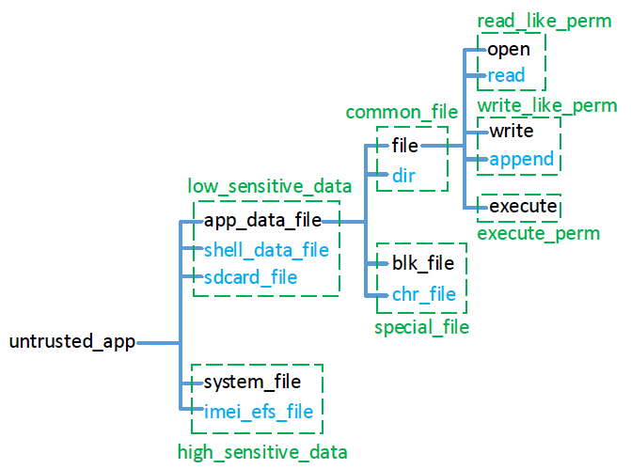
Decision-Tree-Based Pattern-to-Rule
Subject label, object labels, tclass, permission
  <untrusted_app, sdcard_file, dir, read>
Notes:
We extract four elements in allow rules:
An access pattern is very close to a rule if it shares the same labels and tclasses only with slightly different permissions
different but similar tclasses (e.g., file vs dir).
Subject label as root, followed by…
Given an access pattern and a decision tree, the distance
measurer walks the decision tree and tries to
match the access pattern’s subject label, object label,
tclass, and permission with each layer. The matching
depth indicates how close a pattern is to existing
rules.
We
create trees for both allow and neverallow rules to
compute the distances from both sides.

Slide 20
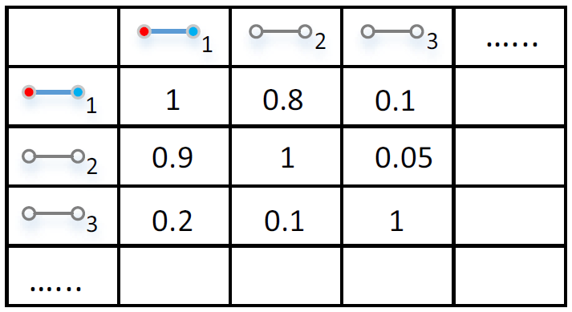
Co-Occurrence Learner
Observation
  A functionality or an attack often involve a series of access patterns captured together
Co-Occurrence Learner
  Infer new access patterns based on known access patterns if they co-occur together
Notes:
When analyzing a large number of audit logs, some access
patterns frequently occur together in many logs.
This is because some high-level benign functionality or
some popular multi-step attacks consist of a series of access
patterns within a time period (typically minutes). If known and new access
patterns occur together, we can use the known
ones to infer the classification of the new ones.
The co-occurrence of access pattern can be represented
using a n×n matrix for all n unique access patterns
from the audit logs, as shown below
0.8 is the percentage of the number of times
that Access pattern 1 co-occurs with Access pattern 2 out of the total number of
Access pattern1 s occurrences throughout the logs.
Higher number is, the more co-occurrence between two access patterns.
For each api row,
the learner sorts columns and selects the set of known
access patterns in columns whose percentage is above a
threshold. A majority vote of this known access pattern
set determines the classification of the new api

Slide 21
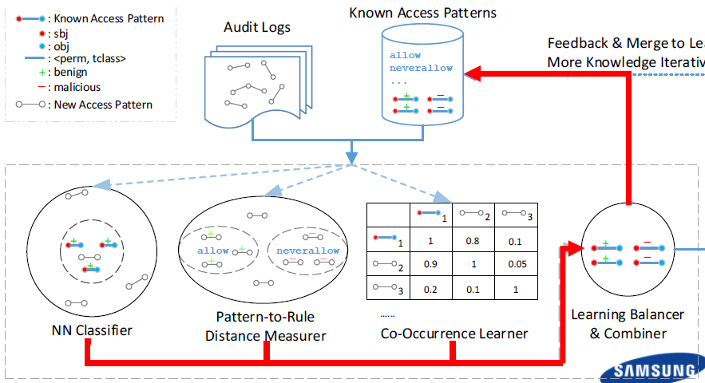
Learning Balancer & Combiner
Manage thresholds of each learner
Combine results to expand knowledge base
Balance precision and coverage
  Automated Mode (high precision)
  Semi-Automated Mode (high coverage)
Notes:
Each learner is configured with its own threshold to
classify new access patterns independently. However,
it is non-trivial to define proper thresholds because too
relaxed thresholds could cause false classification, lowering
the learning precision, while too strict thresholds
could leave potential access pattern candidates unclassified,
lowering the learning coverage.
The learning balancer & combiner manages the
threshold of each learner, balances the precision and coverage,
and combines the classification results from the
three learners. It has two modes: (1) an automated mode
that uses strict threshold in each learner to achieve high
precision with the cost of less coverage; and (2) a semiautomated
mode This mode relaxes the thresholds
to get more access pattern candidates. It uses a majority
vote to choose the candidates shared by at least two
learners with the same classification result, and the third
learner must not have conflicting result.

Slide 22
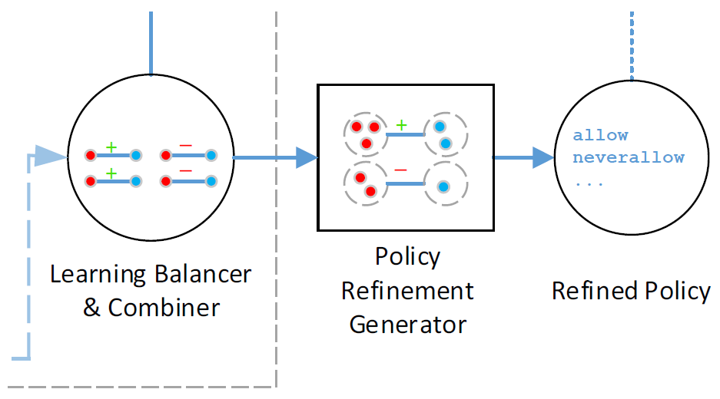
Policy Refinement Generator
Suggest new security labels and rules
Group sbjs/objs together based on existing coarse-grained labels
Infer fine-grained labels and encode into rules
  <sbj_label, perm, tclass, obj_label>
Notes:
Finally, the policy generator takes newly classified access
patterns as input from the combiner, to suggest new rules and new security
labels. It uses a clustering algorithm to group similar
subjects and objects together to get the fine-grained labels. the policy refinement generator takes all access patterns
as input and clusters them into groups where each
group shares the same 4-tuple (sbj label, perm, tclass, obj label).

Slide 23
Implementation
A prototype of EASEAndroid on an 8-node Hadoop cluster with each node having 8-core Xeon 2GHz, 32 GB memory.
Open source Cloudera Impala as the distributed SQL layer, with 10K SLOC Java as the learning layer
Notes:
We build a prototype of EASEAndroid on an 8-node Hadoop cluster with 256 GB memory.

Slide 24
Evaluation
Audit Log Dataset
  1.3M logs from real-world Samsung devices with Android 4.3 over 2014
  145K unique access events and generalized into 3530 access patterns
Initial Knowledge
  5094 allow rules and 59 neverallow rules
  17 malicious access pattern
Ground Truth
  A later version of human-refined policy (6337/94)
  Consult with experienced policy analysts
Notes:
All devices are loaded with an early
version of Samsung SEAndroid policy. The policy contains
5,094 allow rules and 59 neverallow rules This policy is loaded as initial knowledge
To analyze the classification result of benign
and malicious access patterns, we use a later version
of human-written policy (6,337 allow rules, 94
neverallow rules) as the ground truth. We also consult
with experienced policy analysts about the result.

Slide 25
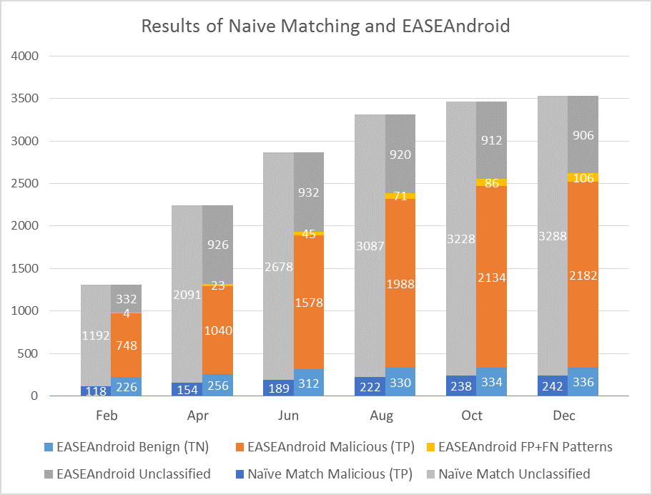
Evaluation
Coverage & Precision
Notes:
It only uses the known subjects and access patterns
in the initial knowledge base and can only match
new access patterns directly related to the
EASEAndroid starts from the initial knowledge
base and keeps expanding the knowledge base.
EASEAndroid also discovers that the
majority of denied access patterns in real world are malicious
and they keep emerging while benign access patterns
gradually stabilize.

Slide 26
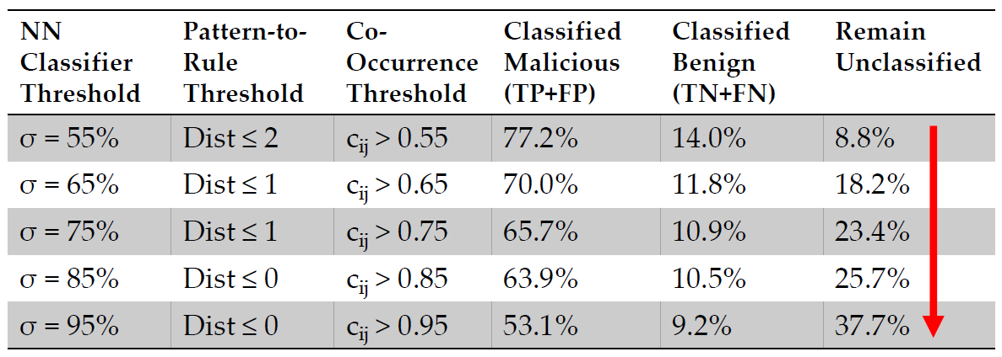
Evaluation
Different Thresholds (Coverage)
Notes:
We can see that the thresholds in Row 1 is largely
relaxed. Although it has the highest coverage, both FP
(37.04%) and FN (41.35%) are too high, making it practically
useless. In contrast, Row 5’s thresholds achieve
100% correctness on classifying benign patterns. But it
also leaves 37.7% patterns unclassified. The middle 3
rows are more balanced. Row 3 and 4 are candidates
for practical use.

Slide 27
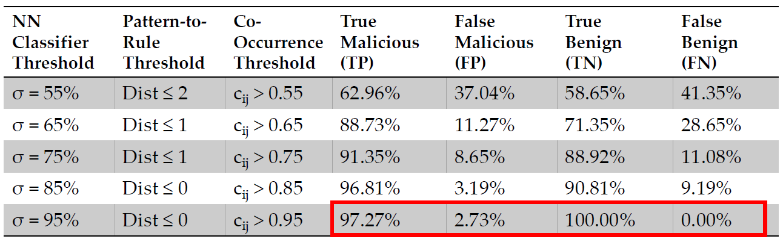
Evaluation
Different Thresholds (Precision)
Notes:
We can see that the thresholds in Row 1 is largely
relaxed. Although it has the highest coverage, both FP
(37.04%) and FN (41.35%) are too high, making it practically
useless. In contrast, Row 5’s thresholds achieve
100% correctness on classifying benign patterns. But it
also leaves 37.7% patterns unclassified. The middle 3
rows are more balanced. Row 3 and 4 are candidates
for practical use.

Slide 28
Limitations
Information missed by audit logs
  High-level semantics in Android framework
Countermeasure against EASEAndroid
  Data poisoning attacks
Unclassified access patterns
  Human can interact with EASEAndroid by adding extra knowledge

Slide 29
Conclusion
SEAndroid policy development and refinement is challenging
Propose EASEAndroid, an analytic system to refine the policy based on semi-supervised learning
Evaluate with 1.3 million audit logs and discovered over 2,500 new access patterns, generated 331 policy rules
Notes:
Evaluate with 1.3 million audit logs and discovered over 2,500 new benign and malicious access patterns, generated 331 policy rules

Slide 30
Quiz
Why semi-supervised learning algorithm is suitable for refining policies？
Are the real-world audit logs trustful?
Can EASEAndroid survive when its audit log system are compromised?

Slide 31
Thank you!

