Slide 1
What’s in Your Dongle and Bank Account? Mandatory and Discretionary Protections of External Resources
Adv. Network security
Cody watson

Slide 2
Lots of Apps and Services

Slide 3
More Sensitive Information

Slide 4
Is Your Information Secure?
Does Android protect external resources?
Most external resources are not protected
Protecting resources limits capabilities, higher overhead, etc.

Slide 5
Why is it Unsecure?
Apps can obtain sensitive information from permissions (SMS, MMS, Audio, Bluetooth)
The only apps that should have access are android and the necessary application

Slide 6
Understanding the Threat

Slide 7
How Real is This Problem?
Out of 13,500 top rated apps, 560 require SMS permission
Once permission is granted, it is granted fully
The authors hacked Jawbone UP wristband activity trackers and gathered all information from it
Can steal information from the Audio jack

Slide 8
Further Security Analysis
When a text message comes in through the channel, it broadcasts the message to apps that register with SMS_RECEIVED_ACTION and have permissions RECEIVE_SMS
Similar with the MMS, which is over 160 characters
Every app they tested was vulnerable to exposing information that was sent
Some apps asked for permissions that were not necessary for them to have
Found vulnerabilities in SMS, Audio and NFC

Slide 9
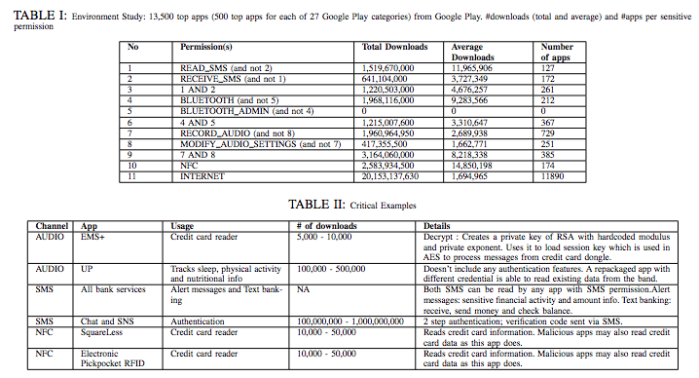
Data on All Applications

Slide 10
Outline
Introduction to Problem
Understanding the Threat
Existing Solutions
(SE)Android
Porscha
Novelty
SEACAT
Policies
Design
Architecture
Walkthrough
What is Protected
Experiment and Results
Conclusion / Quiz

Slide 11
What are Android’s Solutions?
Sandbox Apps
Androids DAC (discretionary access control) controls access to local resources
DAC permissions are binary
SEAndroid (Security enhanced android)
SEAndroid has a MAC, but only for local resources
SEAndroid cannot even assign a security tag to an external resource
Lacks types for different channels (audio, SMS, NFC and Bluetooth)

Slide 12
Porscha Solution
Controls the content an app can access by way of an IBE encrypted message to a Porscha proxy
Proxies further authorize apps according to the set of policies
Porscha must make changes to the SMS, adding the proxy to intercept messages
Does not offer layered protection (i.e. kernel and framework layer)

Slide 13
Novelty of This Paper
New approach called SEACAT, which is integrated into SEAndroid
Investigation of a new set of channels that have never been studied before
Protection of different external resources over the channels
Allow system admins and users to specify how to allow use of external resources

Slide 14
SEACAT
Security Enhanced Android Channel Control integrates MAC and DAC in a way that compliance checks and enforcement go through the same mechanism
MAC is more powerful than DAC since DAC is user controlled
Incorporates security hooks, which check an applications ability to access a channel
Creates policies and types for external resources
Major assumption, the kernel cannot be compromised

Slide 15
Policies
Policy example:
Type is what dictates access to all objects
All apps associated with domain untrusted_app are allow to perform read and write permissions on objects associated with shell_data_file which is of class file.
Policy files are read only
allow untrusted_app shell_data_file:file rw_file_perms

Slide 16
How Do These Policies Help?
A policy enables a certain application to to access a specific resource of a certain type
DAC policies can enable only the com.android.sms and the sensitive application to read text messages from that application
DAC is controlled by user, and is the same for kernel and frameworks levels
Can restrict channel while in use, then release control after

Slide 17
How Are Policies Determined?
MAC policies are determined by administrators that grant trusted apps permissions to use external resources
Audio doesn’t have MAC policies because there is no specific audio device that can be mapped, and there is no way to identify it
DAC policies are determined by the user, but those policies cannot undermine the MAC policies
The application can specify the external resources it uses (e.g. facebook app messages)
User can always edit the DAC policies, and this is done through simple question interface rather than low level questions

Slide 18
Design of SEACAT
Policy module stores security polices and provides an efficient compliance check service to the framework and kernel layers
MAC is static while DAC is dynamic and can be updated during runtime
Policy engine performs the compliance checks
SEACAT labels apps, as well as resources and then checks to see if an apps attempts to access a resource that it is not assigned to

Slide 19
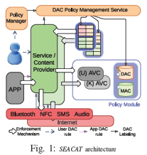
Architecture
Policy management service handles DAC rules (user interface)
The policy module handles both framework and kernel layer compliance checks
Enforces MAC and DAC policies with same hooks
Each AVC (access vector caches) caches the policies recently enforced using a hash map
DAC policies in the same format as MAC rules so that the AVC and policy engine can serve both

Slide 20
Refined Walkthrough
App
Security Hook
MAC and DAC Tables
Let me read a text message
We got angry birds here wanting to look at message 18478
Let me see your credentials
Here is angry birds permissions
You don’t have the right.
Denied Entry to Channel
AVC
Notes:
Application makes a call and a security hook which are placed in the system functions responsible for the operations over the channels check the security context of the caller so an application then the object (bluetooth, text message) by searching a MAC mapping table first and then the DAC table. This info is then used to query the AVC and policy engine based on that outcome it decides whether or not to let the call go through.

Slide 21
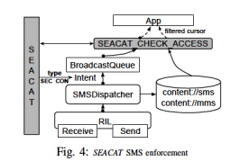
What Is Protected?
NFC protection places hooks in essential functions for connecting to NFC device
Internet controlled inside the kernel with hooks at the different socket operations
Audio, which is only hooked at the framework layer and locks the channel if the app using it is approved.
Notes:
Hooks are placed in the Bluetooth stack
Dabinder is just a framework-layer protection mechanism that was proposed in past work to protect Bluetooth information
leaks (circumvented with native code
Inside the stack we query the devices access
Hooks call getCallingPid to find out the apps PID and then its security context, and passes the information to the stack
The query results in either a connection or termination.

Slide 22
Evaluation
The evaluation has two nexus 4 phones, one with Android 4.4 the other with 4.3
One phone has unmodified OS, the other with SEACAT
All channels were protected under MAC and DAC policies except for audio
Attempts were made to assign a resource specified by MAC by way of a DAC user policy
Checked performance overhead on installation of apps and different processes

Slide 23
Attacks

Slide 24
Results
All attacks on unmodified OS were successful, while none were successful with SEACAT
Labeling resources takes a long time at 189 ms
Assigning apps to domains takes 49 ms, security hooks happens almost instantaneously
Does not include the delay from human intervention
There are some user experience issues, specifically with the NFC protections

Slide 25
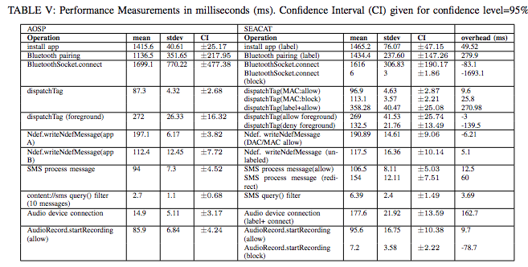
Performance Measurements

Slide 26
Conclusions
SEACAT was designed to provide integrated security control through both MAC and DAC across different Android Layers
MAC and DAC policies guide the access to external resources and are enforced by security hooks
Misconfigured DAC rules will not override MAC policies

Slide 27
Quiz Questions
What is one vulnerability that SEACAT has and can it be avoided?
What is the fail safe in SEACAT that attempts to block attacks when the vulnerability in question 1 happens?
What is one channel not included in the MAC policies and why?

